Slide 1
Developer Advocacy - Helm
Sahdev P. Zala @sp_zala
spzala@us.ibm.com
Mar 10 2018

Slide 2
Presentation Layout
Overview of Containers
Overview of Kubernetes
Helm
What is Helm and Helm Charts?
Chart structure
Why Helm?
Five keywords
Helm architecture
Install Helm
Test or development environment
Production environment
Using Helm
Where is Helm?

Slide 3
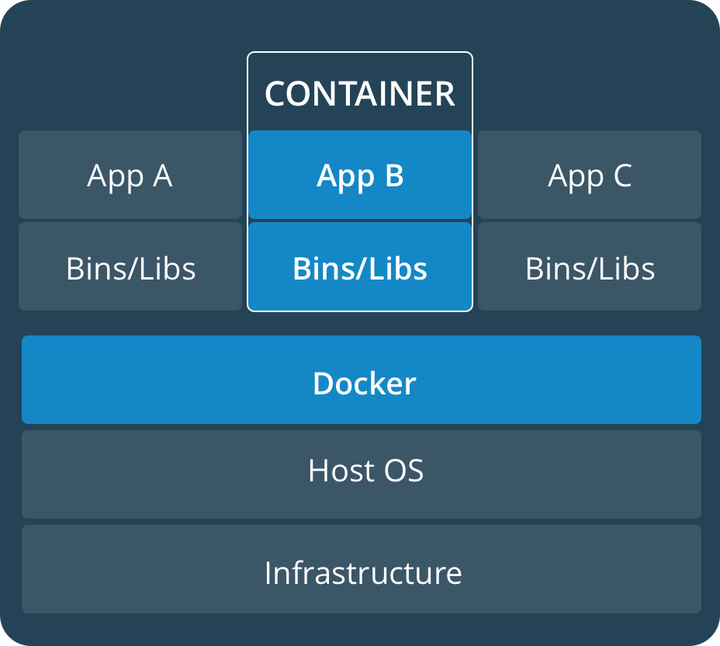
Overview of Containers
Abstraction at the app layer that packages code and dependencies together
Multiple containers can run on the same machine and share the OS kernel with other containers, each running as isolated processes in user space
Learn more about containers here - https://developer.ibm.com/courses/all/docker-essentials-extend-your-apps-with-containers/

Slide 4
Overview of Kubernetes
Enterprise level container orchestration
Provision, manage, scale applications (containers) across a cluster
Manage infrastructure resources needed by applications
Compute
Volumes
Networks
And many many many more...
Declarative model
Provide the "desired state" and Kubernetes will make it happen
What's in a name?
Kubernetes (K8s/Kube): "Helmsman" in ancient Greek
Learn more about containers here - https://github.com/IBM/container-service-getting-started-wt

Slide 5
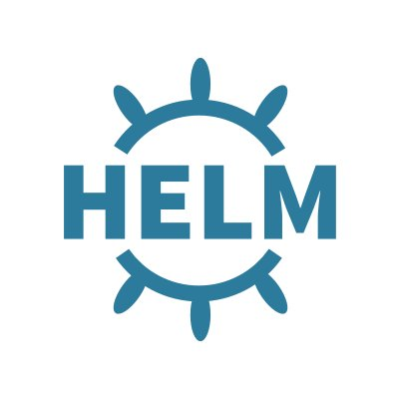
What is Helm and Helm Charts?
Helm is a tool that streamlines installation and management of Kubernetes applications.
It uses a packaging format called charts.
Charts are packages of pre-configured Kubernetes resources.
Think of Helm like apt/yum/homebrew for Kubernetes
You can:
Use existing charts created by others
Create your own charts and share with others
Easily manage your Kubernetes manifest files, configuration values and related resources as a package
Release charts and manage releases
Run Helm on laptop or where ever you want
Install Helm on various operating platforms like OSX, Linux and Windows
https://github.com/kubernetes/charts contains several ready to use official Helm charts.
Notes:
In order to know Helm, you need to know Helm Charts.

Slide 6
Why helm?
Helm provides probably an easiest way to use Kubernetes
Use existing chart vs creating your own manifest
Configuring deployment with user values
Helm is the only way to provide variables to Kubernetes in a way similar to programming languages like go, Java etc.
Templating resource definition
Active development with strong community behind
Even there is a dedicated Helm Summit
Used widely in IBM and among industry

Slide 7
Five keywords
Helm
While Helm is the name of the project, the command line client is also named helm. By convention, when speaking of the project, Helm is capitalized. When speaking of the client, helm is in lowercase.
Tiller
Tiller is the Helm server. It interacts directly with the Kubernetes API server to install, upgrade, query, and remove Kubernetes resources.
Chart
It contains all of the resource definitions necessary to run an application, tool, or service inside of a Kubernetes cluster. A chart is basically a package of pre-configured Kubernetes resources.
Release
An instance of a chart running in a Kubernetes cluster.
Same chart can be deployed multiple time.
Repository
Place where charts resides and can be shared with others.
Notes:
Before we go further, you may want to know these keywords. You will run into many glossary items but the most common once you need to know are these five.

Slide 8
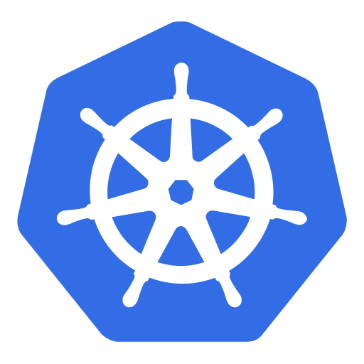
Helm Architecture
The Helm Client is a command-line client for end users
Interacts with the Tiller server sending charts to be installed
Asks for information about releases
Requests upgrading or uninstalling of existing releases
The Tiller Server is an in-cluster server that interacts with the Helm client, and interfaces with the Kubernetes API server
Listens for incoming requests from the Helm client
Installs charts into Kubernetes, and then tracks the subsequent release
Upgrades and uninstalls charts by interacting with Kubernetes
Tiller is installed as a pod in the cluster
Helm Client
( helm)
Chart
Helm Server (Tiller)
Kubernetes
API Server
Kubernetes Cluster
Notes:
Tiller is installed as a pod in a kube-system namespace.

Slide 9
Install Helm
Things to consider
There are two parts to Helm: The Helm client (helm) and the Helm server (Tiller). Both of them are separate install.
Also installation depends on whether you are installing for test purpose or production
Non-production/unsecure install
Default installation which applies no security configuration
Ideal for minikube or a cluster on a private network in which sharing is not a concern
Production level secure install
For cluster that is exposed to a larger network or if you share your cluster with others
Secure your installation to prevent careless or malicious actors from damaging the cluster or its data.
Notes:
Helm client is available as a binary to install. After client it installed, Helm server can simply installed using client. The Helm server is part of Kubernetes cluster and runs on its own pod.
If you’re using Helm on a cluster that you completely control, like minikube or a cluster on a private network in which sharing is not a concern, the default installation – which applies no security configuration – is fine, and it’s definitely the easiest.
For Production install - production clusters requires extra security and you must take extra steps to secure your installation to prevent careless or malicious actors from damaging the cluster or its data.

Slide 10
Non-production/unsecure/test install
Install Helm Client (Helm)
Binary downloads of the Helm client can be found at the following links:
OSX
Linux
Linux 32-bit
Windows
Refer to the, https://github.com/kubernetes/helm#install
Install Helm Server (Tiller)
In order to use helm you need to install tiller which can be installed within you Kubernetes cluster or on its own where later is less common and mostly for development purpose.
The easiest way to install Tiller is to initialize helm. Initializing helm will install tiller in your Kubernetes cluster
$ helm init
Need to upgrade tiller?
$ helm init --upgrade
Notes:
This is a typical install for non-production/unsecure cluster or test or development environment.

Slide 11
Consideration for security
Consider secure install for following cases:
Clusters that are exposed to uncontrolled network environments: either untrusted network actors can access the cluster, or untrusted applications that can access the network environment.
Clusters that are for many people to use -- multitenant clusters -- as a shared environment
Clusters that have access to or use high-value data or networks of any type
The secure install ensure the safety of the cluster, the data in it, and the network to which it is connected.
Notes:
Proper security configurations to Helm and Tiller to ensure the safety of the cluster, the data in it, and the network to which it is connected.

Slide 12
Production Level Secure Install - I
The main difference between non-secure and secure install is security of Tiller or Helm server. Four main areas to consider while securing Tiller:
Role-based access control, or RBAC
Tiller's gRPC endpoint and its usage by Helm
Tiller release information
Helm charts
For detailed information refer to the, https://github.com/kubernetes/helm/blob/master/docs/securing_installation.md

Slide 13
Production Level Secure Install - II
In order to secure Tiller, initialize Tiller with best practices as recommended by Helm team.
Create a cluster with RBAC enabled
Configure each Tiller gRPC endpoint to use a separate TLS certificate
Release information should be a Kubernetes Secret
Install one Tiller per user, team, or other organizational entity with the --service-account flag, Roles, and RoleBindings
Use the --tiller-tls-verify option with helm init and the --tls flag with other Helm commands to enforce verification
If these steps are followed, an example helm init command might look something like this:
$ helm init --tiller-tls --tiller-tls-verify --tiller-tls-ca-cert=ca.pem --tiller-tls-cert=cert.pem --tiller-tls-key=key.pem --service-account=<accountname>

Slide 14
Chart Structure
A chart is organized as a collection of files inside of a directory. The directory name is the name of the chart e.g. Wordpress.
Inside of directory the expected file structure is,
Required files:
Optional files:
Chart.yaml - A YAML file containing information about the chart
values.yaml - The default configuration values for this chart
LICENSE - A plain text file containing the license for the chart
README.md - A human-readable README file requirements.yaml - A YAML file listing dependencies for the chart
charts/ - A directory containing any charts upon which this chart depends.
templates/ - A directory of templates that, when combined with values.yaml, will generate valid Kubernetes manifest files.
templates/NOTES.txt - A plain text file containing short usage notes
Note: While the charts and templates directories are optional there must be at least one chart dependency or template file for the chart to be valid.

Slide 15
Using Helm
Some common helm commands are,
Install
The most common way you going to use Helm is by installing/deploying charts
Install a chart with default release name
helm install stable/nginx
Install a chart by specifying your own release name
helm install –name mynginx stable/nginx
Inspect - inspect a chart
Status - displays the status of the named release
Search - search for charts
List - list releases of charts
Delete - given a release name, delete the release from Kubernetes
Upgrade
Rollback
Notes:
OK, so now we have Helm installed. The next things is how do I use it? How do I deploy a application? You can deploy your application by installing chart.

Slide 16
Upgrade and Rollback
Upgrade
In many cases you may want to change your existing application with newer version, you can upgrades a release to a new version of a chart,
helm upgrade <RELEASE> <CHART>
Rollback
If a need arise to go back to previous version of your application, you can roll back a release to a previous revision,
helm rollback <flags> <RELEASE> <REVISION or VERSION name>
Notes:
Upgrade and Rollback are important so a separate slide for it.

Slide 17
Where is Helm?
GitHub repository - https://github.com/kubernetes/helm
Special Interest Group (SIG) - https://github.com/kubernetes/community/tree/master/sig-apps
Slack channels on Kubernetes slack
#helm-users
#helm-dev
#charts
Mailing list
Helm mailing list - https://lists.cncf.io/g/cncf-kubernetes-helm
Kubernetes SIG Apps Mailing List - https://groups.google.com/forum/#!forum/kubernetes-sig-apps
Developer call – Every Thursdays at 9:30-10:00 Pacific. https://zoom.us/j/4526666954

Slide 18
Backup

