Slide 1
Helm 101: Tame the chaos of your Kubernetes apps with Helm charts
Sahdev Zala
spzala@us.ibm.com
Henry Nash
henry.nash@uk.ibm.com
Martin Hickey
martin.hickey@ie.ibm.com

Slide 2
I want to be able to deploy and share my app everywhere consistently, and operate on its constituent parts as one?

Slide 3
Agenda
Deploying app on a running Kubernetes cluster
kubectl way
Helm way
Helm in action
Learn more about Helm
How it works?
Charts
Repository
Release
Installation
Where is Helm?
Helm 3
Summary
Kubernetes vs Helm
Notes:
This is the overview of what this presentation is about. The knowledge of containers and Kubernetes are required/pre-requisite and the deck assumes audience is already have a basic knowledge. We will start with Guestbook sample application – what is it and what it takes to deploy it with kubectl, what are the some pain points and how Helm can provide solution to those pain points. Then we discuss Helm architecture etc.
At the end we will show some important differences between deploying workloads into a Kubernetes cluster using Kubectl (the Kubernetes client) and Helm. We then show the open source side of Helm and new features of Helm V3.

Slide 4
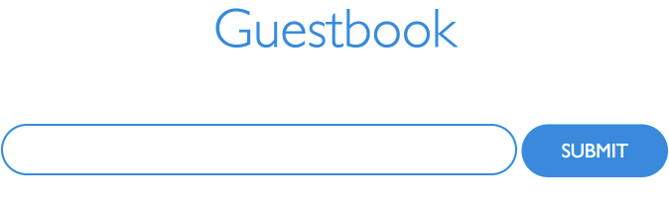
Guestbook App
Sample multi-tier web application which stores guest entries
User
Redis backend
PHP Frontend
Find out more:
https://github.com/IBM/guestbook/tree/master/v1/guestbook
Notes:
Let’s see briefly about what it takes to deploy application no a running Kubernetes cluster. We will be using Guestbook application for this purpose. It’s a mutli-tier dockerized web application that allows user to store guest entries. The application is developed in go and java script, and it has PHP frontend. The data are stored in Redis backend.

Slide 5
Deploying Guestbook – kubectl Way
Let’s see what it takes to deploy this app on a running Kubernetes cluster
Total 6 YAML Kubernetes manifest files
Application deployment and service configuration
Redis master deployment and service configuration
Redis slaves deployment and service configuration
Using the Kubernetes client, kubectl
Create Deployment
Manage Deployment
Check out files at: https://github.com/IBM/guestbook/tree/master/v1
Notes:
OK, so let’s talk about deploying guestbook app with Kubernetes client Kubectl. Mention that production level workload deployment will require many YAML manifest files. This chart simply shows what are the guestbook manifest files.

Slide 6
Deploying Guestbook – kubectl Way
Pain points
CI/CD pipeline
kubectl deployments are not easy to configure, update and rollback
Deploying app to dev/test/production may require different configuration
Update deployment e.g. update with a new image
Change the configuration based on certain conditions
A different serviceType is needed in different environments (e.g. NodePort/LoadBalancer)
Need for rollback
Need of having multiple deployments (e.g. multiple Redis deployments)
Requires to track your deployment and modify YAML files (can be error prone)
Does not allow multiple deployments without updating metadata in manifest files
Share your deployment configurations with your friend, team or customer?
You need to share many files and related dependencies
Your users are required to have knowledge of deployment configuration
Notes:
As you work more with Kubectl or calling Kubernetes APIs by yourself, you will notice many pain points as described in this slide.

Slide 7
Deploying Guestbook – Desired Way
Templatize YAML files which allows providing configuration values at runtime and eliminate the need of modifying YAML files for
Scaling
Update
Rollback
Package YAML files and all other dependencies
Easily share the package with others
Install the packaged app by providing desired configuration at runtime
Eliminate the need for user to learn details of Kubernetes resources
Deploy same workload multiple times
Notes:
Talk about what’s probably a desired way of using Kubernetes. Templatizing the YAML files and hiding configuration details from user is probably a better way of deploying our guestbook or any other application on Kubernetes cluster. Also how easy is to share your deployments is very important. Post deployment steps, to work with already deployed application, like easily tracking the app and making changes are equally important.
Deploying same workload multiple times is typically helpful for databases like running multiple Redis databases on a single VM.

Slide 8
Here Comes Helm
Deploying Guestbook – Helm Way
No expertise of Kubernetes deployment needed as Helm hides Kubernetes domain complexities
Helm packages all dependencies
Desired configuration can be passed at runtime as key-value
Helm tracks deployment making it easy to update and rollback
Same workload can be deployed multiple times
Helm allows assigning workload release names at runtime
Easy to share
Notes:
This slides shows how Helm addresses the pain points of deploying via Kubectl discussed in the previously.

Slide 9

So, What is Helm?
Helm is a tool that streamlines installation and management of Kubernetes applications
Helm became a CNCF project in mid 2018
It uses a packaging format called charts
A chart is a collection of files that describe Kubernetes resources
Think of Helm like apt/yum/homebrew for Kubernetes
Helm is available for various operating systems like OSX, Linux and Windows
Run Helm anywhere e.g. laptop, CI/CD etc.
Notes:
Let’s talk about what is helm. You can call Helm a tool or package manager for the Kubernetes, for deployment and management of applications into a Kubernetes cluster. The Helm is a all about charts - a chart is a collection of Kubernetes resource definitions along with any dependencies, files containing pre-defined values and definition of Chart itself.

Slide 10
So, What Helm is NOT
A fully fledged system package manager
A configuration management tool like Chef, puppet etc.
A Kubernetes resource lifecycle controller
Notes:
It is important to not overzealously compare Helm to programming language library package managers, as such systems have a fundamentally different goal. Helm fits into such a paradigm, by providing some but not all capabilities of package managers. Helm doesn’t adhere strictly to:
A defined security model (signing, verification, etc)
Management logic??
implement (or make it easy to implement) environment-specific (os, processor, distro) optimizations
Helm is not a configuration management tool (such as Chef or Puppet). Helm does provide certain features of such systems, though. Helm's templating and configuration model is a common feature of configuration managers (and also of package managers).
It does not respond real-time to Kuberenetes resources. Helm does something only when someone invokes it essentially.

Slide 11
Five Keywords
helm
While Helm is the name of the project, the command line client is also named helm. By convention, when speaking of the project, Helm is capitalized. When speaking of the client, helm is in lowercase.
Tiller
Tiller is the Helm server. It interacts directly with the Kubernetes API server to install, upgrade, query, and remove Kubernetes resources. It is installed in the Kubernetes cluster.
Chart
It contains all of the resource definitions necessary to run an application, tool, or service inside of a Kubernetes cluster. A chart is basically a package of pre-configured Kubernetes resources.
Release
An instance of a chart running in a Kubernetes cluster
Same chart can be deployed multiple time
Repository
Place where charts reside and can be shared with others
Notes:
Before we go further, you may want to know these keywords. You will run into many glossary items but the most common once you need to know are these five.

Slide 12


Let’s See Helm in Action

Slide 13
Demo – Guestbook Chart Deployment
Check existing installation of Helm chart
helm ls
Check what repo do you have
helm repo list
Add repo
helm repo add helm101 https://ibm.github.io/helm101/
Verify that helm101/guestbook is now in your repo
helm repo list
helm search helm101
Install
helm install helm101/guestbook --name myguestbook --set serviceType=NodePort – follow the output instructions to see your guestbook application
Verify that your guestbook chart is installed
helm ls
Check chart release history
helm history myguestbook
Notes:
Run these commands to deploy guestbook and verify many things as described in the slide.

Slide 14
Demo – Guestbook Upgrades and Rollback
First let’s see what we have
helm history myguestbook
REVISION UPDATED STATUS CHART DESCRIPTION
1 Thu May 17 21:54:29 2018 DEPLOYED guestbook-0.1.0 Install complete
Upgrade
helm upgrade myguestbook helm101/guestbook
helm history myguestbook
REVISION UPDATED STATUS CHART DESCRIPTION
1 Thu May 17 21:54:29 2018 SUPERSEDED guestbook-0.1.0 Install complete
2 Fri May 18 09:08:10 2018 DEPLOYED guestbook-0.1.0 Upgrade complete
Rollback
helm rollback myguestbook 1
helm history myguestbook
REVISION UPDATED STATUS CHART DESCRIPTION
1 Thu May 17 21:54:29 2018 SUPERSEDED guestbook-0.1.0 Install complete
2 Fri May 18 09:08:10 2018 SUPERSEDED guestbook-0.1.0 Upgrade complete
3 Fri May 18 09:11:25 2018 DEPLOYED guestbook-0.1.0 Rollback to 1
Notes:
The slide contains commands to upgrade and rollback guestbook deployment, and verification of it.

Slide 15
Demo – Clean Up
Remove repo
helm repo remove helm101
Remove chart completely
helm delete --purge myguestbook
Delete all Kubernetes resources generated when the chart was instantiated
Notes:
This slide contains commands to clean up the files and deployment created previously as part of the demo.

Slide 16

Guestbook Chart
https://github.com/IBM/helm101/tree/master/charts/guestbook

Slide 17
Let’s Learn More About Helm

Slide 18
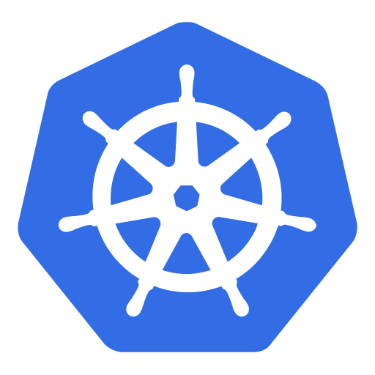
Helm Architecture
The Helm Client (helm)
Command-line client for end users
Interacts with the Tiller server sending charts to be installed/upgrade/uninstall
Interacts with the chart repository
The Helm Server (Tiller)
Interacts with the Helm client and interfaces with the Kubernetes API server
Renders templates to Kubernetes manifest files
Install/Upgrade/Uninstall charts into Kubernetes, and then tracks the subsequent release
Helm Client
( helm)
Chart
Repository
Helm chart
Helm Server (Tiller)
Kubernetes
API Server
Kubernetes Cluster
Notes:
Helm is a client-server architecture. Helm server is known as Tiller and Helm clients can interact with Tiller with client tool called helm. Interestingly, Helm server is installed with Kubernetes cluster i.e. Tiller is installed as a pod in a kube-system namespace.

Slide 19
What’s the Chart all about?
A collection of files that describe a related set of Kubernetes resources
Files laid out in a directory tree structure
Templates based on "Go template language" + functions from “Sprig” lib + specialized functions:
values, functions, pipelines, operators, flow control, variables, built-in objects
Templates rendered by Helm template engine into Kubernetes manifest files
Can be packaged into versioned objects for sharing (repos)
Version numbers (SemVer2 ‘major.minor.path’) used as release markers
Charts can have dependencies on other charts

Slide 20
Chart Template Snippet
apiVersion: apps/v1
kind: Deployment
metadata:
name: {{ include "guestbook.fullname" . }}
labels:
app.kubernetes.io/name: {{ include "guestbook.name" . }}
helm.sh/chart: {{ include "guestbook.chart" . }}
app.kubernetes.io/instance: {{ .Release.Name }}
app.kubernetes.io/managed-by: {{ .Release.Service }}
spec:
replicas: {{ .Values.replicaCount }}
selector:
………………………………………….
spec:
ports:
- name: http-server
containerPort: {{ .Values.service.port }}

Slide 21
Chart Structure
A chart is organized as a collection of files inside of a directory
The directory name is the name of the chart e.g. guestbook.
Inside of the directory, the expected file structure is
Required files:
Optional files:
Chart.yaml - A YAML file containing information about the chart.
One of the charts or templates directory:
charts/ - A directory containing any charts upon which this chart depends. (static linked)
templates/ - A directory of templates with Kubernetes manifest files or that will generate valid Kubernetes manifest files when combine with values.yaml.
LICENSE - A plain text file containing the license for the chart
README.md - A human-readable README file
requirements.yaml - A YAML file listing dependencies for the chart (dynamic linked)
values.yaml - The default configuration values for this chart
templates/NOTES.txt - A plain text file containing short usage notes
template/_helpers.tpl – template helpers that you can re-use throughout the chart
Notes:
If you are from Java background, you can think of Chart as a WAR file. The chart is a package of files with chart.yaml is a required manifest file describing the chart.
Other files are optional, however, for a chart to be a valid Helm chart it also must have at least one chart/template either in the charts/template directory.
The value.yaml file can have pre-defined values created by a chart author. The user of chart can override these values at runtime i.e. user can pass values when install a helm chart.
NOTES.txt contains usage notes that the chart author wants to display to the user at the end of deployment of chart.
_helpers.tpl allows to create reusable helper functions and variables using go templating
requirements.yaml - As the applications your packaging as charts increase in complexity, you might find you need to pull in a dependency such as a database. Helm allows you to specify sub-charts that will be created as part of the same release.

Slide 22
Helm Repository
A chart repository is an HTTP server that houses an index.yaml file and some packaged charts
The index file contains information/metadata about each chart in the repository
The preferred way of sharing chart is by uploading them to a chart repository
Use cloud provider, third party repository or Create your own
A valid chart repository must have an index.yaml file
The helm repo index will generate an index file based on a given local directory that contains packaged charts
Add repo to your local environment
helm repo add myguestbook https://ibm.github.io/helm101/
Where myguestbook is the name of local repo and https:// url provides the remote repository
This downloads charts locally and allows you to search and install any of the charts without using the repository URL
helm repo list provides list of available repositories locally
Notes:
Helm repository is a place to keep Helm charts. Once charts are uploaded to the repository, the users of charts can add repository to their local environment and quickly install charts. Most cloud providers provides such a repository. There are third parties, e.g. Jfrog, which provides such a repository. Users can easily create their own repository as well.

Slide 23
Where are the Charts?
Charts reside in:
Helm upstream charts repository
https://github.com/helm/charts
Contains several official Helm charts.
The Charts in this repository are organized into two folders:
Stable – ready to use
Incubator – under active development
IBM provided Helm charts
https://github.com/IBM/charts
Charts for IBM and third party applications
Various cloud provider repositories e.g. Google cloud storage
Individually owned repository e.g. GitHub
Local repository
File system
Notes:
After defining what are Helm charts, in this slide we are telling users where pre-built charts are available to user. Helm chart can be available on a remote repository or in a local environment/repository. It is easy to create Helm repository. One’s own Github repository can be easily converted to use as a Helm charts repository. We will show a step by step process of creating/converting Helm repository in the workshop. For now, keep in mind that in order to use existing Github repository as a Helm repository, one needs to create an index.yaml file at the root level in the Master branch and set the Master branch as gh-pages using Github repository Settings. The next slide provides an URL of guestbook chart and index.yaml file.

Slide 24
Helm Release
When a chart is installed, Helm creates a release to track that installation
A single chart may be installed many times into the same cluster using different releases
Let’s say you need multiple, independent, instance of database on a same cluster
You can reuse the same chart that can deploy a database by specifying different release names
helm install --name redis1 stable/redis
helm install --name redis2 stable/redis
A single release can be upgraded or rolled back multiple times
A sequential counter is used to track releases as they change
After a first helm install, a release will have release number 1
Each time a release is upgraded, the release number will be incremented
Since release history is stored, a release can also be rolled back to a previous release
Notes:
Helm uses Release to track installation of chart. A single chart can be used multiple times on the same machine by using different release name. Release has a number. A sequential counter is used to track releases as they change. After a first helm install, a release will have release number 1. Each time a release is upgraded or rolled back, the release number will be incremented.

Slide 25
Upgrade and Rollback
Upgrade
helm upgrade <RELEASE> <CHART>
This will upgrade existing deployment of specified release
Rollback
helm rollback <RELEASE> <REVISION>
This will rollback a helm deployment to the specified revision number
To see revision numbers, run helm history <RELEASE>
Get the history of upgrades and rollbacks
helm history < RELEASE>
Notes:
Upgrade and Rollback are important so a separate slide for it. The slide just shows upgrade and rollback command in connection with the previous slide on what’s the Helm release and how release works.

Slide 26
Installing Helm
Things to consider
There are two parts to Helm install:
Helm Client (helm)
Helm Server (Tiller)
Both of them are separate installs
Client version installed should not be later than the server version
Securing Helm requires additional steps: https://docs.helm.sh/using_helm/#securing-your-helm-installation
Find out more about installation: https://docs.helm.sh/using_helm/#installing-helm
Notes:
Helm client is available as a binary to install. After client it installed, Helm server can simply installed using client. The Helm server is part of Kubernetes cluster and runs on its own pod.
If you’re using Helm on a cluster that you completely control, like minikube or a cluster on a private network in which sharing is not a concern, the default installation – which applies no security configuration – is fine, and it’s definitely the easiest.
For Production install - production clusters requires extra security and you must take extra steps to secure your installation to prevent careless or malicious actors from damaging the cluster or its data.

Slide 27
Helm Client Install
Install Helm Client (helm)
Binary downloads of the Helm client can be found for the following OSes:
OSX
Linux
Windows
Helm releases: https://github.com/helm/helm/releases
You can also use package manager:
macOS homebrew users
brew install kubernetes-helm
Windows chocolatey users
choco install kubernetes-helm
Linux snap users
sudo snap install helm --classic
Notes:
This is a typical install for non-production/unsecure cluster or test or development environment.

Slide 28
Helm Server Install
Install Helm Server (Tiller)
Tiller can be installed in one of two ways:
In the Kubernetes cluster (recommended way)
Running locally (in some dev scenarios)
Install/Upgrade in the Kuberentes cluster:
helm init [–upgrade]
Command also initializes the CLI
Run locally:
tiller
export HELM_HOST=localhost:44134 (for helm client. Alternatively, can pass –host when running client command)
Notes:
This is a typical install for non-production/unsecure cluster or test or development environment.

Slide 29
Where is Helm?
GitHub repository - https://github.com/helm/helm
Channels on the Kubernetes Slack workspace - https://kubernetes.slack.com
#helm-users
#helm-dev
#charts
Mailing list - https://lists.cncf.io/g/cncf-kubernetes-helm
Developer call Every Thursdays at 9:30-10:00 Pacific - https://zoom.us/j/696660622
Helm Documentation - https://docs.helm.sh
Interested in contributing to the Helm?
Refer to the Helm Community - https://github.com/helm/community
Notes:
This is just an informative slide showcasing open source side of the Helm.

Slide 30
Future

Slide 31
Helm v3
Key Changes
No Server component (Tiller) – everything done via client
All operations under user credentials
Charts are updated with:
Libraries that allow “define” attributes to be shared across charts
Schema to control values
Reserved ‘ext’ directory for extensions/scripts
Helm will use a "lifecycle events" emitter/handler model
Hooks are still supported, and will now be managed
Helm has an embedded Lua engine for scripting some event handlers - scripts stored in charts
For pull-based DevOps workflow, a new Helm Controller project will be started
This is not required for a deployment and will be optional
Cross platform plugins in Lua that only have a runtime dependency on Helm
A complementary command to ’helm fetch’, to push packages to a repository

Slide 32
Helm v3 Architecture
Helm CLI
( helm)
Chart
Repository
The Helm v3 Client (helm) is a command-line client façade that uses the (new) helm library to:
Interface with the Kubernetes API server directly
Supports all the functionality of helm v2
With a few exceptions that don’t make sense with the new architecture
Stores release state in the same namespace as the application destination
Can push as well as fetch charts to/from a chart repository
Helm
Library
push/fetch
Helm chart
Kubernetes
API Server
Kubernetes Cluster
Notes:
Helm is a client only architecture

Slide 33
Helm v3 Time Frame
Provisional dates:
Alpha version: 2018 EOY
Release: Mid 2019
More detail on v3 functionality
https://github.com/helm/community/blob/master/helm-v3/000-helm-v3.md
Milestones can be tracked
https://github.com/kubernetes/helm/milestones
A second use of the (new) Helm library is proposed as a “Helm Controller” that could be installed into the cluster to enable pull operations. Details of this are, as yet, not defined. However, this would NOT act on behalf of the v3 Helm client, rather have its own TBD interface.

Slide 34
Summary

Slide 35
Deployment - Kubernetes vs Helm
Deployment
You need to know the manifest YAML file(s) you are deploying $ kubectl create –f *.yaml Can not deploy same workload without modifying YAML files. Requires valid manifest upfront because it lacks templating mechanism like helm. With helm, a valid manifest can be produced at runtime combining YAML templates and values.yaml file.
No need to know the which YAML files to use. Install with chart name, helm install charts/guestbook --name guestbook1 Same chart can be deployed multiple times by simply providing different release names at runtime. Templating provides robustness of generating manifest files at runtime.
kubectl
helm
Notes:
This slide shows the differences in using Kubectl (or kubernetes APIs) vs Helm in reference with the deployment of application.

Slide 36
Upgrade/Rollback - Kubernetes vs Helm
Upgrade/Rollback with new values
Multiple ways but each can add complexities Modify the values in the YAML files OR Create ConfigMap OR Set environmental variables Other users can not get your environment. User need to know the configuration for rollback.
No need to touch Kuberntes manifest files. Change the values in values.yaml or provide on command line. For example, $ helm install charts/guestbook --name guestbook1 --set serviceType=NodePort Configuration files are saved by Helm release which makes rollback easy.
kubectl
helm
Notes:
This slide shows the differences in using Kubectl (or kubernetes APIs) vs Helm in reference with the upgrade/rollback of deployed application.

Slide 37
Share Configuration Files - Kubernetes vs Helm
Share
Not as easy as Helm chart unless for a basic deployments with a single YAML manifest file. User need to download multiple files/dependencies.
Easy to share by uploading charts to remote repository For example, several ready to use charts are available at: Helm official chart repo: https://github.com/helm/charts IBM chart repo: https://github.com/IBM/charts
kubectl
helm
Notes:
This slide shows the differences in using Kubectl (or kubernetes APIs) vs Helm in reference with the sharing the Kubernetes resource definitions.

Slide 38


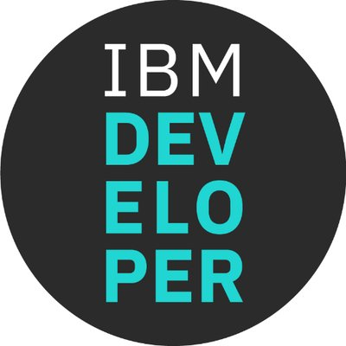
Thank you
twitter.com/sp_zala
twitter.com/henrynash
twitter.com/mhickeybot
github.com/spzala
github.com/henrynash
github.com/hickeyma
developer.ibm.com

Slide 39
Backup

Slide 40
Demo – Chart Deployment
Check existing installation of Helm chart
helm ls
Check what repo do you have
helm repo list
Add repo
helm repo add helm101 https://ibm.github.io/helm101/
Verify that helm101/guestbook is now in your repo
helm repo list
helm search helm101
Install
helm install helm101/guestbook --name myguestbook --set serviceType=NodePort – follow the output instructions to see your guestbook application
Verify that your guestbook chart is installed
helm ls
Check chart release history
helm history myguestbook

Slide 41
Demo – Upgrades and Rollback
First let’s see what we have
helm history myguestbook
REVISION UPDATED STATUS CHART DESCRIPTION
1 Thu May 17 21:54:29 2018 DEPLOYED guestbook-0.1.0 Install complete
Upgrade
helm upgrade myguestbook helm101/guestbook
helm history myguestbook
REVISION UPDATED STATUS CHART DESCRIPTION
1 Thu May 17 21:54:29 2018 SUPERSEDED guestbook-0.1.0 Install complete
2 Fri May 18 09:08:10 2018 DEPLOYED guestbook-0.1.0 Upgrade complete
Rollback
helm rollback myguestbook 1
helm history myguestbook
REVISION UPDATED STATUS CHART DESCRIPTION
1 Thu May 17 21:54:29 2018 SUPERSEDED guestbook-0.1.0 Install complete
2 Fri May 18 09:08:10 2018 SUPERSEDED guestbook-0.1.0 Upgrade complete
3 Fri May 18 09:11:25 2018 DEPLOYED guestbook-0.1.0 Rollback to 1

Slide 42
Demo – Clean Up
Remove repo
helm repo remove helm101
Remove chart completely
helm delete --purge myguestbook
Without –purge Helm will not completely remove your chart

Slide 43
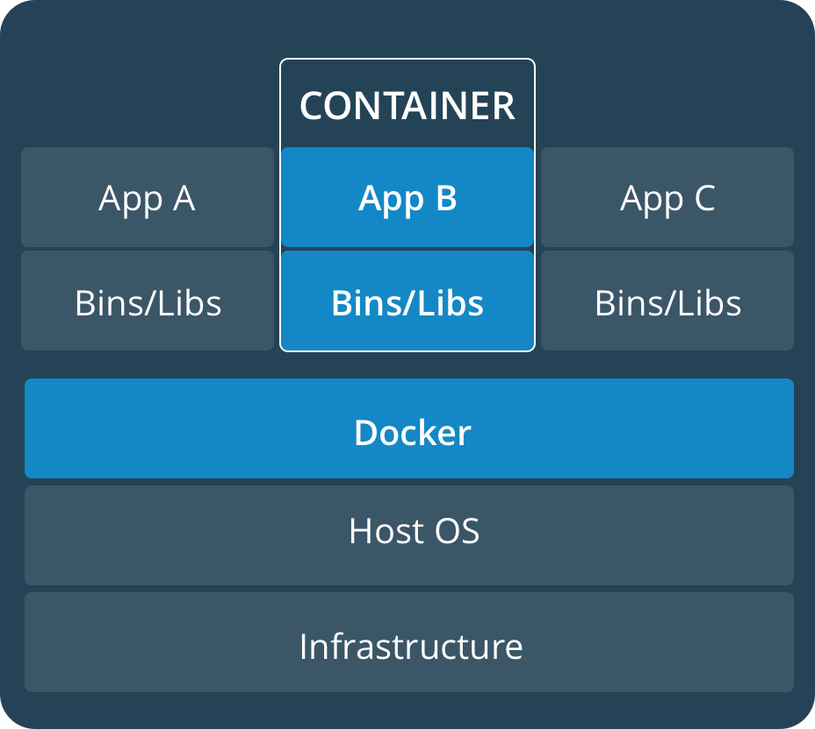
Overview of Containers
Abstraction at the app layer that packages code and dependencies together
Multiple containers can run on the same machine and share the OS kernel with other containers, each running as isolated processes in user space
Learn more about containers here - https://developer.ibm.com/courses/all/docker-essentials-extend-your-apps-with-containers/
Notes:
In order to learn Helm, a basic knowledge of Containers in general and Kubernetes in particular is required.

Slide 44
Why Helm?
Helm provides probably the easiest way to use Kubernetes
You can:
Use existing charts created by others
Create your own charts and share with others
Easily manage your Kubernetes manifest files, configuration values and related resources as a package
Release charts and manage releases
Configuring deployment with user values
Active development with a strong community behind it
There is even a dedicated Helm Summit
Used widely in IBM and in the industry
Notes:
Helm makes it easy to use Kubernetes. This slide shows benefits of Helm.

Slide 45
Overview of Kubernetes
Enterprise level container orchestration
Provision, manage, scale applications (containers) across a cluster
Manage infrastructure resources needed by applications
Compute
Volumes
Networks
And many many many more...
Declarative model
Provide the "desired state" and Kubernetes will make it happen
What's in a name?
Kubernetes (K8s/Kube): "Helmsman" in ancient Greek
Learn more about Kubernetes here - https://github.com/IBM/kube101
Notes:
The Kuber101 link providers good education on Kubernetes.

Slide 46
Kubernetes vs Helm deployments
Deployment | Upgrade/Rollback with new values | Share
You need to know the manifest YAML file(s) you are deploying $ kubectl create –f *.yaml Can not deploy same workload without modifying YAML files. Requires valid manifest upfront because it lacks templating mechanism like helm. With helm, a valid manifest can be produced at runtime combining YAML templates and values.yaml file. | Multiple ways but each can add complexities Modify the values in the YAML files OR Create ConfigMap OR Set environmental variables Other users can not get your environment. User need to know the configuration for rollback. | Not as easy as Helm chart unless for a basic deployments with a single YAML manifest file. User need to download multiple files.
No need to know the which YAML files to use. Install with chart name, helm install charts/guestbook --name guestbook1 Same chart can be deployed multiple times by simply providing different release names at runtime. Templating provides robustness of generating manifest files at runtime. | No need to touch Kuberntes manifest files. Change the values in values.yaml or provide on command line. For example, $ helm install charts/guestbook --name guestbook1 --set serviceType=NodePort Configuration files are saved by Helm release which makes rollback easy. | Easy to share by uploading charts to remote repository For example, several ready to use charts are available at the https://github.com/IBM/charts
kubectl
helm
Notes:
This slide shows the differences in using Kubectl (or kubernetes APIs) vs Helm in three important areas – deployment, upgrade/rollback and sharing the Kubernetes resource definitions.

Slide 47
Helm Security Considerations
The main difference between non-secure and secure install is security of Tiller or Helm server
Four main areas to consider
Role-based access control (RBAC)
Create a cluster with RBAC enabled
Protecting the Tiller endpoint with TLS
Configure each Tiller gRPC endpoint to use a separate TLS certificate
Tiller release information
Tiller stores its release information in ConfigMaps by default
Recommendation is to change default to Secrets
Helm charts
Validate all software you install yourself before you install it.
Notes:
The default installation of Helm is completely appropriate to use this type of installation when you are working against a cluster with no or very few security concerns, such as local development with Minikube or with a cluster that is well-secured in a private network with no data-sharing or no other users or teams. However for cases where clusters that are exposed to uncontrolled network environments: either untrusted network actors can access the cluster, or untrusted applications that can access the network environment OR clusters that are for many people to use -- multitenant clusters -- as a shared environment, it is highly recommended to secure the Helm. This slide gives high level overview of areas to consider to secure the Helm tiller or server.

Slide 48
Helm Chart Installation Flow
User via ”helm" installs a new chart
The Helm server (Tiller) will resolve chart templates and dependencies into a Kubernetes Manifest files and send a request to the Kubernetes API server. The Helm server will track the deployment as a Helm release.
API server receives the request and stores it in the DB (etcd)
Watchers/controllers detect the resource changes and act upon it
ReplicaSet watcher/controller detects the new app and creates new pods to match the desired # of instances
Scheduler assigns new pods to a kubelet
Kubelet detects pods and deploys them via the container runing (e.g. Docker)
Kubeproxy manages network traffic for the pods – including service discovery and load-balancing
Chart
Repository
Helm Client
( helm)
1
Helm chart
Node
Helm Server (Tiller)
2
Master
API Server
Storage
(etcd)
3
4
Node
Controllers
Replication
Endpoints
...
Kublet
7
Kube-Proxy
8
Scheduler
5
Images
Ubuntu
Liberty
6
Pod
Pod/Service
Docker Engine
C
C
C
Base OS/Kernel
Note: Steps 3 onwards are a normal Kubernetes flow.

Slide 49
Using Helm
Some other common helm commands are
create - create a new baseline chart with the given name
delete - given a release name, delete the release from Kubernetes
list - list releases of charts
inspect - inspect a chart
search - search for charts
status - displays the status of the named release
repo list – list local repositories
version – helm version information
Run helm --help to find out all the commands
Notes:
OK, so by now we have Helm installed and we have also provided an example of deploying workloads via using “helm install” command. This slide provides a high level view of what are some other common helm commands and how to get a full list of commands by using “helm –help”.

