Slide 1
Setting up environment
Install IBM cloud CLI(bx) :
https://console.bluemix.net/docs/cli/reference/bluemix_cli/get_started.html#getting-started
Install container service Plugins :
bx plugin install container-service -r Bluemix
Install Kubernetes Cluster :
https://console.bluemix.net/containers-kubernetes/catalog/cluster/create
Install Kubernetes CLI:
https://kubernetes.io/docs/tasks/tools/install-kubectl/
Install Helm:
https://github.com/kubernetes/helm/blob/master/docs/install.md
Git Link: https://github.com/IBMDevConnect/kube_ICP#setting-up-environment

Slide 2
What is Containers?
Containers are an abstraction at the app layer that packages code and dependencies together
Containers provide isolation similar to virtual machines (VMs), except provided by the OS and at the process level
Multiple containers can run on the same machine and share the OS kernel with other containers, each running as isolated processes in user space
Containers take up less space than VMs (container images are typically tens of MBs in size), and start almost instantly.
It is light weight, open sourced and secured.

Slide 3
What is Kubernetes?
Container orchestrator
Runs and manages containers
Unified API for deploying web applications, batch jobs, and databases
Maintains and tracks the global view of the cluster
Supports multiple cloud and bare-metal environments
Manage applications, not machines
Rolling updates, canary deploys, and blue-green deployments
Designed for extensibility
Rich ecosystem of plug-ins for scheduling, storage, networking
Open source project managed by the Linux Foundation
Inspired and informed by Google's experiences and internal systems
100% open source, written in Go

Slide 4
Need for Kubernetes
Replication of components
Auto-scaling
Load balancing
Rolling updates
Logging across components
Monitoring and health checking
Service discovery
Authentication

Slide 5
Bins/
Libs
Bins/
Libs
Bins/
Libs
App
A
App
A’
App
B
Guest
OS
Guest
OS
Guest
OS
Guest
OS
Guest
OS
VM
Bins/Libs
Bins/Libs
App A
App B’
App B’
App A’
App B
App B’
Container
Hypervisor (Type 2)
Host OS
Host OS
Server
Server
© Copyright IBM Corporation 2017

Slide 6

CNTR1
CNTR2
CNTR3
CNTR4
Layer
app1
app2
app3
app4
Layer
tomcat
liberty
tomcat
Layer
Fedora
Ubuntu
Base OS / Kernel
Filesystem
Layers allow for reuse
More containers per host
Faster start-up/download time – base layers are "cached"
Images
Tarball of layers (each layer is a tarball)
© Copyright IBM Corporation 2017

Slide 7
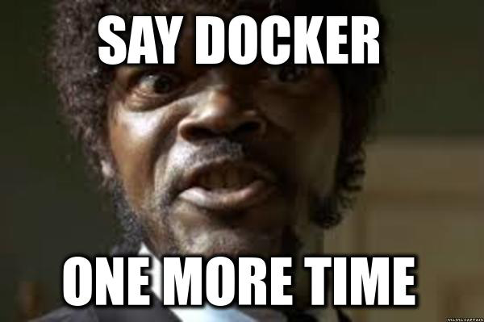


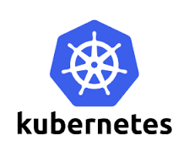

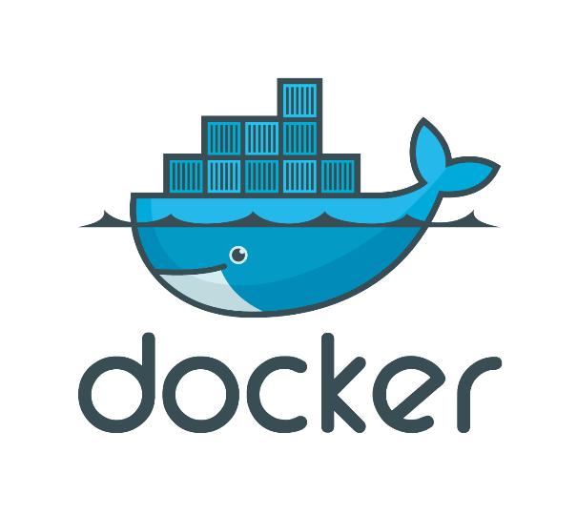


Serverless
PaaS
Container Orchestration
Swarm/
Swarm Mode
Container Engine

Slide 8
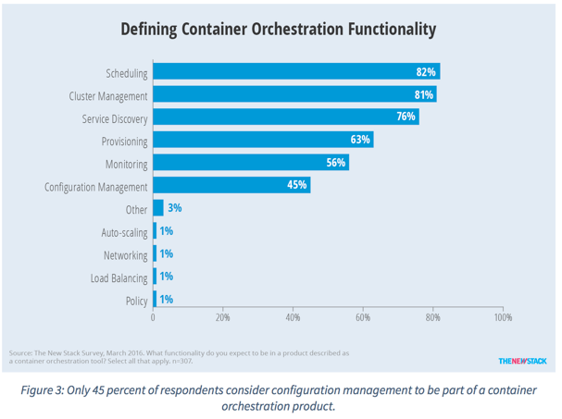
Container Orchestration Responsibilities
Container orchestration
Scheduling
Cluster management
Service discovery
Related functionality
Provisioning
Monitoring
Configuration management

Slide 9
Layer 6
Development Workflow
Opinionated Containers
OpenShift, Cloud Foundry, Docker Cloud, Deis, Apcera, Apprenda
Layer 5
Orchestration/Scheduling
Service Model
Kubernetes, Docker Swarm, Marathon/Mesos, Nomad, Diego
Layer 4
Container Engine
Docker, rkt, runC (OCI), Osv, LXC, LXD
Layer 3
Operating System
Ubuntu, RHEL, CoreOS, Unikernels
Layer 2
Virtual Infrastructure
vSphere, EC2, GCP, Azure, OpenStack
Layer 1
Physical Infrastructure
Raw Compute, Storage, Network

Slide 10
Kubernetes Architecture
internet
kubectl
Kubernetes cluster
firewall
Worker node
kube-proxy
kubelet
docker
Master node
pod
pod
pod
cAdvisor
container
container
authentication authorization
container
container
container
APIs
scheduling
actuator
REST
Worker node
kube-proxy
controller manager
kubelet
Distributed watchable storage (etcd)
docker
pod
pod
pod
cAdvisor
container
container
container
container
container

Slide 11
Master Node
Responsible for management of Cluster
Entry point for all administrative tasks
Orchestrate the Worker Nodes
API Server: Entry Point for REST Commands to control the Cluster
Etcd Storage: Distributed and consistent Key-Value Store, used for Shared configuration and Service Discovery. REST interface for CURD operations and register watcher on specific nodes. Example data like Jobs Scheduled, Created and deployed, pods and Service states.
Scheduler: Deployment of configured Pods and Services onto the Nodes
Controller Manager: Uses the API server to watch the shared State of cluster and make corrective changes to current state to change desired state. examples are replication controller, endpoints controller, namespace controller, and service accounts controller.

Slide 12
Kube-controller-manager
Node Controller: Responsible for noticing and responding when nodes go down.
Replication Controller: Responsible for maintaining the correct number of pods for every replication controller object in the system.
Endpoints Controller: Populates the Endpoints object (that is, joins Services & Pods)
Service Account & Token Controllers: Create default accounts and API access tokens for new namespaces.

Slide 13
Worker Node
Your application runs here. Contains required services to mange the network between containers and communicate to Master Node.
Docker Runtime: Runs the configured Pods, it takes care of downloading container images and starting the container. Kubernetes also support RKT another Container runtime.
Kubelet: An agent that runs in each Node in the cluster, It makes sure containers are running in a pod. It uses the PodSpec for container configurations.
Kube-Proxy: Enables Service abstractions by maintaining Network rules and Connection Forwarding.
Pods: Group of one or more containers (such as Docker containers), with shared storage/network, and a specification for how to run the containers
Service : Is an abstraction which defines a logical set of Pods and a policy by which to access them. Services enable a loose coupling between dependent Pods

Slide 14
Kubernetes Architecture: Workloads
Container
Packaging of an app
Pod
Unit of deployment
Service
Fixed endpoint for 1+ pods
App A
App B
Master Node
Pod
Pod
Worker Node 1
App A Client
App A Service
App B
App A
Pod
Pod
Worker Node 2
App B Client
App B Service
App A
App B
Pod
Pod
Kubernetes components
Worker Node 3
© Copyright IBM Corporation 2017

Slide 15
Cluster – Master Communication
All cluster communications terminates at API Server
API Server listens on HTTPS secured protocol with authentication and authorization enabled
Nodes can connect to API server using public root certificate and valid credential.
Service is configured with Virtual IP redirected vi kube-proxy

Slide 16
Master – Cluster communication
There are two communications paths from Master to Cluster.
API Server -> Kubelet
API Server -> Node, Pod, Service
API Server -> Kubelet : The communication terminates at Kubelet’s https endpoint. Used to fetch logs for Pods, attaching kubectl to running pods and Port forwarding
API Server -> Nodes, Pods and Services : The communication between API Server to Nodes, Pods and Services are plain HTTP connection.
SSH Tunnels: SSH Tunnels can be used to protect the Master–Cluster communication so that the traffic is not exposed outside of the private network.

Slide 17
Benefits of K8s cluster
Open source
Better management through modularity
Deployment and Scale application online: Scalability, Visibility, Time savings, Version control Horizontal autoscaling, Rolling updates, Canary deployments
Efficient use of hardware
Orchestrate containers on multiple hosts
Webhooks- automate updating your apps from DockerHub or any other repository.

Slide 18
Resources
Docker tutorial
https://docs.docker.com/get-started/
Kubernetes tutorial
https://kubernetes.io/docs/tutorials/kubernetes-basics/
Istio
https://github.com/istio
https://istio.io/docs/
The Evolution of Linux Containers and Their Future
https://dzone.com/articles/evolution-of-linux-containers-future
Introduction to container orchestration
https://www.exoscale.ch/syslog/2016/07/26/container-orch/
TNS Research: The Present State of Container Orchestration
https://thenewstack.io/tns-research-present-state-container-orchestration/
Large-scale cluster management at Google with Borg
https://research.google.com/pubs/pub43438.html

