Slide 1
Setting up environment
Install IBM cloud CLI(bx) :
https://console.bluemix.net/docs/cli/reference/bluemix_cli/get_started.html#getting-started
Install container service Plugins :
bx plugin install container-service -r Bluemix
Install Kubernetes Cluster :
https://console.bluemix.net/containers-kubernetes/catalog/cluster/create
Install Kubernetes CLI:
https://kubernetes.io/docs/tasks/tools/install-kubectl/
Install Helm:
https://github.com/kubernetes/helm/blob/master/docs/install.md
Git Link: https://github.com/IBMDevConnect/kube_ICP#setting-up-environment

Slide 2
Helm

Slide 3
Topics
Life without Helm
What is Helm
How to use helm
Hands-on with helm

Slide 4
Life without Helm
Write Kubernetes manifests by hand
Do this every time you need to release anything
Figure out your own sharing
Tweak resources by hand
Use kubectl to manage these

Slide 5
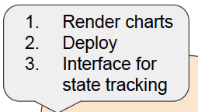

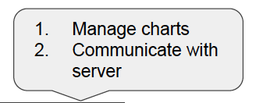
Helm
The client is responsible for managing charts, and the server is responsible for managing releases
Package manager for Kubernetes
RedHat/Fedora – rpm
Microsoft – msi
Ubuntu – apt
Kubernetes – helm
Two components – a client (helm) and a server (tiller)
app1
App2
app3
Helm Client
worker1
worker2
worker3
or...
helm
master
tiller
k8s cluster

Slide 6
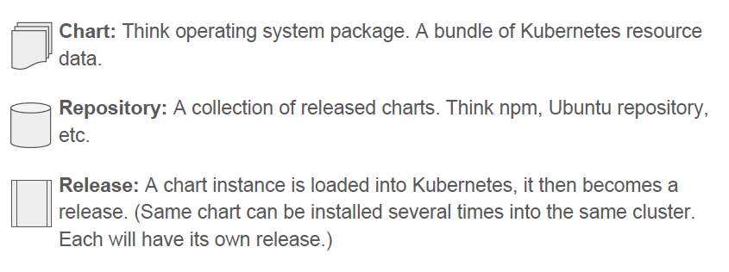
Charts, Repositories, Releases

Slide 7
Helm packages are called "charts"
Each chart is a folder named for the chart
A minimum chart contains:
description - Chart.yaml
templates – folder with kubernetes resource definitions
Most charts include values.yaml to specify installation defaults used in templates
wordpress/
Chart.yaml # A YAML file containing information about the chart
LICENSE # OPTIONAL: A plain text file containing the license for the chart
README.md # OPTIONAL: A human-readable README file
requirements.yaml # OPTIONAL: A YAML file listing dependencies for the chart
values.yaml # The default configuration values for this chart
charts/ # OPTIONAL: A directory containing any charts upon which this chart depends.
templates/ # A directory of templates that, when combined with values,
# will generate valid Kubernetes manifest files.
templates/NOTES.txt # OPTIONAL: A plain text file containing short usage notes

Slide 8
Template processing
cloudant-deployment.yaml :
apiVersion: apps/v1beta1
kind: Deployment
metadata:
name: "{{ template "fullname" . }}"
labels:
spec:
replicas: 1
strategy:
type: Recreate
template:
metadata:
labels:
...
spec:
terminationGracePeriodSeconds: 0
containers:
- name: "{{ template "fullname" . }}"
image: "{{ .Values.image.repository }}:{{ .Values.image.tag }}"
imagePullPolicy: {{ .Values.image.pullPolicy }}
ports:
- containerPort: 80
name: http
values.yaml :
## image parameters
image:
repository: ibmcom/cloudant-developer
tag: latest
pullPolicy: Always

Slide 9
Chart repositories
Charts can be collected and shared using a repository
The index file can be created by helm
$ helm repo index
example:
https://github.com/IBM/charts/tree/master/repo/stable
charts/
bar-dev-0.1.0.tgz # tarball of the bar chart
foo-dev-1.0.0.tgz # tarball of the foo chart
...
index.yaml # A YAML file with catalog of charts

Slide 10
Prepare Helm Chart
After successful completion of section 1, you will be able to connect to you Kubernete cluster using kubectl and helm. Next step in this lab is to create Helm chart.
Step 1: Execute “helm create lets-chat”, This creates following folder structure and template files will be created in respective folder.
lets-chat
├── Chart.yaml
├── charts
├── templates
│ ├── NOTES.txt
│ ├── _helpers.tpl
│ ├── deployment.yaml
│ ├── ingress.yaml
│ └── service.yaml
└── values.yaml
All the required files are generated and it has to be modified as per your required.
Replace the values.yaml, deployment.yaml and service.yaml with the one provided to you.

Slide 11
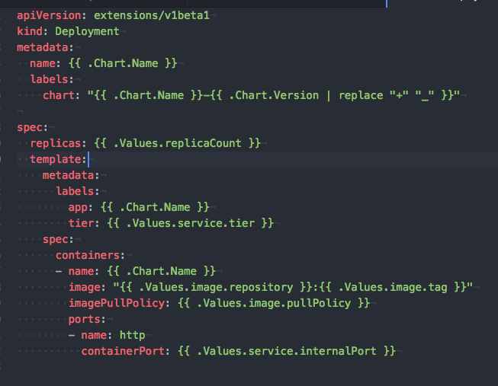
deployment.yaml

Slide 12
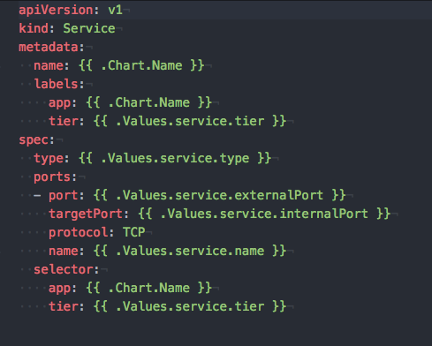
service.yaml

Slide 13
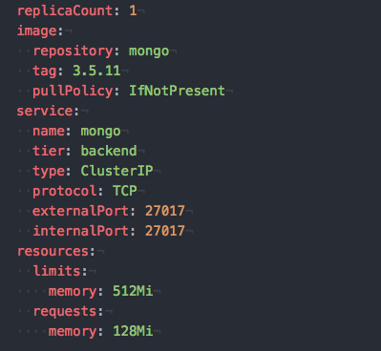
Values.yaml

Slide 14
Built-in Objects
Release - Release.Name, Release.Time, Release.Namespace, Release.Service, Release.Revision, Release.IsUpgrade, Release.IsInstall
Values – by default Values is empty
Chart - Chart.Name, Chart.Version
Files - Files.Get, Files.GetBytes
Capabilities- Capabilities.APIVersions, Capabilities.KubeVersion, Capabilities.TillerVersion
Template – Template.Name, Template.BasePath

Slide 15
Charts lifecycle hooks
pre-install: Executes after templates are rendered, but before any resources are created in Kubernetes.
post-install: Executes after all resources are loaded into Kubernetes
pre-delete: Executes on a deletion request before any resources are deleted from Kubernetes.
post-delete: Executes on a deletion request after all of the release's resources have been deleted.
pre-upgrade: Executes on an upgrade request after templates are rendered, but before any resources are loaded into Kubernetes

Slide 16
Charts lifecycle hooks-Continued
post-upgrade: Executes on an upgrade after all resources have been upgraded.
pre-rollback: Executes on a rollback request after templates are rendered, but before any resources have been rolled back.
post-rollback: Executes on a rollback request after all resources have been modified

Slide 17
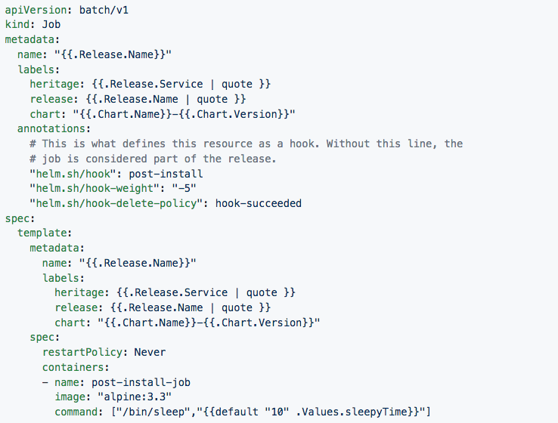
Sample Hook implementation

Slide 18
Lab: Helm

Slide 19
Step1 : Install Helm Client
https://docs.helm.sh/using_helm/#installing-helm
From Homebrew (macOS)
Members of the Kubernetes community have contributed a Helm formula build to Homebrew. This formula is generally up to date.
brew install kubernetes-helm
Based on your OS install helm client

Slide 20
Login to IBM Cloud and initialize the Helm
Step 1: Login to IBM cloud, Execute “bx login “on your local system terminal window to login. Note if you are using IBM federated email then execute with –sso option.
Step 2: After successful login to IBM cloud, Initialize the Container plugin by executing the below command.
Execute “bx cs init”
Step 3: Make sure kubectl is installed properly and it can communicate to the cluster.
Execute “kubectl version”,
the output of this command should return both server and client version, you can see the client and server version in the below sample output.
Example output:
Client Version: version.Info{Major:"1", Minor:"7", GitVersion:"v1.7.3", GitCommit:"2c2fe6e8278a5db2d15a013987b53968c743f2a1", GitTreeState:"clean", BuildDate:"2017-08-03T07:00:21Z", GoVersion:"go1.8.3", Compiler:"gc", Platform:"darwin/amd64"}
Server Version: version.Info{Major:"1", Minor:"8+", GitVersion:"v1.8.8-2+9d6e0610086578", GitCommit:"9d6e06100865789613cbac936edce948f0710a2f", GitTreeState:"clean", BuildDate:"2018-02-23T08:20:09Z", GoVersion:"go1.8.3", Compiler:"gc", Platform:"linux/amd64"}
Notes:
kubectl config set-context $(kubectl config current-context) --namespace=ramesh
kubectl config view -o jsonpath='{.users[0].user.auth-provider.config.id-token}'

Slide 21
Configure kubectl client
Step 4: Configure the kubectl client to connect to your cluster
Step 4.1 Execute “bx cs cluster” to get the list of clusters available in your account. If there is no cluster reported then create one by login to Bluemix console.
Step 4.2: Execute “bx cs cluster-config <cluster name>",
Replace <cluster name > with your cluster name, received from step 4.1, Output of this command return the cluster name and environment setting need to be execute.
Execute the export command in the output of cluster-config command.
Example: export KUBECONFIG=/Users/rameshpoomalai/.bluemix/plugins/container-service/clusters/mycluster/kube-config-hou02-mycluster.yml

Slide 22
Deploy mongo Chart
Step 1: Execute the following command to initialize the helm, This will make sure that server side tiller also ready to accept the request.
“helm init”
Step 2: Execute the following command to package your charts.
“helm package mongo”
This will package your charts and that be released to release to your repos.
Step 3: Execute “helm install --debug --dry-run mongo --name bankend” to to test your charts
Step 4: Execute “helm install mongo --name bankend” to install your package on your cluster.
Note: if you are creating a new Helm chart, Execute “helm lint <path>” to verify no errors in chart.
Git Repo : https://github.com/IBMDevConnect/kube_ICP#steps-helm

Slide 23
Deploy letschat Chart
Step 1: Execute the following command to package your charts.
“helm package letschat”
This will package your charts and that be released to release to your repos.
Step 2: Execute “helm install --debug --dry-run letschat --name frontend” to to test your charts
Step 3: Execute “helm install letschat --name frontend” to install your package on your cluster.
Step 4: Check the status of deployment.
“Helm list”
Step 5: Check the status of the application. Make sure that all the pods are running.
“kubectl get pods”

Slide 24
Access your Deployed Application
Step 1: Execute the following command to get the public IP address.
“bx cs workers <your_cluster_name_created_under_ibm_cloud>”
The output will be similar to as below. The ip marked i bold is cluster IP in my case.
ID Public IP Private IP
kube-mel01-paedbc7786e21c450e813eadc69ebaf43b-w1 168.1.149.16 10.118.243.226
Step 2: Execute “kubectl get svc” to get Ports exposed by service
$ kubectl get svc
NAME CLUSTER-IP EXTERNAL-IP PORT(S) AGE
letschat 172.21.108.9 <nodes> 8080:30080/TCP 2h
mongo 172.21.43.81 <none> 27017/TCP 2h
Step 3: You can access letschat application by below url.
http://<your_cluster_ip>:30080

Slide 25
High availability Demo

Slide 26
Thank you

