Slide 1
Kubernetes
Kubernetes is a portable, extensible open-source platform for managing containerized workloads and services, that facilitates both declarative configuration and automation.
Need for Kubernetes:
Replication of components
Auto-scaling
Load balancing
Rolling updates
Logging across components
Monitoring and health checking
Service discovery
Authentication

Slide 2
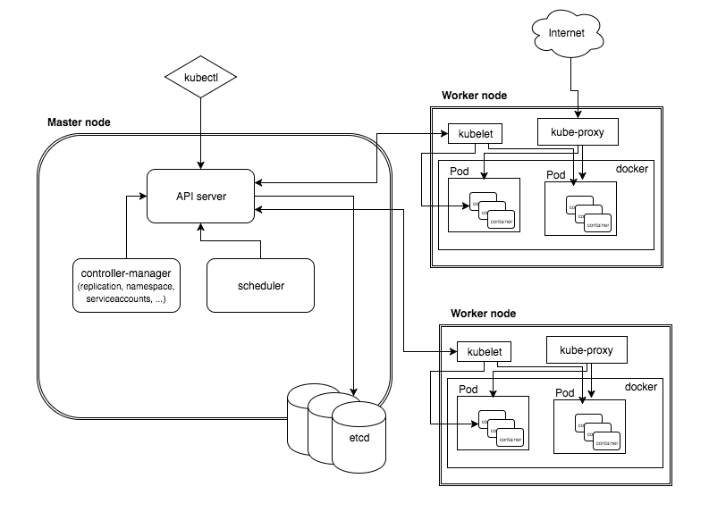
Kubernetes High Level Architecture

Slide 3
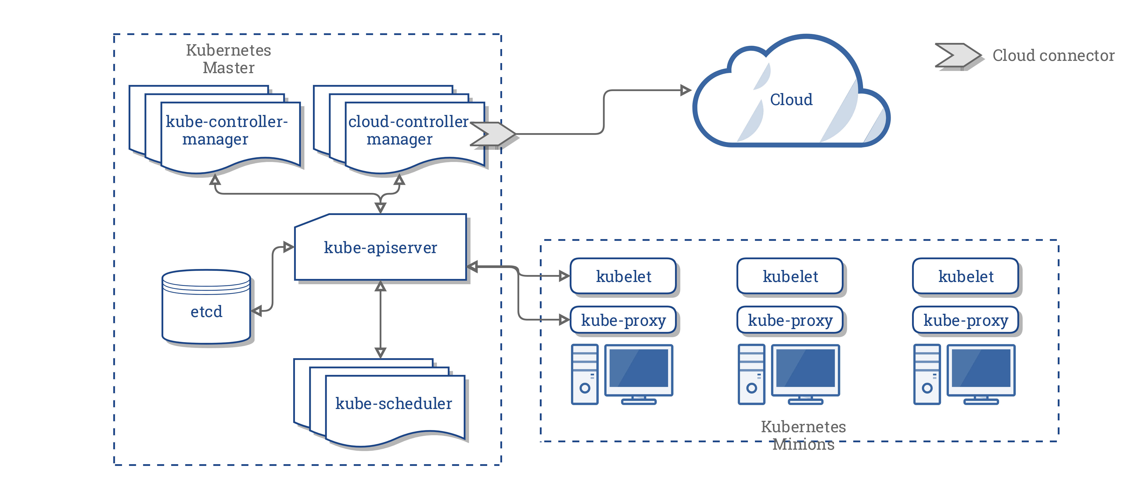
Kubernetes Architecture - CCM

Slide 4
Master Node
Responsible for management of Cluster
Entry point for all administrative tasks
Orchestrate the Worker Nodes
API Server: Entry Point for REST Commands to control the Cluster
Etcd Storage: Distributed and consistent Key-Value Store, used for Shared configuration and Service Discovery. REST interface for CURD operations and register watcher on specific nodes. Example data like Jobs Scheduled, Created and deployed, pods and Service states.
Scheduler: Deployment of configured Pods and Services onto the Nodes
Controller Manager: Uses the API server to watch the shared State of cluster and make corrective changes to current state to change desired state. examples are replication controller, endpoints controller, namespace controller, and service accounts controller.

Slide 5
Kube-controller-manager
Node Controller: Responsible for noticing and responding when nodes go down.
Replication Controller: Responsible for maintaining the correct number of pods for every replication controller object in the system.
Endpoints Controller: Populates the Endpoints object (that is, joins Services & Pods)
Service Account & Token Controllers: Create default accounts and API access tokens for new namespaces.

Slide 6
Worker Node
Your application runs here. Contains required services to mange the network between containers and communicate to Master Node.
Docker Runtime: Runs the configured Pods, it takes care of downloading container images and starting the container. Kubernetes also support RKT another Container runtime.
Kubelet: An agent that runs in each Node in the cluster, It makes sure containers are running in a pod. It uses the PodSpec for container configurations.
Kube-Proxy: Enables Service abstractions by maintaining Network rules and Connection Forwarding.
Pods: Group of one or more containers (such as Docker containers), with shared storage/network, and a specification for how to run the containers
Service : Is an abstraction which defines a logical set of Pods and a policy by which to access them. Services enable a loose coupling between dependent Pods

Slide 7
Cluster – Master Communication
All cluster communications terminates at API Server
API Server listens on HTTPS secured protocol with authentication and authorization enabled
Nodes can connect to API server using public root certificate and valid credential.
Service is configured with Virtual IP redirected vi kube-proxy

Slide 8
Master – Cluster communication
There are two communications paths from Master to Cluster.
API Server -> Kubelet
API Server -> Node, Pod, Service
API Server -> Kubelet : The communication terminates at Kubelet’s https endpoint. Used to fetch logs for Pods, attaching kubectl to running pods and Port forwarding
API Server -> Nodes, Pods and Services : The communication between API Server to Nodes, Pods and Services are plain HTTP connection.
SSH Tunnels: SSH Tunnels can be used to protect the Master–Cluster communication so that the traffic is not exposed outside of the private network.

