Slide 1
Setting up environment
Install IBM cloud CLI(bx) :
https://console.bluemix.net/docs/cli/reference/bluemix_cli/get_started.html#getting-started
Install container service Plugins :
bx plugin install container-service -r Bluemix
Install Kubernetes Cluster :
https://console.bluemix.net/containers-kubernetes/catalog/cluster/create
Install Kubernetes CLI:
https://kubernetes.io/docs/tasks/tools/install-kubectl/
Install Helm:
https://github.com/kubernetes/helm/blob/master/docs/install.md
Git Link: https://github.com/IBMDevConnect/kube_ICP#setting-up-environment

Slide 2
What is Containers?
Containers are an abstraction at the app layer that packages code and dependencies together
Containers provide isolation similar to virtual machines (VMs), except provided by the OS and at the process level
Multiple containers can run on the same machine and share the OS kernel with other containers, each running as isolated processes in user space
Containers take up less space than VMs (container images are typically tens of MBs in size), and start almost instantly.
It is light weight, open sourced and secured.

Slide 3
What is Kubernetes?
Container orchestrator
Runs and manages containers
Unified API for deploying web applications, batch jobs, and databases
Maintains and tracks the global view of the cluster
Supports multiple cloud and bare-metal environments
Manage applications, not machines
Rolling updates, canary deploys, and blue-green deployments
Designed for extensibility
Rich ecosystem of plug-ins for scheduling, storage, networking
Open source project managed by the Linux Foundation
Inspired and informed by Google's experiences and internal systems
100% open source, written in Go

Slide 4
Need for Kubernetes
Replication of components
Auto-scaling
Load balancing
Rolling updates
Logging across components
Monitoring and health checking
Service discovery
Authentication

Slide 5
Bins/
Libs
Bins/
Libs
Bins/
Libs
App
A
App
A’
App
B
Guest
OS
Guest
OS
Guest
OS
Guest
OS
Guest
OS
VM
Bins/Libs
Bins/Libs
App A
App B’
App B’
App A’
App B
App B’
Container
Hypervisor (Type 2)
Host OS
Host OS
Server
Server
© Copyright IBM Corporation 2017

Slide 6

CNTR1
CNTR2
CNTR3
CNTR4
Layer
app1
app2
app3
app4
Layer
tomcat
liberty
tomcat
Layer
Fedora
Ubuntu
Base OS / Kernel
Filesystem
Layers allow for reuse
More containers per host
Faster start-up/download time – base layers are "cached"
Images
Tarball of layers (each layer is a tarball)
© Copyright IBM Corporation 2017

Slide 7
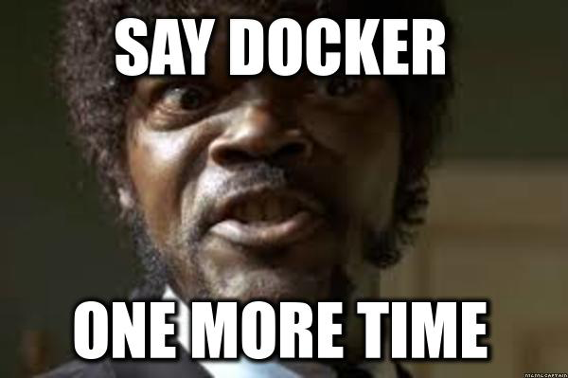


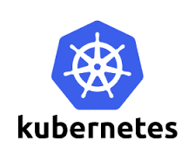

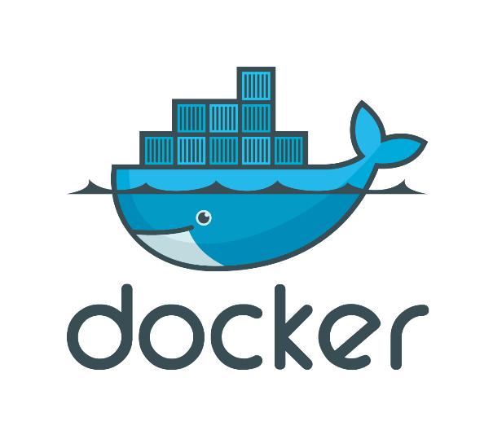


Serverless
PaaS
Container Orchestration
Swarm/
Swarm Mode
Container Engine

Slide 8
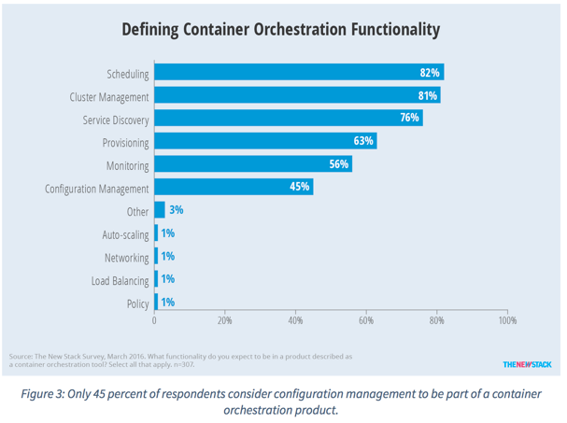
Container Orchestration Responsibilities
Container orchestration
Scheduling
Cluster management
Service discovery
Related functionality
Provisioning
Monitoring
Configuration management

Slide 9
Layer 6
Development Workflow
Opinionated Containers
OpenShift, Cloud Foundry, Docker Cloud, Deis, Apcera, Apprenda
Layer 5
Orchestration/Scheduling
Service Model
Kubernetes, Docker Swarm, Marathon/Mesos, Nomad, Diego
Layer 4
Container Engine
Docker, rkt, runC (OCI), Osv, LXC, LXD
Layer 3
Operating System
Ubuntu, RHEL, CoreOS, Unikernels
Layer 2
Virtual Infrastructure
vSphere, EC2, GCP, Azure, OpenStack
Layer 1
Physical Infrastructure
Raw Compute, Storage, Network

Slide 10
Kubernetes Architecture
internet
kubectl
Kubernetes cluster
firewall
Worker node
kube-proxy
kubelet
docker
Master node
pod
pod
pod
cAdvisor
container
container
authentication authorization
container
container
container
APIs
scheduling
actuator
REST
Worker node
kube-proxy
controller manager
kubelet
Distributed watchable storage (etcd)
docker
pod
pod
pod
cAdvisor
container
container
container
container
container

Slide 11
Master Node
Responsible for management of Cluster
Entry point for all administrative tasks
Orchestrate the Worker Nodes
API Server: Entry Point for REST Commands to control the Cluster
Etcd Storage: Distributed and consistent Key-Value Store, used for Shared configuration and Service Discovery. REST interface for CURD operations and register watcher on specific nodes. Example data like Jobs Scheduled, Created and deployed, pods and Service states.
Scheduler: Deployment of configured Pods and Services onto the Nodes
Controller Manager: Uses the API server to watch the shared State of cluster and make corrective changes to current state to change desired state. examples are replication controller, endpoints controller, namespace controller, and service accounts controller.

Slide 12
Kube-controller-manager
Node Controller: Responsible for noticing and responding when nodes go down.
Replication Controller: Responsible for maintaining the correct number of pods for every replication controller object in the system.
Endpoints Controller: Populates the Endpoints object (that is, joins Services & Pods)
Service Account & Token Controllers: Create default accounts and API access tokens for new namespaces.

Slide 13
Worker Node
Your application runs here. Contains required services to mange the network between containers and communicate to Master Node.
Docker Runtime: Runs the configured Pods, it takes care of downloading container images and starting the container. Kubernetes also support RKT another Container runtime.
Kubelet: An agent that runs in each Node in the cluster, It makes sure containers are running in a pod. It uses the PodSpec for container configurations.
Kube-Proxy: Enables Service abstractions by maintaining Network rules and Connection Forwarding.
Pods: Group of one or more containers (such as Docker containers), with shared storage/network, and a specification for how to run the containers
Service : Is an abstraction which defines a logical set of Pods and a policy by which to access them. Services enable a loose coupling between dependent Pods

Slide 14
Kubernetes Architecture: Workloads
Container
Packaging of an app
Pod
Unit of deployment
Service
Fixed endpoint for 1+ pods
App A
App B
Master Node
Pod
Pod
Worker Node 1
App A Client
App A Service
App B
App A
Pod
Pod
Worker Node 2
App B Client
App B Service
App A
App B
Pod
Pod
Kubernetes components
Worker Node 3
© Copyright IBM Corporation 2017

Slide 15
Cluster – Master Communication
All cluster communications terminates at API Server
API Server listens on HTTPS secured protocol with authentication and authorization enabled
Nodes can connect to API server using public root certificate and valid credential.
Service is configured with Virtual IP redirected vi kube-proxy

Slide 16
Master – Cluster communication
There are two communications paths from Master to Cluster.
API Server -> Kubelet
API Server -> Node, Pod, Service
API Server -> Kubelet : The communication terminates at Kubelet’s https endpoint. Used to fetch logs for Pods, attaching kubectl to running pods and Port forwarding
API Server -> Nodes, Pods and Services : The communication between API Server to Nodes, Pods and Services are plain HTTP connection.
SSH Tunnels: SSH Tunnels can be used to protect the Master–Cluster communication so that the traffic is not exposed outside of the private network.

Slide 17
Benefits of K8s cluster
Open source
Better management through modularity
Deployment and Scale application online: Scalability, Visibility, Time savings, Version control Horizontal autoscaling, Rolling updates, Canary deployments
Efficient use of hardware
Orchestrate containers on multiple hosts
Webhooks- automate updating your apps from DockerHub or any other repository.

Slide 18
Resources
Docker tutorial
https://docs.docker.com/get-started/
Kubernetes tutorial
https://kubernetes.io/docs/tutorials/kubernetes-basics/
Istio
https://github.com/istio
https://istio.io/docs/
The Evolution of Linux Containers and Their Future
https://dzone.com/articles/evolution-of-linux-containers-future
Introduction to container orchestration
https://www.exoscale.ch/syslog/2016/07/26/container-orch/
TNS Research: The Present State of Container Orchestration
https://thenewstack.io/tns-research-present-state-container-orchestration/
Large-scale cluster management at Google with Borg
https://research.google.com/pubs/pub43438.html

Slide 19
Helm

Slide 20
Topics
Life without Helm
What is Helm
How to use helm
Hands-on with helm

Slide 21
Life without Helm
Write Kubernetes manifests by hand
Do this every time you need to release anything
Figure out your own sharing
Tweak resources by hand
Use kubectl to manage these

Slide 22
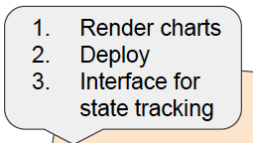

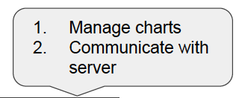
Helm
The client is responsible for managing charts, and the server is responsible for managing releases
Package manager for Kubernetes
RedHat/Fedora – rpm
Microsoft – msi
Ubuntu – apt
Kubernetes – helm
Two components – a client (helm) and a server (tiller)
app1
App2
app3
Helm Client
worker1
worker2
worker3
or...
helm
master
tiller
k8s cluster

Slide 23
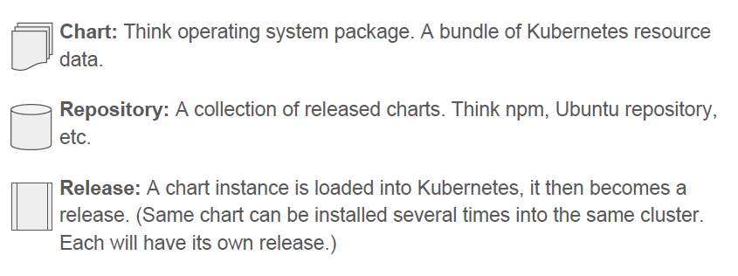
Charts, Repositories, Releases

Slide 24
Helm packages are called "charts"
Each chart is a folder named for the chart
A minimum chart contains:
description - Chart.yaml
templates – folder with kubernetes resource definitions
Most charts include values.yaml to specify installation defaults used in templates
wordpress/
Chart.yaml # A YAML file containing information about the chart
LICENSE # OPTIONAL: A plain text file containing the license for the chart
README.md # OPTIONAL: A human-readable README file
requirements.yaml # OPTIONAL: A YAML file listing dependencies for the chart
values.yaml # The default configuration values for this chart
charts/ # OPTIONAL: A directory containing any charts upon which this chart depends.
templates/ # A directory of templates that, when combined with values,
# will generate valid Kubernetes manifest files.
templates/NOTES.txt # OPTIONAL: A plain text file containing short usage notes

Slide 25
Template processing
cloudant-deployment.yaml :
apiVersion: apps/v1beta1
kind: Deployment
metadata:
name: "{{ template "fullname" . }}"
labels:
spec:
replicas: 1
strategy:
type: Recreate
template:
metadata:
labels:
...
spec:
terminationGracePeriodSeconds: 0
containers:
- name: "{{ template "fullname" . }}"
image: "{{ .Values.image.repository }}:{{ .Values.image.tag }}"
imagePullPolicy: {{ .Values.image.pullPolicy }}
ports:
- containerPort: 80
name: http
values.yaml :
## image parameters
image:
repository: ibmcom/cloudant-developer
tag: latest
pullPolicy: Always

Slide 26
Chart repositories
Charts can be collected and shared using a repository
The index file can be created by helm
$ helm repo index
example:
https://github.com/IBM/charts/tree/master/repo/stable
charts/
bar-dev-0.1.0.tgz # tarball of the bar chart
foo-dev-1.0.0.tgz # tarball of the foo chart
...
index.yaml # A YAML file with catalog of charts

Slide 27
Prepare Helm Chart
After successful completion of section 1, you will be able to connect to you Kubernete cluster using kubectl and helm. Next step in this lab is to create Helm chart.
Step 1: Execute “helm create lets-chat”, This creates following folder structure and template files will be created in respective folder.
lets-chat
├── Chart.yaml
├── charts
├── templates
│ ├── NOTES.txt
│ ├── _helpers.tpl
│ ├── deployment.yaml
│ ├── ingress.yaml
│ └── service.yaml
└── values.yaml
All the required files are generated and it has to be modified as per your required.
Replace the values.yaml, deployment.yaml and service.yaml with the one provided to you.

Slide 28
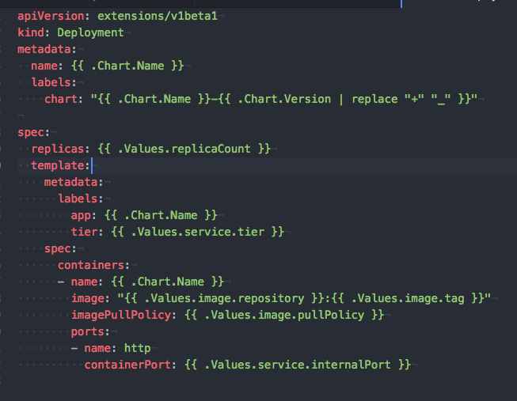
deployment.yaml

Slide 29
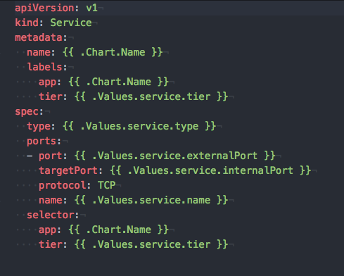
service.yaml

Slide 30
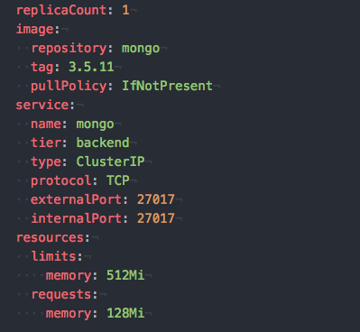
Values.yaml

Slide 31
Built-in Objects
Release - Release.Name, Release.Time, Release.Namespace, Release.Service, Release.Revision, Release.IsUpgrade, Release.IsInstall
Values – by default Values is empty
Chart - Chart.Name, Chart.Version
Files - Files.Get, Files.GetBytes
Capabilities- Capabilities.APIVersions, Capabilities.KubeVersion, Capabilities.TillerVersion
Template – Template.Name, Template.BasePath

Slide 32
Charts lifecycle hooks
pre-install: Executes after templates are rendered, but before any resources are created in Kubernetes.
post-install: Executes after all resources are loaded into Kubernetes
pre-delete: Executes on a deletion request before any resources are deleted from Kubernetes.
post-delete: Executes on a deletion request after all of the release's resources have been deleted.
pre-upgrade: Executes on an upgrade request after templates are rendered, but before any resources are loaded into Kubernetes

Slide 33
Charts lifecycle hooks-Continued
post-upgrade: Executes on an upgrade after all resources have been upgraded.
pre-rollback: Executes on a rollback request after templates are rendered, but before any resources have been rolled back.
post-rollback: Executes on a rollback request after all resources have been modified

Slide 34
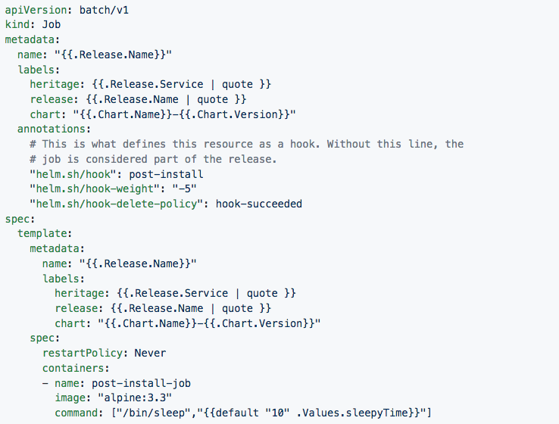
Sample Hook implementation

Slide 35
Lab: Helm

Slide 36
Step1 : Install Helm Client
https://docs.helm.sh/using_helm/#installing-helm
From Homebrew (macOS)
Members of the Kubernetes community have contributed a Helm formula build to Homebrew. This formula is generally up to date.
brew install kubernetes-helm
Based on your OS install helm client

Slide 37
Login to IBM Cloud and initialize the Helm
Step 1: Login to IBM cloud, Execute “bx login “on your local system terminal window to login. Note if you are using IBM federated email then execute with –sso option.
Step 2: After successful login to IBM cloud, Initialize the Container plugin by executing the below command.
Execute “bx cs init”
Step 3: Make sure kubectl is installed properly and it can communicate to the cluster.
Execute “kubectl version”,
the output of this command should return both server and client version, you can see the client and server version in the below sample output.
Example output:
Client Version: version.Info{Major:"1", Minor:"7", GitVersion:"v1.7.3", GitCommit:"2c2fe6e8278a5db2d15a013987b53968c743f2a1", GitTreeState:"clean", BuildDate:"2017-08-03T07:00:21Z", GoVersion:"go1.8.3", Compiler:"gc", Platform:"darwin/amd64"}
Server Version: version.Info{Major:"1", Minor:"8+", GitVersion:"v1.8.8-2+9d6e0610086578", GitCommit:"9d6e06100865789613cbac936edce948f0710a2f", GitTreeState:"clean", BuildDate:"2018-02-23T08:20:09Z", GoVersion:"go1.8.3", Compiler:"gc", Platform:"linux/amd64"}
Notes:
kubectl config set-context $(kubectl config current-context) --namespace=ramesh
kubectl config view -o jsonpath='{.users[0].user.auth-provider.config.id-token}'

Slide 38
Configure kubectl client
Step 4: Configure the kubectl client to connect to your cluster
Step 4.1 Execute “bx cs cluster” to get the list of clusters available in your account. If there is no cluster reported then create one by login to Bluemix console.
Step 4.2: Execute “bx cs cluster-config <cluster name>",
Replace <cluster name > with your cluster name, received from step 4.1, Output of this command return the cluster name and environment setting need to be execute.
Execute the export command in the output of cluster-config command.
Example: export KUBECONFIG=/Users/rameshpoomalai/.bluemix/plugins/container-service/clusters/mycluster/kube-config-hou02-mycluster.yml

Slide 39
Deploy mongo Chart
Step 1: Execute the following command to initialize the helm, This will make sure that server side tiller also ready to accept the request.
“helm init”
Step 2: Execute the following command to package your charts.
“helm package mongo”
This will package your charts and that be released to release to your repos.
Step 3: Execute “helm install --debug --dry-run mongo --name bankend” to to test your charts
Step 4: Execute “helm install mongo --name bankend” to install your package on your cluster.
Note: if you are creating a new Helm chart, Execute “helm lint <path>” to verify no errors in chart.
Git Repo : https://github.com/IBMDevConnect/kube_ICP#steps-helm

Slide 40
Deploy letschat Chart
Step 1: Execute the following command to package your charts.
“helm package letschat”
This will package your charts and that be released to release to your repos.
Step 2: Execute “helm install --debug --dry-run letschat --name frontend” to to test your charts
Step 3: Execute “helm install letschat --name frontend” to install your package on your cluster.
Step 4: Check the status of deployment.
“Helm list”
Step 5: Check the status of the application. Make sure that all the pods are running.
“kubectl get pods”

Slide 41
Access your Deployed Application
Step 1: Execute the following command to get the public IP address.
“bx cs workers <your_cluster_name_created_under_ibm_cloud>”
The output will be similar to as below. The ip marked i bold is cluster IP in my case.
ID Public IP Private IP
kube-mel01-paedbc7786e21c450e813eadc69ebaf43b-w1 168.1.149.16 10.118.243.226
Step 2: Execute “kubectl get svc” to get Ports exposed by service
$ kubectl get svc
NAME CLUSTER-IP EXTERNAL-IP PORT(S) AGE
letschat 172.21.108.9 <nodes> 8080:30080/TCP 2h
mongo 172.21.43.81 <none> 27017/TCP 2h
Step 3: You can access letschat application by below url.
http://<your_cluster_ip>:30080

Slide 42
High availability Demo

Slide 43
Thank you

