Slide 1
Agenda
Definition of YAML
Why YAML?
Relation to JSON and XML
Preview of YAML
Properties vs YAML
Usages of YAML
Ansible Playbook
Python – examples
Kubernetes:
POD creation
Service creation
Deployment creation
Basic and Advanced yaml features
Code Pattern

Slide 2
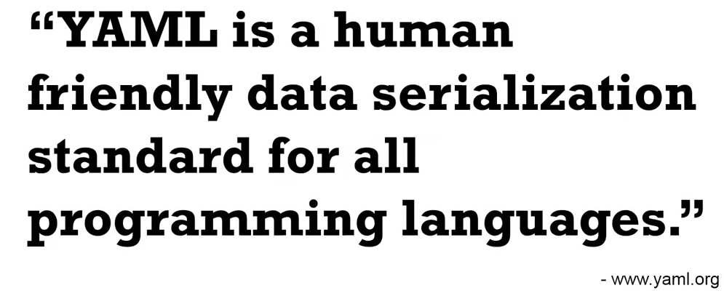
Definition of YAML
Notes:
Definition of YAML - There are hundreds of different languages for programming, but only a handful of languages for storing and transferring data.
Even though its potential is virtually boundless, YAML was specifically created to work well for common use cases such as:
a) configuration files,
b) log files,
c) interprocess messaging,
d) cross-language data sharing,
e) object persistence, and
f) complex data structures

Slide 3
Why YAML?
Easily readable by humans, expressive and extensible.
Easy to implement and use.
Easily portable between programming languages.
Matches the native data structures of agile languages.
Has a consistent model to support generic tools.
Supports one-pass processing.
Convenience: You’ll no longer have to add all of your parameters to the command line
Maintenance: YAML files can be added to source control, so you can track changes
Flexibility: You’ll be able to create much more complex structures using YAML than you can on the command line
Notes:
Why YAML: Let us look into what are the advantages of using YAML:
It is easily readable by humans, easily portable between programming languages, it matches native data structures of agile languages.
It has a consistent model to support generic tools, one-pass processing, expressive and extensible.
You will no longer have to add all the parameters as the command line arguments.
Maintenance - YAML files can be added to the source control so that you can track the changes
Flexibility: You’ll be able to create much more complex structures using YAML than you can on the command line

Slide 4
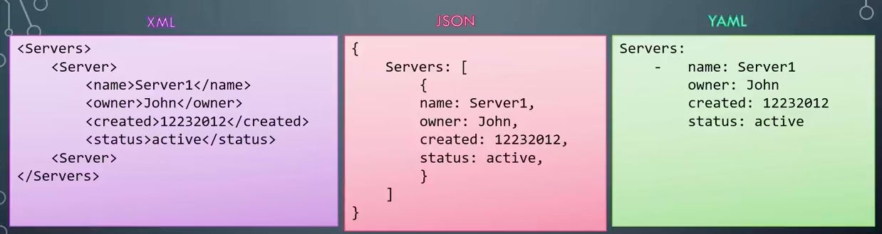
XML vs JSON vs YAML
Notes:
XML was designed to be backwards compatible with the Standard Generalized Markup Language (SGML), which was designed to support structured documentation.
XML therefore had many design constraints.
XML is a pioneer in many domains,
----------------------------------------------------------------------------------
JSON’s design goal is simplicity and universality.
JSON is trivial to generate and parse,
It has reduced human readability.
JSON data can be processed easily by every modern programming environment.
---------------------------------------------------------------------------------- YAML’s design goals are human readability and more complete information model.
YAML is more complex to generate and parse.
YAML can therefore be viewed as a natural superset of JSON. Every JSON file is also a valid YAML file.
This makes it easy to migrate from JSON to YAML if/when the additional features are required.
YAML is the result of lessons learned from XML.

Slide 5
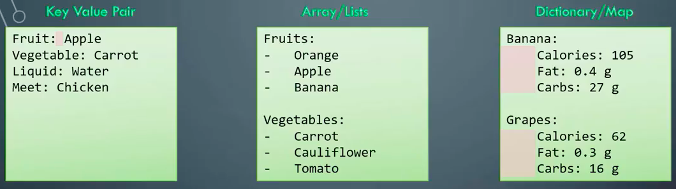
Key Value Pair, Array/Lists, Dictionary/Map
Notes:
Key Value pair: The basic type of entry in a YAML file is of key value pair. After Key and colon there is a space and then the value.
Lists would have number of items listed under the name of the list. The elements of the list would start with a -
There can be n number of lists as shown here.
There is a list of fruits and vegetables.
Each element of fruit and vegetable start with the - at the starting.
Please note that the indentation of various elements of the array matters a lot.
More complex type would be a Dictionary and Map as shown below.
The various attributes - Calories, Fat and Carbs are listed each for Banana and Grapes.
Please note the attributes being indented properly.

Slide 6
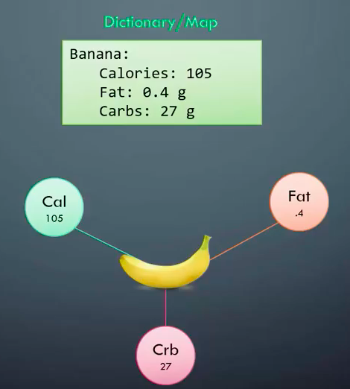
Importance of SPACES in YAML
Notes:
In this diagram Banana and its attributes have been displayed. The 3 attributes which are displayed are calories, fats and carbs. Each of the attribute have a value as displayed here. As all the attributes have been indented properly with right number of spaces, these are attributes of Banana.

Slide 7
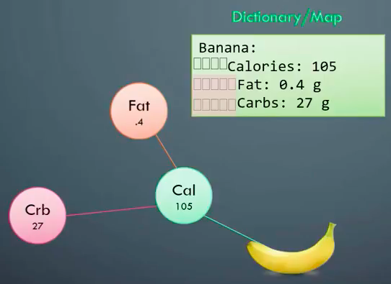
Importance of SPACES in YAML NEVER use tabs in a YAML file
Notes:
Suppose we forget and write incorrectly the attributes in this fashion.
With the indentation it would mean that Fats and Cards are child of Calories which is wrong.
A slight indentation or unequal number of spaces would change the meaning fully.
Also never use tabs in YAML. Always remember to use right number of spaces

Slide 8
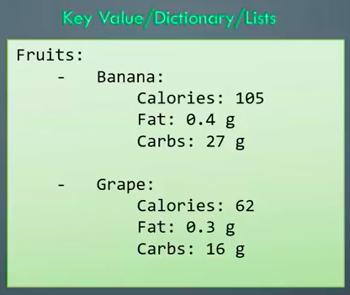
Complex YAML structures
Notes:
YAML as it looks is very simple and human readable. But it can become more and more complex when there is combination of various elements with one another. Such as this one displayed here. It is a list of fruits. Each fruit has attributes and each attribute is a key value pair. So if you start combination of various such attributes, the YAML file would turn out to be more complex.

Slide 9
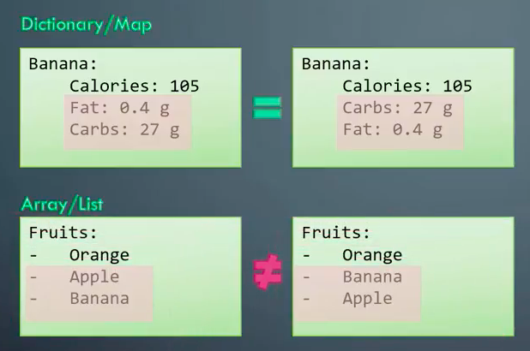
Complex YAML structures
Notes:
Some more learning about the complex YAML file. Here we observe that there are key value pair under a dictionary. So suppose we interchange the attributes of an element under the dictionary such as this where Fats and Carbs have been interchanged, it still point to the same element and the order does not matter and does not change the element.
But suppose you change the order of the elements of the array list, it would result in a new array list as the elements in the list have been altered. Hence we have to be careful when we are dealing with the array list.

Slide 10
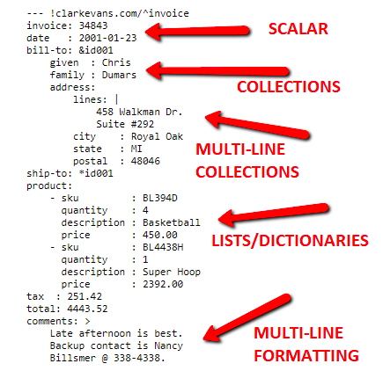
YAML Basics in one slide
Notes:
There are many features which are specified in the YAML 1.2 specification. However to cover the basic understanding to get started with YAML and we want to cover the basics in a slide, then the displayed slide is very apt.
The greater than symbol allows you to write your text on multiple lines, knowing that when your YAML is parsed those lines will be collapsed into a single line.
The vertical pipe allows you to write your text on multiple lines, knowing that those multiple lines will be kept when the YAML is parsed. The vertical pipe is really great for embedding code samples in YAML:

Slide 11
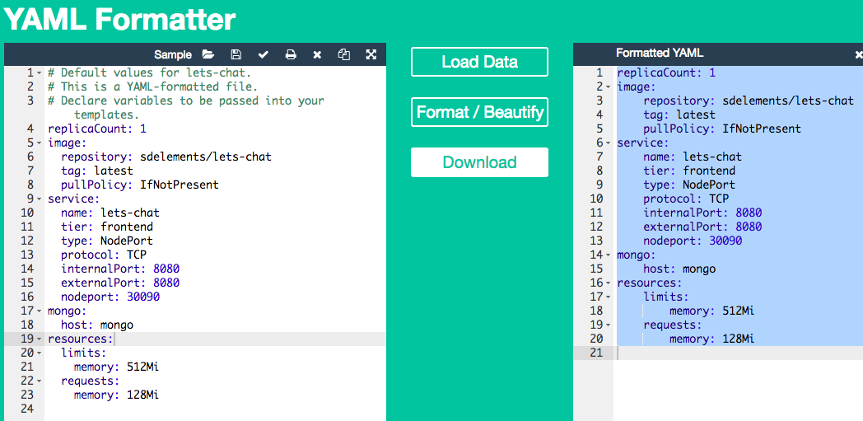
YAML Validator/Formatter https://jsonformatter.org/yaml-formatter
Notes:
Usually whenever we have so tightly typed nomenclature for YAML it may become difficult for developers to indent them and format the files.
But there are online YAML formatter as such displayed which can be made use of.

Slide 12
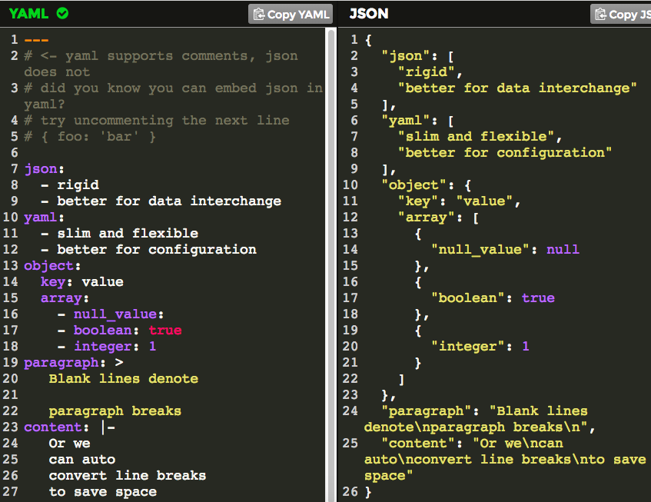
YAML Conversion to JSON https://www.json2yaml.com/convert-yaml-to-json https://yaml-online-parser.appspot.com/
Notes:
There could be requirement of converting the YAML to JSON and few links such as these help to covert the YAML file to a JSON.

Slide 13
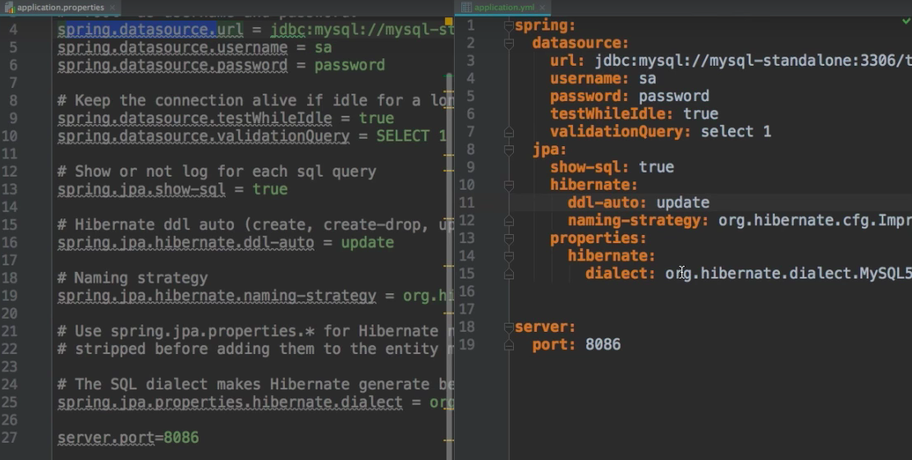
Properties file vs YAML
Notes:
In properties file you have to rewrite all the properties again whereas in YAML it has to be written once.
Also using YAML it is easy to read, where as in properties file it is too elaborate.
Whenever we want to add another entry in the properties file then we need to not repeat the parent child relationship for YAML file, but had it been properties file we had to repeat the property.
With increasing number of properties people are going towards YAML because it is easy to follow and also to maintain.

Slide 14
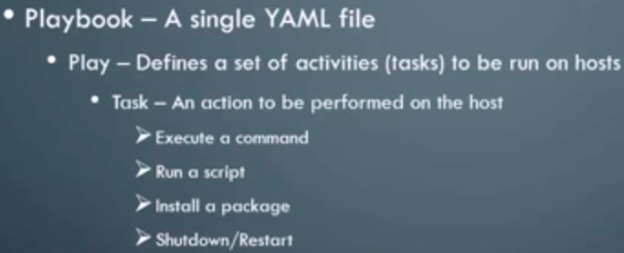
ANSIBLE PLAYBOOK
Notes:
Let us further look into the usage of YAML. Every modern programming language, configuration files, data storage files etc are making use of YAML. One such usage is in Ansible Playbook.
Ansible:
The Ansible playbook is a single YAML file which contains of defined set of activities and tasks to be run on hosts. Task here is nothing but an action to be performed on the host such as execute a command, run a script, install a package and restart.
These all tasks and actions are documented in the YAML file.

Slide 15
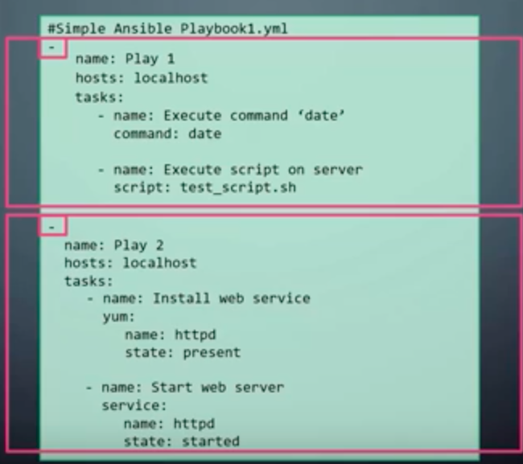
ANSIBLE PLAYBOOK FORMAT
Notes:
Ansible Playbook format looks like below:
There are 2 Plays - Play 1 and Play2 which would be run on localhost.
The tasks are mentioned as below and the order matters a lot.
The order of the name and hosts does not matter, it would be the same.
However the tasks are different and the position does matter. The sequence of commands is mandatory.
The host parameter is the host where the commands need to be run. Different tasks run are called Modules.
yum - Manages packages with the yum package manager

Slide 16
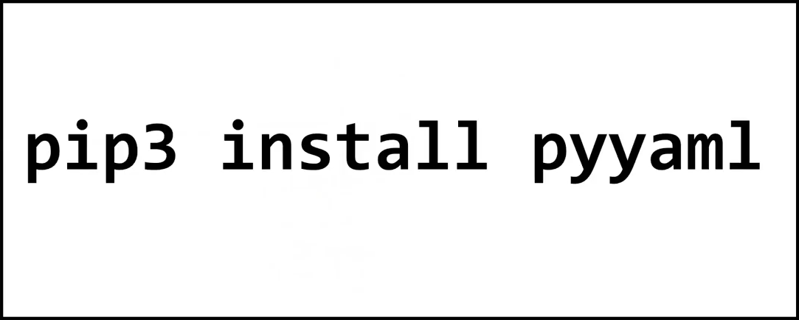
YAML in Python
Notes:
To install yaml library then we have to run this command.

Slide 17
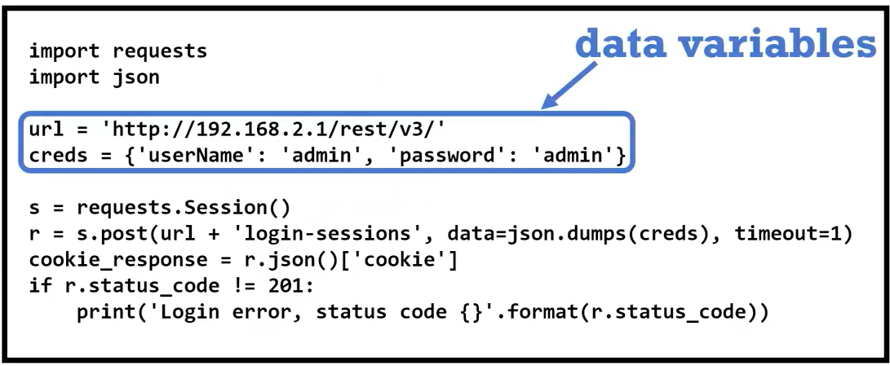
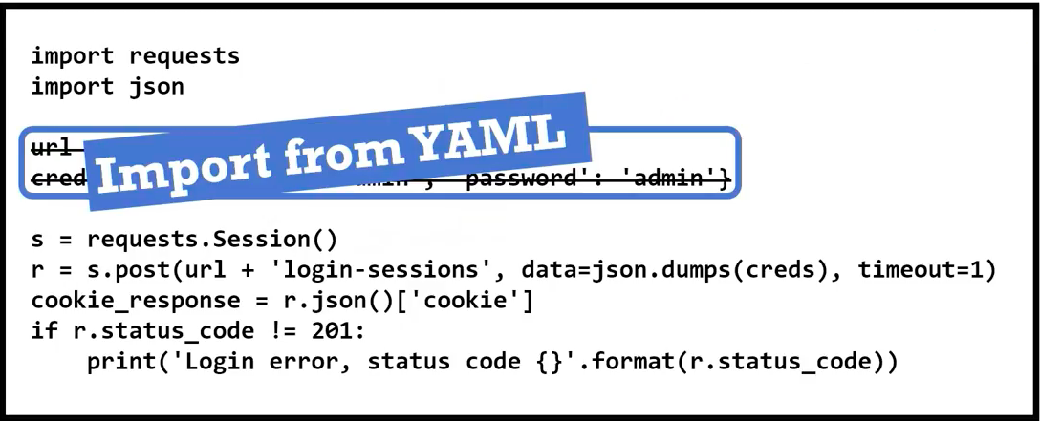
YAML in Python
Notes:
To install yaml library then we have to run this command.

Slide 18

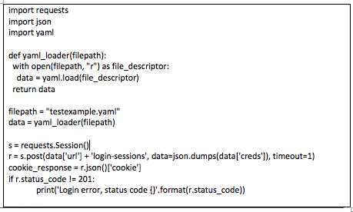
YAML in Python
Notes:
To install yaml library then we have to run this command.

Slide 19
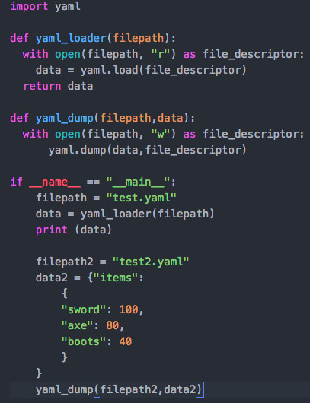
YAML in Python
Notes:
In python loading data and dumping data looks like something as shown.
The code has 2 functions - yaml_loader and yaml_dump
yaml_loader - it opens the file in read mode and loads the file making use of the yaml.load command
yaml_dump - it opens the file in write mode and dumps the data into the specified file mentioned.
The output of the above code looks like below:
Output of YAML Load
Output of YAML dump

Slide 20
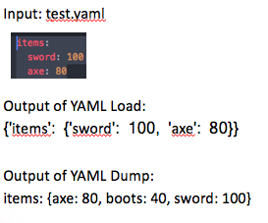
YAML in Python

Slide 21
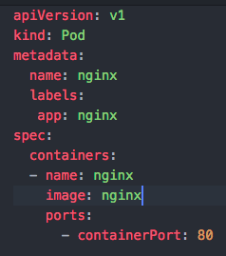
Usage in Kubernetes: POD creation
Notes:
YAML is extensively used in Kubernetes. It is used in POD creation, service creation and deployment
For example for POD creation - Lets look at the example - The value of kind is POD, this means that we need to create a POD with version V1. The metadata of POD indicates the name and labels of POD. Name of the POD is ’nginx’ and has a label with ‘app’ value as ‘nginx’ only. This name should match with image name in the container specification mentioned.

Slide 22
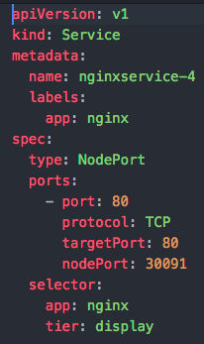
Usage in Kubernetes: Service creation

Slide 23
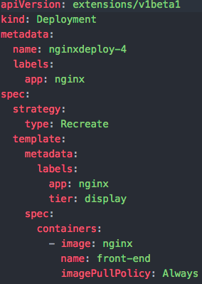
Usage in Kubernetes: Deployment creation

Slide 24
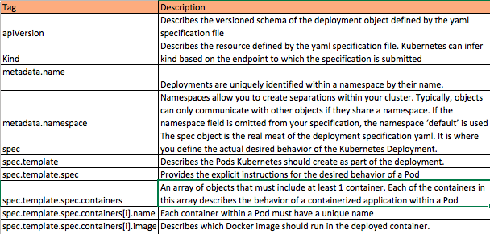
Kubernetes deployment: Basic specification

Slide 25
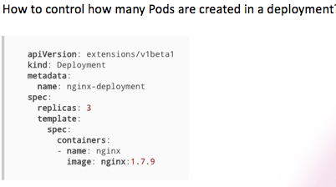
Kubernetes deployment: Advanced specification

Slide 26
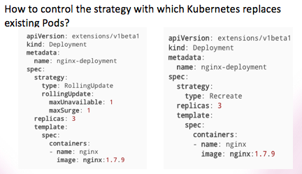
Kubernetes deployment: Advanced specification

Slide 27
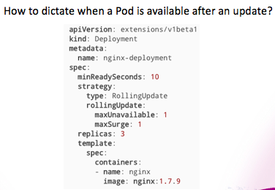
Kubernetes deployment: Advanced specification
Notes:
spec.minReadySeconds is an optional Integer that describes the minimum number of seconds for which a new pod should be ready without any of its container crashing, for it to be considered available.
The omission of this field defaults spec.minReadySeconds to 0 seconds. Thus, with the omission of this field Pods are considered available as soon as they have been updated

Slide 28
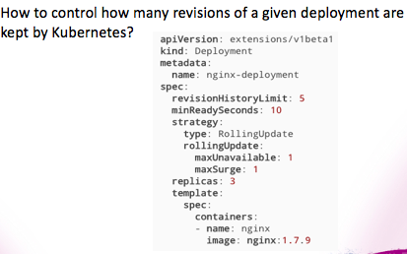
Kubernetes deployment: Advanced specification
Notes:
spec.minReadySeconds is an optional Integer that describes the minimum number of seconds for which a new pod should be ready without any of its container crashing, for it to be considered available.
The omission of this field defaults spec.minReadySeconds to 0 seconds. Thus, with the omission of this field Pods are considered available as soon as they have been updated

Slide 29
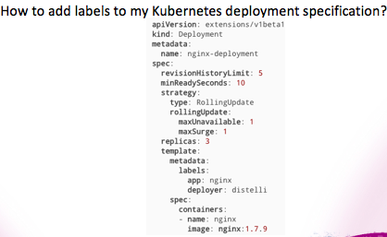
Kubernetes deployment: Advanced specification
Notes:
One can use spec.template.metadata.labels to add labels to a deployment specification spec.template.metadata.labels is an optional array of key/value pairs.
Here is an example of two labels being added to our example deployment specification

Slide 30
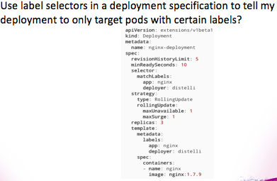
Kubernetes deployment: Advanced specification
Notes:
Labels are not unique and it is expected that labels will be used on multiple objects as a way to easily group objects.
Label selectors are constructs that can be used by users to identify groups of objects that share labels.
spec.selector is an optional object that tells the Kubernetes deployment controller to only target pods that match the specified labels.
Thus, to only target pods with the labels “app” and “deployer” we can make the following modification to our deployment yaml

Slide 31
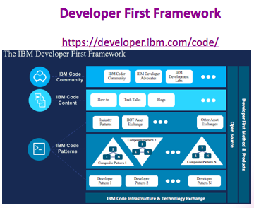

Slide 32
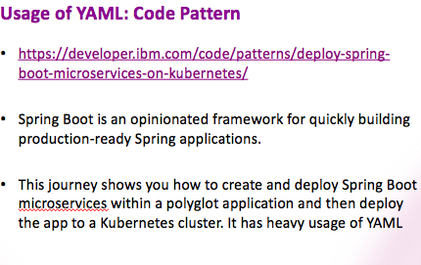

Slide 33


Slide 34


Slide 35
Thank you

