Slide 1
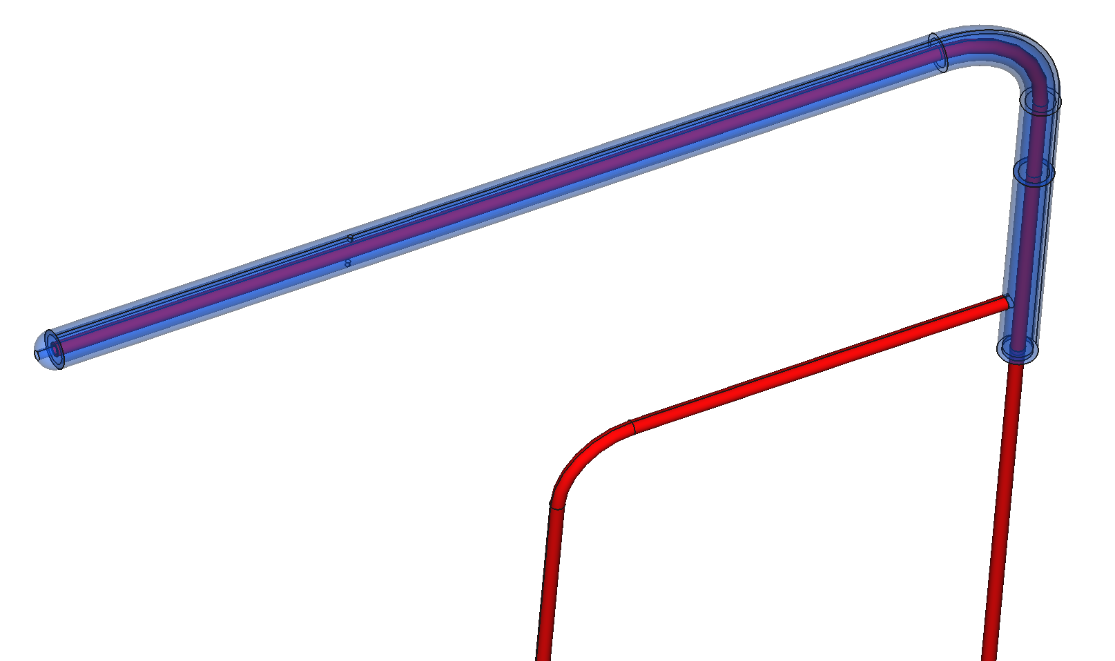
Simulation of Pitot Tube with OpenFoam®
Community Christmas Competition III organised by József Nagy
Participant Name:
P. Jadhav
Email ID: pajadhav50@gmail.com

Slide 2
Aim:
Simulate Pitot tube for wide range of velocity using OpenFoam®
Road Map:
Prepare 3D/2D CAD model of Pitot tube considering given velocity range
Meshing with appropriate tool
Considering flow physics choose suitable solver for particular velocity
Calculating velocity of fluid with help of pressure values or liquid height obtained from simulation
Comparing simulation results with theoretical calculations
Simulation Matrix:
Table 1: Simulation Matrix
Sr. No | Velocity (m/s) | Number of phases | Simulation type | CAD Model | Solver
1 | 0.1 | Single phase | Incompressible steady state -laminar | 2D & 3D | simpleFoam
2 | 0.5 | Single phase | Incompressible steady state -laminar | 2D & 3D | simpleFoam
3 | 1 | Single phase | Incompressible steady state-laminar | 2D & 3D | simpleFoam
4 | 5 | Single phase | Incompressible steady state-laminar | 2D & 3D | simpleFoam
5 | 67 | Single &Two Phase | Incompressible steady (3D) & transient (2D) -laminar | 2D & 3D | simpleFoam & InterFoam
6 | 100 | Single &Two Phase | Incompressible steady (3D) & transient (2D) -laminar | 2D & 3D | simpleFoam & InterFoam
7 | 240 | Single phase | Compressible steady state –turbulent (subsonic) | 2D | rhoSimpleFoam
8 | 570 | Single phase | Compressible transient –laminar (supersonic) | 2D | rhoCentralFoam

Slide 3
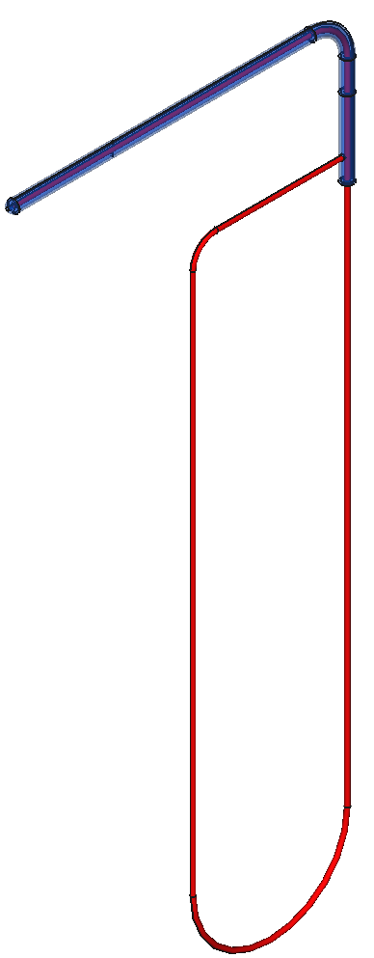
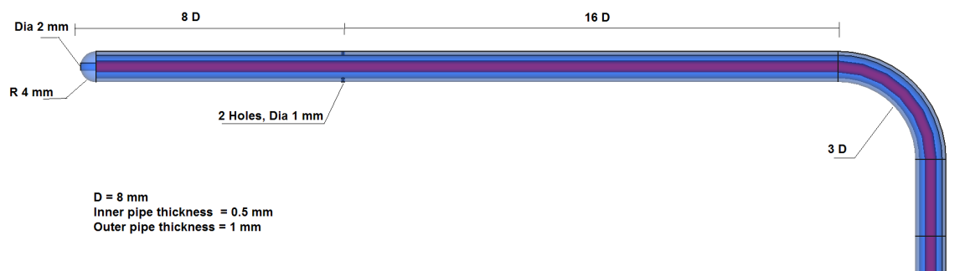
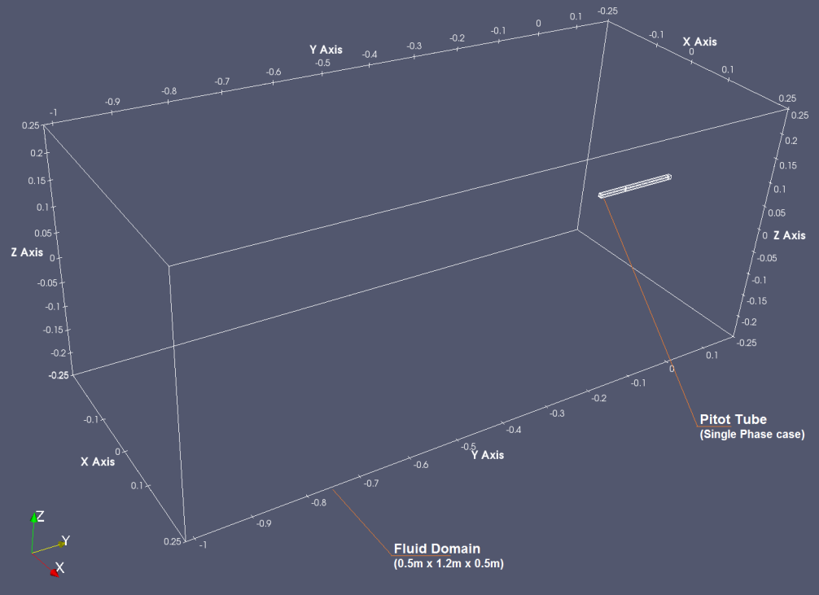
CAD Model
Fig 1: Pitot Tube CAD model
3D CAD model of pitot tube is built in Salome 8.3.0. In case of multiphase flow simulation, 3D CAD model is projected on a mid plane to get 2D model.
Model essentially consisting of inner pipe and outer pipe to measure stagnation pressure and static pressure. Inner pipe has cavity whose opening is perpendicular to flow direction. Outer pipe has two holes as shown in above figure whose openings are parallel to flow direction. Fluid domain is selected as rectangular box.

Slide 4
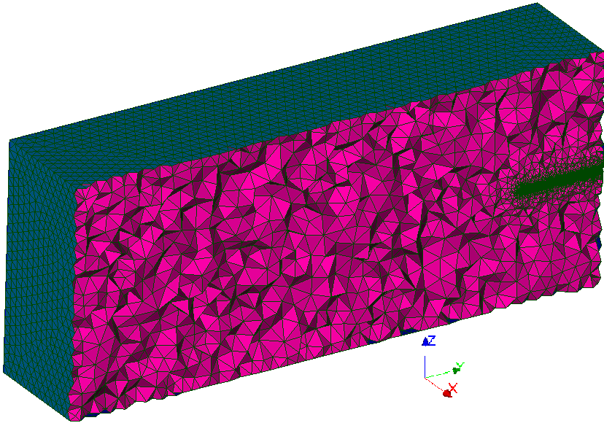
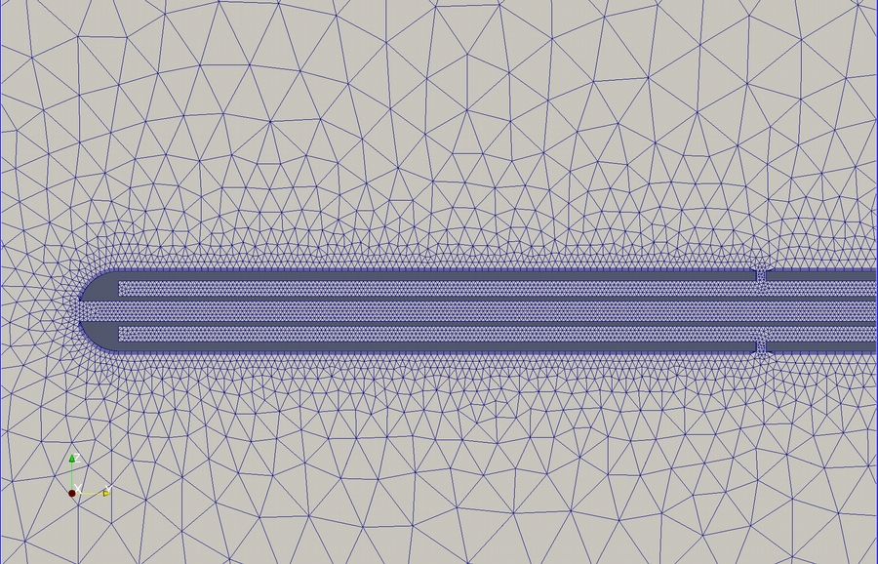
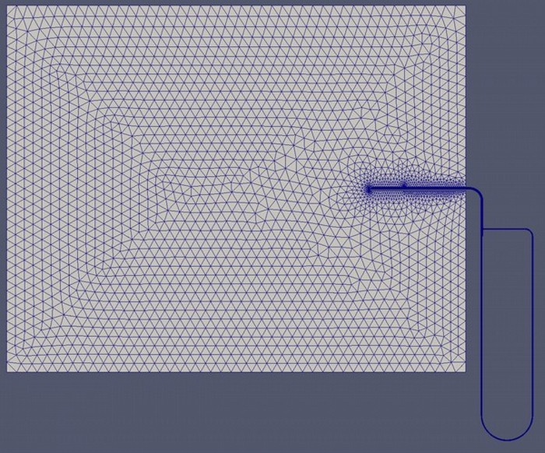
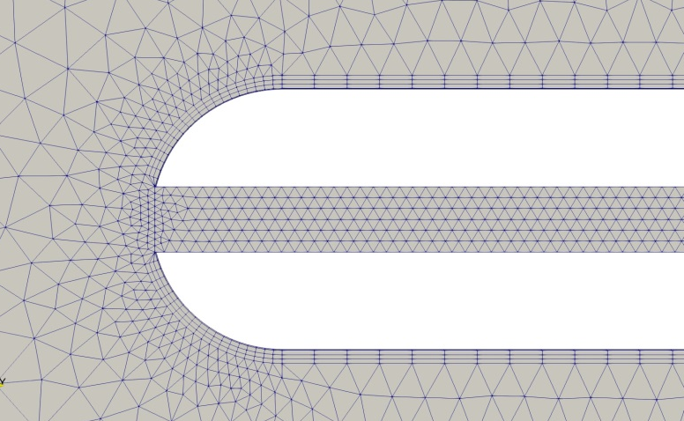
Meshing
Meshing Tool: Salome 8.3.0
2D Mesh Statistics:
- Tet: 23K
- Prism:1K
Fig 2: Pitot Tube mesh : 3D model
Fig 3: Pitot Tube mesh : 2D model

Slide 5
Boundary Conditions
Table 2: Boundary Conditions
Sr. No | Velocity (m/s) | Variable | Inlet | Outlet | Wall
1 | 0.1 | p | type zeroGradient; Value uniform 0; | type fixedValue; Value uniform 0; | type zeroGradient
 | (similar for 0.5m/s, 1m/s, 5 m/s, 100m/s-Single phase) | phi | type calculated; Value uniform 0; | type calculated; Value uniform 0; | type calculated; Value uniform 0;
 |  | U | type fixedValue; value uniform (0 0.1 0); | type zeroGradient; | type movingWallVelocity; value uniform (0 0 0);
2 | 67 | alpha.air | type fixedValue; value uniform 0; | type zeroGradient; | type zeroGradient;
 | (Similar for 100m/s- Two phase) | alpha.mercury | type fixedValue; value uniform 0; | type zeroGradient; | type zeroGradient;
 |  | p & p_rgh | type fixedFluxPressure; gradient uniform 0; value uniform 100000; | type fixedValue; value uniform 100000; | type fixedFluxPressure; gradient uniform 0; value uniform 100000;
 |  | T, T.air, T.mercury | type fixedValue; value uniform 300; | type zeroGradient; | type zeroGradient;
 |  | U | type fixedValue; value uniform (0 67 0); | type zeroGradient; | type movingWallVelocity; value uniform (0 0 0);
3 | 240 | alphat | type calculated; Value uniform 0; | type calculated; Value uniform 0; | type compressible::alphatWallFunction; Prt 0.71; value uniform 0;
 |  | k | type inletOutlet; inletValue uniform $kInlet; //(kInlet 0.01) Value uniform $kInlet; | type inletOutlet; inletValue uniform $kInlet; //(kInlet 0.01) Value uniform $kInlet; | type kqRWallFunction; Value uniform $kInlet;
 |  | nut | type calculated; Value uniform 0; | type calculated; Value uniform 0; | type nutkWallFunction; Value uniform 0;
 |  | Omega | type inletOutlet; inletValue uniform $omegaInlet; Value uniform $omegaInlet; //omegaInlet 10; | type inletOutlet; inletValue uniform $omegaInlet; Value uniform $omegaInlet; //omegaInlet 10; | type omegaWallFunction; Value uniform $omegaInlet;
 |  | p | type fixedValue; Value uniform 1e5; | type fixedValue; Value $internalField; | type zeroGradient;
 |  | T | type fixedValue; Value uniform 293; | type zeroGradient; | type zeroGradient;
 |  | U | type fixedValue; Value uniform (0 240 0) | type zeroGradient; | type noSlip;
4 | 570 | p | type fixedValue; Value uniform 1e5; | type zeroGradient; | type zeroGradient;
 |  | T | type fixedValue; Value uniform 300; | type fixedValue; Value uniform 300; | type fixedValue; Value uniform 300;
 |  | U | type fixedValue; value uniform (0 570 0); | type zeroGradient; | type slip

Slide 6
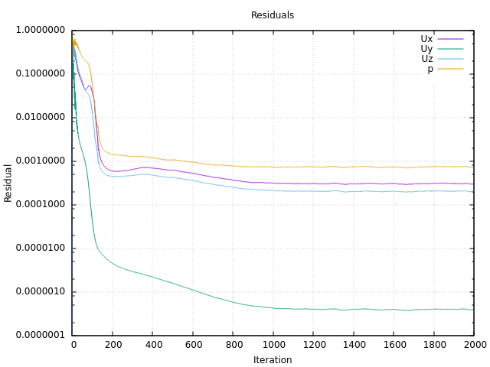
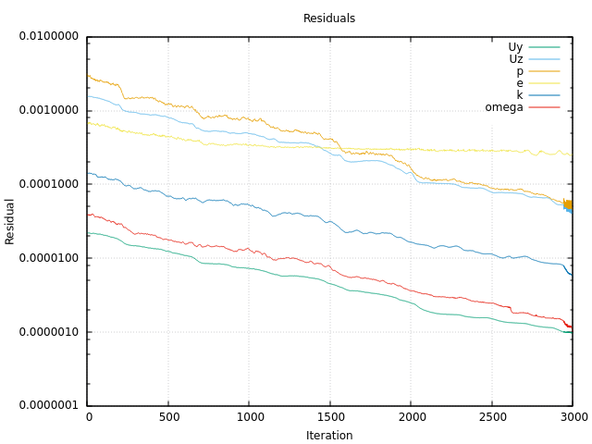




Results
Convergence : All simulations were converged with residuals below 1e-3
Fig 4a: Convergence plot for 5m/s Fig 4b:Convergence plot for 240m/s
Formulae used:
2. For Single phase incompressible:
3. For Single phase compressible Subsonic:
1. For Multiphase :
4. For Single phase compressible Supersonic:

Slide 7
Calculated U from CFD values:
Table 3: Velocity Calculations
2D Single Phase Simulation
Sr No | Velocity (m/s) | P_stagnation (Pa): CFD data | P_static (Pa): CFD data | rho_air (kg/m3) | Calculated Velocity (m/s) | % Error
1 | 0.1 | 5.736E-03 | -1.737E-04 | 1 | 0.109 | -8.72
2 | 0.5 | 1.308E-01 | -1.678E-04 | 1 | 0.512 | -2.37
3 | 1 | 5.158E-01 | -1.169E-02 | 1 | 1.027 | -2.71
4 | 5 | 1.268E+01 | 1.026E-01 | 1 | 5.014 | -0.29
5 | 67 | 2.233E+03 | -3.060E+01 | 1 | 67.290 | -0.43
6 | 100 | 4.852E+03 | -4.398E+01 | 1 | 98.950 | 1.05
3D Single Phase Simulations
Sr No | Velocity (m/s) | P_stagnation (Pa): CFD data | P_static (Pa): CFD data | rho_air (kg/m3) | Calculated Velocity (m/s) | % Error
1 | 0.1 | 5.733E-03 | -2.500E-05 | 1 | 0.107 | -7.31
2 | 0.5 | 1.258E-01 | -9.141E-05 | 1 | 0.502 | -0.36
3 | 1 | 4.956E-01 | -6.622E-04 | 1 | 0.996 | 0.37
4 | 5 | 1.240E+01 | -1.124E-01 | 1 | 5.002 | -0.04
5 | 67 | 2.183E+03 | -1.919E+01 | 1 | 66.361 | 0.95
6 | 100 | 4.867E+03 | -4.387E+01 | 1 | 99.104 | 0.90
2D Multiphase Simulation
Sr No | Velocity (m/s) | Δh (mm): CFD data | rho_mercury (kg/m3) | Calculated Velocity (m/s) | % Error
1 | 67 | 16.381 | 13545 | 65.98 | 1.52
2 | 100 | 36.96 | 13545 | 99.11 | 0.89
2D Single Phase- Subsonic and Supersonic simulation
Sr No | Velocity (m/s) | P_stagnation (Pa) | P_static (Pa) | rho_air (kg/m3) | Calculated Velocity (m/s) | % Error
1 | 240 | 130015 | 99852.6 | 0.9645 | 238.26 | 0.73
2 | 570 | 389493 | 100000 | No required | 563.33 | 1.17

Slide 8
Graph: True velocity Vs Simulation velocity
3D incompressible simulation results are selected further since those have less % error compared to 2D simulation results.
Most of simulation results almost coincide with expected values.

Slide 9
Animation Video : Multiphase simulation
16.38 mm
36.96 mm
Fig 5: 67 m/s alpha.mercury
Fig 6: 100 m/s alpha.mercury
To calculate Δh for multiphase simulation, alpha.mercury were plotted in paraview over lines passing through mid of left and right manometer columns.
Difference between arc length were calculated corresponding to last point where alpha.mercury=1

Slide 10
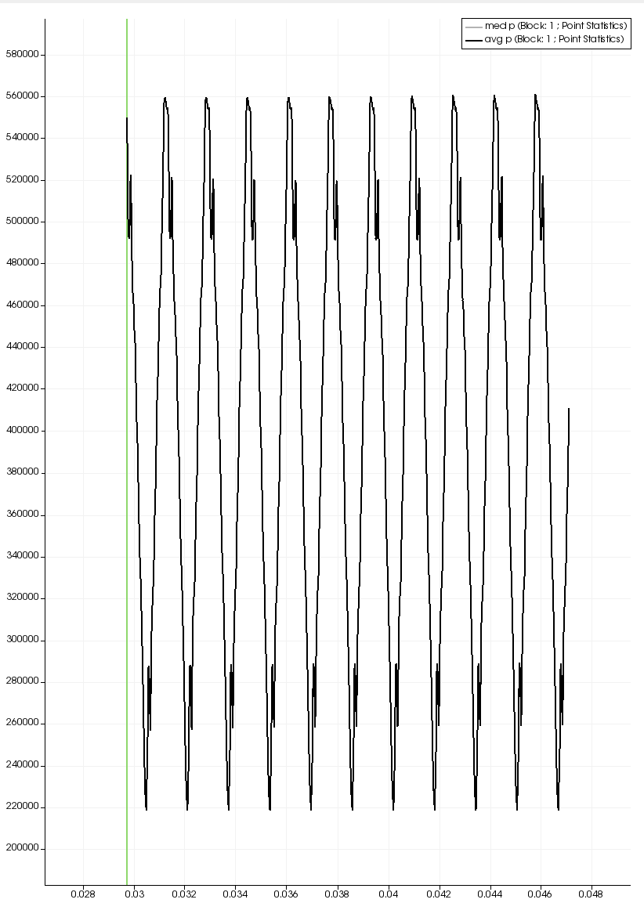
Animation Video: 570 m/s
Pulsating flow
Shock wave
Fig 7a: 67 m/s alpha.mercury
Fig 7b:Pressure in Pulsating flow
Average of Max and Min pressure at various points inside inner tube has been extracted from CFD simulation and used in formula (4) to calculate velocity of air for given velocity of sound at same temperature.

Slide 11
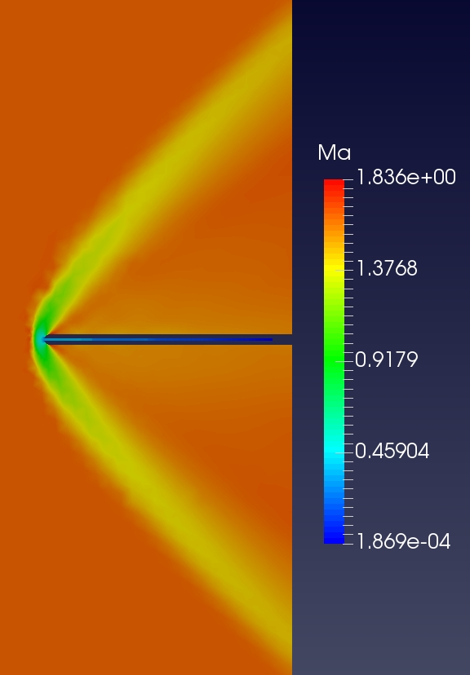
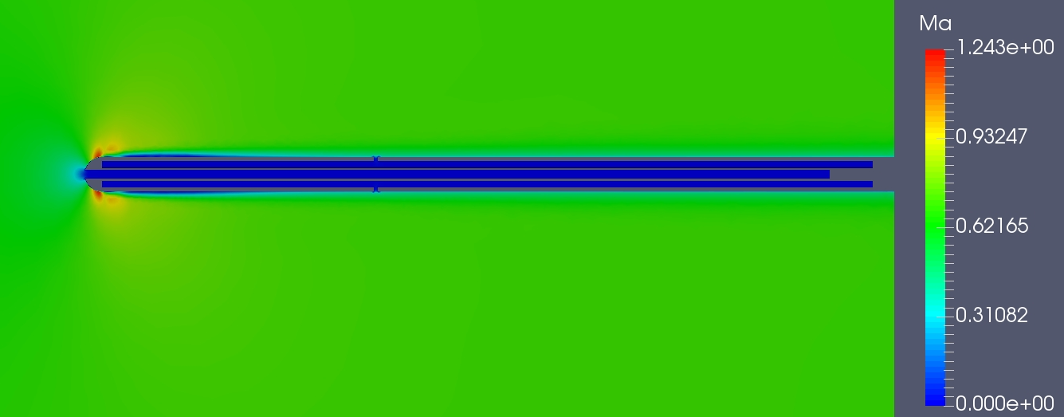
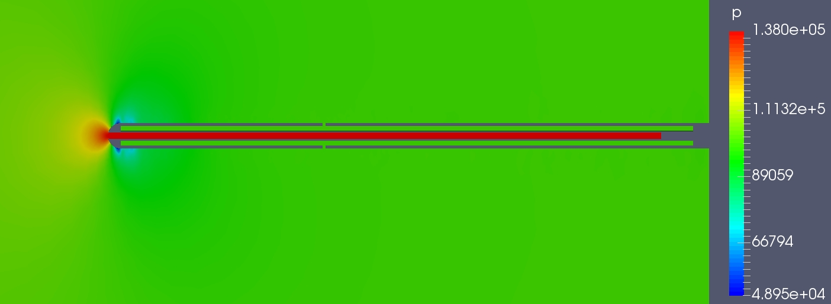
Some Colorful Pictures
Supersonic flow
Subsonic flow
Fig 8a : Mach Number for 240 m/s
Fig 9 : Mach Number for 570 m/s
Fig 8b : Pressure contour for 240 m/s

