Slide 1
Brief history of “programming”
“Programming” in the sense of devising rules, methods, procedures, recipes, algorithms, has always been present in human thought.
“Algorithm” originates from the name of Al-Khwarizmi, Arab mathematician from 800AD.

Slide 2
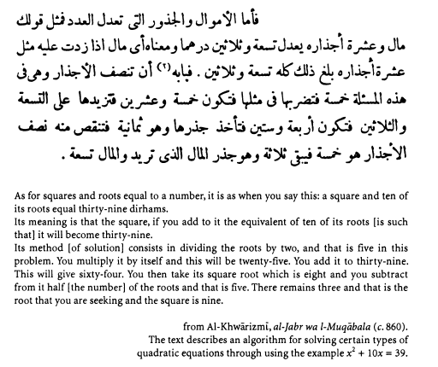
Al-Khwarizmi, 860AD

Slide 3
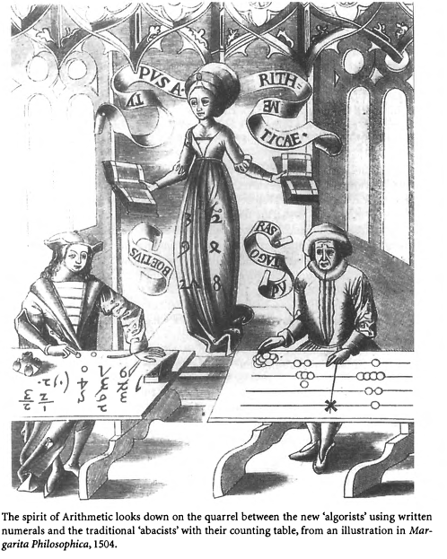
“Algorists” 1504AD

Slide 4
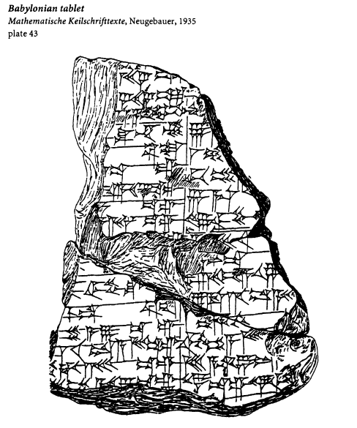
Sumerian division algorithm, 2000BC

Slide 5
Sumerian division, translated
[The number is 4;10. What is its inverse?
Proceed as follows.
Form the inverse of 10, you will find 6.
Multiply 6 by 4, you will find 24.
Add on 1, you will find 25.
Form the inverse of 25], you will find 2;24.
[Multiply 2;24 by 6], you will find 14;24.
[The inverse is 14;24]. Such is the way to proceed.

Slide 6
Sumerian division, symbolically
The number is x. What is its inverse?
Proceed as follows.
Form the inverse of y, you will find y’.
Multiply y’ by z. You will find t.
Add on 1. You will find u.
Form the inverse of u. You will find u’ .
Multiply u’ by y’. You will find v.
The inverse is v. Such is the way to proceed.

Slide 7
Euclid’s algorithm for GCD
Proposition 2
Given two numbers not prime to one another, to find their greatest common measure.
Let AB, CD be the two given numbers not prime to one another.
Thus it is required to find the greatest common measure of AB, CD.
…..
But, if CD does not measure AB, then the less of the numbers AB, CD, being continually subtracted from the greater, some number will be left which will measure the one before it.
…Let such a number measure them, and let it be G.
Now, since G measures CD, while CD measures BE, G also measures BE.

Slide 8
Functional vs imperative
The Sumerian division algorithm, which is representative of most algorithms in Mathematics, is an example of a functional computation.
The Euclid’s GCD algorithm is an example of an imperative computation, involving iteration and state change.
[For more details, see: Jean-Luc Chabert: A History of Algorithms, Springer, 1994]

Slide 9
Functional computation
Apply functions to input values or intermediate values to compute new outputs.
Type checking helps ensure the “plug-compatibility” of the inputs/outputs.

Slide 10
Imperative computation
Commands operate on the store, which contain locations, and read or write them.
One view is: commands transform the state of the store (i.e., “functions” of some sort).
Types are not of much help to ensure correctness.
Store
Commands

Slide 11
Introduction to Haskell
(Borrowed from
Peyton Jones & John Mitchell)

Slide 12
Language Evolution
Lisp
Algol 60
Algol 68
Pascal
C
Smalltalk
ML
Modula
C++
Haskell
Java
Many others: Algol 58, Algol W, Scheme, EL1, Mesa (PARC), Modula-2, Oberon, Modula-3, Fortran, Ada, Perl, Python, Ruby, C#, Javascript, F#…
Notes:
It may seem like programming languages never change. That the language you are programming in today is the same as yesterday, and it will always be that way. However, programming languages do change, and have changed quite significantly over the past 50 years. And not just in terms of minor things like syntax! Programming language researchers have made significant strides in developing better programming languages. To appreciate this development, we’re going to spend a little time looking back at some of the languages in use 20 to 50 years ago to see where we’ve come from. We’re also going to spend some time looking at Haskell, which is a programming language at the forefront of language research, ahead of main-stream languages, so you can see where we might be going.
Graph roughly breaks down by decade. Lisp late 50s, Algol 60’s, Pascal & C 70s, ML, Modula, C++, Smalltalk 80s, Haskell and Java 90s and on-going. (Of course many languages not represented)
C.A.R. Hoare: Here is a language so far ahead of its time, that it was not only an improvement on its predecessors, but also on nearly all its successors.
LISP: astonishingly modern compared to other languages of the time; needed decades for machine power to catch up to the power of the language.
languages are designed with a set of world assumptions; when those assumptions change, “best” language can also change.
why do language research when there is C++?
ex: garbage collection
cost of software: hardware cost to peoplecosts
12

Slide 13
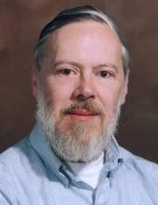
C Programming Language
Dennis Ritchie, ACM Turing Award for Unix
Statically typed, general purpose systems programming language
Computational model reflects underlying machine
Relationship between arrays and pointers
An array is treated as a pointer to first element
E1[E2] is equivalent to ptr dereference: *((E1)+(E2))
Pointer arithmetic is not common in other languages
Not statically type safe
If variable has type float, no guarantee value is floating pt
Ritchie quote
“C is quirky, flawed, and a tremendous success”
Notes:
Odd syntax: comes from how they knew how to parse with extremely limited memory.
very difficult to optimize C code because so much about the underlying machine is exposed to the programmer. compiler can only make changes that the programmer can’t distinguish, because otherwise, the behavior of the program might change in unacceptable ways. Programmers responsibility to write fast code.
How many of you have written a little C code? a lot of C code?
13

Slide 14
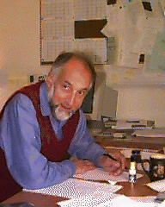
ML programming language
Robin Milner, ACM Turing-Award for ML, LCF Theorem Prover, …
Statically typed, general-purpose programming language
“Meta-Language” of the LCF theorem proving system
Type safe, with formal semantics
Compiled language, but intended for interactive use
Combination of Lisp and Algol-like features
Expression-oriented
Higher-order functions
Garbage collection
Abstract data types
Module system
Exceptions
Used in printed textbook as example language
Notes:
For many years, ML served as the language in which most research into type systems was done.
How many of you have programmed a little in ML? a lot?
14

Slide 15
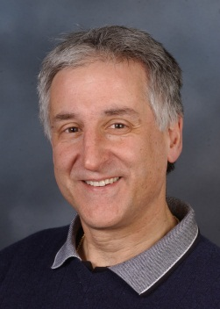


Haskell
Haskell programming language is
Similar to ML: general-purpose, strongly typed, higher-order, functional, supports type inference, interactive and compiled use
Different from ML: lazy evaluation, purely functional core, rapidly evolving type system
Designed by committee in 80’s and 90’s to unify research efforts in lazy languages
Haskell 1.0 in 1990, Haskell ‘98, Haskell’ ongoing
“A History of Haskell: Being Lazy with Class” HOPL 3
Paul Hudak
Simon Peyton Jones
John Hughes
Phil Wadler
Notes:
15

Slide 16
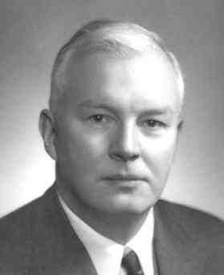
Haskell B Curry
Combinatory logic
Influenced by Russell and Whitehead
Developed combinators to represent substitution
Alternate form of lambda calculus that has been used in implementation structures
Type inference
Devised by Curry and Feys
Extended by Hindley, Milner
Although “Currying” and “Curried functions” are named after Curry, the idea was invented by Schoenfinkel earlier

Slide 17
Why Study Haskell?
Good vehicle for studying language concepts
Types and type checking
General issues in static and dynamic typing
Type inference
Parametric polymorphism
Ad hoc polymorphism (aka, overloading)
Control
Lazy vs. eager evaluation
Tail recursion and continuations
Precise management of effects
Notes:
17

Slide 18
Why Study Haskell?
Functional programming will make you think differently about programming.
Mainstream languages are all about state
Functional programming is all about values
Haskell is “cutting edge”
A lot of current research is done using Haskell
Rise of multi-core, parallel programming likely to make minimizing state much more important
New ideas can help make you a better programmer, in any language
Notes:
Sea change: the rise of multi-core and much more parallel programming likely to make minimizing state much more important.
18

Slide 19
Most Research Languages
1,000,000
Practitioners
10,000
100
The quick death
Geeks
1
1yr
5yr
10yr
15yr
Notes:
19

Slide 20
Successful Research Languages
1,000,000
Practitioners
10,000
100
The slow death
Geeks
1
1yr
5yr
10yr
15yr
Notes:
20

Slide 21
C++, Java, Perl, Ruby
Threshold of immortality
1,000,000
Practitioners
10,000
The complete absence of death
100
Geeks
1
1yr
5yr
10yr
15yr
Notes:
21

Slide 22
Committee languages
1,000,000
Practitioners
10,000
100
The slow death
Geeks
1
1yr
5yr
10yr
15yr
Notes:
22

Slide 23
Haskell
“Learning Haskell is a great way of training yourself to think functionally so you are ready to take full advantage of C# 3.0 when it comes out” (blog Apr 2007)
“I'm already looking at coding problems and my mental perspective is now shifting back and forth between purely OO and more FP styled solutions” (blog Mar 2007)
1,000,000
Practitioners
10,000
100
The second life?
Geeks
1
1990
1995
2000
2005
2010
Notes:
Initial motto: Avoid success at all costs! So designers could play with different options and not have to support a user base
After a while, people started wanting to use the language for real though.
Haskell98: stable version for users and tool writers
Haskell’: updated stable version for users, that incorporates innovations of intervening decade
Hackage: online repository of libraries, which contains >2000 libraries as of July 2010; these libraries have been downloaded over a million times. Business like Amgen, a biotech company, and credit suisse first boston, are using Haskell because it solves their problems better than any other language out there.
23

Slide 24
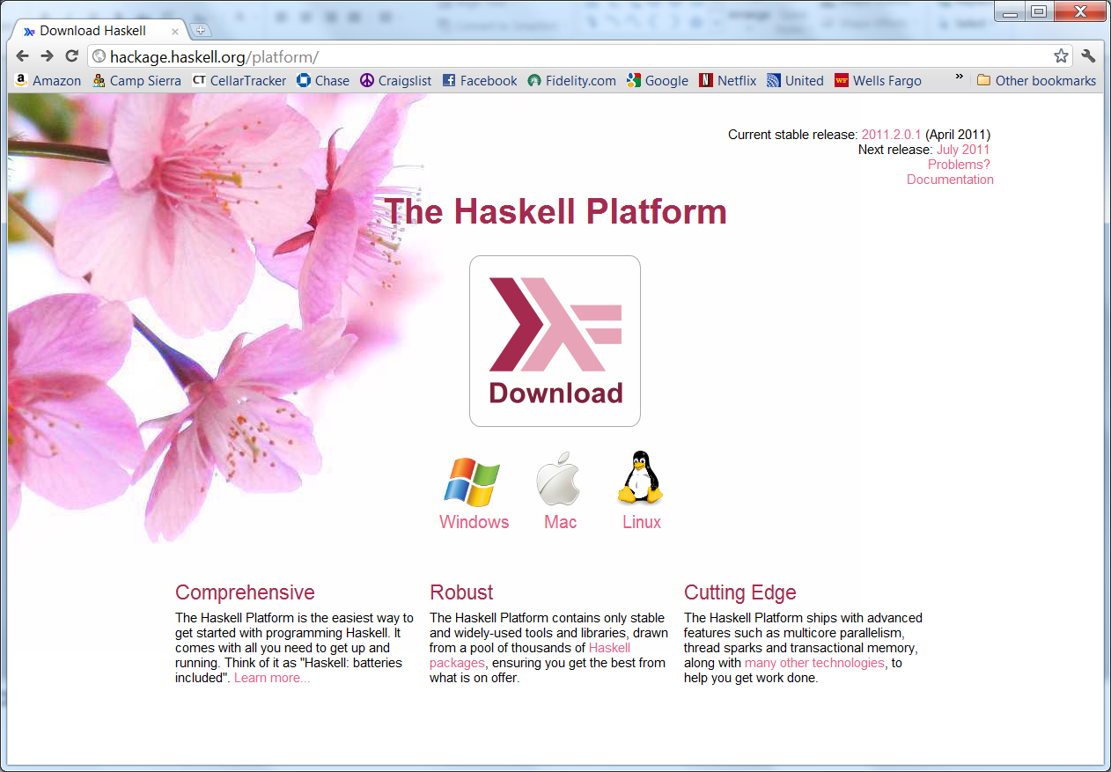

Slide 25
Function Types in Haskell
In Haskell, f :: A → B means for every x ∈ A,
f(x) =
In words, “if f(x) terminates, then f(x) ∈ B.”
In ML, functions with type A → B can throw an exception or have other effects, but not in Haskell
some element y = f(x) ∈ B
run forever

Slide 26
Basic Overview of Haskell
Prelude> (5+3)-2
6
it :: Integer
Prelude> if 5>3 then “Harry” else “Hermione”
“Harry”
it :: [Char] -- String is equivalent to [Char]
Prelude> 5==4
False
it :: Bool
Interactive Interpreter (ghci): read-eval-print
ghci infers type before compiling or executing
Type system does not allow casts or other loopholes!
Examples

Slide 27
Overview by Type
Booleans
Integers
Strings
Floats
True, False :: Bool
if … then … else … --types must match
0, 1, 2, … :: Integer
+, * , … :: Integer -> Integer -> Integer
“Ron Weasley”
1.0, 2, 3.14159, … --type classes to disambiguate
Haskell Libraries

Slide 28
Simple Compound Types
Tuples
Lists
Records
(4, 5, “Griffendor”) :: (Integer, Integer, String)
[] :: [a] -- polymorphic type
1 : [2, 3, 4] :: [Integer] -- infix cons notation
data Person = Person {firstName :: String,
lastName :: String}
hg = Person { firstName = “Hermione”,
lastName = “Granger”}
Notes:
Note that in Haskell, ‘:’ means “cons” and ‘::’ means “has type.” In ML, the meaning of these two symbols is reversed: ‘:’ means “has type” and ‘::’ means “cons.”
In Haskell, lower case types are type variables, such as the type ‘a’ in the type of []. In ML, type variables are preceeded by a tick: ‘a.
28

Slide 29
Patterns and Declarations
Patterns can be used in place of variables
<pat> ::= <var> | <tuple> | <cons> | <record> …
Value declarations
General form: <pat> = <exp>
Examples
Local declarations
myTuple = (“Flitwick”, “Snape”)
(x,y) = myTuple
myList = [1, 2, 3, 4]
z:zs = myList
let (x,y) = (2, “Snape”) in x * 4
Notes:
29

Slide 30
Functions and Pattern Matching
<name> <pat₁> = <exp₁>
<name> <pat₂> = <exp₂> …
<name> <pat_{n}> = <exp_{n}> …
f (x,y) = x+y --argument must match pattern (x,y)
length [] = 0
length (x:s) = 1 + length(s)
Function declaration form
Examples

Slide 31
More Functions on Lists
append ([], ys) = ys
append (x:xs, ys) = x : append (xs, ys)
reverse [] = []
reverse (x:xs) = (reverse xs) ++ [x]
Append lists
Reverse a list
Questions
How efficient is reverse?
Can it be done with only one pass through list?

Slide 32
More Efficient Reverse
reverse xs =
let rev ( [], accum ) = accum
rev ( y:ys, accum ) = rev ( ys, y:accum )
in rev ( xs, [] )
1
3
2
2
2
2
3
3
1
3
1
1

Slide 33
List Comprehensions
myData = [1,2,3,4,5,6,7]
twiceData = [2 * x | x <- myData]
-- [2,4,6,8,10,12,14]
twiceEvenData = [2 * x| x <- myData, x `mod` 2 == 0]
-- [4,8,12]
Notation for constructing new lists from old:
Similar to “set comprehension”
{ x | x ∈ Odd ∧ x > 6 }

Slide 34
Datatype Declarations
Examples
elements are Red, Yellow, Blue
elements are Atom “A”, Atom “B”, …, Number 0, ...
elements are Nil, Cons(Atom “A”, Nil), …
Cons(Number 2, Cons(Atom(“Bill”), Nil)), ...
General form
Type name and constructors must be Capitalized.
data Color = Red | Yellow | Blue
data Atom = Atom String | Number Int
data List = Nil | Cons (Atom, List)
data <name> = <clause> | … | <clause>
<clause> ::= <constructor> | <contructor> <type>

Slide 35
Datatypes and Pattern Matching
Recursively defined data structure
Recursive function
data Tree = Leaf Int | Node (Int, Tree, Tree)
4
Node(4, Node(3, Leaf 1, Leaf 2),
Node(5, Leaf 6, Leaf 7))
3
5
1
2
6
7
sum (Leaf n) = n
sum (Node(n,t1,t2)) = n + sum(t1) + sum(t2)

Slide 36
Case Expression
Datatype
Case expression
Indentation matters in case statements in Haskell.
data Exp = Var Int | Const Int | Plus (Exp, Exp)
case e of
Var n -> …
Const n -> …
Plus(e1,e2) -> …

Slide 37
Evaluation by Cases
data Exp = Var Int | Const Int | Plus (Exp, Exp)
ev ( Var n) = Var n
ev ( Const n ) = Const n
ev ( Plus ( e1,e2 ) ) =
case ev e1 of
Var n -> Plus( Var n, ev e2)
Const n -> case ev e2 of
Var m -> Plus( Const n, Var m)
Const m -> Const (n+m)
Plus(e3,e4) -> Plus ( Const n,
Plus ( e3, e4 ))
Plus(e3, e4) -> Plus( Plus ( e3, e4 ), ev e2)

Slide 38
Laziness
Haskell is a lazy language
Functions and data constructors don’t evaluate their arguments until they need them
Programmers can write control-flow operators that have to be built-in in eager languages
cond :: Bool -> a -> a -> a
cond True t e = t
cond False t e = e
Short-circuiting “or”
(||) :: Bool -> Bool -> Bool
True || x = True
False || x = x
Notes:
In Haskell, putting parens around an infix operator converts that operator to be an ordinary function.
38

Slide 39
Using Laziness
isSubString :: String -> String -> Bool
x `isSubString` s = or [ x `isPrefixOf` t
| t <- suffixes s ]
suffixes:: String -> [String]
-- All suffixes of s
suffixes[] = [[]]
suffixes(x:xs) = (x:xs) : suffixes xs
type String = [Char]
or :: [Bool] -> Bool
-- (or bs) returns True if any of the bs is True
or [] = False
or (b:bs) = b || or bs
Notes:
Putting ticks around a function converts the function to an infix operator.
39

Slide 40
A Lazy Paradigm
nextMove :: Board -> Move
nextMove b = selectMove allMoves
where
allMoves = allMovesFrom b
A gigantic (perhaps infinite) tree of possible moves
Generate all solutions (an enormous tree)
Walk the tree to find the solution you want
Notes:
40

Slide 41
Core Haskell
Basic Types
Unit
Booleans
Integers
Strings
Reals
Tuples
Lists
Records
Patterns
Declarations
Functions
Polymorphism
Type declarations
Type Classes
Monads
Exceptions

Slide 42
Testing
reverse xs =
let rev ( [], zs ) = zs
rev ( y:ys, zs ) = rev( ys, y:zs )
in rev( xs, [] )
-- Write properties in Haskell
type TS = [Int] -- Test at this type
prop_RevRev :: TS -> Bool
prop_RevRev ls = reverse (reverse ls) == ls
It’s good to write tests as you write code
E.g. reverse undoes itself, etc.
Notes:
42

Slide 43
Test Interactively
Test.QuickCheck is simply a Haskell library (not a “tool”)
bash$ ghci intro.hs
Prelude> :m +Test.QuickCheck
Prelude Test.QuickCheck> quickCheck prop_RevRev
+++ OK, passed 100 tests
...with a strange-looking type
Prelude Test.QuickCheck> :t quickCheck
quickCheck :: Testable prop => prop -> IO ()
Demo QuickCheck
Notes:
43

Slide 44
QuickCheck
Generate random input based on type
Generators for values of type a has type Gen a
Have generators for many types
Conditional properties
Have form <condition> ==> <property>
Example:
ordered xs = and (zipWith (<=) xs (drop 1 xs))
insert x xs = takeWhile (<x) xs++[x]++dropWhile (<x) xs
prop_Insert x xs =
ordered xs ==> ordered (insert x xs)
where types = x::Int

Slide 45
QuickCheck
QuickCheck output
When property succeeds:
quickCheck prop_RevRev OK, passed 100 tests.
When a property fails, QuickCheck displays a counter-example.
prop_RevId xs = reverse xs == xs where types = xs::[Int]
quickCheck prop_RevId
Falsifiable, after 1 tests: [-3,15]
Conditional testing
Discards test cases which do not satisfy the condition.
Test case generation continues until
100 cases which do satisfy the condition have been found, or
until an overall limit on the number of test cases is reached (to avoid looping if the condition never holds).
See : http://www.cse.chalmers.se/~rjmh/QuickCheck/manual.html

Slide 46
Things to Notice
No side effects. At all.
A call to reverse returns a new list; the old one is unaffected.
A variable ‘l’ stands for an immutable value, not for a location whose value can change.
Laziness forces this purity.
reverse:: [w] -> [w]
prop_RevRev l = reverse(reverse l) == l
Notes:
46

Slide 47
Things to Notice
Purity makes the interface explicit.
Takes a list, and returns a list; that’s all.
Takes a list; may modify it; may modify other persistent state; may do I/O.
reverse:: [w] -> [w] -- Haskell
void reverse( list l ) /* C */
Notes:
47

Slide 48
Things to Notice
prop_RevRev l = reverse(reverse l) == l
Pure functions are easy to test.
In an imperative or OO language, you have to
set up the state of the object and the external state it reads or writes
make the call
inspect the state of the object and the external state
perhaps copy part of the object or global state, so that you can use it in the post condition
Notes:
48

Slide 49
Things to Notice
reverse:: [w] -> [w]
Types are everywhere.
Usual static-typing panegyric omitted...
In Haskell, types express high-level design, in the same way that UML diagrams do, with the advantage that the type signatures are machine-checked.
Types are (almost always) optional: type inference fills them in if you leave them out.
Notes:
49

Slide 50
More Info: haskell.org
The Haskell wikibook
http://en.wikibooks.org/wiki/Haskell
All the Haskell bloggers, sorted by topic
http://haskell.org/haskellwiki/Blog_articles
Collected research papers about Haskell
http://haskell.org/haskellwiki/Research_papers
Wiki articles, by category
http://haskell.org/haskellwiki/Category:Haskell
Books and tutorials
http://haskell.org/haskellwiki/Books_and_tutorials
Notes:
50

