Slide 1
Password Cracking
Andrew Knoblach, Carter McGee

Slide 2
The Problem
We have a copy of a database containing usernames and hashed passwords and we want the plaintext passwords.

Slide 3
Solution: Brute Force Password Search
Iterate through every possible password in the password space and check if the password’s hash matches one found in the leaked database.
Pros:
Effective
Simple to implement
Cons:
Takes a long time

Slide 4
Password Space
The password space experiences polynomial growth with every new character added to the character set and exponential growth when the length of the password increases.

Slide 5
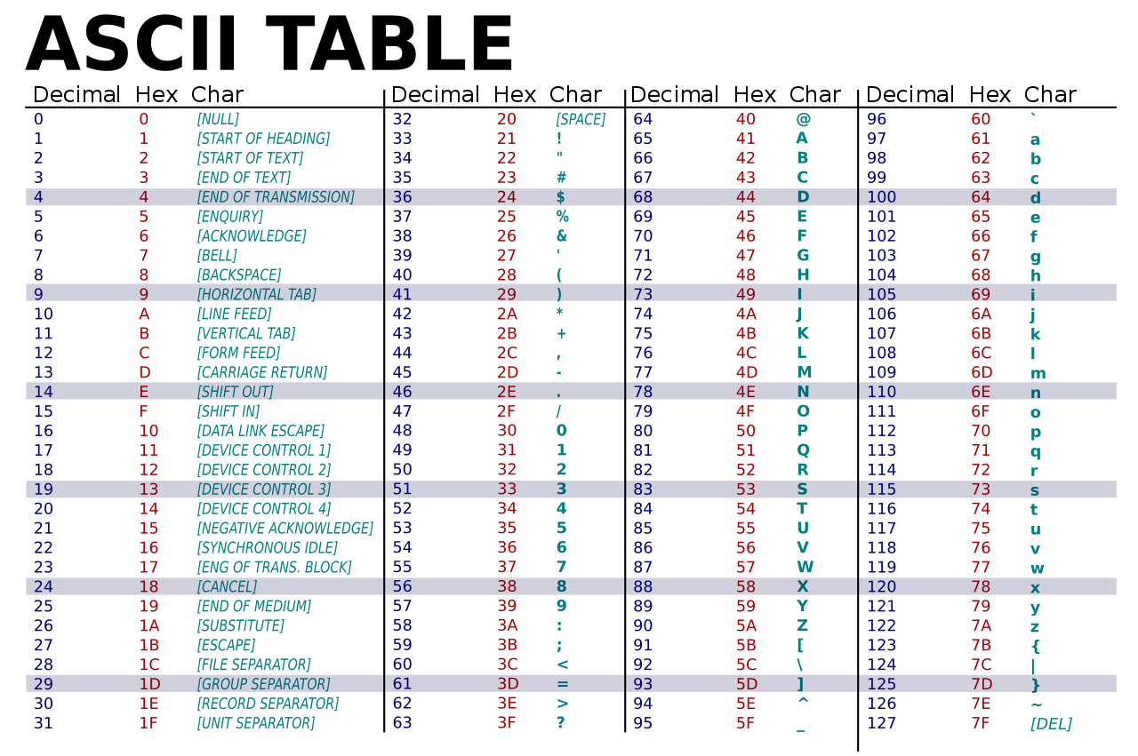
Password Space
Example:
Character set: 95 printable ascii characters, Length: 8

Slide 6
Password Space
Example:
Character set: 95 printable ascii characters, Length: 8
Password space = 95⁸= 6.6 Quadrillion!
Assuming we can test 1,000,000 passwords per second, it will take 210 years to fully crack this password space.

Slide 7
Our Approach: Dividing the Password Space
Character set = [‘a’, ‘b’, ‘c’, ‘d’]
Number of processes = 2
Password Length = 3
Process 1: aaa - caa
Process 2: caa - ddd

Slide 8
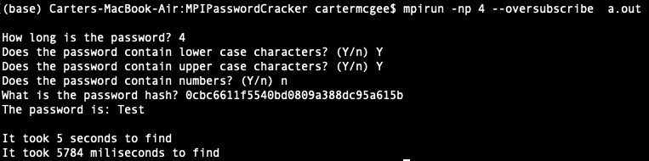
Example Output

Slide 9
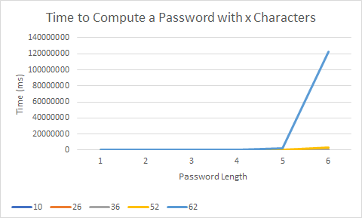
Results

Slide 10
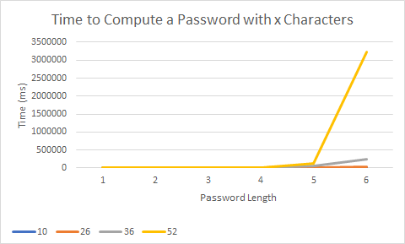
Results

Slide 11
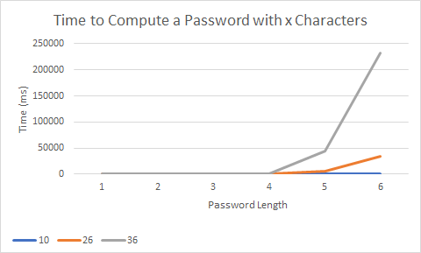
Results

