Slide 1

VajraGrid
AI-Driven Cyber Defense for Smart Power Grids
Team Details
Team: Innovibe
Lead: D Shantan Dheer
Members: MJ Emmanuel, Jakkula Tarun
Problem: Smart Grid Cybersecurity & AI Defense

Slide 2

Brief About the Idea
575+ GW
India's Grid — 3rd Largest
₹100+ Cr
Cost Per Hour of Downtime
ZERO
AI Cyber Defense for Indian Grid
The Problem
• 2020 Mumbai blackout: Chinese malware in SCADA • 2023 ransomware: zero automated response • 20 Cr smart meters = new attack surfaces • No AI cyber defense exists for Indian grids
VajraGrid Solution
• 4-layer AI detection (Rules→Physics→Stats→ML) • VajraShield™ autonomous FLISR healing • <3s detection, 16s full grid restoration • Edge-first on AMD Ryzen AI NPU
VajraShield™ detects attacks in <3 seconds and restores grid in 16 seconds — no human intervention

Slide 3
Opportunities & Differentiation
How Is It Different?
Existing tools (OSIsoft PI, ABB FOX615) are passive monitors. VajraGrid is the FIRST to combine: • Multi-layer AI detection • Autonomous grid healing • Edge NPU deployment • India-specific grid topology
How Does It Solve?
Manual response: 30-90 minutes. VajraGrid: 3s detect + 16s heal. • Zero false positive design • Works on airgapped substations • Scales to 250K+ substations • ₹2-5L per edge node
USP
• 4-Layer Fusion Detection • Physics-aware (Kirchhoff validation) • Self-healing FLISR algorithm • AMD Ryzen AI NPU optimized • Real working prototype • ₹100+ Cr/incident savings

Slide 4
Key Features
4-Layer Detection
Rules (9) → Physics → Stats → ML/ONNX. Each <500ms.
AlertClassifier Fusion
Multi-signal confidence → triggers VajraShield at 0.90+
VajraShield™ FLISR
Fault locate → isolate → reroute → restore in 16s
5 Attack Types
FDI, Command Spoof, MaDIoT, Sensor Tamper, Smart Meter
SOC Dashboard
Live telemetry, topology map, threat timeline, alert feed
Topology Agnostic
5-bus demo scales to 10K+ node state grids
Edge Deployment
ONNX on AMD Ryzen AI NPU — 50 TOPS, 15W cTDP
Mobile Responsive
Full SOC on mobile: drawer nav, compact cards

Slide 5
Detection & Healing Pipeline
DATA FLOW: SCADA Telemetry (1s) → API → DataGenerator → 4 Detection Engines → AlertClassifier → VajraShield
Rule Engine
9 rules <100ms
Physics Engine
4 Kirchhoff checks <100ms
Statistical
Z-score + CUSUM <200ms
ML/ONNX
Isolation Forest <500ms
ALERTCLASSIFIER FUSION: All 4 layers → Multi-signal confidence score ≥ 0.90 → VajraShield™ trigger
DETECTING
ISOLATING
REROUTING
MONITORING
RESTORING
RESTORED
TIMING: Detection <3s | Full Heal Cycle: 16s | Manual baseline: 30-90 min

Slide 6
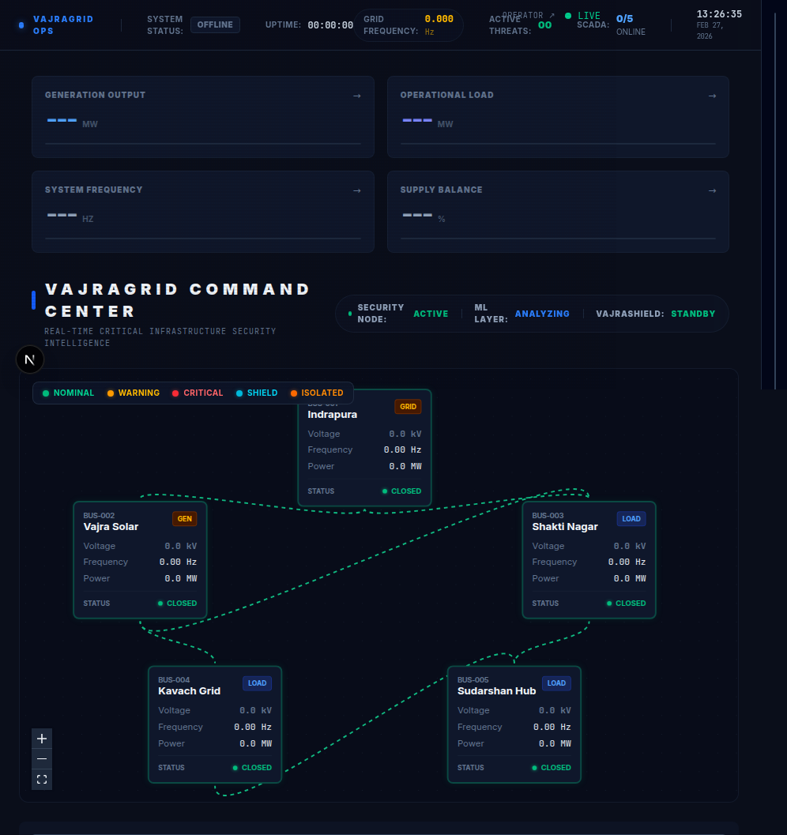
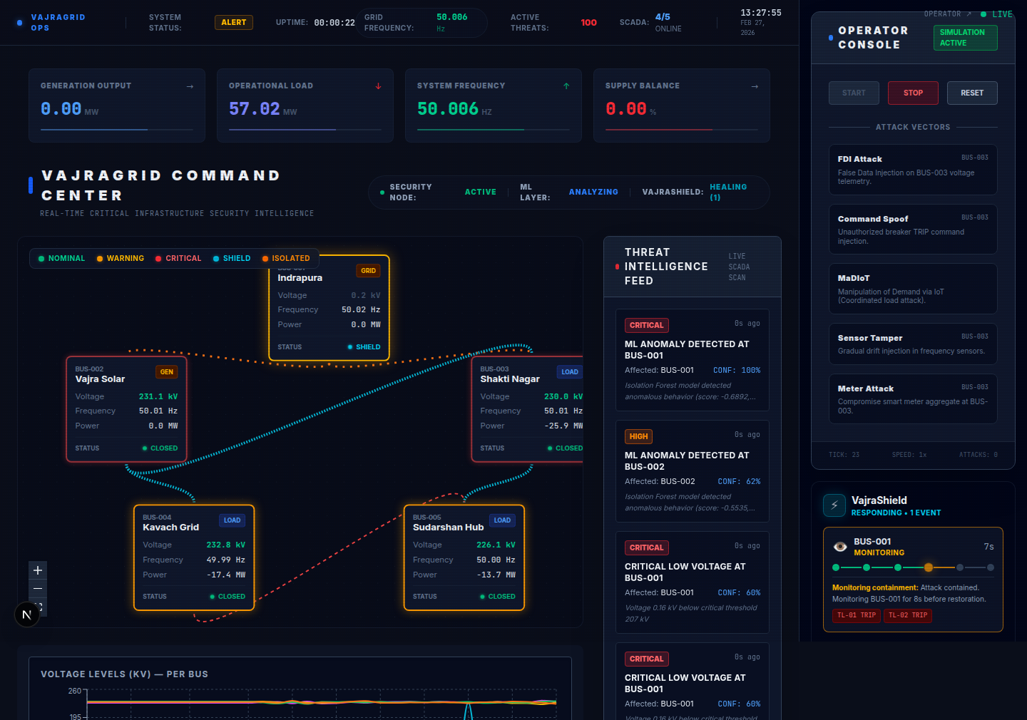
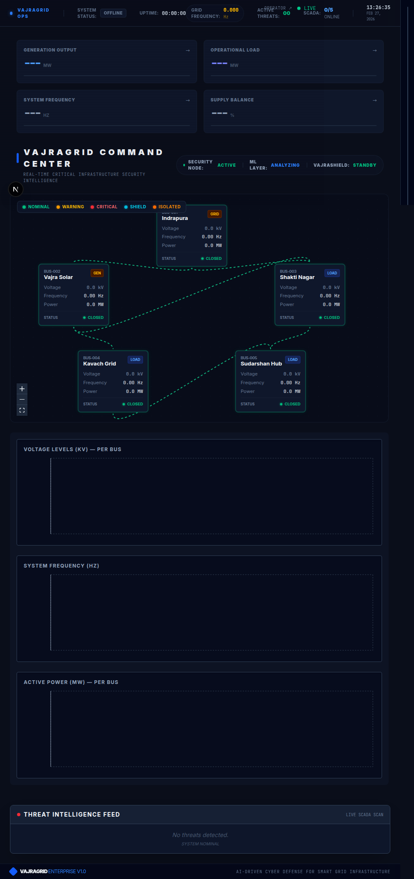
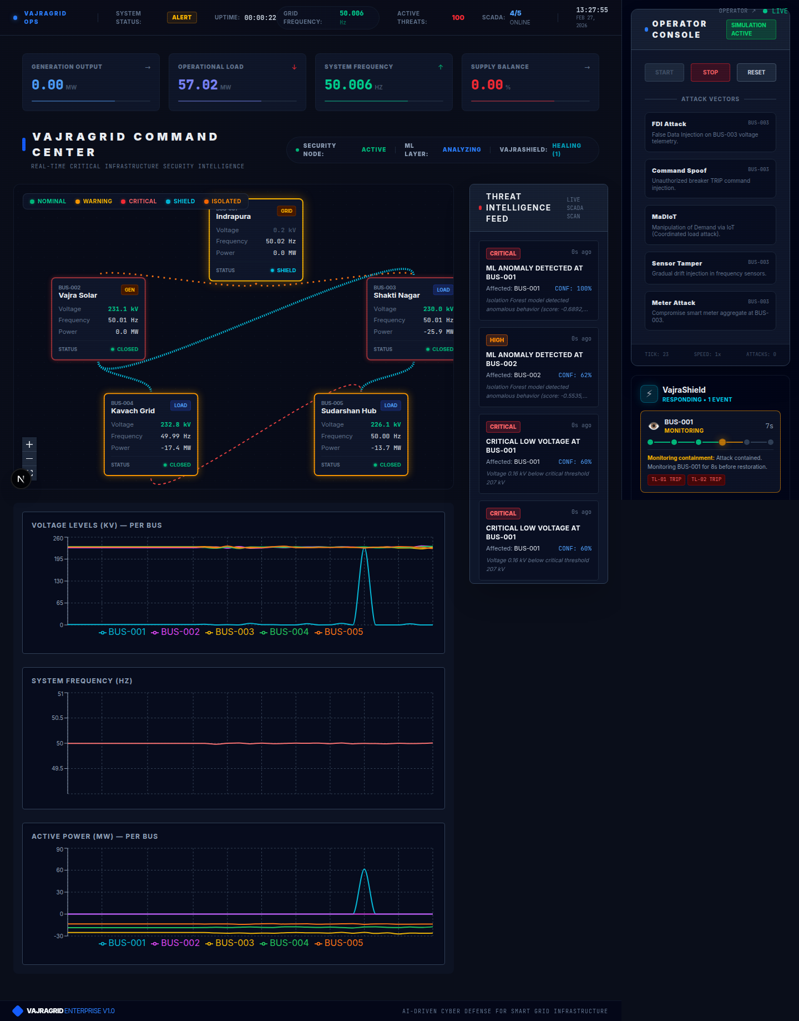
Live Dashboard
Dashboard at Startup
Topology map, metric cards, dark SOC theme
Live Simulation + Healing
Real-time telemetry, alerts, VajraShield FLISR

Slide 7
System Architecture
PRESENTATION
Next.js 16 + React 19 | Tailwind v4 | Recharts + Topology Canvas
API LAYER
REST: /api/simulation/{start,stop,attack} | SSE: /api/simulation/stream
SIMULATION ENGINE
DataGenerator → Telemetry (V, f, P, Q, θ, AMI) | 5 Attack Injectors
4-LAYER DETECTION
Rules (9) → Physics (4) → Statistical (Z+CUSUM) → ML/ONNX (IsolationForest)
VAJRASHIELD™
FLISR: Fault Location → Breaker Isolation → Power Rerouting → Restoration
AMD HARDWARE
Edge: Ryzen AI NPU (XDNA 50 TOPS) + VitisAI | Dev: EPYC AVX2+FMA3

Slide 8
Technology Stack
Layer | Technology
Frontend | Next.js 16, React 19, Tailwind v4, Recharts, D3.js
Backend | Next.js API Routes, Server-Sent Events (SSE)
AI/ML | ONNX Runtime (Isolation Forest), 4-Layer Detection Pipeline
Simulation | Custom DataGenerator, 5 Attack Models, Physics Engine
Self-Healing | VajraShield FLISR Algorithm (6 phases)
Hardware Target | AMD Ryzen AI NPU (XDNA), Vitis AI EP, Quark INT8
Dev Platform | AMD EPYC (AVX2+FMA3), GitHub Codespaces
Testing | Vitest (37/37), ESLint, TypeScript Strict

Slide 9
AMD Products & Solutions
AMD Ryzen™ AI NPU — XDNA
• Edge inference at substations • 50 TOPS sustained, 15W cTDP • Runs anomaly_detector.onnx locally • <5ms inference vs 200ms cloud
ONNX + Vitis AI EP
• Model already in ONNX format • VitisAI Execution Provider for NPU • Quark INT8 quantization (<1% loss) • Zero framework changes needed
AMD EPYC — Dev Platform
• Current prototype on EPYC/AVX2 • 31,500 inferences/sec achieved • OpenBLAS DYNAMIC_ARCH support • Cloud dev → edge deployment path
Zen 5 CPU — Heterogeneous
• Rules/Physics/Stats on CPU cores • ML offloaded to NPU • Parallel processing pipeline • ROCm GPU path for training
Edge node: ~₹2-5L/substation | Up to 5-8x inference speedup (NPU vs CPU) | 15W cTDP

Slide 10
Commercial Impact & ROI
$8.3B
Grid Market 2025
$22.7B
2034 @ 11.7% CAGR
11.7%
Smart Grid Cyber CAGR
<1 Event
Payback Period
Revenue Stream | Pricing
SaaS per-substation | ₹5,000/month/node
Enterprise license | ₹50L-1Cr/year per DISCOM
Edge hardware | ₹2-5L per AMD Ryzen AI node
ROI Case
• Avg blackout: ₹100+ Cr/incident • VajraGrid: <3s detect, 16s heal • Manual: 30-90 min response • Risk reduction: ~99% • Payback: <1 prevented event
Customers: State DISCOMs (BESCOM, MSEDCL, TPDDL) | PGCIL | Smart Meter Vendors | Industrial

Slide 11
Prototype Assets
GitHub Repository
Primary: github.com/vajragrid Mirror: github.com/D Shantan Dheer/vajragridr Tech: Next.js 16 + ONNX Runtime License: MIT Open Source
Demo Walkthrough
1. Open VajraGrid dashboard 2. Click "Start Simulation" 3. Observe live telemetry 4. Trigger attack → watch detection 5. VajraShield auto-heals grid
37/37
Tests Pass
0
Warnings
95.8%
ML Rate
0.2%
False +ve

Slide 12
Scalability & Roadmap
Component | 5-Bus (Demo) | 100-Bus | 10K+ (State)
Buses/Nodes | 5 | 100 | 10,000+
Detection Latency | <3s | <5s | <10s
Heal Cycle | 16s | 30s | 60s
Hardware | 1 Ryzen AI | 10 edge nodes | 250K+ nodes
Deployment | Single campus | City DISCOM | State/National
Near-Term
• OPC-UA SCADA adapter • Real telemetry integration • CERC compliance module
Mid-Term
• GIS Mapbox dashboard • Multi-DISCOM federation • AMI head-end protection
Long-Term
• Commercial SaaS platform • International grid standards • ROCm GPU training pipeline

Slide 13
Attack Detection — How It Works
Layer 1: Rule Engine
9 predefined rules check voltage (±5%), frequency (±0.5Hz), ROCOF, breaker status, power factor. Deterministic, <100ms. Catches command spoofing and sensor tampering instantly.
Layer 2: Physics Engine
4 physics-based validations: power balance (ΔP<5%), Kirchhoff current law, reactive power coupling, voltage-angle consistency. Catches FDI and MaDIoT attacks.
Layer 3: Statistical Engine
Z-score outlier detection + CUSUM change detection. Cross-bus correlation analysis. Catches slow drift attacks and ramp manipulations.
Layer 4: ML/ONNX
Isolation Forest trained on normal+attack patterns. ONNX Runtime inference. 95.8% accuracy, 0.2% false positive. Catches novel zero-day attacks.

Slide 14
VajraShield™ — Autonomous Grid Healing
DETECTING (0-3s)
AlertClassifier fuses all 4 layers. When combined confidence ≥ 0.90, VajraShield activates. Identifies affected bus segment.
ISOLATING (3-5s)
Opens breakers on compromised bus. Prevents cascading failures. Logs isolation event to SOC dashboard.
REROUTING (5-10s)
Calculates alternate power paths. Transfers load to healthy buses. Maintains grid stability during transition.
MONITORING (10-13s)
Validates grid stability post-reroute. Checks voltage, frequency, power balance on all buses. Confirms no secondary faults.
RESTORING (13-16s)
Gradually brings isolated segment back online. Re-closes breakers. Confirms full grid restoration. Total: 16 seconds.

Slide 15

VajraGrid | Team Innovibe
AI-Driven Cyber Defense for Smart Power Grids

