Slide 1
S1223_15 (15% thickness)
3” thickness

Slide 2
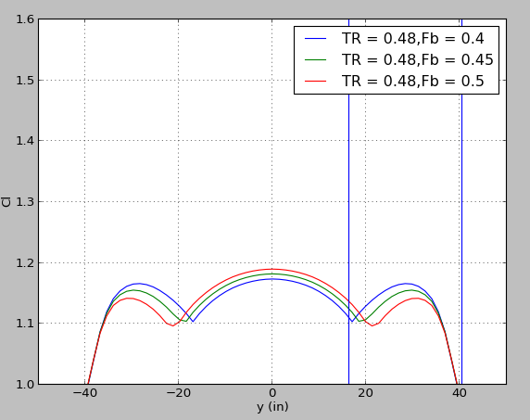
FB choice

Slide 3
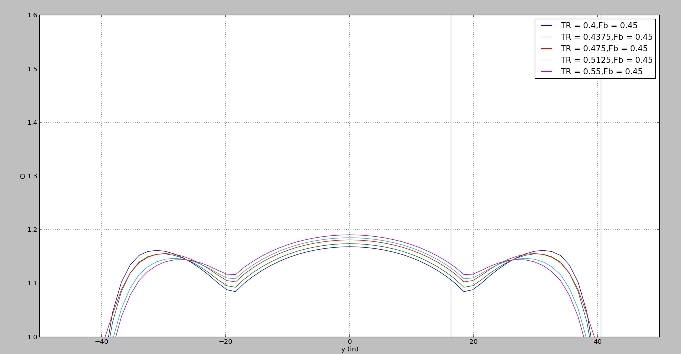
Selecting a Taper Ratio

Slide 4
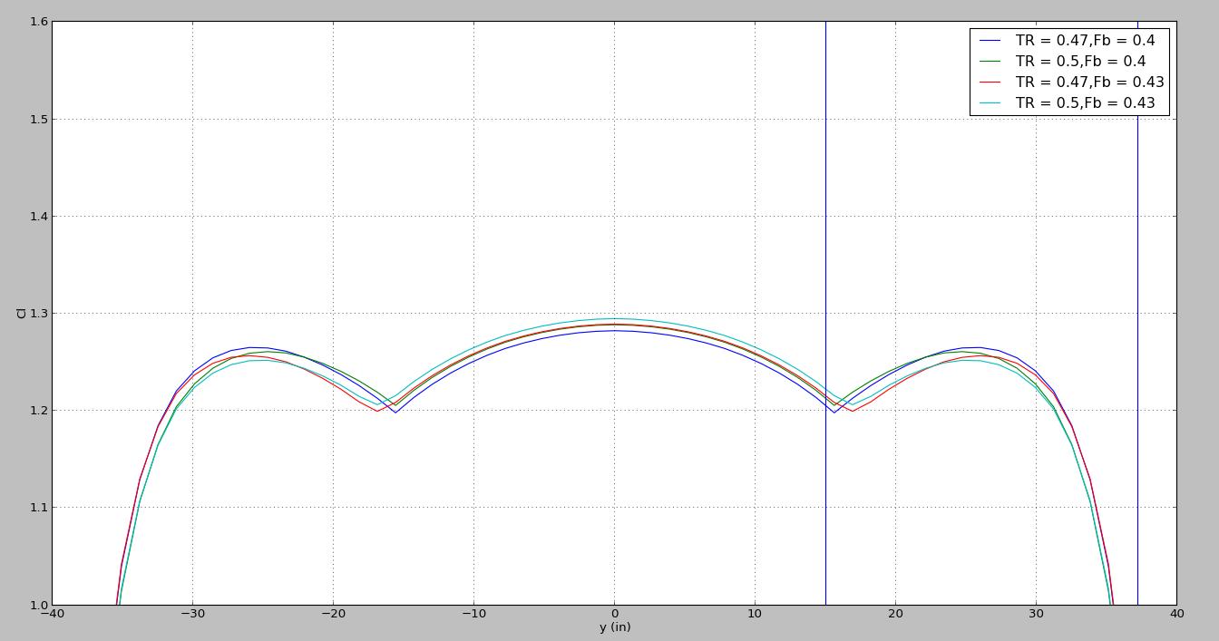
Final TR and FB Choices

Slide 5
Airfoil stats
TR: 0.48
FB: 0.45

Slide 6
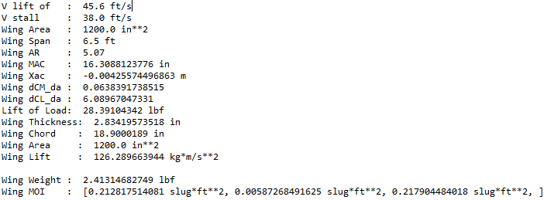
Wing Attributes

Slide 7
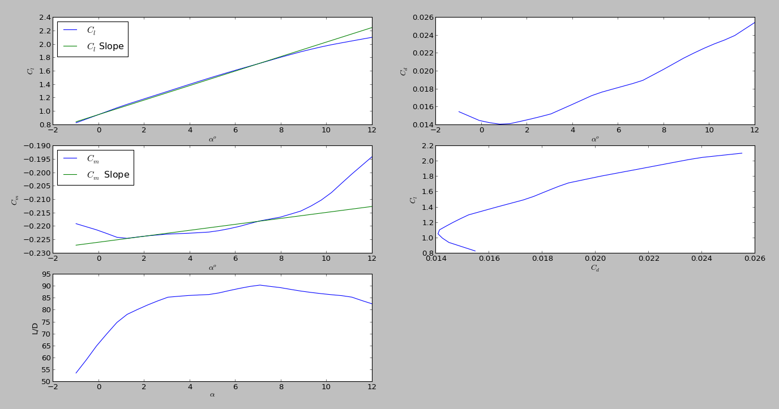
Linear Approximations

Slide 8
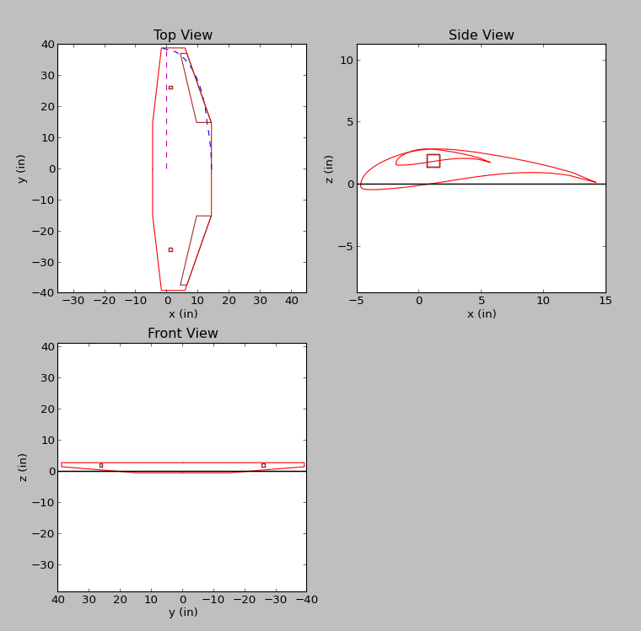
Wing Planform

