Slide 1
Stability and Controls
10-14-14

Slide 2
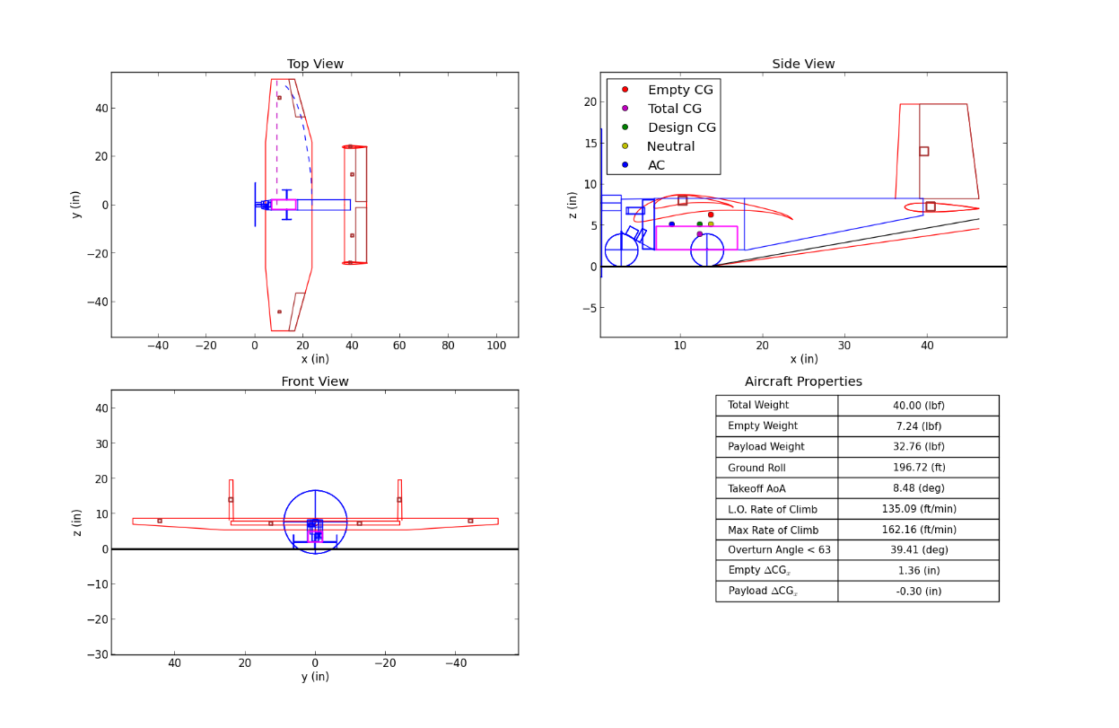
Aircraft Changes
Wing moved back
Htail NACA0012
With S increased by 50 in²
Payload = 32 lbs
Ground roll < 200 ft
CG within static margin

Slide 3
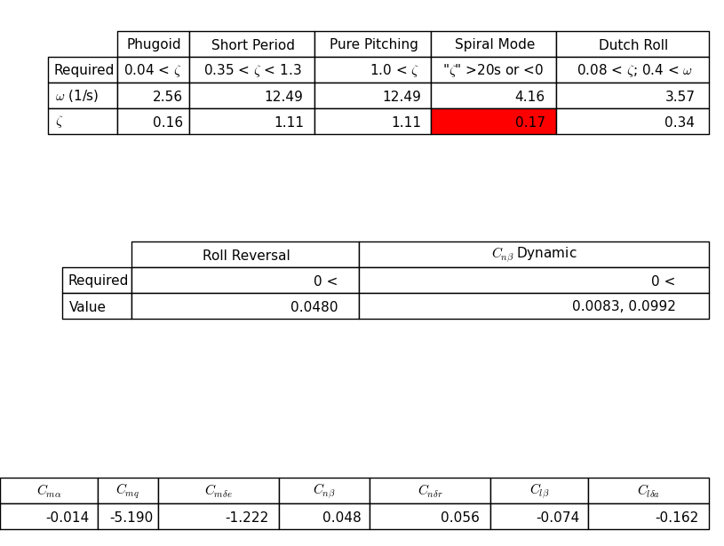
Dynamic Derivatives
All aerodynamic derivatives stable
Except spiral mode
Calculated with 0 dihedral
Previous years estimated that there would be enough dihedral on wing to stabilize the spiral mode
Reduced overall pitching moment

Slide 4
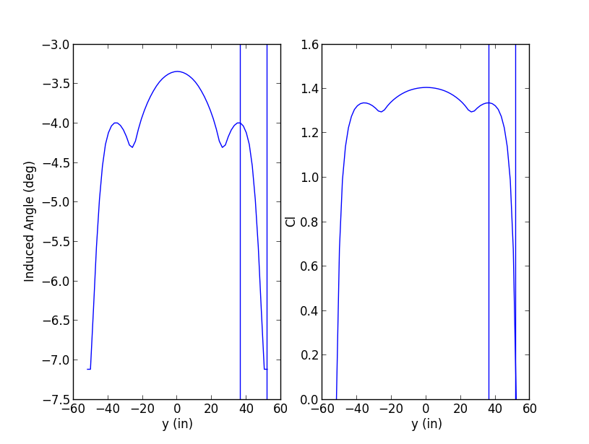
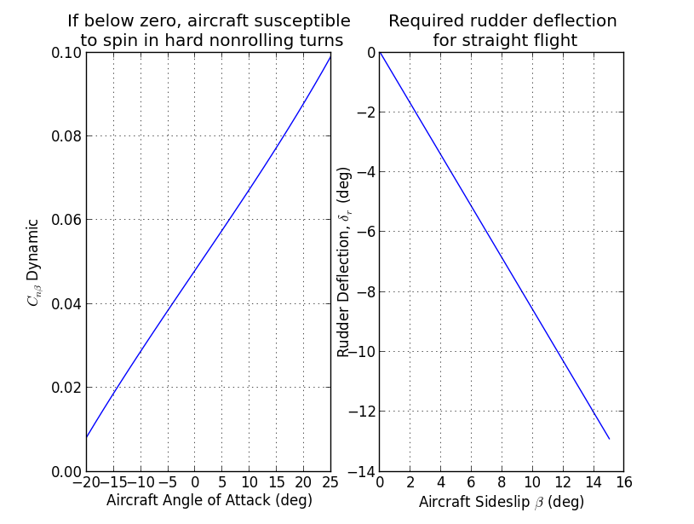
Aileron and Rudder

Slide 5
Marshall Says…
There is a way to change the main gear shape to a bent shape
MainGear.Theta
Add height to the fuselage possibly instead of adding height with the gear
Might be more stable and the straight gear is easier to manufacture

