Slide 1
Stability and Controls and Other Stuff

Slide 2
Potential Changes to Aircraft
Lower motor mount height
Raise aircraft ground roll height
Increase horizontal tail chord
Increase elevator chord
Lower wing into fuselage
Move wing aft to move static margin
Decrease static margin to 10% (to start)

Slide 3
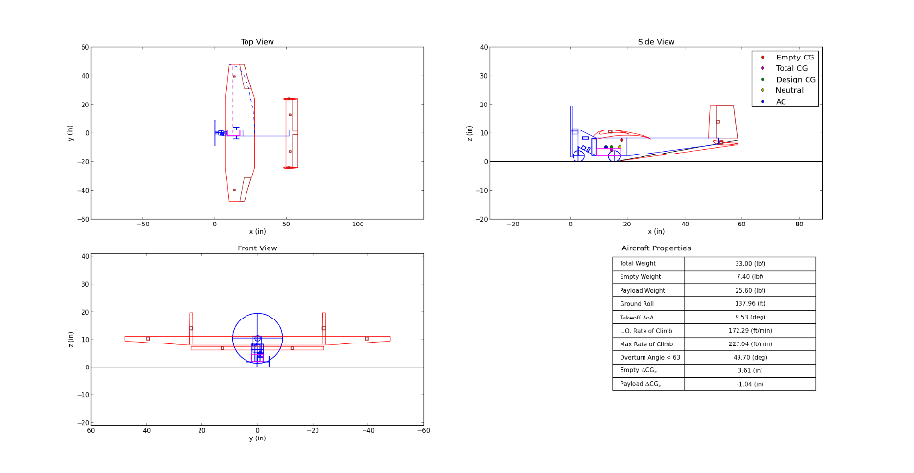
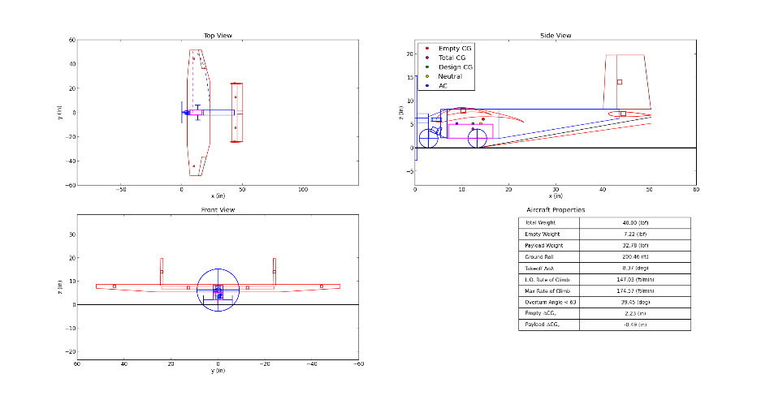

Slide 4
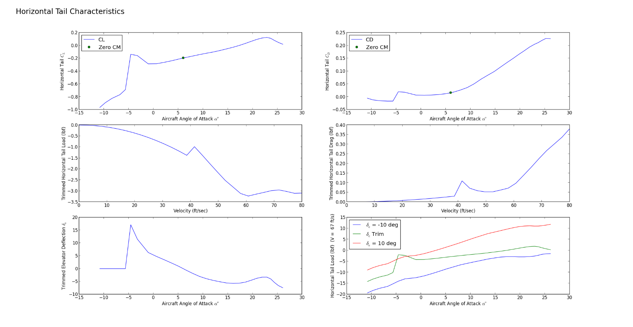
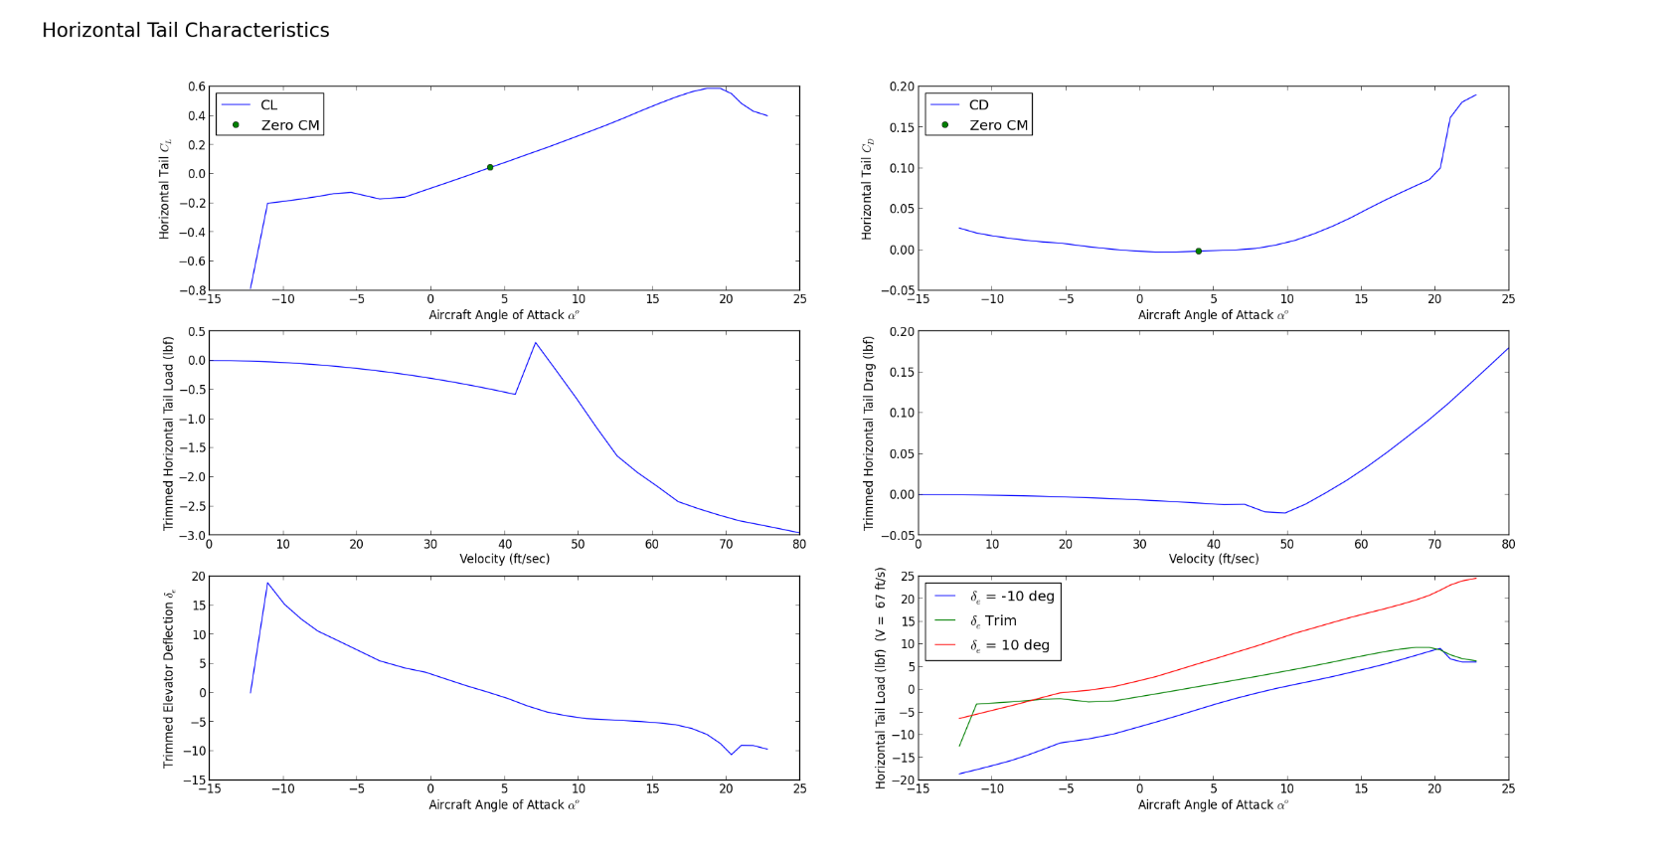

Slide 5
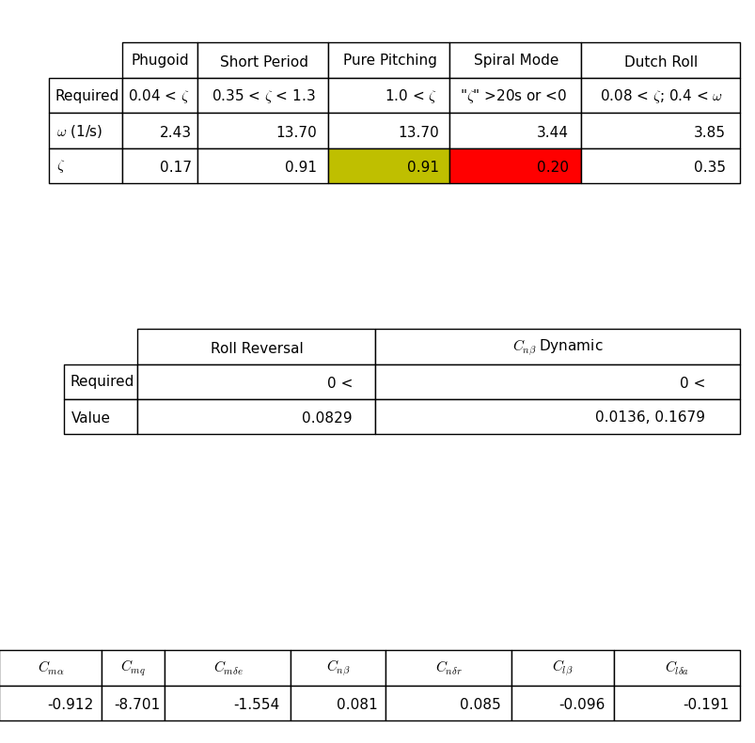
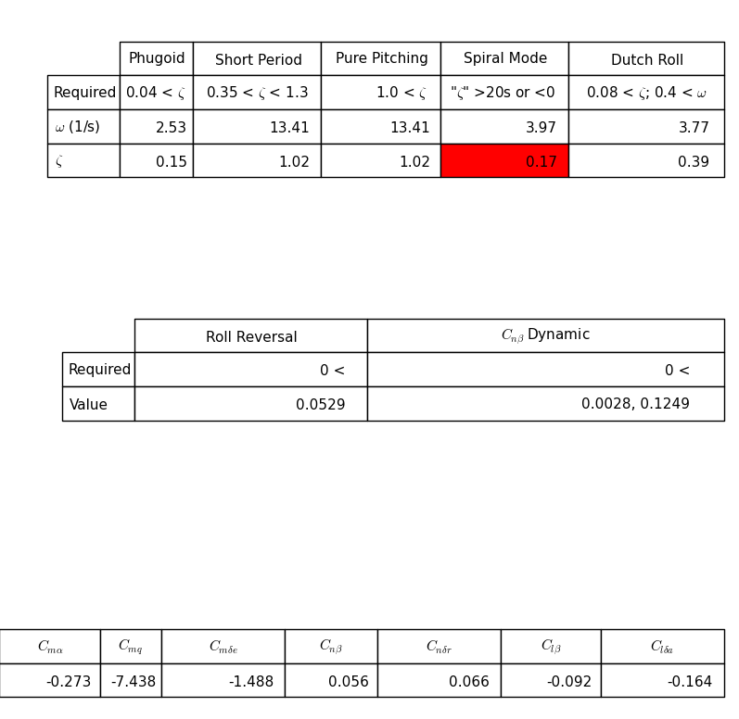
Aerodynamic Derivatives

Slide 6
What these changes require
Structures and CAD groups incorporating into overall aircraft design
Spar through fuselage?
Landing gear raised?
Aerodynamics group incorporating into wing design
Taper
Effect on CG
Main gear axle placement

Slide 7
Next
Control surface sizing
Control surface placement
Servo Sizing

