Slide 1
Wing Aerodynamics Update
10/23/14

Slide 2
Purpose
Mistake made in script calculating difference between Wingtip C_{L} and Root C_{L}
Resulted in incorrect plots
Resolved using derivative of data points to more accurately identify changes in slope which better indicates where the wingtip C_{L}’s begin and end
General C_{L} and C_{D} trends unchanged
Method to identify optimal wing shape altered
Demonstrate new wing design’s validity

Slide 3
Source of Error in New Script
temp = LLT.Cl(y)
last = len(temp)
for x in range(2, npy.round(last/2)):
slope1 = temp[x] - temp[x-1]
slope2 = temp[x+1] - temp[x]
if slope2 < 0 or slope2 > slope1:
wingtipmax = x
break
Eclipse stores variables to over 17 decimal places. Originally, the slopes, due to automatic rounding by python, would occasionally meet the criteria where slope2 < slope1 even though in reality they don’t.
This issue is solved by stating that the slope difference must be greater than 0.0001.
temp = LLT.Cl(y)
last = len(temp)
for x in range(2, npy.round(last/2)):
slope1 = temp[x] - temp[x-1]
slope2 = temp[x+1] - temp[x]
if slope2 < 0 or (slope2-slope1) > 0.0001:
wingtipmax = x
break

Slide 4
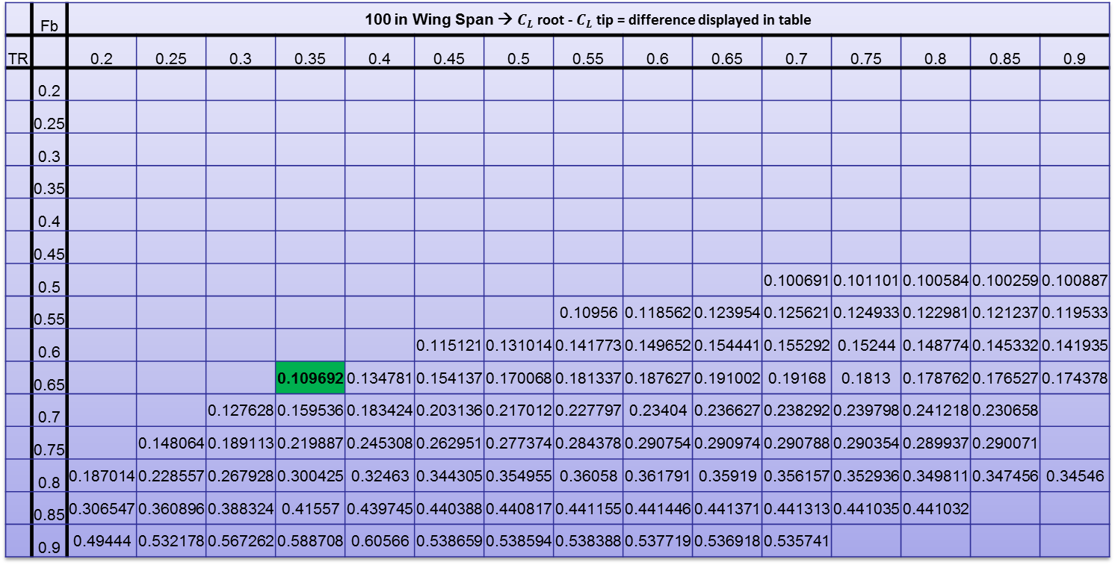
 | Fb | 100 in Wing Span → $C_{L}$ root - $C_{L}$ tip = difference displayed in table
TR |  | 0.2 | 0.25 | 0.3 | 0.35 | 0.4 | 0.45 | 0.5 | 0.55 | 0.6 | 0.65 | 0.7 | 0.75 | 0.8 | 0.85 | 0.9
 | 0.2
 | 0.25
 | 0.3
 | 0.35
 | 0.4
 | 0.45
 | 0.5 |  |  |  |  |  |  |  |  |  |  | 0.100691 | 0.101101 | 0.100584 | 0.100259 | 0.100887
 | 0.55 |  |  |  |  |  |  |  | 0.10956 | 0.118562 | 0.123954 | 0.125621 | 0.124933 | 0.122981 | 0.121237 | 0.119533
 | 0.6 |  |  |  |  |  | 0.115121 | 0.131014 | 0.141773 | 0.149652 | 0.154441 | 0.155292 | 0.15244 | 0.148774 | 0.145332 | 0.141935
 | 0.65 |  |  |  | 0.109692 | 0.134781 | 0.154137 | 0.170068 | 0.181337 | 0.187627 | 0.191002 | 0.19168 | 0.1813 | 0.178762 | 0.176527 | 0.174378
 | 0.7 |  |  | 0.127628 | 0.159536 | 0.183424 | 0.203136 | 0.217012 | 0.227797 | 0.23404 | 0.236627 | 0.238292 | 0.239798 | 0.241218 | 0.230658
 | 0.75 |  | 0.148064 | 0.189113 | 0.219887 | 0.245308 | 0.262951 | 0.277374 | 0.284378 | 0.290754 | 0.290974 | 0.290788 | 0.290354 | 0.289937 | 0.290071
 | 0.8 | 0.187014 | 0.228557 | 0.267928 | 0.300425 | 0.32463 | 0.344305 | 0.354955 | 0.36058 | 0.361791 | 0.35919 | 0.356157 | 0.352936 | 0.349811 | 0.347456 | 0.34546
 | 0.85 | 0.306547 | 0.360896 | 0.388324 | 0.41557 | 0.439745 | 0.440388 | 0.440817 | 0.441155 | 0.441446 | 0.441371 | 0.441313 | 0.441035 | 0.441032
 | 0.9 | 0.49444 | 0.532178 | 0.567262 | 0.588708 | 0.60566 | 0.538659 | 0.538594 | 0.538388 | 0.537719 | 0.536918 | 0.535741
Difference very close to 0.1 indicating similar C_{L} at root and at wing tip i.e. they both stall reasonably close to each other while providing maximum lift. Large Fb gives easier building (constant chord for longer down the wing), small TR means less structural weight near tip.

Slide 5
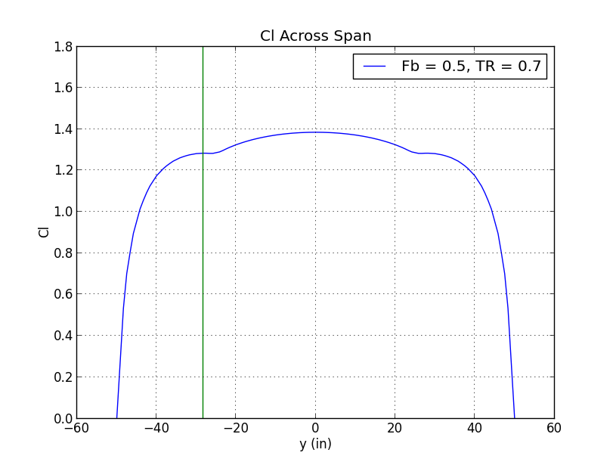
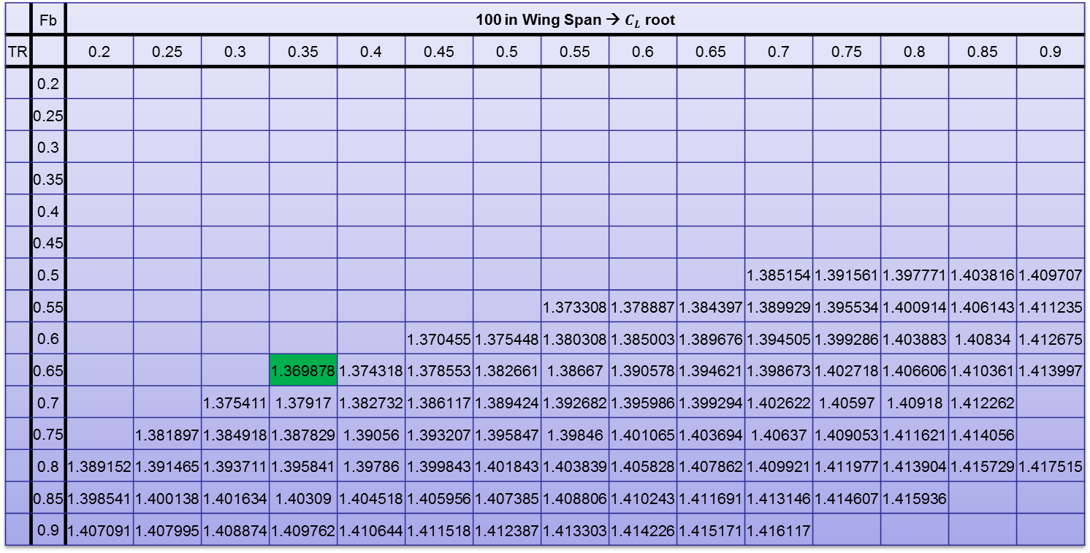
 | Fb | 100 in Wing Span → $C_{L}$ root
TR |  | 0.2 | 0.25 | 0.3 | 0.35 | 0.4 | 0.45 | 0.5 | 0.55 | 0.6 | 0.65 | 0.7 | 0.75 | 0.8 | 0.85 | 0.9
 | 0.2
 | 0.25
 | 0.3
 | 0.35
 | 0.4
 | 0.45
 | 0.5 |  |  |  |  |  |  |  |  |  |  | 1.385154 | 1.391561 | 1.397771 | 1.403816 | 1.409707
 | 0.55 |  |  |  |  |  |  |  | 1.373308 | 1.378887 | 1.384397 | 1.389929 | 1.395534 | 1.400914 | 1.406143 | 1.411235
 | 0.6 |  |  |  |  |  | 1.370455 | 1.375448 | 1.380308 | 1.385003 | 1.389676 | 1.394505 | 1.399286 | 1.403883 | 1.40834 | 1.412675
 | 0.65 |  |  |  | 1.369878 | 1.374318 | 1.378553 | 1.382661 | 1.38667 | 1.390578 | 1.394621 | 1.398673 | 1.402718 | 1.406606 | 1.410361 | 1.413997
 | 0.7 |  |  | 1.375411 | 1.37917 | 1.382732 | 1.386117 | 1.389424 | 1.392682 | 1.395986 | 1.399294 | 1.402622 | 1.40597 | 1.40918 | 1.412262
 | 0.75 |  | 1.381897 | 1.384918 | 1.387829 | 1.39056 | 1.393207 | 1.395847 | 1.39846 | 1.401065 | 1.403694 | 1.40637 | 1.409053 | 1.411621 | 1.414056
 | 0.8 | 1.389152 | 1.391465 | 1.393711 | 1.395841 | 1.39786 | 1.399843 | 1.401843 | 1.403839 | 1.405828 | 1.407862 | 1.409921 | 1.411977 | 1.413904 | 1.415729 | 1.417515
 | 0.85 | 1.398541 | 1.400138 | 1.401634 | 1.40309 | 1.404518 | 1.405956 | 1.407385 | 1.408806 | 1.410243 | 1.411691 | 1.413146 | 1.414607 | 1.415936
 | 0.9 | 1.407091 | 1.407995 | 1.408874 | 1.409762 | 1.410644 | 1.411518 | 1.412387 | 1.413303 | 1.414226 | 1.415171 | 1.416117
Not highest C_{L} however benefits mentioned in previous slide, in my opinion, out weigh the non-maximum C_{L} detriment.

Slide 6
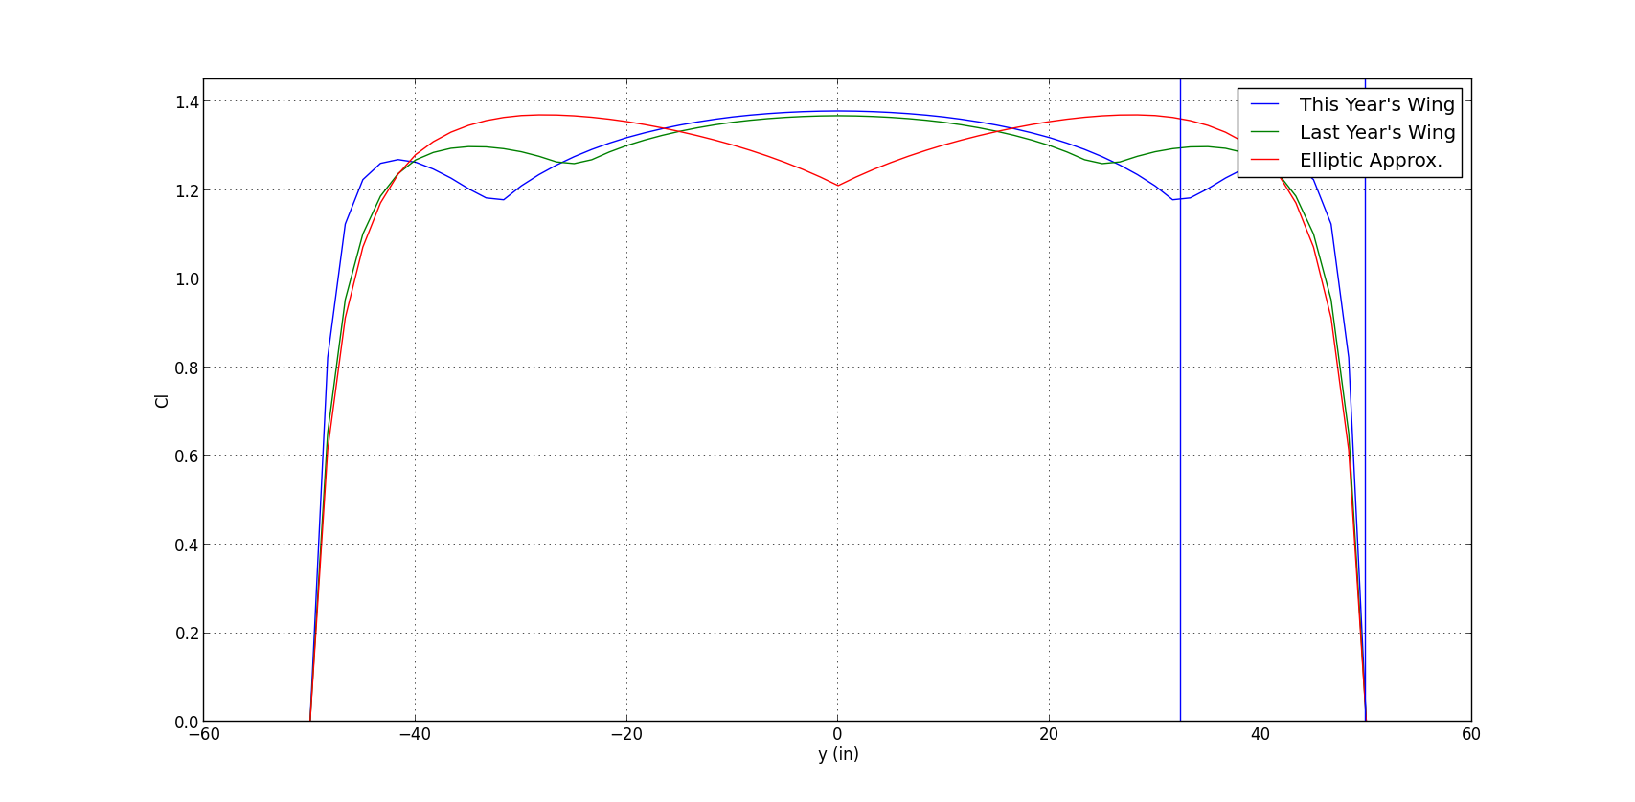
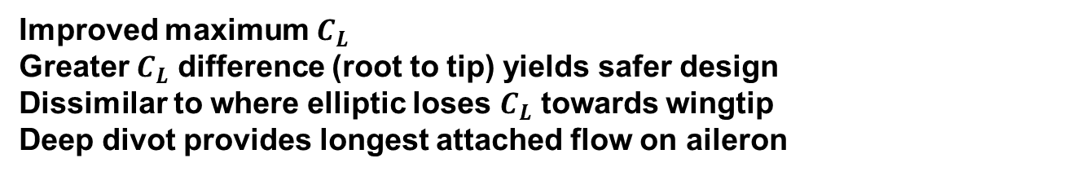
Improved maximum $C_{L}$
Greater $C_{L}$ difference (root to tip) yields safer design
Dissimilar to where elliptic loses $C_{L}$ towards wingtip
Deep divot provides longest attached flow on aileron

Slide 7
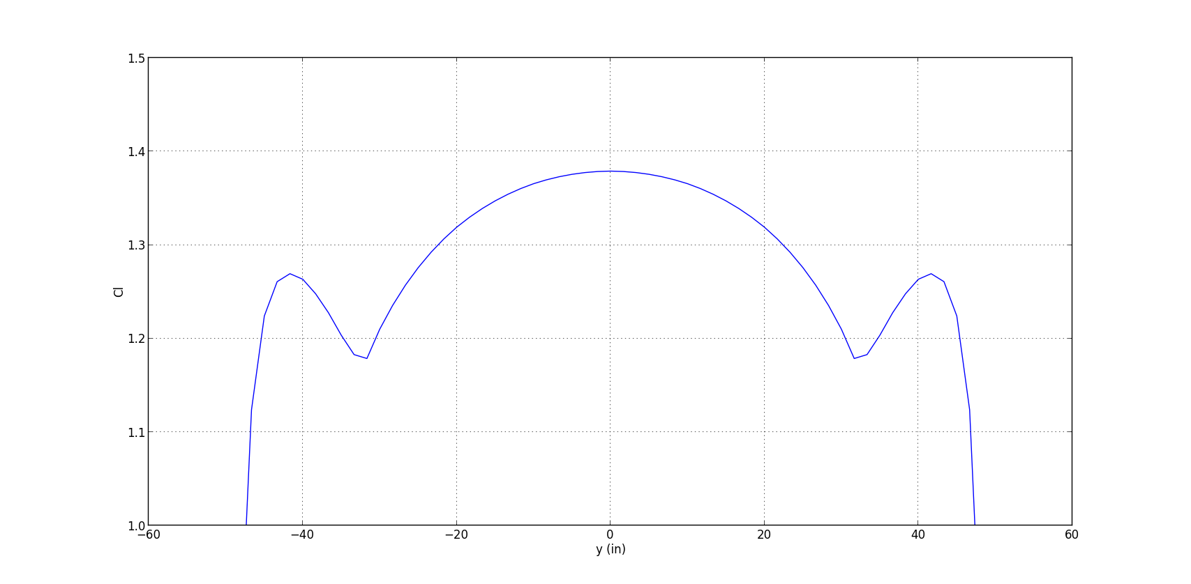
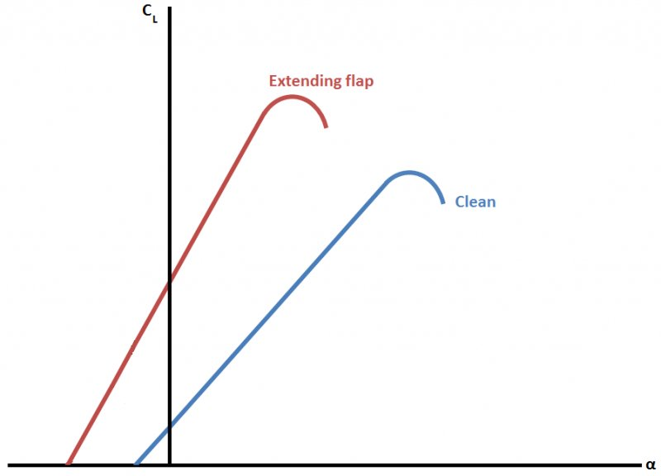
Optimal CL vs. Span Config.
Root
Wing Tip

Slide 8
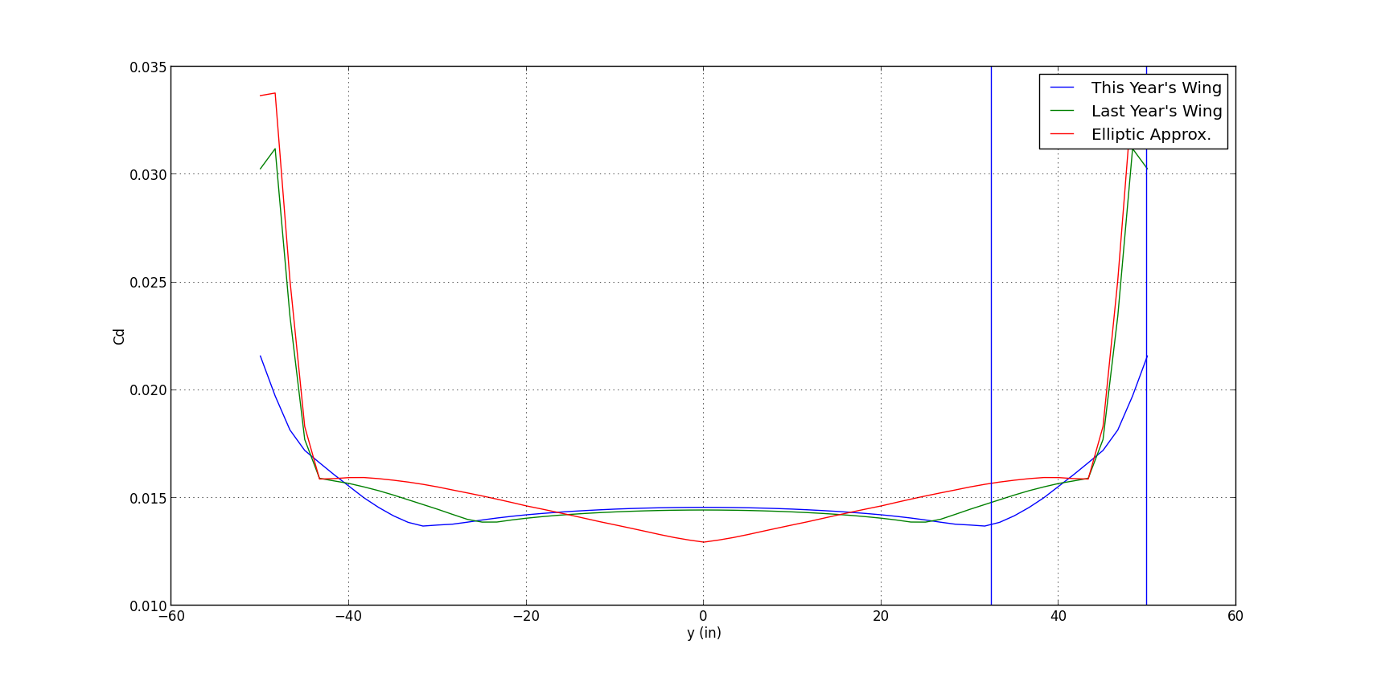
Overall less drag compared with last years
Increased drag at root but minimal towards tips

Slide 9
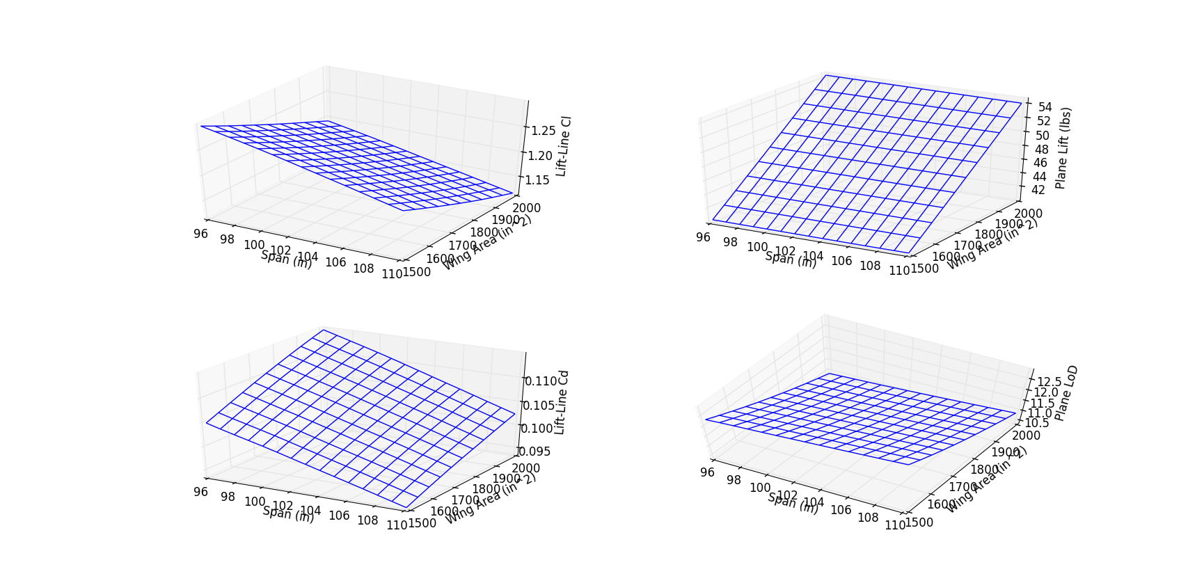
Span vs. Area

Slide 10
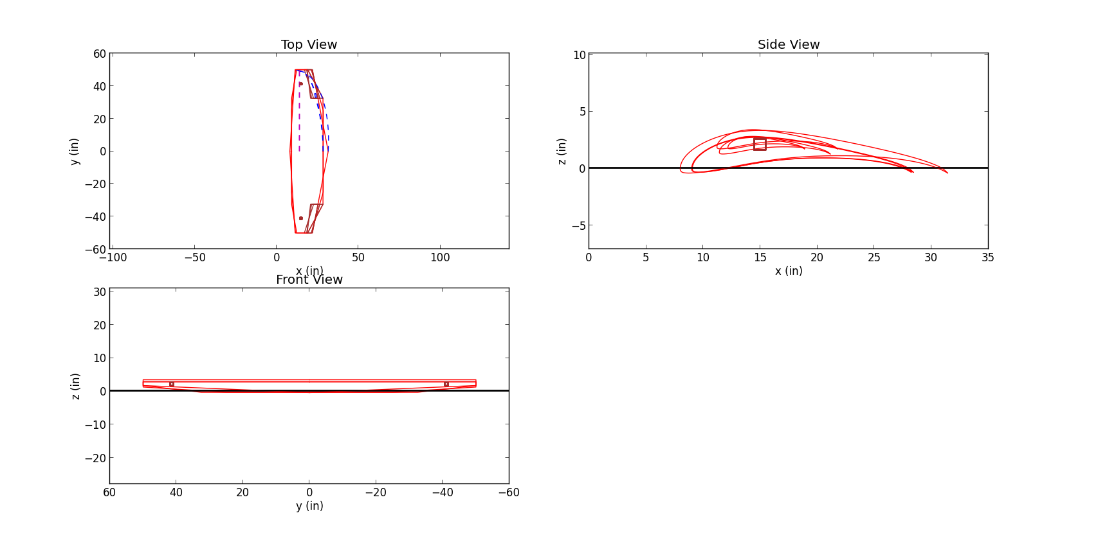
Wing Shape
This year
Last year
Elliptic

Slide 11
This year
Last year
Elliptic

Slide 12
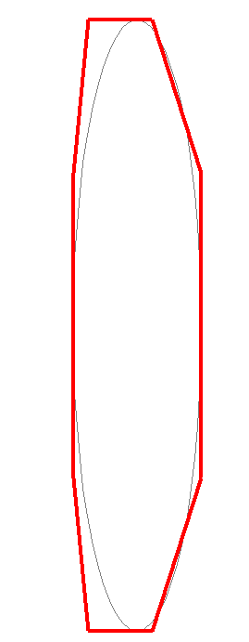
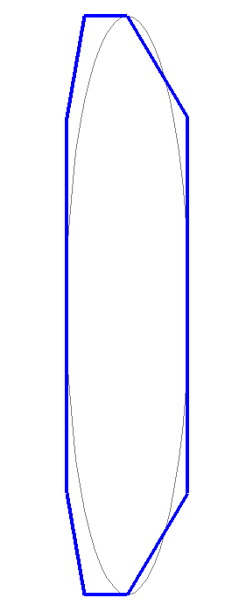
Wing Shape
Figure 1: Last Year’s Model*
Figure 2: This Year’s Model*
*Span = 96”, Root Chord = 20.16” for both wings (last year’s dimensions), approximate shape (unable to calculate area)

Slide 13
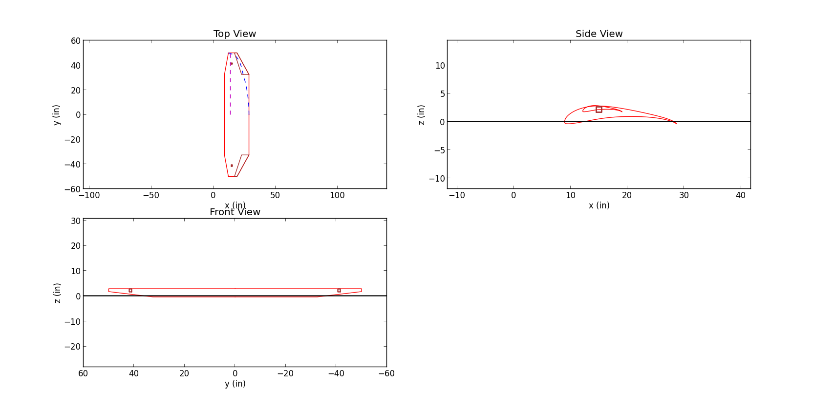
New Wing Design
 | Previous* | New*
Taper Ratio | 0.5 | 0.35
Taper Break | 0.3 | 0.65
Wing Span | 100 in | 100 in
Wing Area | 1750 in² | 1750 in²
Anticipated Lift | ~33.5 lbs | ~47 lbs
*potential error in script, lift values are not guaranteed

Slide 14
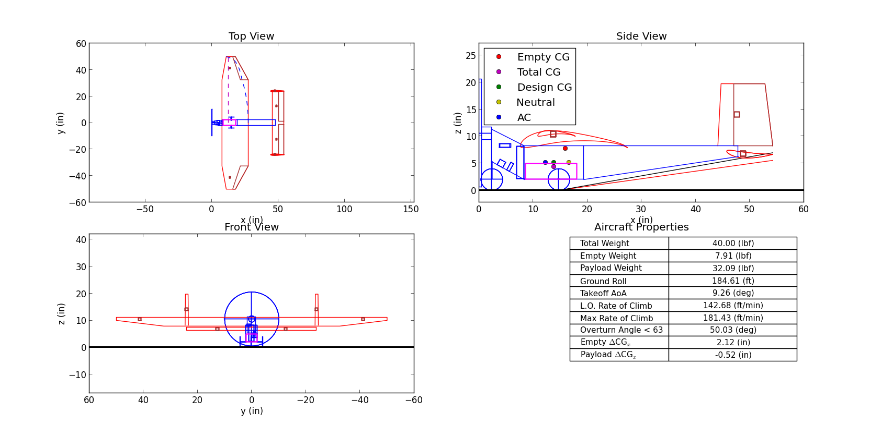
Last Year’s Properties (Our Wing)

Slide 15
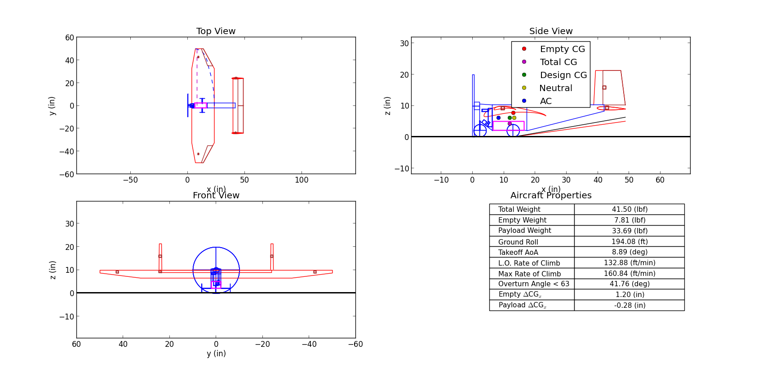
New Aircraft Layout (Our Wing)
 | Last Year | This Year
Total Weight | 40.00 (lbf) | 41.50 (lbf)
Empty Weight | 7.91 (lbf) | 7.81 (lbf)
Payload Weight | 32.09 (lbf) | 33.69 (lbf)
Ground Roll | 184.61 (ft) | 194.08 (ft)
Takeoff AoA | 9.26 (deg) | 8.89 (deg)
L.O. Rate of Climb | 142.68 (ft/min) | 132.88 (ft/min)
Max Rate of Climb | 181.43 (ft/min) | 160.84 (ft/min)
Overturn Angle < 63 | 50.03 (deg) | 41.76 (deg)
Empty Δ CG_{x} | 2.12 (in) | 1.20 (in)
Payload Δ CG_{x} | -0.52 (in) | -0.28 (in)

Slide 16
End

