Slide 1
Aerodynamics Trade Study Sweep, Taper Ratios, and Fb
Andrew Clemens
9/30/14

Slide 2
Purpose
Investigate effects of altering taper ratio, wing sweep, and the location where taper ratio begins.

Slide 3
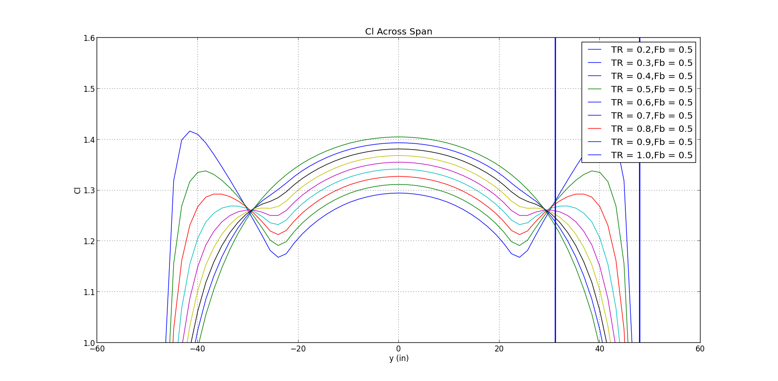
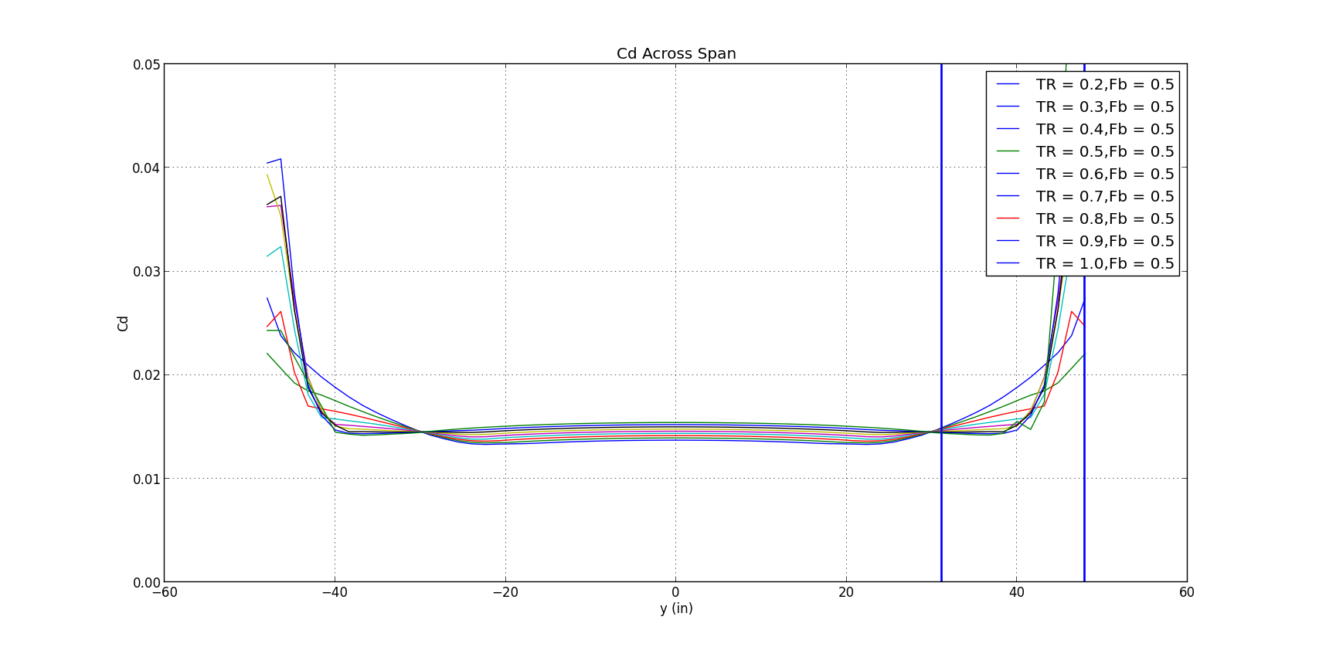
Taper Ratio Sweep
0.2 → 1.0 step size = 0.1
Outside peaks closest to center peak when taper ratio is 0.385
“Pinch” – due to change of rectangular to tapered

Slide 4
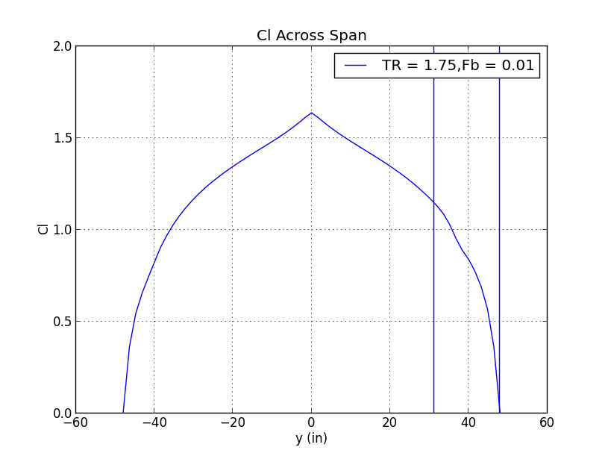
Not recommended

Slide 5
Taper Ratio Starting Location Sweep
0.2 → 0.8 step size = 0.1
Outside peaks closest to center peak when taper ratio is 0.385
Obtain balance between wingtip and root lift

Slide 6
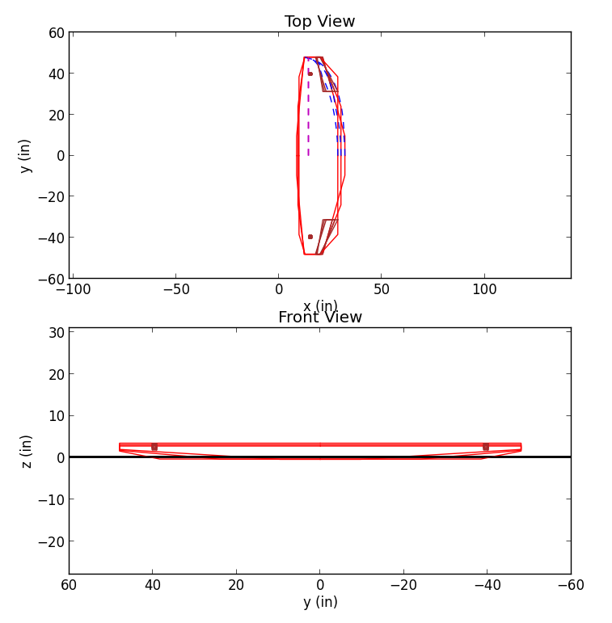
Taper Ratio Starting Location Sweep
Code accounts for TR in X, Y, & Z

Slide 7
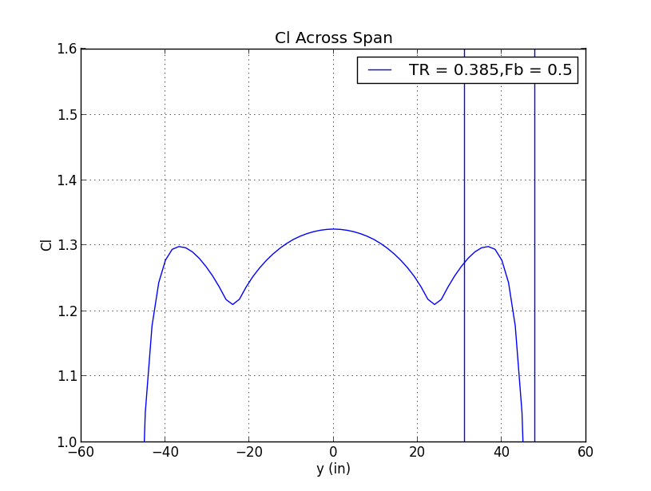
-15°, 0°, 15° Wing Sweep
Sweep does not affect C_{l}

Slide 8
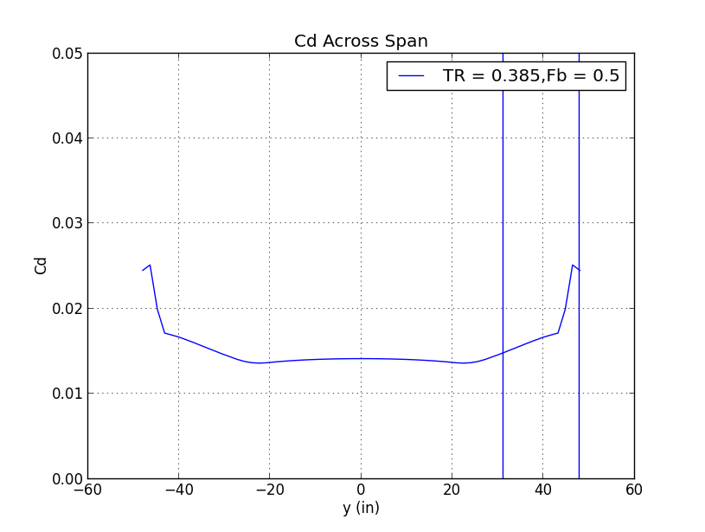
-15°, 0°, 15° Wing Sweep
Sweep does not affect C_{d}

