Slide 1
Design Approach for Aerodynamics and Overall Impact
Jacob Keller
9/30/14

Slide 2
Purpose
Develop design approach that estimates critical performance parameters that have been dictated by various requirements, such as, maximum weight, overall dimensions, available power, and ground roll.
Provides a starting point from which aerodynamics (and others) can begin a detailed analysis (optimization).
Big picture approach where the impact of design changes (estimates) can be investigated/examined.
Design approach compliments the conceptual design phase, where aerodynamics, propulsion, and performance are the major drivers.

Slide 3
Design Approach
1. Requirements
2. First Weight Estimate
3. Critical Performance Parameters
a. Maximum Lift Coefficient
b. Lift-to-Drag Ratio
c. Wing Loading
d. Thrust-to-Weight Ratio
Iterate
4. Configuration Layout (overall shape)
5. Better Weight Estimate
No
6. Performance Analysis
Does the design meet or exceed requirements?
Yes
7. Optimization – Achieve Best Design

Slide 4
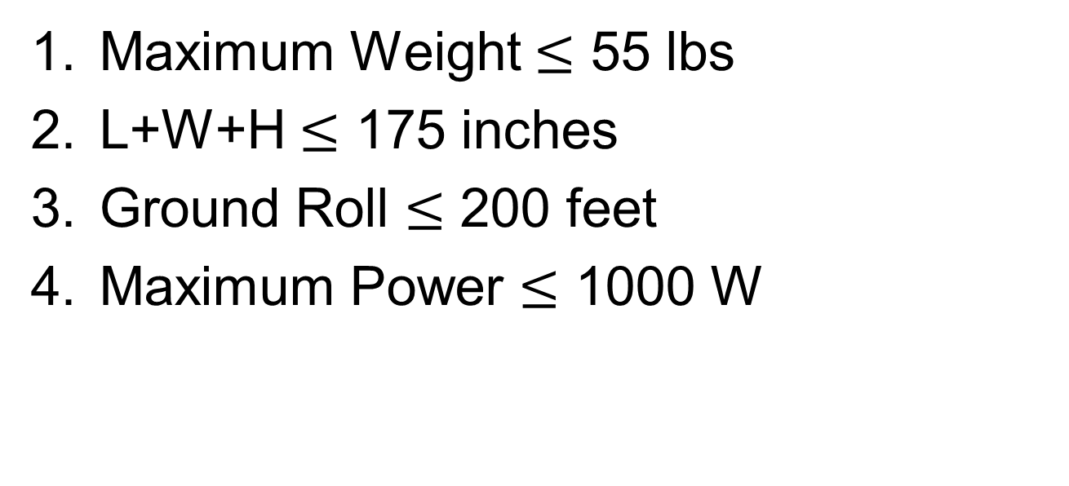
1. Requirements
Maximum Weight $≤$ 55 lbs
L+W+H $≤$ 175 inches
Ground Roll $≤$ 200 feet
Maximum Power $≤$ 1000 W

Slide 5
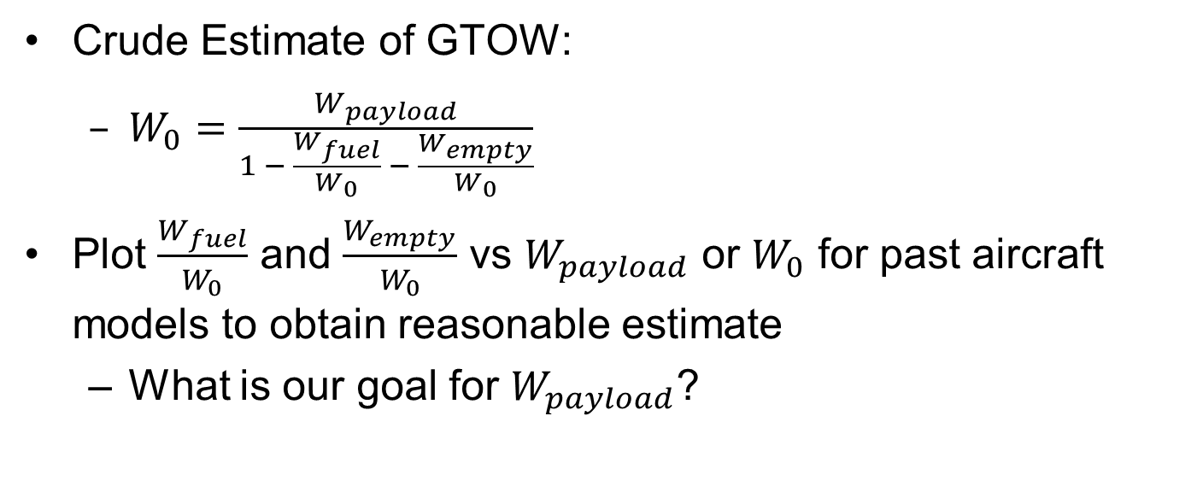
2. First Weight Estimate
Crude Estimate of GTOW:
$W_{0}=\frac{W_{payload}}{1 − \frac{W_{fuel}}{W_{0}} − \frac{W_{empty}}{W_{0}}}$
Plot $\frac{W_{fuel}}{W_{0}}$ and $\frac{W_{empty}}{W_{0}}$ vs $W_{payload}$ or $W_{0}$ for past aircraft models to obtain reasonable estimate
What is our goal for $W_{payload}$?

Slide 6
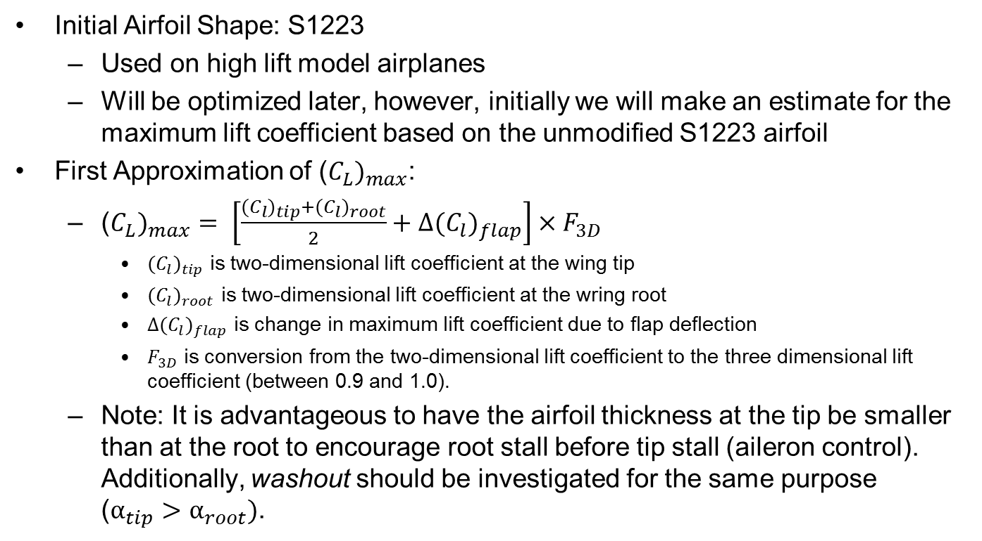
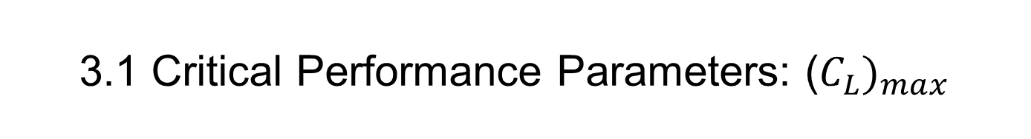
3.1 Critical Performance Parameters: ($C_{L})_{max}$
Initial Airfoil Shape: S1223
Used on high lift model airplanes
Will be optimized later, however, initially we will make an estimate for the maximum lift coefficient based on the unmodified S1223 airfoil
First Approximation of ($C_{L})_{max}$:
($C_{L})_{max}= \left[\frac{{(C}_{l})_{tip}+{(C}_{l})_{root}}{2}+{∆(C}_{l})_{flap}\right]×F_{3D}$
${(C}_{l})_{tip}$ is two-dimensional lift coefficient at the wing tip
${(C}_{l})_{root}$ is two-dimensional lift coefficient at the wring root
${∆(C}_{l})_{flap}$ is change in maximum lift coefficient due to flap deflection
$F_{3D}$ is conversion from the two-dimensional lift coefficient to the three dimensional lift coefficient (between 0.9 and 1.0).
Note: It is advantageous to have the airfoil thickness at the tip be smaller than at the root to encourage root stall before tip stall (aileron control). Additionally, washout should be investigated for the same purpose ($α_{tip}>α_{root})$.

Slide 7
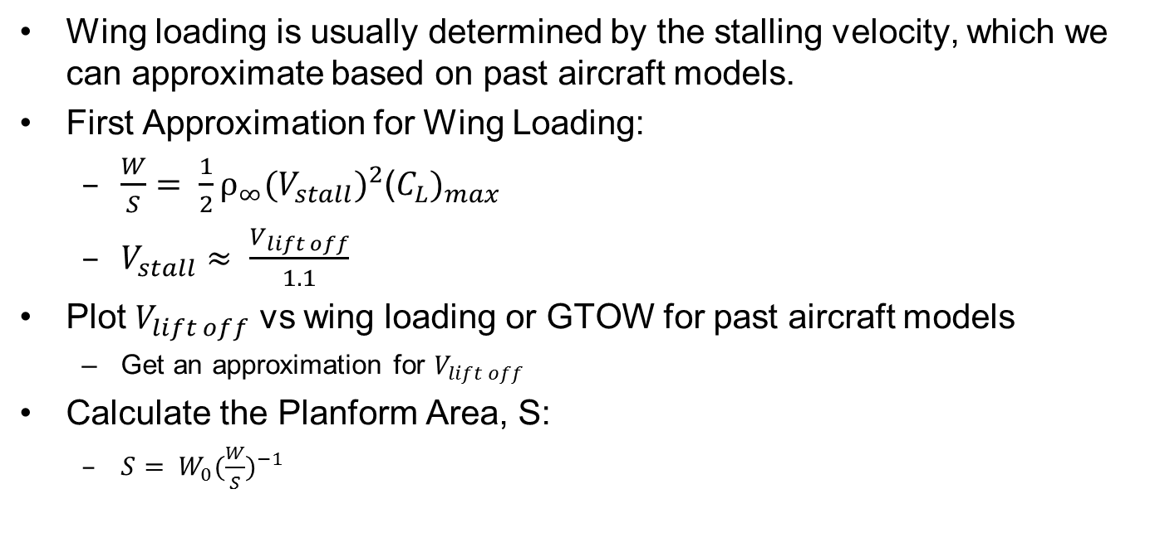
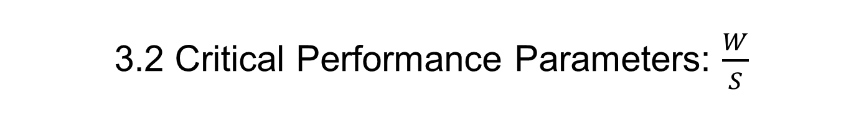
3.2 Critical Performance Parameters: $\frac{W}{S}$
Wing loading is usually determined by the stalling velocity, which we can approximate based on past aircraft models.
First Approximation for Wing Loading:
$\frac{W}{S}= \frac{1}{2}ρ_{∞}(V_{stall})^{2}\text{(}C_{L})_{max}$
$V_{stall}≈ \frac{V_{lift off}}{1.1}$
Plot $V_{lift off}$ vs wing loading or GTOW for past aircraft models
Get an approximation for $V_{lift off}$
Calculate the Planform Area, S:
$S= W_{0}(\frac{W}{S})^{−1}$

Slide 8
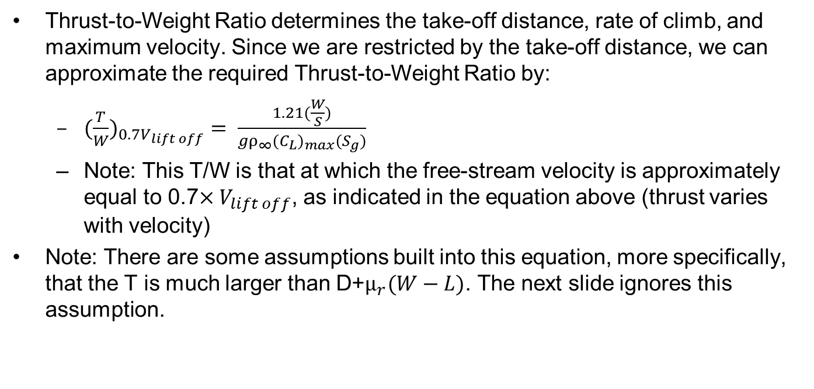
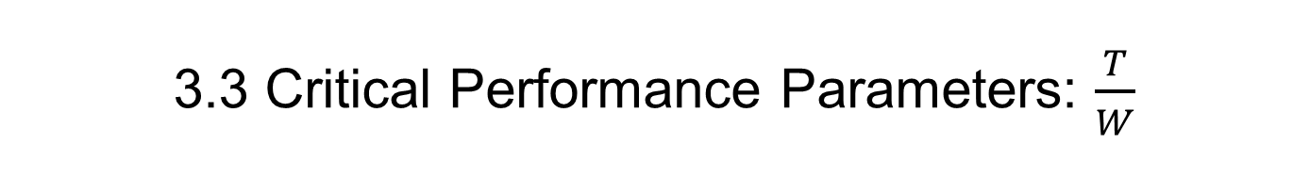
3.3 Critical Performance Parameters: $\frac{T}{W}$
Thrust-to-Weight Ratio determines the take-off distance, rate of climb, and maximum velocity. Since we are restricted by the take-off distance, we can approximate the required Thrust-to-Weight Ratio by:
$(\frac{T}{W})_{0.7V_{lift off}}= \frac{1.21(\frac{W}{S})}{gρ_{∞}(C_{L})_{max}{(S}_{g})}$
Note: This T/W is that at which the free-stream velocity is approximately equal to 0.7$×V_{lift off}$, as indicated in the equation above (thrust varies with velocity)
Note: There are some assumptions built into this equation, more specifically, that the T is much larger than D+$μ_{r}(W−L)$. The next slide ignores this assumption.

Slide 9
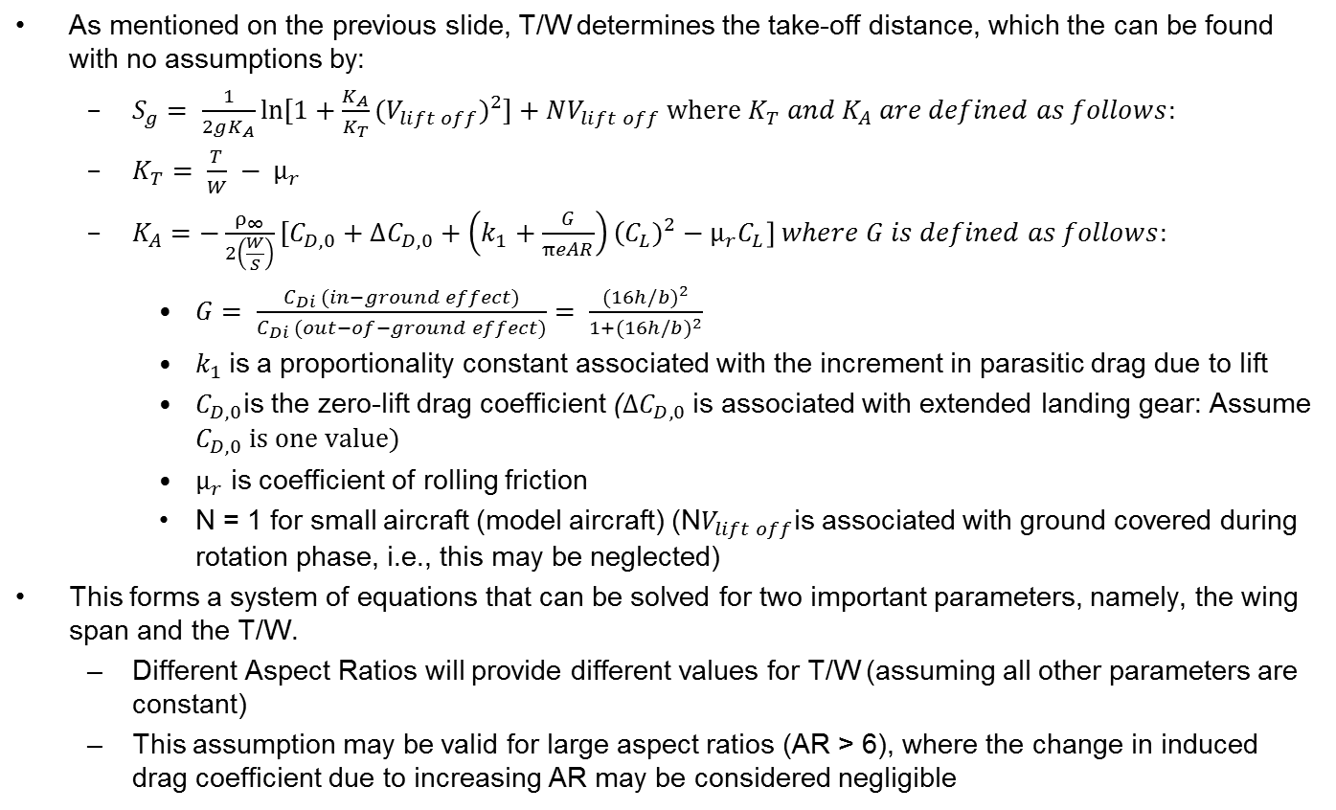
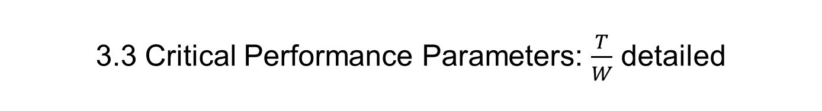
3.3 Critical Performance Parameters: $\frac{T}{W}$ detailed
As mentioned on the previous slide, T/W determines the take-off distance, which the can be found with no assumptions by:
$S_{g}= \frac{1}{2gK_{A}}\ln{[1+\frac{K_{A}}{K_{T}}(V_{lift off})^{2}}]+NV_{lift off} where K_{T} and K_{A} are defined as follows:$
$K_{T}= \frac{T}{W} − μ_{r}$
$K_{A}=−\frac{ρ_{∞}}{2\left(\frac{W}{S}\right)}[C_{D,0}+∆C_{D,0}+\left(k_{1}+\frac{G}{πeAR}\right)\left(C_{L})^{2}−μ_{r}C_{L}\right] where G is defined as follows:$
$G= \frac{C_{Di} (in−ground effect)}{C_{Di} (out−of−ground effect)}= \frac{(16h/b)^{2}}{1+(16h/b)^{2}}$
$k_{1}$is a proportionality constant associated with the increment in parasitic drag due to lift
$C_{D,0}$is the zero-lift drag coefficient ($∆C_{D,0}$ is associated with extended landing gear: Assume $C_{D,0} is one value)$
$μ_{r}$ is coefficient of rolling friction
N = 1 for small aircraft (model aircraft) (N$V_{lift off}$is associated with ground covered during rotation phase, i.e., this may be neglected)
This forms a system of equations that can be solved for two important parameters, namely, the wing span and the T/W.
Different Aspect Ratios will provide different values for T/W (assuming all other parameters are constant)
This assumption may be valid for large aspect ratios (AR > 6), where the change in induced drag coefficient due to increasing AR may be considered negligible

Slide 10
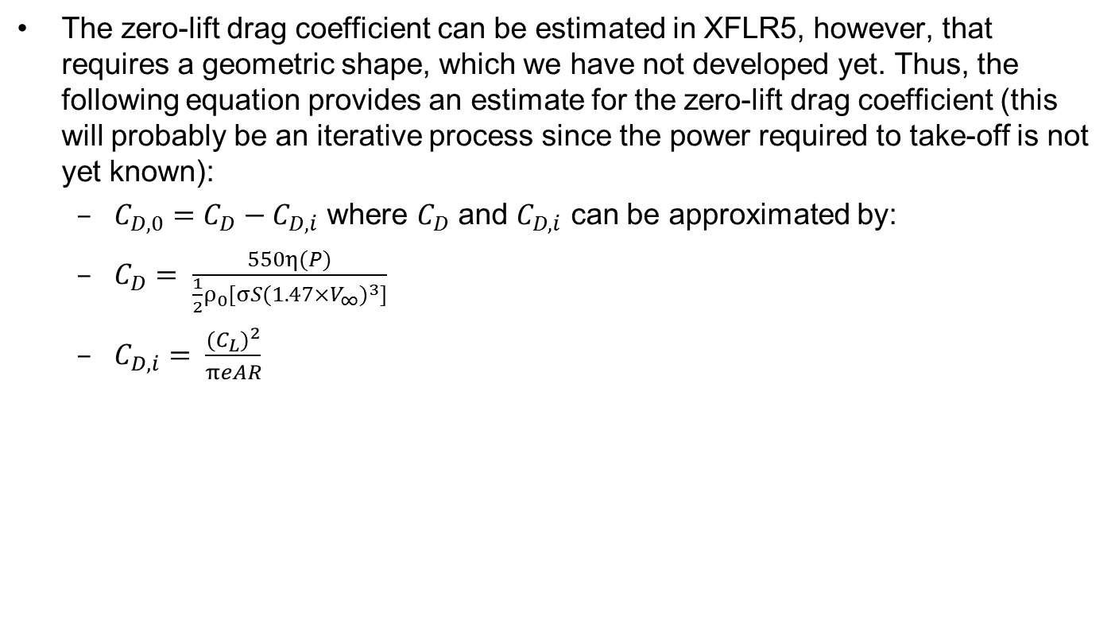
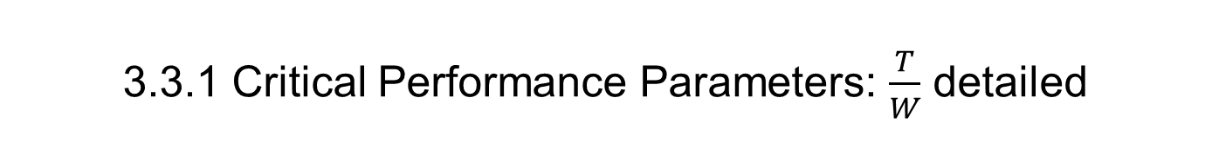
3.3.1 Critical Performance Parameters: $\frac{T}{W}$ detailed
The zero-lift drag coefficient can be estimated in XFLR5, however, that requires a geometric shape, which we have not developed yet. Thus, the following equation provides an estimate for the zero-lift drag coefficient (this will probably be an iterative process since the power required to take-off is not yet known):
$C_{D,0}=C_{D}−C_{D,i}$ where $C_{D}$ and $C_{D,i}$ can be approximated by:
$C_{D}= \frac{550η(P)}{\frac{1}{2}ρ_{0}[σS(1.47×V_{∞})^{3}]}$
$C_{D,i}= \frac{(C_{L})^{2}}{πeAR}$

Slide 11
4. Configuration Layout (Aerodynamics)
Wing:
Geometric twist
Taper ratio
Variation in airfoil thickness
High-wing, mid-wing, low-wing
Fuselage:
Smooth changes in cross-sectional areas

Slide 12
4. Configuration Layout (General)
Stability and Control:
Iterative process with aerodynamics group in determining if enough length is available for stability.
Structures:
Are the suggestions by aerodynamics achievable (structurally safe, possible to build, etc.)?

Slide 13
5. Better Weight Estimate
Use all the above information to calculate the approximate GTOW (estimate weight of wings, motor, fuselage, landing gear, etc.)
Use all the above information to estimate the center of gravity

Slide 14
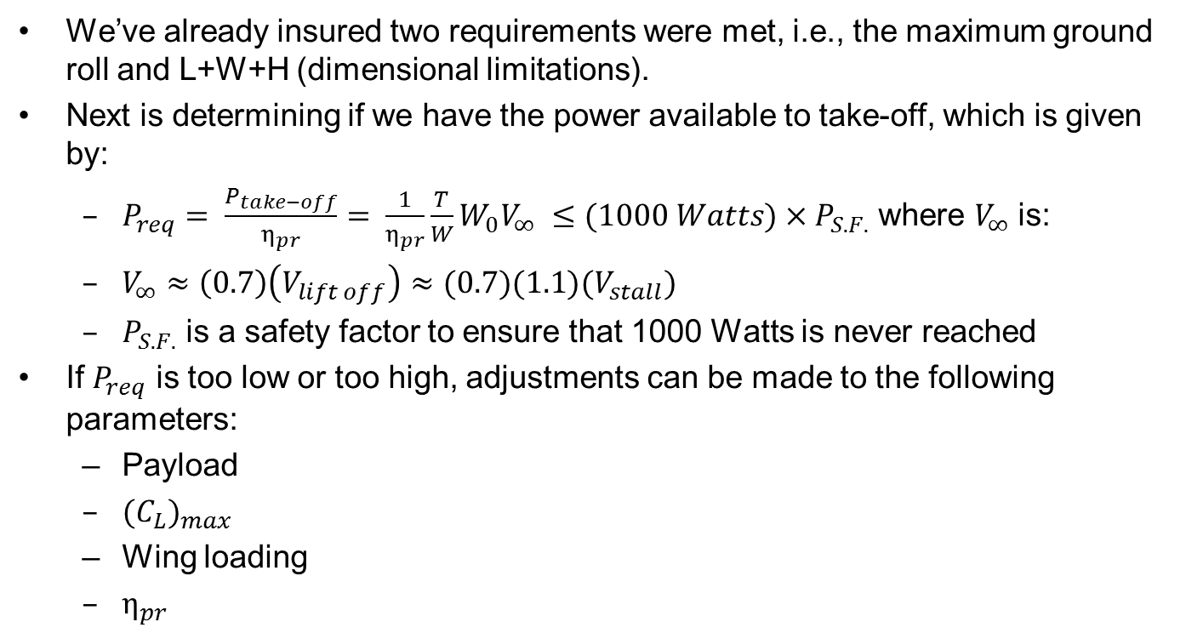
6. Performance Analysis
We’ve already insured two requirements were met, i.e., the maximum ground roll and L+W+H (dimensional limitations).
Next is determining if we have the power available to take-off, which is given by:
$P_{req}= \frac{P_{take−off}}{η_{pr}}= \frac{1}{η_{pr}}\frac{T}{W}W_{0}V_{∞} ≤(1000 Watts)×P_{S.F.}$ where $V_{∞}$ is:
$V_{∞}≈\left(0.7\right)\left(V_{lift off}\right)≈(0.7)(1.1)(V_{stall})$
$P_{S.F.}$ is a safety factor to ensure that 1000 Watts is never reached
If $P_{req}$ is too low or too high, adjustments can be made to the following parameters:
Payload
$(C_{L})_{max}$
Wing loading
$η_{pr}$

Slide 15
7. Optimization (Aerodynamics)
Optimize Aerodynamics Performance
Wing, airfoil, and fuselage

Slide 16
Aerodynamics Trade Study Sweep, Taper Ratios, and Fb
Andrew Clemens
9/30/14

Slide 17
Purpose
Investigate effects of altering taper ratio, wing sweep, and the location where taper ratio begins.

Slide 18
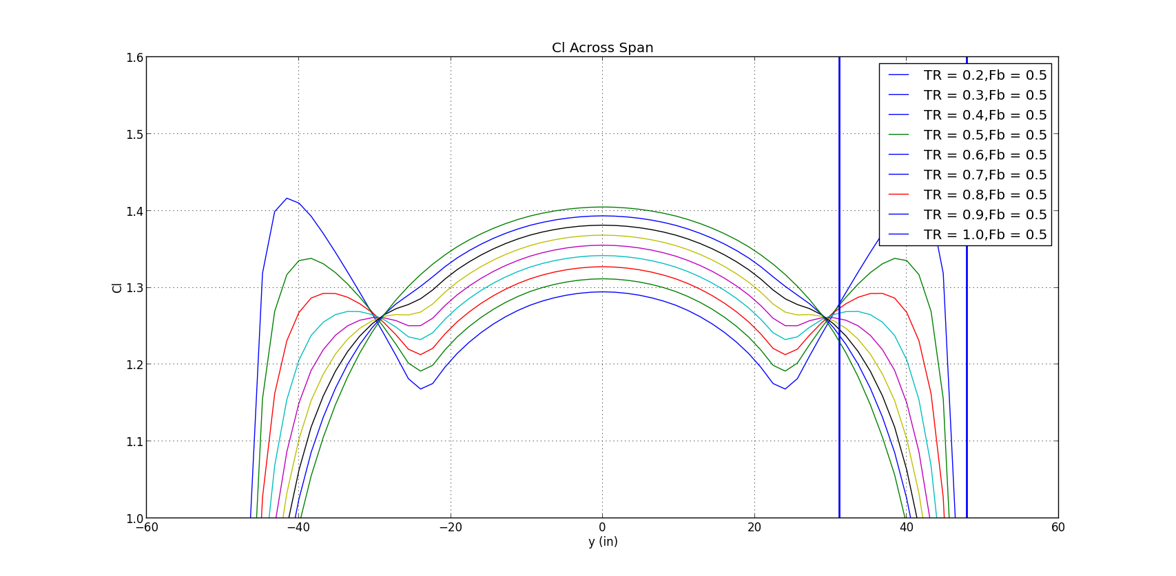
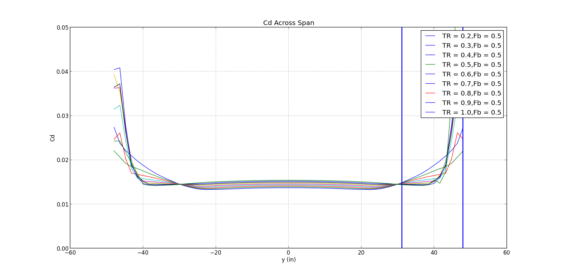
Taper Ratio Sweep
0.2 → 1.0 step size = 0.1
Outside peaks closest to center peak when taper ratio is 0.385
“Pinch” – due to change of rectangular to tapered

Slide 19
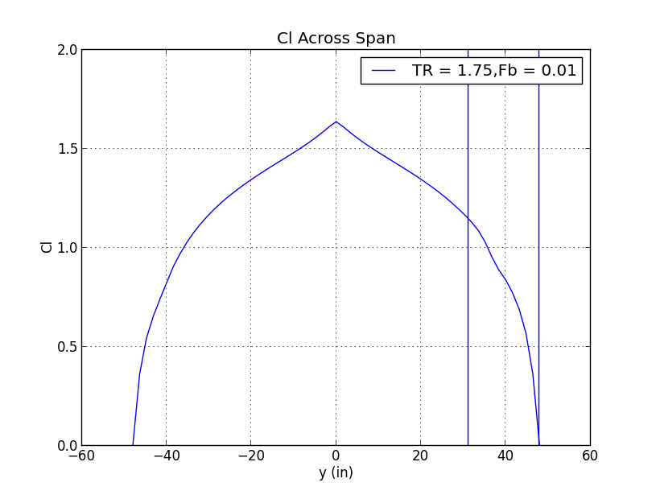
Not recommended

Slide 20
Taper Ratio Starting Location Sweep
0.2 → 0.8 step size = 0.1
Outside peaks closest to center peak when taper ratio is 0.385
Obtain balance between wingtip and root lift

Slide 21
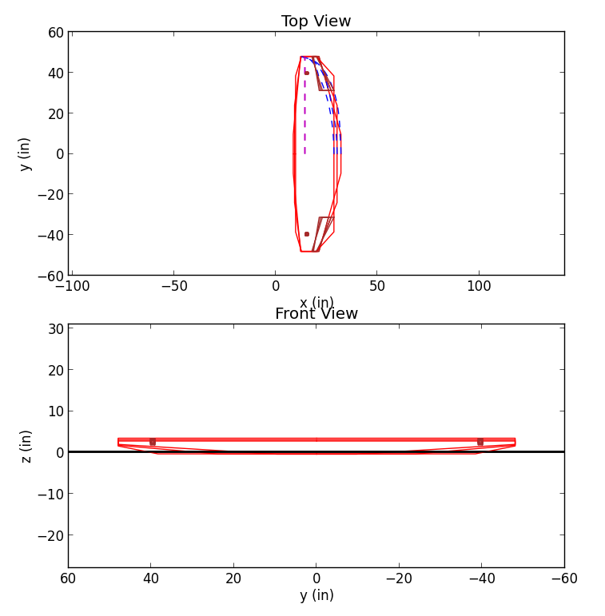
Taper Ratio Starting Location Sweep
Code accounts for TR in X, Y, & Z

Slide 22
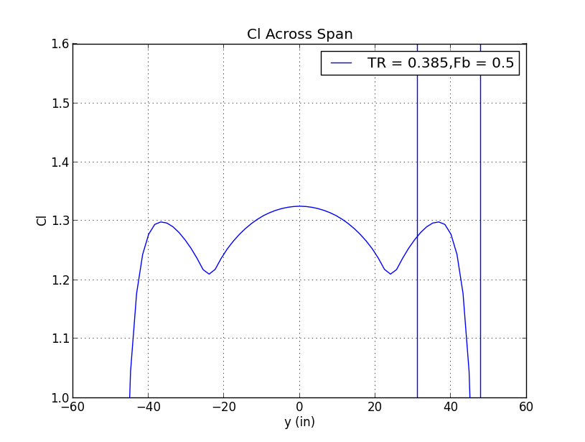
-15°, 0°, 15° Wing Sweep
Sweep does not affect C_{l}

Slide 23
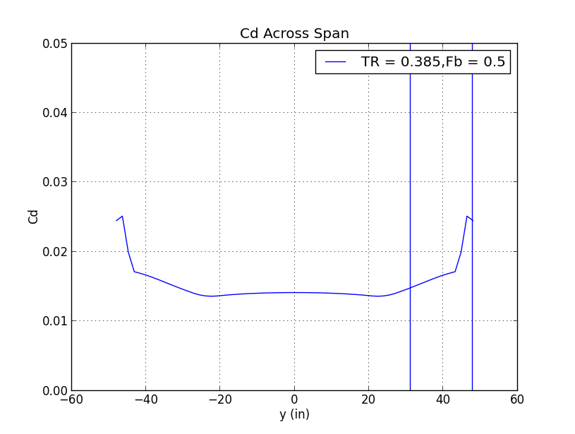
-15°, 0°, 15° Wing Sweep
Sweep does not affect C_{d}

Slide 24
Airfoil Selection

Slide 25
Airfoil Requirements
High lift (CL > 2)
Intended for low Reynolds numbers
Competition Re ~405000

Slide 26
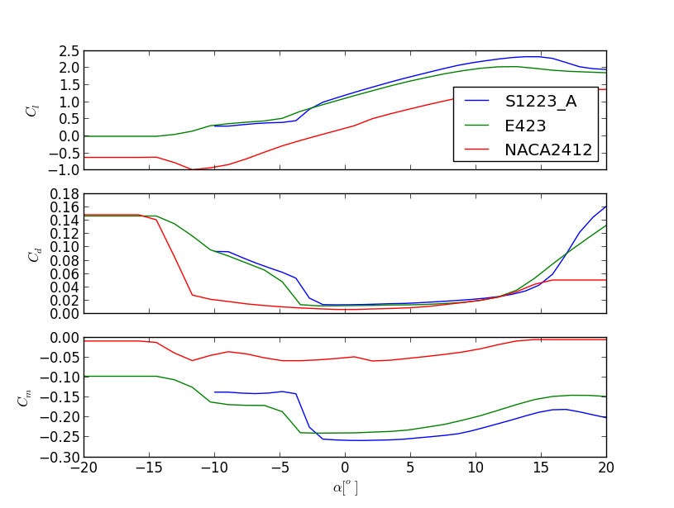
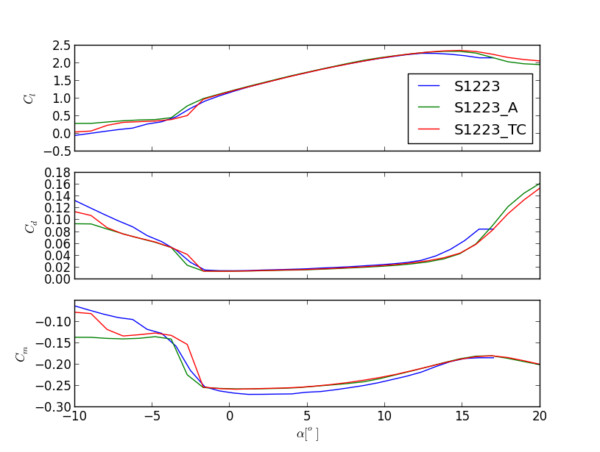
Airfoil Comparison

Slide 27
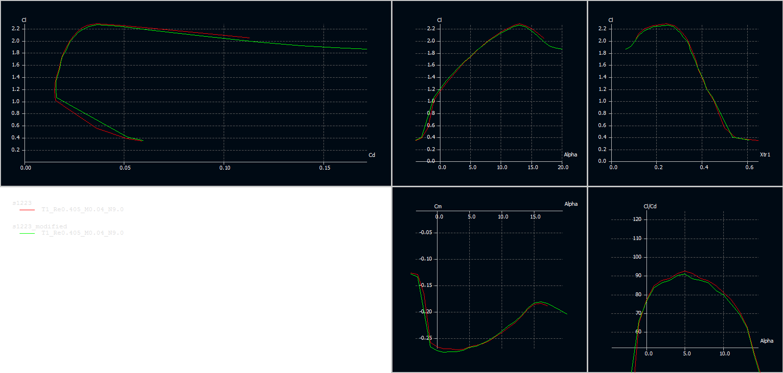
Attemped Reoptimization

Slide 28
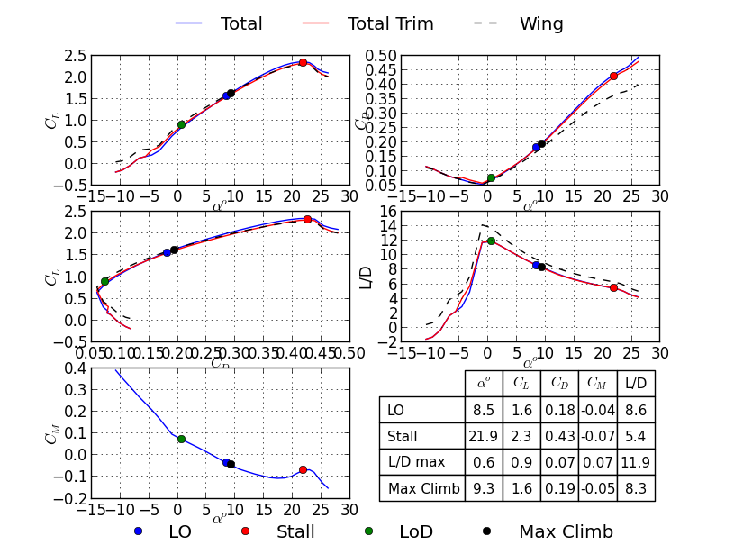
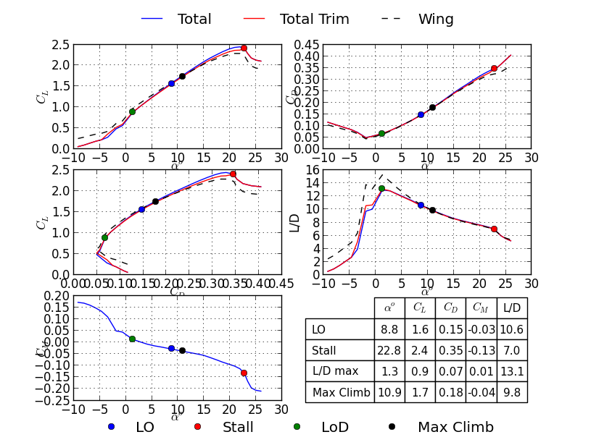
Polars for Aircraft Redesign

