Slide 1
Motor Comparison
APC 18 x 8E

Slide 2
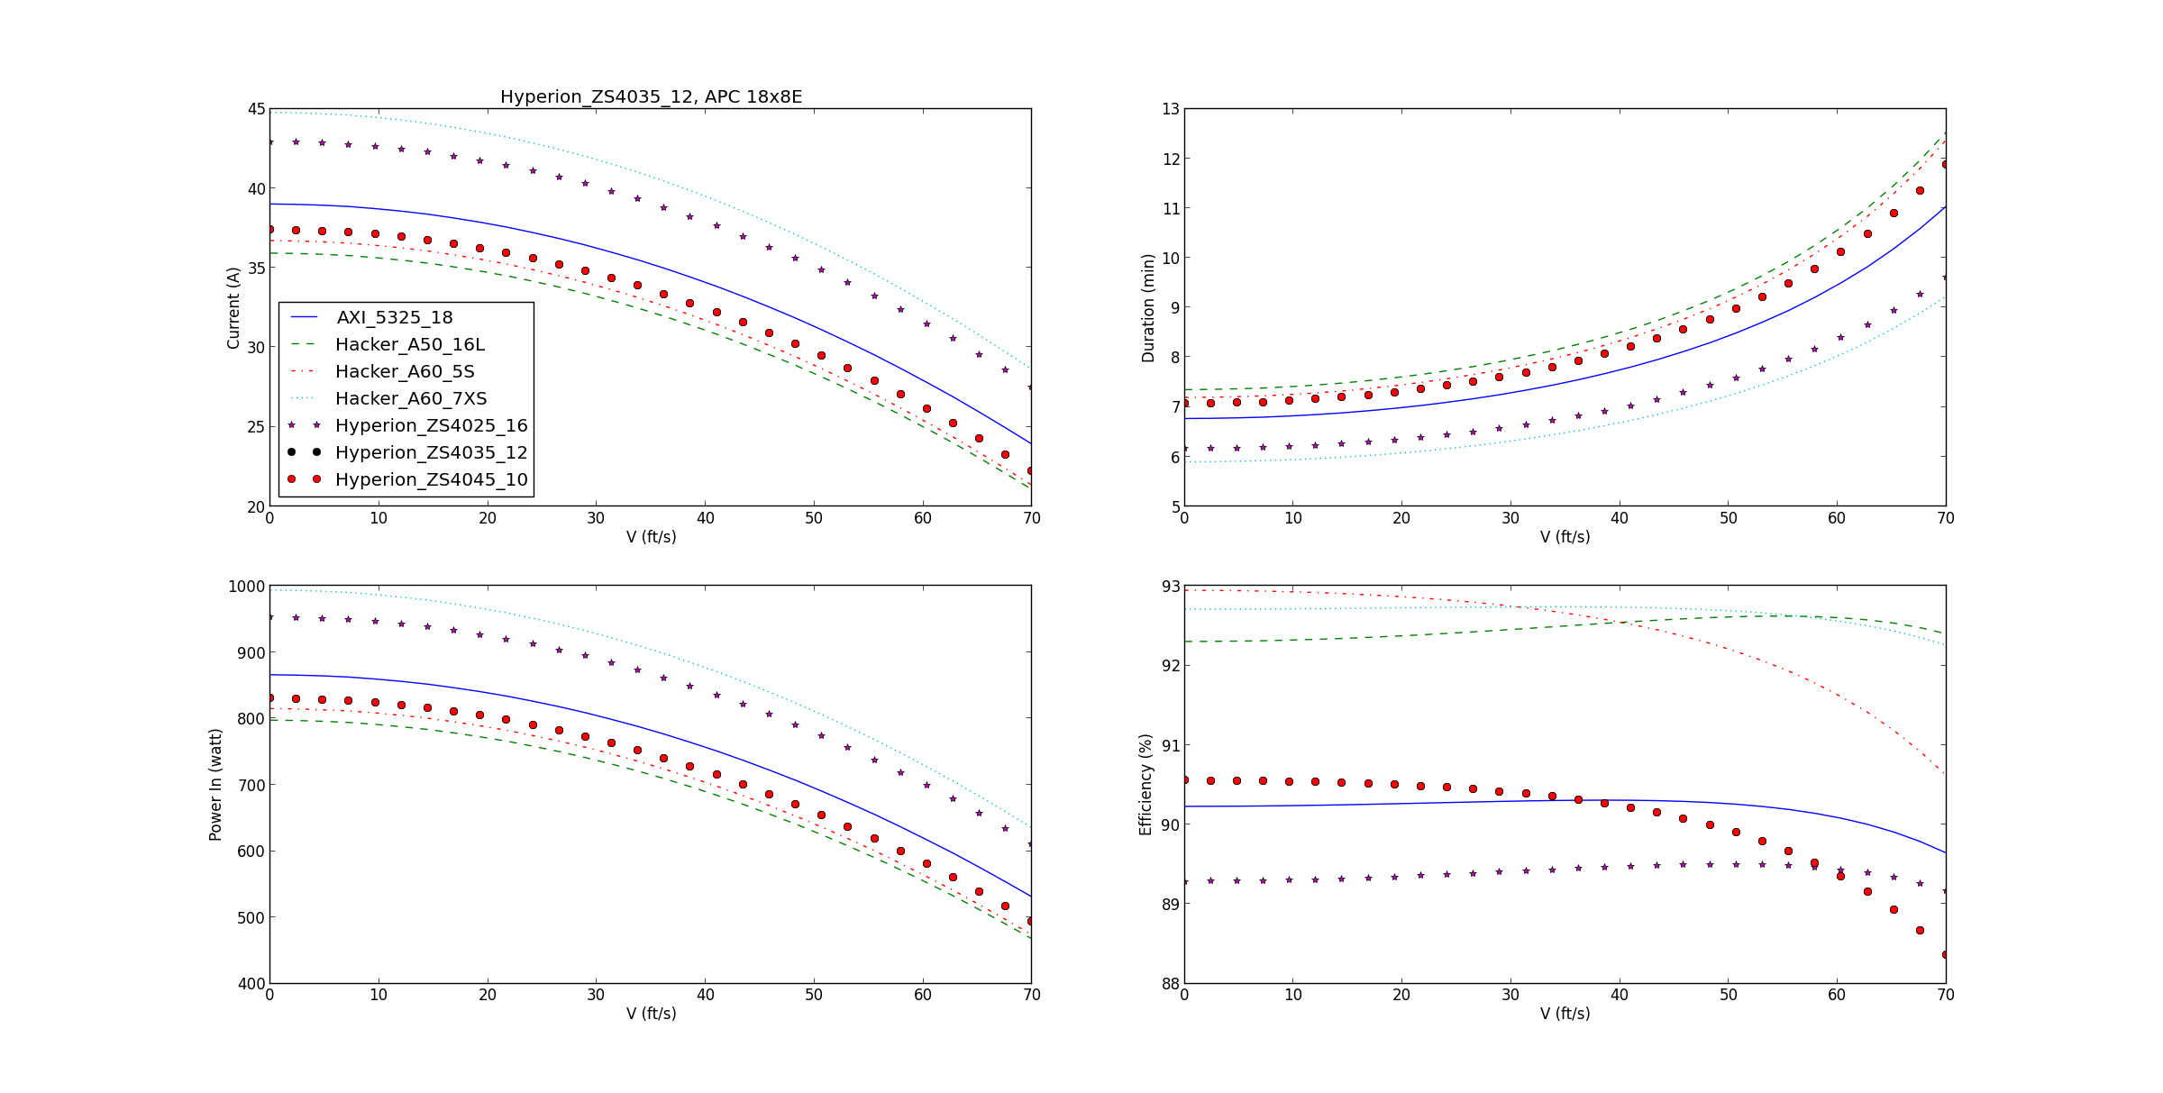
Engine Power Draw
4 min minimum requirement
Acceptable
Ideal Power Draw
Typical VLO Range
Notes:
Where did the 4 minute minimum requirement come from? Past data? Santiago?

Slide 3
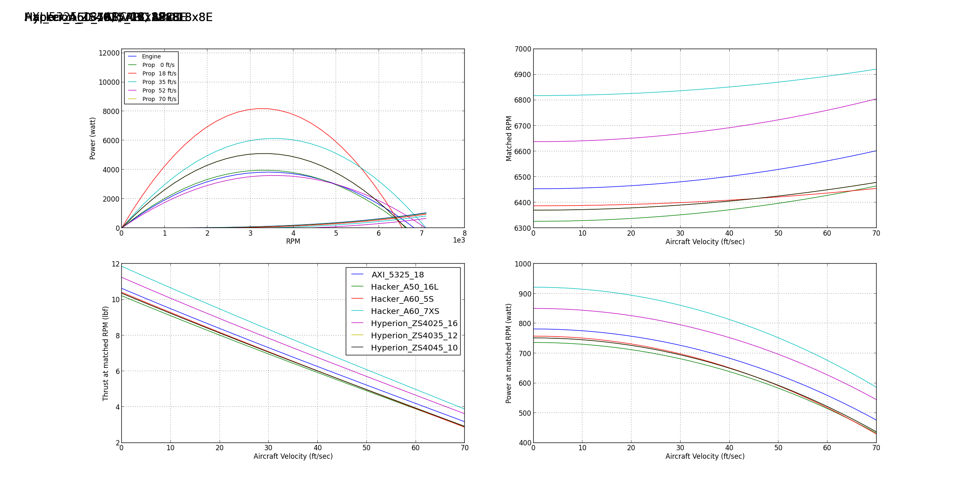
Engine Thrust
Relatively large split in thrust value between 7XS and 5S
Notes:
How does this Hacker A60_7XS compare to last year’s selected motor and prop combination?

Slide 4
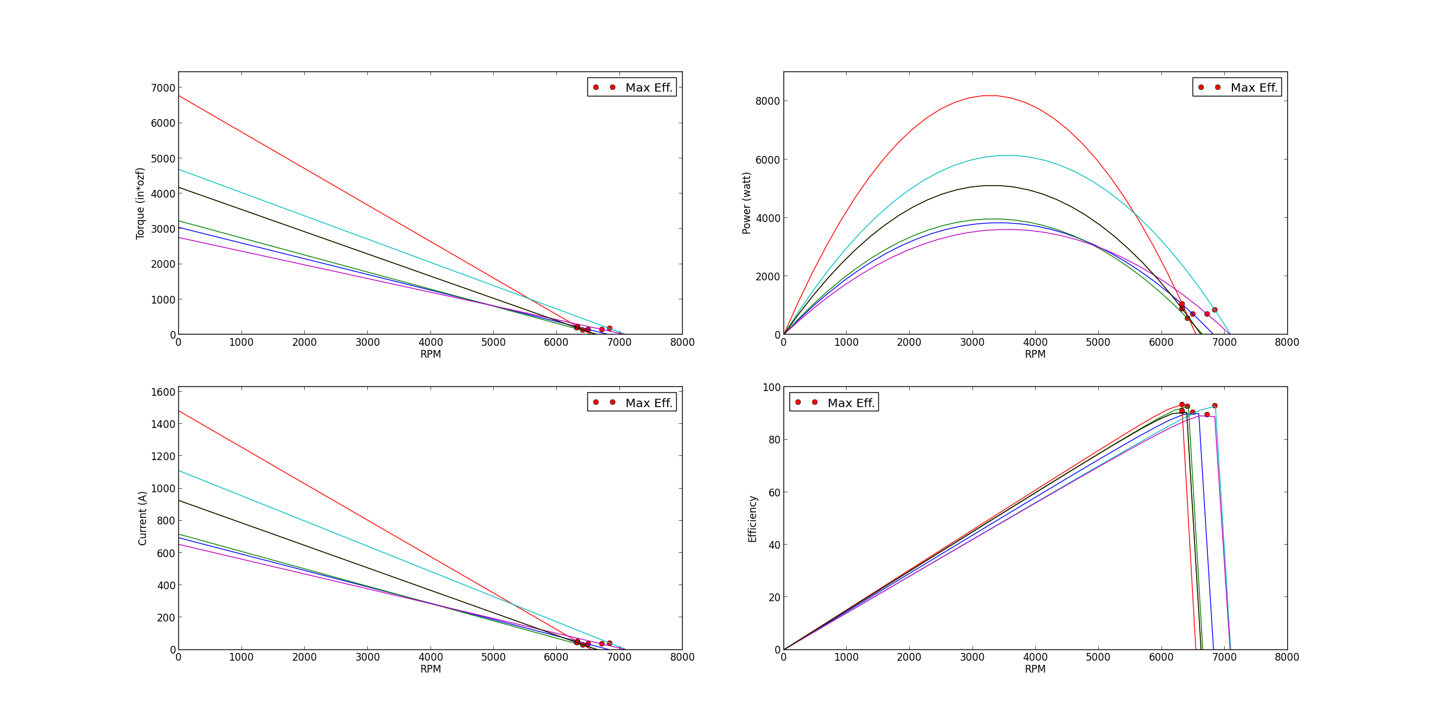
Torque and Efficiency
Hacker A60 5S
Hacker A60 7XS
Hacker A60 5S
-.-.-
Hacker A60 7XS …..
From Slide 1

Slide 5
18x8E Summary
Hacker A60 7XS
Highest Thrust – 12 lb_{f}
Lower Torque – 4700 in*oz_{f}
Power draw near 1000 W
480 grams
Hacker A60 5S
Lower Thrust – 10 lb_{f}
Higher Torque – 6900 in*oz_{f}
Power draw near 825 W
595 grams

