Slide 1
PokeAPI v2
Barry Hu & Aesa Kamar

Slide 2
Restful API's
Creating a new RESTful API
REpresentational State Transfer
Application-Program Interface
Server
"Stateless"
Server
i
o

Slide 3
Our Project
Making MVC for pokemon, abilities, and moves
Making a robust databse
Currently mySQL, moving to PG
Getting and organizing data
Scraping, filtering, compiling
Views
Models
Controllers
Routes
Client

Slide 4
Demo

Slide 5
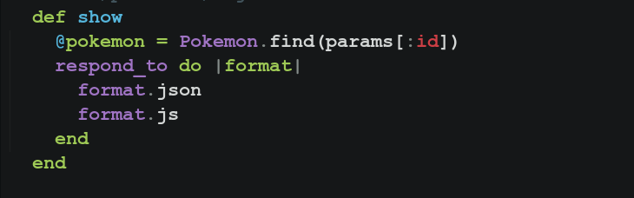
Ruby on Rails is magic
Blocks, Procs, and Lambdas
Anonymous Function Templating
Best of Functional and high level Object Oriented Programming

Slide 6
Another Demo
Not in Ruby...
But not in Haskell!
And stillshows why Ruby is pretty cool

