Slide 1
Why Code?

Slide 2
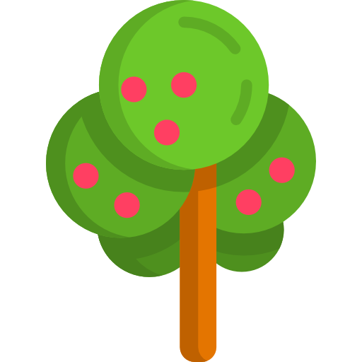
How do I describe things?
Tree,
Leafy,
Green,
Has red fruit

Slide 3
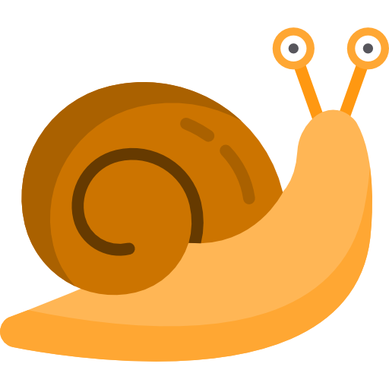
How do I describe things?
Snail,
Curly,
Slow,
Slimy
These things which describe an object are called data

Slide 4
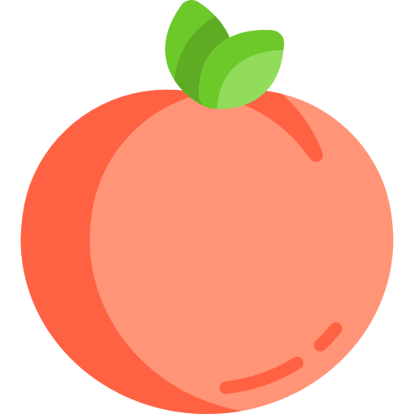










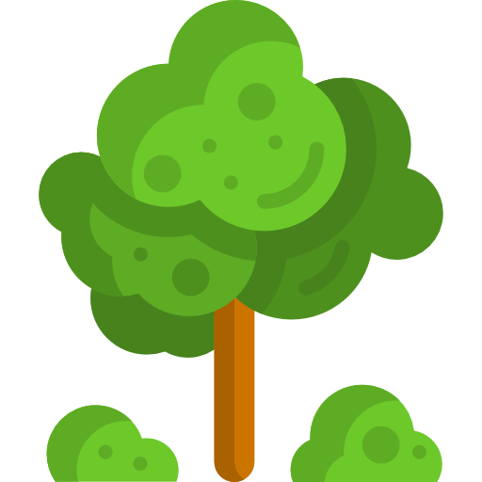



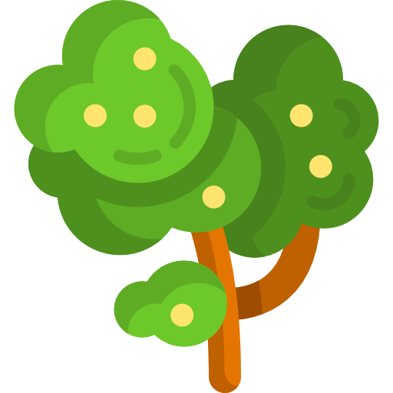

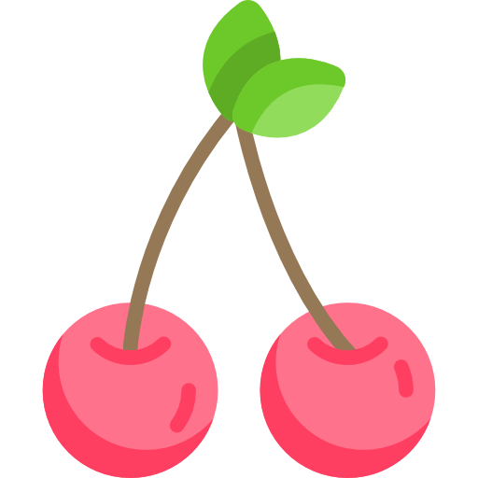

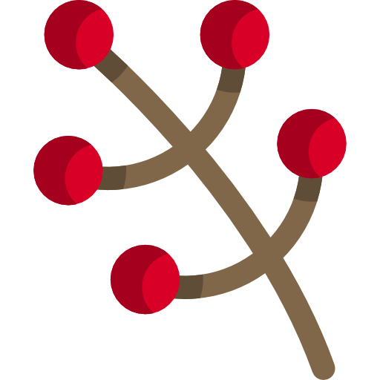



Can I ask questions about what I’ve seen?
Which trees have fruit?
Which things are edible?
Find me all the yellow things

Slide 5
Giving data some structure
this_thing = {
name: “Apple Tree”,
height: 18.6,
has_fruits: true,
color: “red”
}

Slide 6

Why does data need structure?
this_thing = {
name: “Apple Tree”,
height: 18.6,
has_fruits: true,
color: “green”
}
How to find trees with fruit => {
look at all the trees
check is the ’has_fruit’ property is true
cross out ones with no fruit
take the remaining trees
}
this_other_thing = {
name: “Pear Tree”,
height: 22,
has_fruits: true,
color: “green”
}
How to find the tallest tree => {
look at all the trees
look at the ‘height’ property
remember the tallest one
cross out ones that are less than it
take the remaining tree
}
this_last_thing = {
name: “Regular Tree”,
height: 16.112,
has_fruits: false,
color: “green”
}

Slide 7
Restrictions on data to keep things simple
We use the keyword
let to tell the computer we’re making some data
Data can fall into 6 categories
Boolean : true, false
Number : 1.7, 93
String : “Hello” , ’single or double quotes!’
Array : [1, 2, 3], [”one”, “two”, “three”]
Object : {
property: ’value’
properties: [“can be”, “any other thing”]
}
Function: (input) => input + 1

Slide 8
Lets jump into it!
We’ll be using a popular language called JavaScript and a tool called VSCode to help guide us along

