Slide 1
PROPOSED EXACT MODEL
M4G — Online Joint OA–PS–TA Order-Splitting Model
Minimise distance per unit of order progress, re-solved every epoch.
Two measured prices. Zero tuned constants.
Notes:
M4G decides order assignment, pod selection and task allocation in one MILP, once per decision epoch.

Slide 2
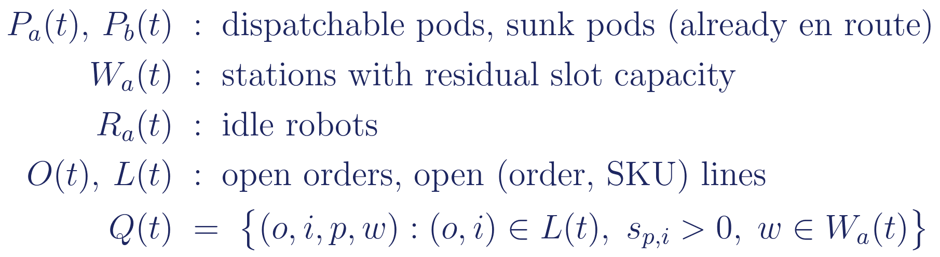
THE DECISION
One solve decides all three layers
OA
PS
TA
Which orders occupy which station slots
Which pods are fetched, and to which station
Which robot is assigned to fetch each pod
Sequential OA → PS → TA cannot price a pod trip against the work it unlocks. M4G solves them jointly, so travel and progress are traded off inside one objective.
Notes:
Q(t) is filtered by stock: pod-SKU pairs with no inventory never become variables. That is what keeps the model tractable.

Slide 3
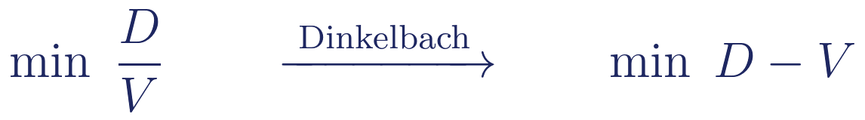
OBJECTIVE FUNCTION
Objective: distance per unit of progress
D is the travel this decision creates, in metres — charged only for pods dispatched now; sunk trips are already paid for.
V is the progress this decision is credited with, priced in metres by the two measured rates.
The ratio is scale-free: it is the marginal cost of one unit of progress, so it stays comparable as the fleet, backlog and congestion change.
Dinkelbach turns the fractional programme into a sequence of linear ones — no approximation, the fixed point is the exact minimiser.
Notes:
Say metres per line closed. Do not say cost function; the objective has no monetary units.

Slide 4
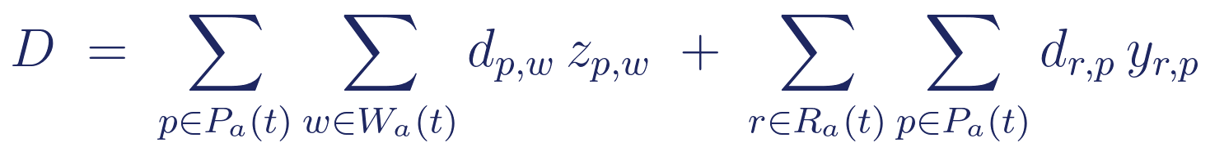
OBJECTIVE FUNCTION · NUMERATOR
D — travel this decision creates
Pod → station leg
Robot → pod leg
Both sums range over P_a(t) only — pods already en route belong to P_b(t) and carry no charge, because that distance is sunk.
This is what makes the model prefer to keep drawing from a pod that is already on its way: extra units from it are free.
Distance is a validated proxy for mechanical energy: 80.65 ± 1.32 J/m within a fixed physical setting (cv 1.6%).
Notes:
The sunk/new split is structural, carried by the P_a subscript. No separate sunk-cost price is needed.

Slide 5
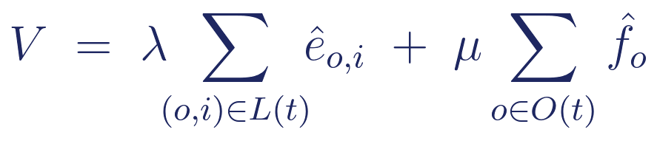
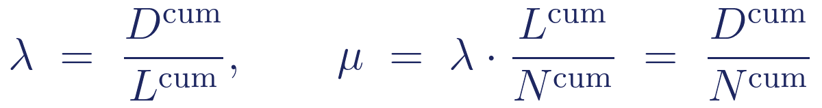
OBJECTIVE FUNCTION · DENOMINATOR
V — progress, converted to metres
The first term counts the lines the valuation layer expects to close, priced at λ (metres per line); the second counts the orders it expects to complete in full, priced at μ (metres per order).
Both are therefore in metres, which is what makes D − V a meaningful difference.
Both prices are running measurements of the system's own history — nothing is tuned. Completion is rewarded on top of the lines it contains, so the model has a reason to finish an order rather than close one line each across several.
Notes:
If asked: a completed order earns lambda per line AND mu, roughly double. That is deliberate, not double counting by accident.

Slide 6
MODEL STRUCTURE
Two layers: what is worth fetching vs. what fits
Valuation layer q̂, ê, f̂
Binding layer q, e, f
Not limited by station slots.
Answers: is this pod worth fetching at all?
A pod that can serve five lines is worth the trip even if only one slot is free now.
Limited by station slots (B3).
Answers: what can actually be committed this epoch?
Only these draws have physical effect.
Separating them stops station congestion from suppressing a good pod choice — the classic failure of slot-limited greedy assignment.
V is built entirely from the valuation layer, so a pod is priced by the work it makes possible, not only by what fits today.
Notes:
The hat means expected, not delivered. Every V term is a hatted variable.

Slide 7
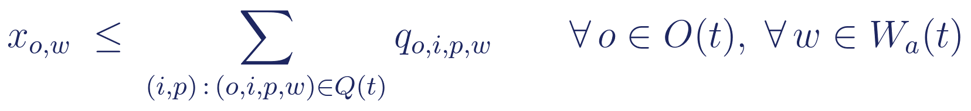
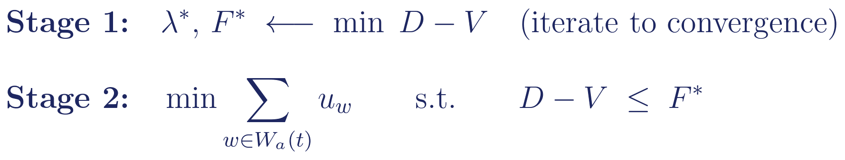
MODEL STRUCTURE · STAGE 2
So why does anything actually get picked?
V contains only valuation variables — the binding layer earns nothing in the objective. Execution is forced by structure, not by a price.
B4 — no empty binding: claiming a slot requires at least one unit actually drawn.
Minimising idle slots therefore maximises Σx, and every x needs a real draw — zero parameters, and it never enters the objective, so λ stays clean.
Stage 2 cannot be infeasible: the stage-1 optimum is itself a witness.
Notes:
This replaces the discount factor beta used in the earlier version. Slot filling is a priority, not a price.

Slide 8
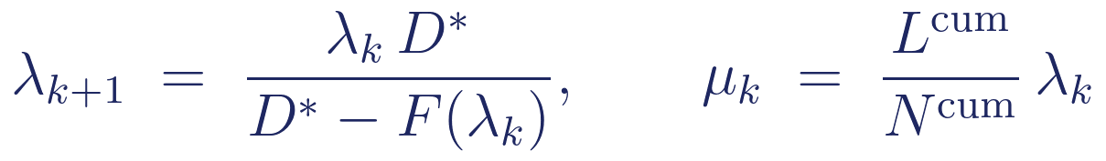
WHY A RATIO, NOT A LINEAR OBJECTIVE
Dinkelbach is also the threshold controller
It tightens the acceptance threshold from “no worse than history” to “the best ratio currently reachable”. Measured by removing it:
11.21 → 3.80
110 → 519
+38%
λ: historical mean → current optimum
pod trips without Dinkelbach (4.7×)
total travel distance
The denominator can never be negative — the null solution is feasible at objective 0, so:
Notes:
The V* >= 0 line is the answer to 'can the denominator be negative'. It cannot.

Slide 9
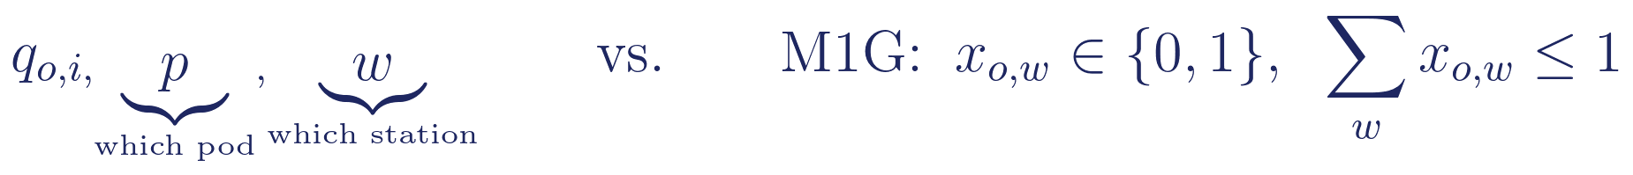
CONTRIBUTION
What makes this a splitting model
The draw variable carries both a pod index p and a station index w, so one order's demand may be served by several pods, at several stations, across several epochs.
M1G assigns a whole order to one station, all-or-nothing. Relaxing that to unit level is the modelling contribution.
Splitting raises pile-on: a pod trip serves more lines, so the same items move for less travel.
The cost is work-in-process — partially served orders wait for consolidation, which the model tracks and the experiments quantify.
Notes:
Compare items handled rather than orders completed: splitting creates WIP, which systematically understates completed orders over a finite horizon.

Slide 10
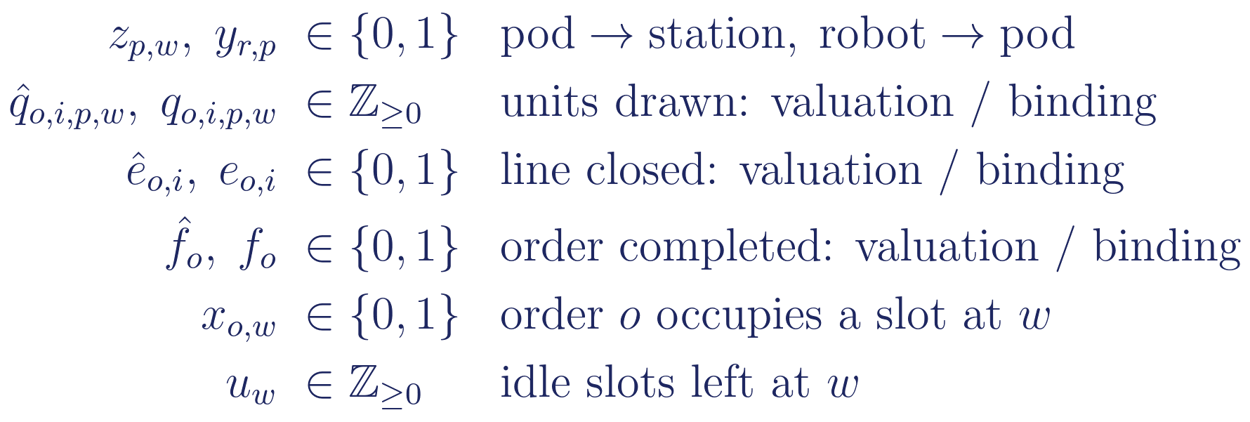
FORMULATION
Decision variables
A hat marks the valuation layer; the same symbol without one is the binding layer. Every term in V is hatted.
The idle-slot variable exists only for stations that still have free capacity — a full station never enters the model at all.
Notes:
Hatted = valuation layer; unhatted = binding layer.

Slide 11
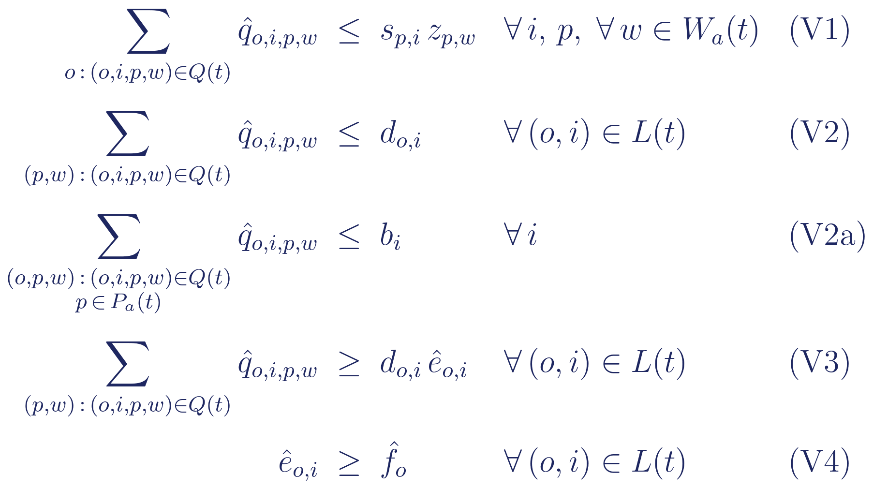
FORMULATION
Constraints — valuation layer
V1 ties every draw to a dispatched pod and its stock · V2 caps a line at its residual demand · V2a discounts inbound replenishment already on its way
V3 credits a line only when it is drawn in full · V4 credits an order only when every one of its lines is closed

Slide 12
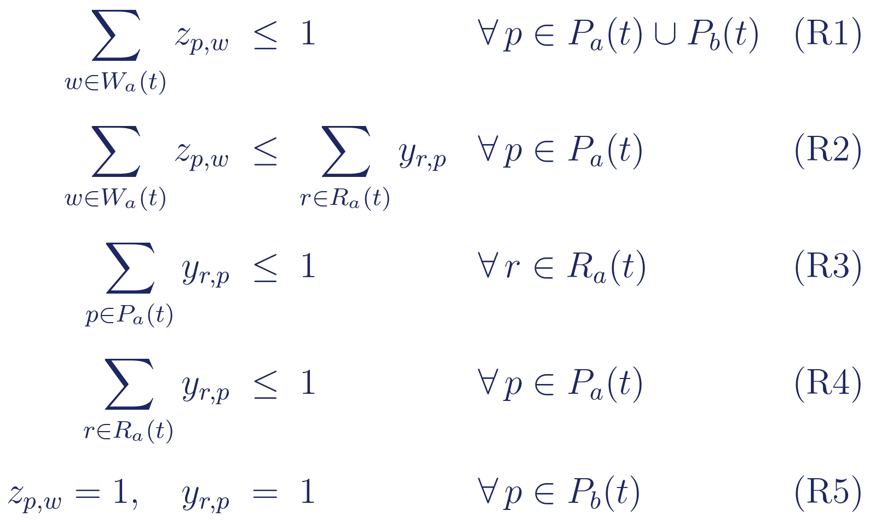
FORMULATION
Constraints — resources
R1 one station per pod · R2 a dispatch needs a carrier · R3 one pod per robot · R4 one robot per pod
R5 pins pods already en route — their assignment is a physical fact, not a decision

Slide 13
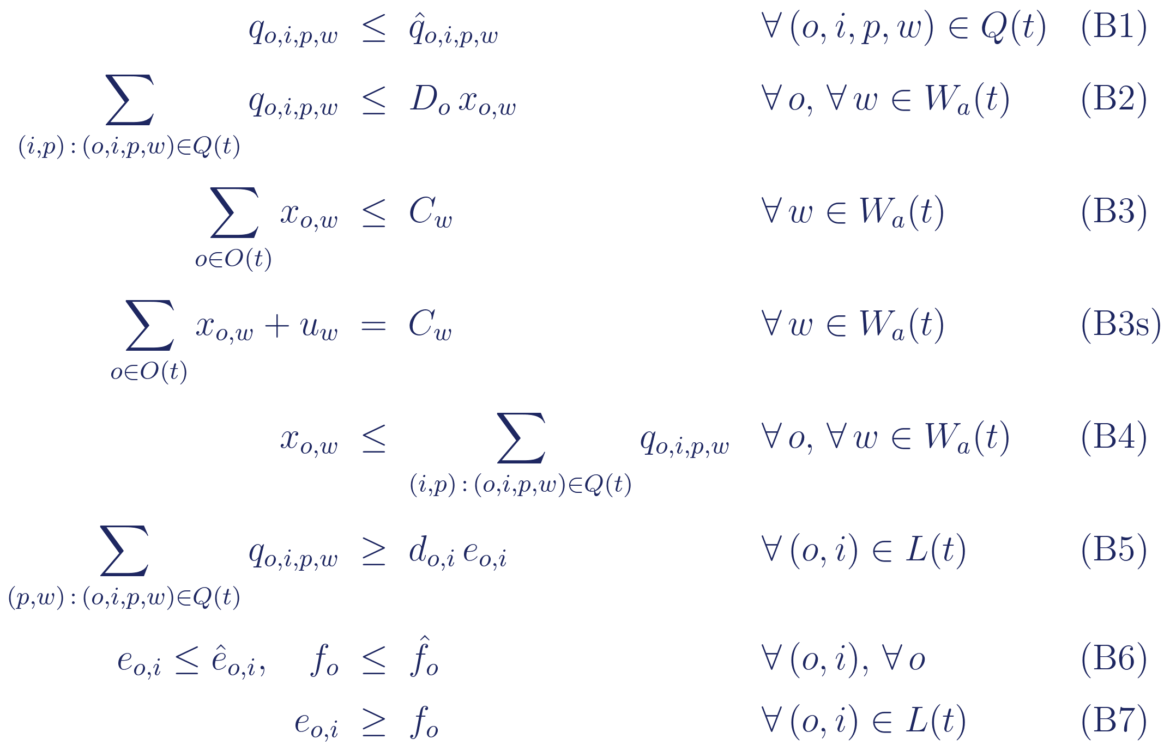
FORMULATION
Constraints — binding layer
B1/B6 make the binding layer a subset of the valuation layer · B2 and B4 together give “drawing ⇔ occupying a slot” · B3s defines the idle-slot variable stage 2 minimises

Slide 14
SUMMARY
Two measured prices, zero tuned constants
λ
metres per line closed
measured from cumulative history
μ
metres per order completed
measured from cumulative history
ρ
pod-tier sunk-cost price
removed — already carried by the pod-set subscript
ε
unit-level tie-break
removed — the only hand-set constant
β
realisation-rate discount
replaced by the stage-2 tie-break
Every remaining price is a measurement of the system's own behaviour, so the model has nothing left to tune.

