Slide 1

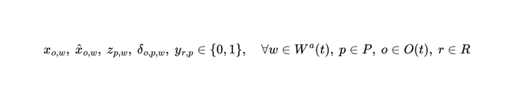


























Chapter 05 · Methodology
第 24 頁
Baseline: M1 — Online Joint OA–PS–TA Optimization Model
Sets and Parameters
Objective (14)
Pending orders
Workstations with free capacity
(14)
SKUs in Warehouse
All pods; Idle pods; Pods already assigned to Workstations
All robots; Idle robots; Busy robots
(15)
(16)
Orders demanding SKU i; Pods holding SKU i
Units of SKU i in Order o; Units of SKU i on Pod p
Constraints (2) – (13)
Free capacity of Workstation;Counted in ORDERS; Pod-Station and Robot-Pod distance
Trigger OJOOPT decision standard - Different from delta above
(2)
(8)
one order to at most one workstation
dispatching a pod requires a robot
Decision Variables
(3)
(9)
an assignable order is not necessarily assigned
a pod is transported by at most one robot
Order o COULD be assigned to Workstation — not slot-limited
(4)
(10)
Order o IS assigned to Workstation — consumes a slot
assigned orders equal capacity minus unused capacity
a robot transports at most one pod
Pod p is assigned to Workstation w
(11)
Robot r transports Pod p — task allocation is inside the model
(5)
a busy robot continues its current transport task
Auxiliary: pod p supplies order o at w
demand for SKU i at w cannot exceed what the pods at w supply
unused capacity of workstation w
(12)
(6)
supply requires the order assigned AND the pod assigned
a pod goes to at most one workstation
(13)
(7)
Jiao, G., Huang, M., Song, Y., Li, H., & Wang, X. (2026). Online joint optimization of order picking process in robotic mobile fulfillment systems. Omega, 138, 103374.
inherit pods already assigned to w
a newly assigned pod must supply at least one assigned order
Copyright © 2026 Center for Internet of Things Innovation, NTUST. All rights reserved.
版權所有 © 2026 國立臺灣科技大學 物聯網創新中心
CITI
The data and material contained in this file is copyrighted.
Please do not use without the author’s permission.
本檔案所含資料受版權保護，未經所有人之同意請勿擅自使用
Center for IoT Innovation

Slide 2
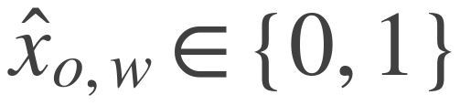

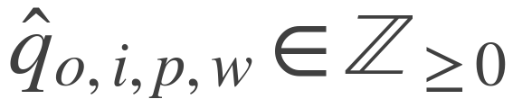
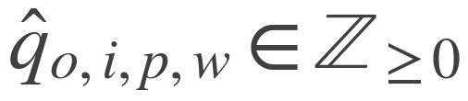
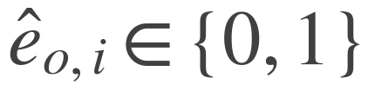
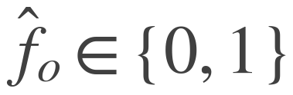
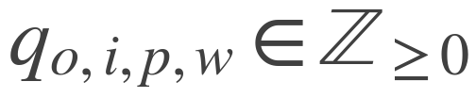
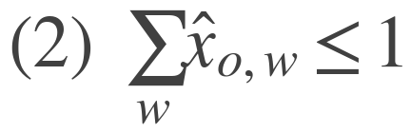
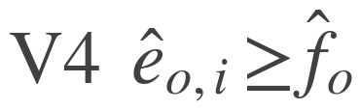
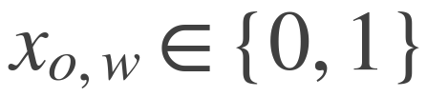

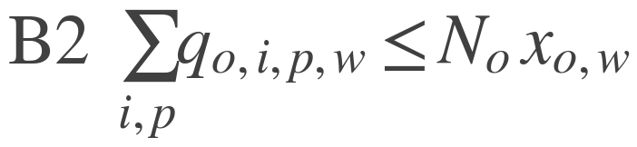
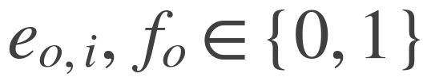

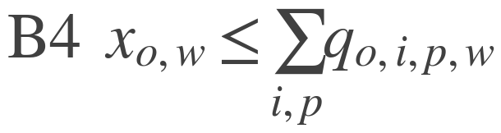
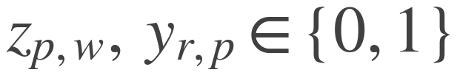
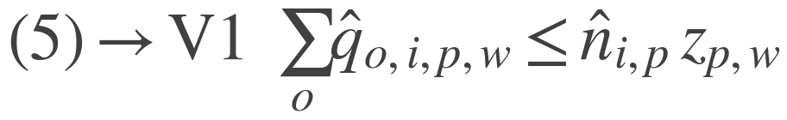
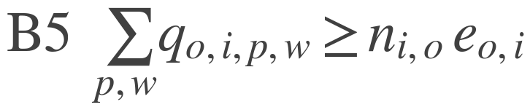
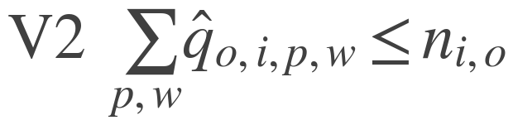
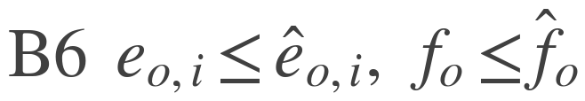
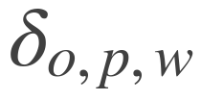
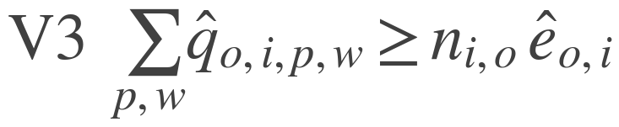



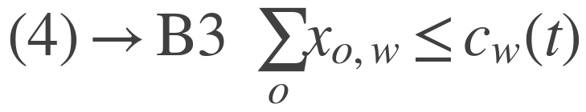
Chapter 05 · Methodology
第 25 頁
Proposed Exact Model: M4 — Online Joint OA–PS–TA Order Splitting Optimization Model
Decision Atom: Order → Item
Objective: Fixed Weights → Measured Prices
M1
M1 (14) a weighted linear sum of orders, distance and idle capacity; the three weights are fixed in advance.
the ORDER is the atom: assigned whole, to one workstation, in one decision
M4
M4
the ITEM is the atom: units of SKU i of order o drawn from pod p at w
Order splitting is not an added feature; it is what the finer atom makes representable.
D and V are both in metres. mu = distance per completed order and beta = bound over valued completions, both read off the run in progress; M1 pins the same ratio by hand at 40 / 1000. Dinkelbach solves min D - V at the current lambda, and mu, epsilon and rho scale with it, so only the level moves and never V's shape.
Decision Variables
Pod tier ρ — binding layer only only bound draws have a real-world effect.
Valuation layer
valued draw
A unit from a pod being picked now saves a future trip; one from a pod this decision dispatches costs an extra trip. Queued and en-route pods are already sunk, as in T1 and T2.
line (o, i) is closed in full
every line of order o is closed
Constraints: What Changes from M1
Binding layer
Removed
Added — completion is no longer implied
executed draw
order o occupies a slot at w
bound line closure and completion
Replaced
Inherited from M1
pod and robot assignment, unchanged
No longer required
the draw variable already names the (order, pod, workstation) triple, so this auxiliary variable and constraints (12)-(13) are subsumed
Unchanged
with (4) relaxed to an inequality there is no unused capacity to price
Relaxed
Copyright © 2026 Center for Internet of Things Innovation, NTUST. All rights reserved.
版權所有 © 2026 國立臺灣科技大學 物聯網創新中心
CITI
The data and material contained in this file is copyrighted.
Please do not use without the author’s permission.
本檔案所含資料受版權保護，未經所有人之同意請勿擅自使用
Center for IoT Innovation

Slide 3

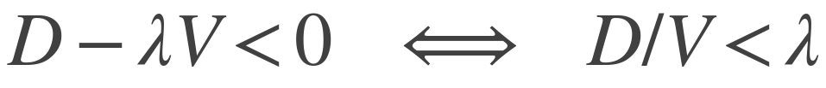





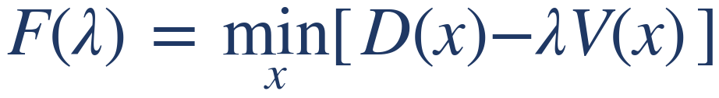



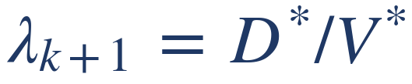
Chapter 05 · Methodology
第 26 頁
Solving M4 — Dinkelbach Transform and Self-Calibrated Prices
Why the Ratio Cannot Be Solved Directly
Where the Prices Come From
A MILP solver minimises a LINEAR expression. Division is not linear, so this cannot be handed to the solver as written.
Travel distance is the only measured quantity. Each price is that distance divided by a different counter of work done.
derived from
unit
measured median
distance / closed lines
metres per line
8.06
Read the transform as a budget: at the guessed rate lambda, V units of value are worth lambda-V metres, and D is what the plan actually spends. Under budget means the plan beat the rate.
lambda x lines per order
metres per order
12.22
distance / units picked
metres per unit
3.70
0.001 x lambda
metres per unit
0.008
The Test, and the Loop
bound lines / valued lines
dimensionless
0.188
No price is set by the modeller. The hand-set numbers are the warm-up seeds, used for the first 50 closed lines only, and the epsilon scale — a tie-break three orders of magnitude below lambda.
some plan beats the rate → lower lambda
Two Invariants the Design Rests On
no plan reaches it → raise lambda
the best plan exactly breaks even → lambda is optimal
1. The price ratios are fixed by the instance, not chosen.
F is decreasing in lambda, so the root is unique: the ratio problem becomes a one-dimensional root search.
Dinkelbach only works if V keeps its SHAPE while lambda searches, so every price scales with lambda together and only the level moves. mu / lambda is lines per order; rho / lambda is the reciprocal of units per line — both properties of the instance.
1. Guess a rate start from the running measured value
2. Solve the linear subproblem min D − lambda-V — this the solver can do
2. beta is bounded on both sides, and the measured value sits inside.
3. Read the rate that plan achieved D* / V*
4. Adopt it and repeat until the objective is within tolerance
beta
what the model does
result
this is Newton's method on F, hence the quadratic convergence
0
credits a pod only for the line it can bind now
pile-on 6.04 → 4.13, energy +24.5 %
0.19
credits unusable coverage at the measured rate
the canonical setting
Measured: 96 % of decisions converge within a single update (0 updates 444, 1 update 449, of 929). Stop at |objective| <= 0.5 m or 5 iterations. The theorem needs V > 0; doing nothing gives V = 0, so that case doubles lambda instead, at most 6 times.
≥ 0.5
execution earns nothing at the margin
the run stops producing orders
beta is conditioned on how many pods are already committed: slot capacity pins the binding layer near one line per decision while the valuation layer grows with committed supply, so a further pod is scored for coverage the binding layer cannot take.
Copyright © 2026 Center for Internet of Things Innovation, NTUST. All rights reserved.
版權所有 © 2026 國立臺灣科技大學 物聯網創新中心
CITI
The data and material contained in this file is copyrighted.
Please do not use without the author’s permission.
本檔案所含資料受版權保護，未經所有人之同意請勿擅自使用
Center for IoT Innovation

