Slide 1

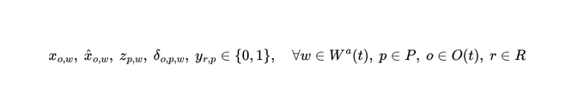


























Chapter 05 · Methodology
第 24 頁
Baseline: M1 — Online Joint OA–PS–TA Optimization Model
Sets and Parameters
Objective (14)
Pending orders
Workstations with free capacity
(14)
SKUs in Warehouse
All pods; Idle pods; Pods already assigned to Workstations
All robots; Idle robots; Busy robots
(15)
(16)
Orders demanding SKU i; Pods holding SKU i
Units of SKU i in Order o; Units of SKU i on Pod p
Constraints (2) – (13)
Free capacity of Workstation;Counted in ORDERS; Pod-Station and Robot-Pod distance
Trigger OJOOPT decision standard - Different from delta above
(2)
(8)
one order to at most one workstation
dispatching a pod requires a robot
Decision Variables
(3)
(9)
an assignable order is not necessarily assigned
a pod is transported by at most one robot
Order o COULD be assigned to Workstation — not slot-limited
(4)
(10)
Order o IS assigned to Workstation — consumes a slot
assigned orders equal capacity minus unused capacity
a robot transports at most one pod
Pod p is assigned to Workstation w
(11)
Robot r transports Pod p — task allocation is inside the model
(5)
a busy robot continues its current transport task
Auxiliary: pod p supplies order o at w
demand for SKU i at w cannot exceed what the pods at w supply
unused capacity of workstation w
(12)
(6)
supply requires the order assigned AND the pod assigned
a pod goes to at most one workstation
(13)
(7)
Jiao, G., Huang, M., Song, Y., Li, H., & Wang, X. (2026). Online joint optimization of order picking process in robotic mobile fulfillment systems. Omega, 138, 103374.
inherit pods already assigned to w
a newly assigned pod must supply at least one assigned order
Copyright © 2026 Center for Internet of Things Innovation, NTUST. All rights reserved.
版權所有 © 2026 國立臺灣科技大學 物聯網創新中心
CITI
The data and material contained in this file is copyrighted.
Please do not use without the author’s permission.
本檔案所含資料受版權保護，未經所有人之同意請勿擅自使用
Center for IoT Innovation

Slide 2

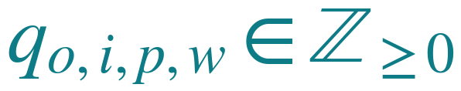

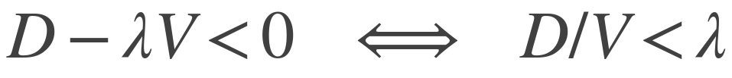


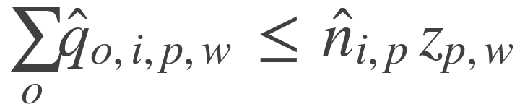


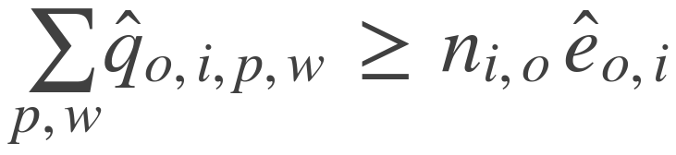
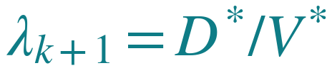
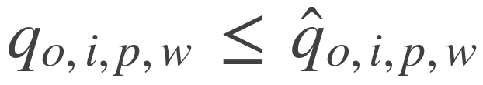
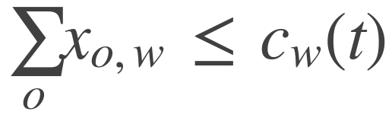
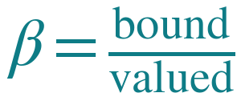
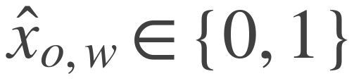
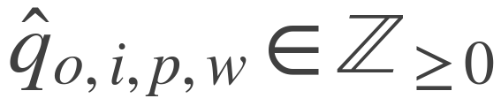
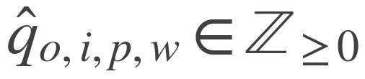
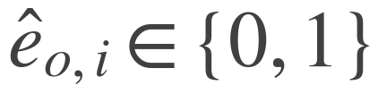
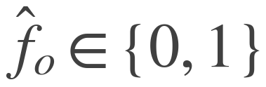
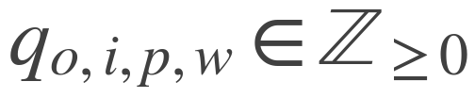
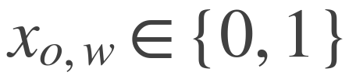
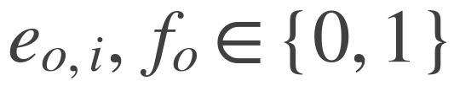
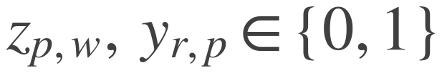
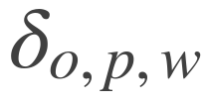


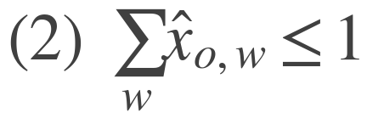


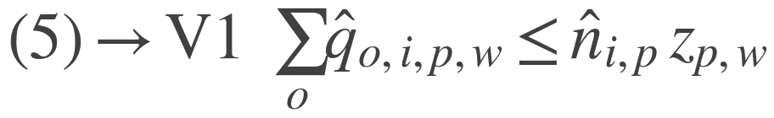
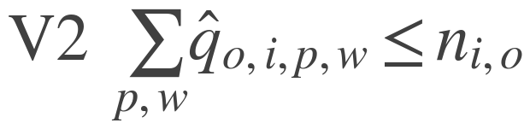
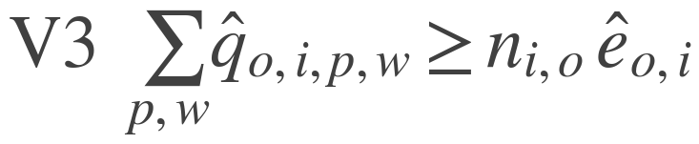
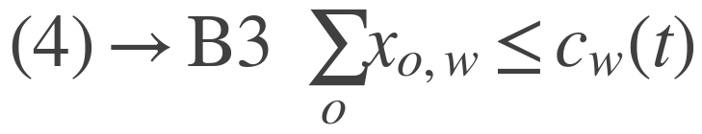
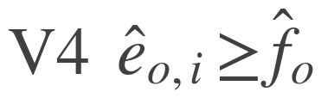
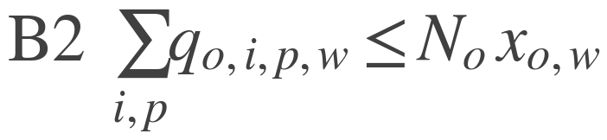
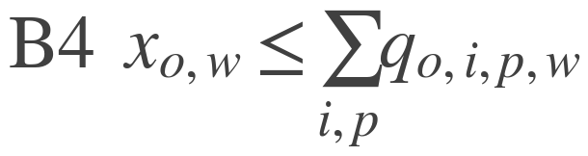
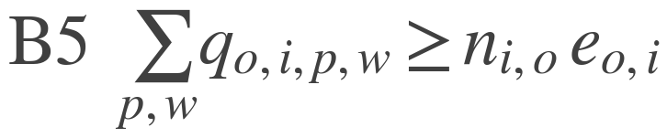
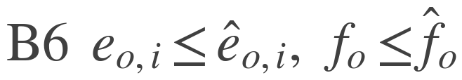


Chapter 05 · Methodology
第 25 頁
Proposed Exact Model: M4 — Online Joint OA–PS–TA Order Splitting Optimization Model
The Decision Atom
Why a Ratio, and How It Is Solved
one order
D distance walked
metres walked per unit of value delivered. A weighted sum would first need an answer to “how many metres is an order worth”. A ratio does not.
units of SKU i of order o, drawn from pod p, at station w
V value delivered
Splitting is what this variable permits — not a feature added on top.
a solver minimises linear expressions, not divisions — so guess the rate λ and ask whether any plan beats it
Constraints That Carry a Modelling Choice
F > 0 raise
1 guess a rate λ
V1
2 solve min D − λV
draw only what that pod carries, and only if it is sent
3 read the rate it achieved
F < 0 lower
4 adopt it, repeat
V3
a line counts only when it is drawn in full
F is decreasing, so the root is unique; the update is Newton's method on F. [Dinkelbach 1967]
B1
what is executed is a subset of what is valued
What the Two Coefficients Mean
B3
a station holds a fixed number of orders at a time
β seen → done
ρ which pod you drain
Pod and robot constraints — one pod per station, one robot per pod, inheritance of assignments already committed — are the physical rules of the floor and are carried over unchanged.
− ρ
+ ρ
0
the share of what the model can see that it can execute now
being picked now
dispatched now
still en route
valued
bound
taking a unit from a pod about to leave saves a future trip; taking one from a pod fetched now costs an extra trip. ρ prices which pod is drained, not how far it travelled.
a bound line earns the full price; a line only seen earns λβ
Copyright © 2026 Center for Internet of Things Innovation, NTUST. All rights reserved.
版權所有 © 2026 國立臺灣科技大學 物聯網創新中心
CITI
The data and material contained in this file is copyrighted.
Please do not use without the author’s permission.
本檔案所含資料受版權保護，未經所有人之同意請勿擅自使用
Center for IoT Innovation

Slide 3






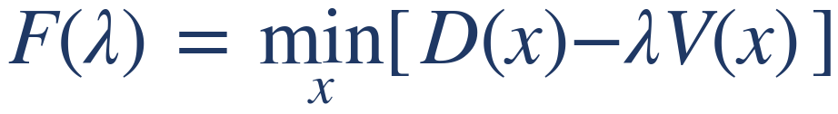



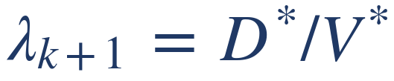
Chapter 05 · Methodology
第 26 頁
Solving M4 — Dinkelbach Transform and Self-Calibrated Prices
Why the Ratio Cannot Be Solved Directly
Where the Prices Come From
A MILP solver minimises a LINEAR expression. Division is not linear, so this cannot be handed to the solver as written.
Travel distance is the only measured quantity. Each price is that distance divided by a different counter of work done.
derived from
unit
measured median
distance / closed lines
metres per line
8.06
Read the transform as a budget: at the guessed rate lambda, V units of value are worth lambda-V metres, and D is what the plan actually spends. Under budget means the plan beat the rate.
lambda x lines per order
metres per order
12.22
distance / units picked
metres per unit
3.70
0.001 x lambda
metres per unit
0.008
The Test, and the Loop
bound lines / valued lines
dimensionless
0.188
No price is set by the modeller. The hand-set numbers are the warm-up seeds, used for the first 50 closed lines only, and the epsilon scale — a tie-break three orders of magnitude below lambda.
some plan beats the rate → lower lambda
Two Invariants the Design Rests On
no plan reaches it → raise lambda
the best plan exactly breaks even → lambda is optimal
1. The price ratios are fixed by the instance, not chosen.
F is decreasing in lambda, so the root is unique: the ratio problem becomes a one-dimensional root search.
Dinkelbach only works if V keeps its SHAPE while lambda searches, so every price scales with lambda together and only the level moves. mu / lambda is lines per order; rho / lambda is the reciprocal of units per line — both properties of the instance.
1. Guess a rate start from the running measured value
2. Solve the linear subproblem min D − lambda-V — this the solver can do
2. beta is bounded on both sides, and the measured value sits inside.
3. Read the rate that plan achieved D* / V*
4. Adopt it and repeat until the objective is within tolerance
beta
what the model does
result
this is Newton's method on F, hence the quadratic convergence
0
credits a pod only for the line it can bind now
pile-on 6.04 → 4.13, energy +24.5 %
0.19
credits unusable coverage at the measured rate
the canonical setting
Measured: 96 % of decisions converge within a single update (0 updates 444, 1 update 449, of 929). Stop at |objective| <= 0.5 m or 5 iterations. The theorem needs V > 0; doing nothing gives V = 0, so that case doubles lambda instead, at most 6 times.
≥ 0.5
execution earns nothing at the margin
the run stops producing orders
beta is conditioned on how many pods are already committed: slot capacity pins the binding layer near one line per decision while the valuation layer grows with committed supply, so a further pod is scored for coverage the binding layer cannot take.
Copyright © 2026 Center for Internet of Things Innovation, NTUST. All rights reserved.
版權所有 © 2026 國立臺灣科技大學 物聯網創新中心
CITI
The data and material contained in this file is copyrighted.
Please do not use without the author’s permission.
本檔案所含資料受版權保護，未經所有人之同意請勿擅自使用
Center for IoT Innovation

