Slide 1





第 1 頁
Online Joint Optimization of the Order Picking Process with Split Orders
in Robotic Mobile Fulfillment Systems
考慮訂單拆分之機器人移動履行系統揀貨流程線上聯合最佳化
Kai-Hsiang, Chuang
2026
Industrial Management Department
Center for Internet of Things Innovation
National Taiwan University of Science and Technology
Copyright@2026 Center for Internet of Things Innovation, NTUST. All rights reserved.
版權所有 © 2026 國立臺灣科技大學 物聯網創新中心
CITI
The data and material contained in this file is copyrighted.
Please do not use without the author’s permission.
本檔案所含資料受版權保護，未經所有人之同意請勿擅自使用
Center for IoT Innovation
Notes:
1.7.2013
‹#›

Slide 2
第 2 頁
Outline
Copyright © 2026 Center for Internet of Things Innovation, NTUST. All rights reserved.
版權所有 © 2026 國立臺灣科技大學 物聯網創新中心
CITI
The data and material contained in this file is copyrighted.
Please do not use without the author’s permission.
本檔案所含資料受版權保護，未經所有人之同意請勿擅自使用
Center for IoT Innovation

Slide 3
第 3 頁
01
Research Background
05
Methodology
02
Literature Gap
06
Experiment and Results
03
Research Objective
07
Conclusion
04
Problem Definition
08
Reference
Copyright © 2026 Center for Internet of Things Innovation, NTUST. All rights reserved.
版權所有 © 2026 國立臺灣科技大學 物聯網創新中心
CITI
The data and material contained in this file is copyrighted.
Please do not use without the author’s permission.
本檔案所含資料受版權保護，未經所有人之同意請勿擅自使用
Center for IoT Innovation
Notes:
1.7.2013
RMFS Routing組目前面臨的問題稱作，Multi-agent path finding problem，會發生衝突問題，最直接的核心原因是缺乏代理間的協同導航，意即robot之間缺乏通訊，無法主動提前決策避讓等等行為，[1] 亦提到，需要將Routing問題拆分成scheduling跟navigation，前者關注在task allocation後者關注在how to reach the destination，並指出未來需要先處理好調度問題，再根據結果開發配置的路徑演算法，並且應該採用散平行分散式系統，已達成大規模應用的方向。
‹#›

Slide 4
第 4 頁
01 Research Background
Copyright © 2026 Center for Internet of Things Innovation, NTUST. All rights reserved.
版權所有 © 2026 國立臺灣科技大學 物聯網創新中心
CITI
The data and material contained in this file is copyrighted.
Please do not use without the author’s permission.
本檔案所含資料受版權保護，未經所有人之同意請勿擅自使用
Center for IoT Innovation

Slide 5
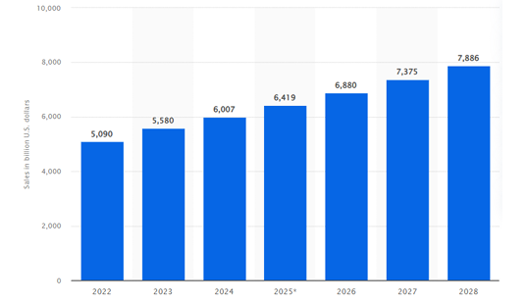
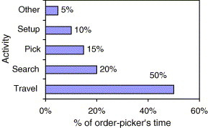
Chapter 01 · Research Background
第 5 頁
Background
Global retail e-commerce revenue projections between 2022 and 2028
Percentage of order-picker’s time
De Koster, R., Le-Duc, T., & Roodbergen, K. J. (2007). Design and control of warehouse order picking: A literature review. European journal of operational research, 182(2), 481-501.
Statista Research Department, “Retail E-Commerce Sales Worldwide from 2022 to 2028,” Statista.
E-commerce growth drives higher order demand and shorter turnaround times.
In traditional person-to-goods picking, worker travel accounts for up to 50% of picking time.
Copyright © 2026 Center for Internet of Things Innovation, NTUST. All rights reserved.
版權所有 © 2026 國立臺灣科技大學 物聯網創新中心
CITI
The data and material contained in this file is copyrighted.
Please do not use without the author’s permission.
本檔案所含資料受版權保護，未經所有人之同意請勿擅自使用
Center for IoT Innovation

Slide 6
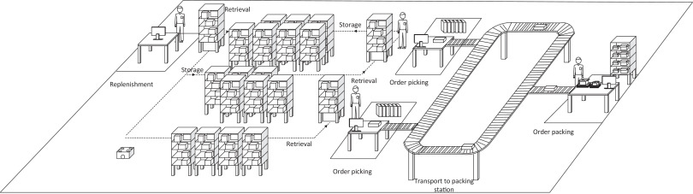
Chapter 01 · Research Background
第 6 頁
RMFS Overview
Picker
Operation Station
Autonomous Mobile Robot
Movable Shelf
(Pod)
Conveyor
Xie, L., Thieme, N., Krenzler, R., & Li, H. (2021). Introducing split orders and optimizing operational policies in robotic mobile fulfillment systems. European Journal of Operational Research, 288(1), 80-97.
Unlike traditional person-to-goods systems, RMFS automates non-value-added travel, allowing workers to focus on value-added picking tasks.
Copyright © 2026 Center for Internet of Things Innovation, NTUST. All rights reserved.
版權所有 © 2026 國立臺灣科技大學 物聯網創新中心
CITI
The data and material contained in this file is copyrighted.
Please do not use without the author’s permission.
本檔案所含資料受版權保護，未經所有人之同意請勿擅自使用
Center for IoT Innovation
Notes:
然而，RMFS 的效益並不只取決於自動化設備本身，更取決於訂單、Pod、機器人與工作站之間如何協調。

Slide 7
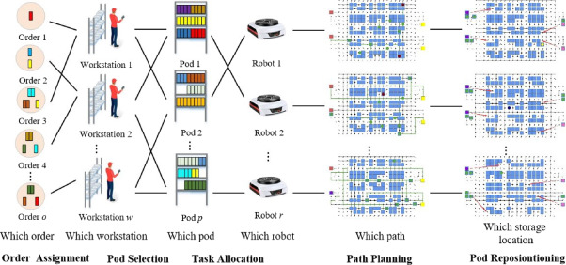
Chapter 01 · Research Background
第 7 頁
Dynamic Operational Decisions in RMFS
RMFS Picking process operational decision
Strategic Level
Tactical Level
Operational Level
RMFS operational decisions are highly interdependent and evolve with system states, creating a need for effective coordination.
Jiao, G., Huang, M., Song, Y., Li, H., & Wang, X. (2026). Online joint optimization of order picking process in robotic mobile fulfillment systems. Omega, 138, 103374.
Copyright © 2026 Center for Internet of Things Innovation, NTUST. All rights reserved.
版權所有 © 2026 國立臺灣科技大學 物聯網創新中心
CITI
The data and material contained in this file is copyrighted.
Please do not use without the author’s permission.
本檔案所含資料受版權保護，未經所有人之同意請勿擅自使用
Center for IoT Innovation

Slide 8













Chapter 01 · Research Background
第 8 頁
Operational Performance of RMFS
The ultimate goal of operational decision-making is to improve overall RMFS performance rather than individual decisions in isolation.
Operational Decisions
Level 1
Decision Level
Order Assigment (OA)
Pod Selection (PS)
Task Allocation (TA)
Operational Efficiency Indicators
Level 2
Operational Efficiency
Pile-on ↑
Pod–Station Visits ↓
Robot Travel Distance ↓
Fulfillment Efficiency
Resource Efficiency
Sustainability
Level 3
Productivity
System Performance
Throughput ↑
Order Completion Time ↓
Energy Consumption ↓
Better Utilization
Effective RMFS decision-making should be assessed from a system-level perspective, considering both operational efficiency and resource consumption.
Copyright © 2026 Center for Internet of Things Innovation, NTUST. All rights reserved.
版權所有 © 2026 國立臺灣科技大學 物聯網創新中心
CITI
The data and material contained in this file is copyrighted.
Please do not use without the author’s permission.
本檔案所含資料受版權保護，未經所有人之同意請勿擅自使用
Center for IoT Innovation

Slide 9
第 9 頁
02 Literature Reviews
Copyright © 2026 Center for Internet of Things Innovation, NTUST. All rights reserved.
版權所有 © 2026 國立臺灣科技大學 物聯網創新中心
CITI
The data and material contained in this file is copyrighted.
Please do not use without the author’s permission.
本檔案所含資料受版權保護，未經所有人之同意請勿擅自使用
Center for IoT Innovation

Slide 10



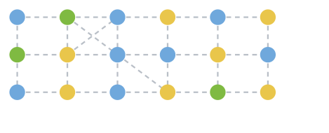
Chapter 02 · Literature Gap
第 10 頁
Sequential Optimization vs Joint Optimization
Traditional Sequential Optimization
Joint Optimization
Step 1:
Step 2:
Step 3:
Order Assignment (OA)
Order Assignment
Pod Selection
Task Allocation
(OA)
(PS)
(TA)
Progressive Shrinkage of the Search Space
Pod Selection (PS)
Task Allocation (TA)
Full Solution Space
Joint Feasible Solution Space
Step 1
After fixing OA
Fixing upstream decisions independently may exclude globally better coordinated combinations.
Obtain the soultion from full solution space
Step 2
After fixing PS
Step 3
Remaining Search Region for TA
Interactions among OA, PS, and TA preserve a richer set of feasible combinations.
This study focuses only on the picking process, excluding replenishment.
However, the trade-off is that searching within a larger solution space requires significantly more computational time, leading to scalability issues.
Copyright © 2026 Center for Internet of Things Innovation, NTUST. All rights reserved.
版權所有 © 2026 國立臺灣科技大學 物聯網創新中心
CITI
The data and material contained in this file is copyrighted.
Please do not use without the author’s permission.
本檔案所含資料受版權保護，未經所有人之同意請勿擅自使用
Center for IoT Innovation

Slide 11













Chapter 02 · Literature Gap
第 11 頁
Order Splitting in RMFS
As order assignment is a key operational decision in RMFS, relaxing the one-order–one-workstation restriction can potentially provide greater fulfillment efficiency.
1. Conventional Fulfillment
2. Split Fulfillment
3. Why Does This Matter in RMFS?
One order must be fully fulfilled at a single workstation.
An order can be fulfilled across multiple workstations.
Split fulfillment enables more flexible coordination among key system resources.
Order O₁
Order O₁
A
B
C
D
A
B
C
D
Orders
Inventory / Pods
Workstations
allow order to muti-stations
A
B
C
D
Workstation 1
More flexible resource coordination and matching opportunities in dynamic RMFS operations.
Workstation 1
Workstation 2
Greater fulfillment flexibility
Limited fulfillment flexibility
• More assignment options
Flexible order fulfillment
Improved resource utilization
Potential operational efficiency
Fewer options to coordinateorders, pods, and workstations.
• Better pod utilization
• Potentially less robot travel / energy consumption
Order splitting provides greater flexibility to coordinate orders, pods, and workstation resources in dynamic RMFS operations.
Copyright © 2026 Center for Internet of Things Innovation, NTUST. All rights reserved.
版權所有 © 2026 國立臺灣科技大學 物聯網創新中心
CITI
The data and material contained in this file is copyrighted.
Please do not use without the author’s permission.
本檔案所含資料受版權保護，未經所有人之同意請勿擅自使用
Center for IoT Innovation

Slide 12
Chapter 02 · Literature Gap
第 12 頁
Jiao & Xie: Two Foundational Papers on Online Joint Optimization and Order Splitting in RMFS
Jiao et al. (2026) – Online Joint Optimization (OA–PS–TA)
Xie et al. (2021) – Order Splitting (OA–PS with Split)
Online joint optimization outperforms sequential optimization under dynamic RMFS environments.
Order splitting significantly improves system efficiency.
What They Did
What They Did
Extended the OA–PS model by allowing order splitting:
Formulated an online joint optimization model integrating Order Assignment (OA), Pod Selection (PS), and Task Allocation (TA).
Considered finite pod inventory, multi-quantity SKU demand, robot travel distance, and dynamic system states.
Compared with sequential optimization through 2-hour RMFS simulations.
Split-among-stations
Split-over-time
Evaluated the impact of splitting on pod-station visits (PSV) and throughput.
Analyzed the effect of packing station capacity.
Key Findings
Key Findings
Splitting reduces pod-station visits by up to ~50% (space) and even more (time).
Joint optimization (M1G) achieves higher throughput and lower robot distance than sequential approaches.
Minimizing pod movements (M2G) does not guarantee higher throughput.
Benefits decrease when packing capacity becomes very limited (e.g., C = 10).
Takeaway: Jointly considering OA, PS, and TA delivers superior system performance.
Takeaway: Order splitting provides more coordination flexibility and better resource utilization.
Copyright © 2026 Center for Internet of Things Innovation, NTUST. All rights reserved.
版權所有 © 2026 國立臺灣科技大學 物聯網創新中心
CITI
The data and material contained in this file is copyrighted.
Please do not use without the author’s permission.
本檔案所含資料受版權保護，未經所有人之同意請勿擅自使用
Center for IoT Innovation

Slide 13
Chapter 02 · Literature Gap
第 13 頁
Research Gap Summary
Publication | Order assignment | Pod selection | Task allocation | Decision unit | Multi-unit Demand | Finite Pod Inventory | Order Splitting
Jiao et al. (2023) | ✓ | ✓ | - | Order | ✓ | ✓ | -
Jiao et al. (2026) | ✓ | ✓ | ✓ | Order | ✓ | ✓ | -
Xie et al. (2021) | ✓ | ✓ | - | Order-line(single demand) | - | - | ✓
This study | ✓ | ✓ | ✓ | Item-unit | ✓ | ✓ | ✓
Xie et al. show the benefits of splitting under simplified assumptions, while Jiao et al. demonstrate the value of online joint optimization without splitting.
Together, They Reveal the Research Gap
However, the integration of the following features remains insufficiently studied in an online framework:
Research Need
Integrate split-order flexibility into online joint OA–PS–TA decision-making and examine its system-level operational value under realistic fulfillment conditions.
Order Splitting
Finite Inventory
Multi-quantity Demand
Robot Task Allocation
(OS = Order Splitting)
Copyright © 2026 Center for Internet of Things Innovation, NTUST. All rights reserved.
版權所有 © 2026 國立臺灣科技大學 物聯網創新中心
CITI
The data and material contained in this file is copyrighted.
Please do not use without the author’s permission.
本檔案所含資料受版權保護，未經所有人之同意請勿擅自使用
Center for IoT Innovation

Slide 14
第 14 頁
03 Research Objective
Copyright © 2026 Center for Internet of Things Innovation, NTUST. All rights reserved.
版權所有 © 2026 國立臺灣科技大學 物聯網創新中心
CITI
The data and material contained in this file is copyrighted.
Please do not use without the author’s permission.
本檔案所含資料受版權保護，未經所有人之同意請勿擅自使用
Center for IoT Innovation

Slide 15
Chapter 03 · Research Objective
第 15 頁
Research Questions
Copyright © 2026 Center for Internet of Things Innovation, NTUST. All rights reserved.
版權所有 © 2026 國立臺灣科技大學 物聯網創新中心
CITI
The data and material contained in this file is copyrighted.
Please do not use without the author’s permission.
本檔案所含資料受版權保護，未經所有人之同意請勿擅自使用
Center for IoT Innovation

Slide 16
Chapter 03 · Research Objective
第 16 頁
Research Scope
Copyright © 2026 Center for Internet of Things Innovation, NTUST. All rights reserved.
版權所有 © 2026 國立臺灣科技大學 物聯網創新中心
CITI
The data and material contained in this file is copyrighted.
Please do not use without the author’s permission.
本檔案所含資料受版權保護，未經所有人之同意請勿擅自使用
Center for IoT Innovation

Slide 17
Chapter 03 · Research Objective
第 17 頁
Contributions
Copyright © 2026 Center for Internet of Things Innovation, NTUST. All rights reserved.
版權所有 © 2026 國立臺灣科技大學 物聯網創新中心
CITI
The data and material contained in this file is copyrighted.
Please do not use without the author’s permission.
本檔案所含資料受版權保護，未經所有人之同意請勿擅自使用
Center for IoT Innovation

Slide 18
第 18 頁
04 Problem Definition
Copyright © 2026 Center for Internet of Things Innovation, NTUST. All rights reserved.
版權所有 © 2026 國立臺灣科技大學 物聯網創新中心
CITI
The data and material contained in this file is copyrighted.
Please do not use without the author’s permission.
本檔案所含資料受版權保護，未經所有人之同意請勿擅自使用
Center for IoT Innovation

Slide 19
Chapter 04 · Problem Definition
第 19 頁
System Setting
Copyright © 2026 Center for Internet of Things Innovation, NTUST. All rights reserved.
版權所有 © 2026 國立臺灣科技大學 物聯網創新中心
CITI
The data and material contained in this file is copyrighted.
Please do not use without the author’s permission.
本檔案所含資料受版權保護，未經所有人之同意請勿擅自使用
Center for IoT Innovation

Slide 20
Chapter 04 · Problem Definition
第 20 頁
Decision Problems
Copyright © 2026 Center for Internet of Things Innovation, NTUST. All rights reserved.
版權所有 © 2026 國立臺灣科技大學 物聯網創新中心
CITI
The data and material contained in this file is copyrighted.
Please do not use without the author’s permission.
本檔案所含資料受版權保護，未經所有人之同意請勿擅自使用
Center for IoT Innovation

Slide 21
Chapter 04 · Problem Definition
第 21 頁
Order Splitting Definition
Copyright © 2026 Center for Internet of Things Innovation, NTUST. All rights reserved.
版權所有 © 2026 國立臺灣科技大學 物聯網創新中心
CITI
The data and material contained in this file is copyrighted.
Please do not use without the author’s permission.
本檔案所含資料受版權保護，未經所有人之同意請勿擅自使用
Center for IoT Innovation

Slide 22
Chapter 04 · Problem Definition
第 22 頁
Assumptions
Copyright © 2026 Center for Internet of Things Innovation, NTUST. All rights reserved.
版權所有 © 2026 國立臺灣科技大學 物聯網創新中心
CITI
The data and material contained in this file is copyrighted.
Please do not use without the author’s permission.
本檔案所含資料受版權保護，未經所有人之同意請勿擅自使用
Center for IoT Innovation

Slide 23
第 23 頁
05 Methodology
Copyright © 2026 Center for Internet of Things Innovation, NTUST. All rights reserved.
版權所有 © 2026 國立臺灣科技大學 物聯網創新中心
CITI
The data and material contained in this file is copyrighted.
Please do not use without the author’s permission.
本檔案所含資料受版權保護，未經所有人之同意請勿擅自使用
Center for IoT Innovation

Slide 24
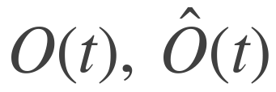



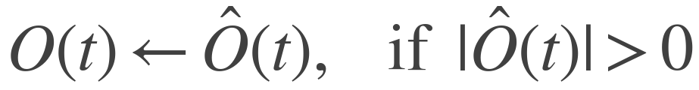

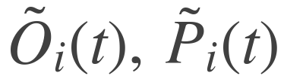
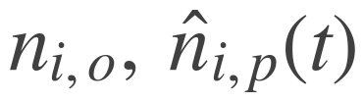
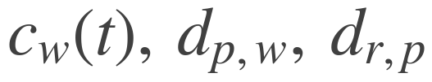
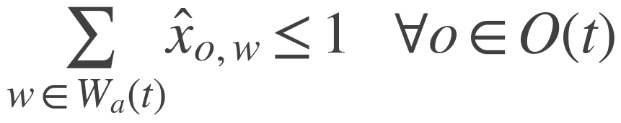


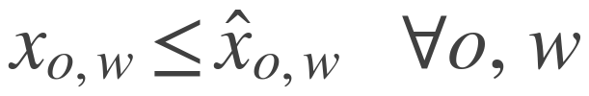
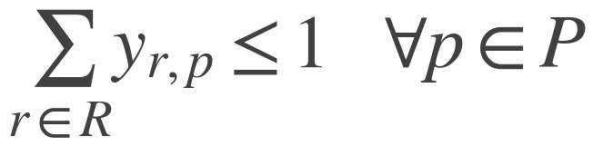
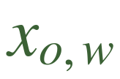
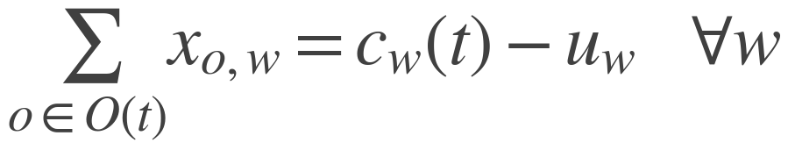
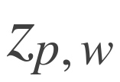
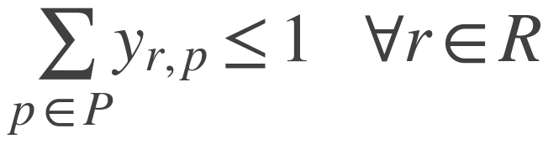
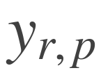
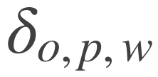
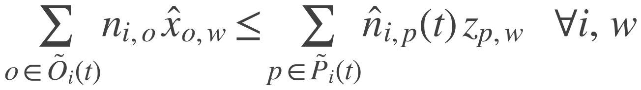

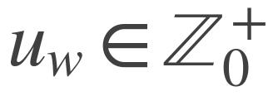
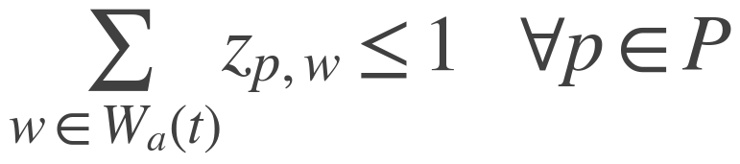

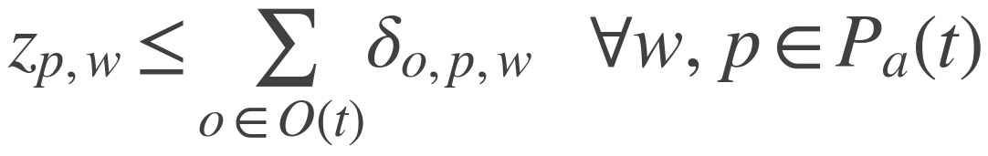
Chapter 05 · Methodology
第 24 頁
Baseline: M1G
Sets and Parameters
Objective (14) and Preprocessing (19)
pending orders; those whose residence time exceeds tau
workstations with free capacity
SKUs
all pods; idle pods; pods already assigned to w
Preprocessing (19): orders that have waited longer than tau take priority, so long-waiting orders are not starved by the objective.
all robots; idle robots; busy robots
orders demanding SKU i; pods holding SKU i
units of SKU i in order o; units of SKU i on pod p
Constraints (2) – (16)
free capacity of w, counted in ORDERS; pod-station and robot-pod distance
(2)
(8)
Decision Variables
one order to at most one workstation
dispatching a pod requires a robot
order o COULD be assigned to w — not slot-limited
(3)
(9)
an assignable order is not necessarily assigned
a pod is transported by at most one robot
order o IS assigned to w — consumes a slot
(4)
pod p is assigned to workstation w
assigned orders equal capacity minus unused capacity
(10)
robot r transports pod p — task allocation is inside the model
a robot transports at most one pod
auxiliary: pod p supplies order o at w
(5)
(11)
unused capacity of workstation w
a busy robot continues its current transport task
demand for SKU i at w cannot exceed what the pods at w supply
All binary except u. Implementation names: x-hat, x, z, y, delta, u -> yos, yaos, xps, yrp, dops, us. The delta here is Jiao's auxiliary variable and is unrelated to the realisation rate used from the next slide onward.
(12)
(6)
supply requires the order assigned AND the pod assigned
a pod goes to at most one workstation
(13)
Where the implementation departs from the paper: u is capped at 6 rather than left unbounded; the (19) substitution fires only when the urgent set exceeds total free capacity, not whenever it is non-empty; and orders whose system stock cannot cover them in full are filtered out before the solve, a step the paper does not state.
(7)
inherit pods already assigned to w
a newly assigned pod must supply at least one assigned order
Copyright © 2026 Center for Internet of Things Innovation, NTUST. All rights reserved.
版權所有 © 2026 國立臺灣科技大學 物聯網創新中心
CITI
The data and material contained in this file is copyrighted.
Please do not use without the author’s permission.
本檔案所含資料受版權保護，未經所有人之同意請勿擅自使用
Center for IoT Innovation

Slide 25



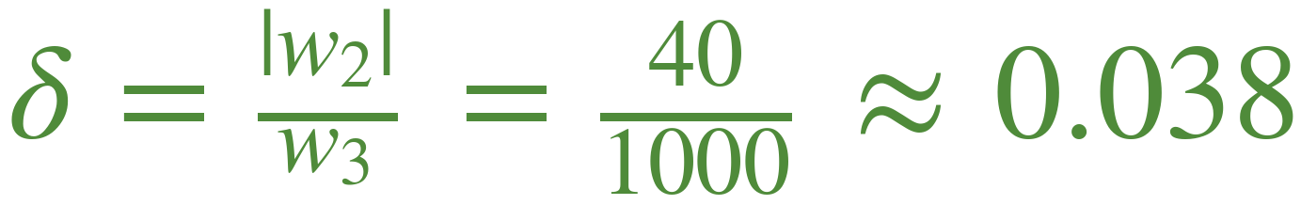

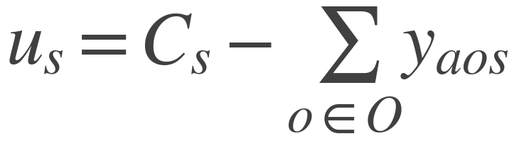
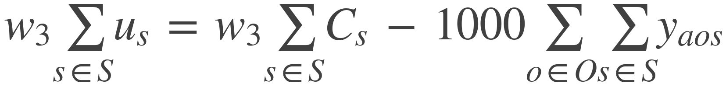
Chapter 05 · Methodology
第 25 頁
Key Observation: The Two Layers Inside M1G
The Two Layers Already in M1G
Consequence · An Implicit Realisation Rate
M1G already separates a valuation layer from a binding layer. This study does not invent that split — it re-prices it.
The constant drops out of the argmin, so what the objective really pays is:
valuation
Constrained by shi2 and shi5 only. Free of the slot limit, so it may claim more value than the station can hold. Carries w2 = -40.
binding
Constrained by shi3 and shi4. This is what actually executes — the station's order queue is built from it. Carries no coefficient of its own.
The ratio between the two layers is pinned by hand.
The long-term benefit it stands for is, in the authors' own words, “cannot be accurately quantified”.
Substituting the shi4 equality
What this study changes
Reducing the decision atom from the order to the item makes this ratio instance-dependent. It is therefore replaced by a quantity measured from the run in progress — the share of valued completions the binding layer actually takes — rather than a constant chosen in advance.
Copyright © 2026 Center for Internet of Things Innovation, NTUST. All rights reserved.
版權所有 © 2026 國立臺灣科技大學 物聯網創新中心
CITI
The data and material contained in this file is copyrighted.
Please do not use without the author’s permission.
本檔案所含資料受版權保護，未經所有人之同意請勿擅自使用
Center for IoT Innovation

Slide 26
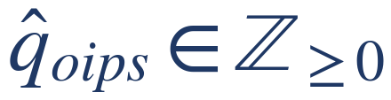
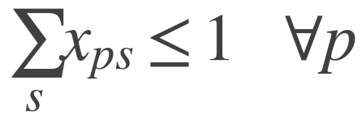



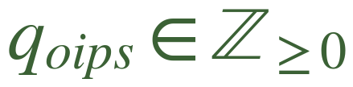
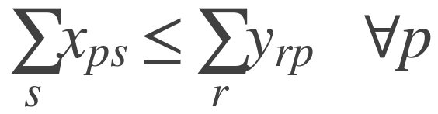

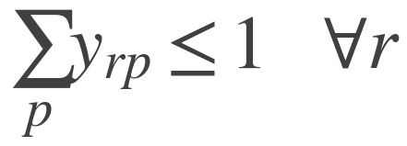
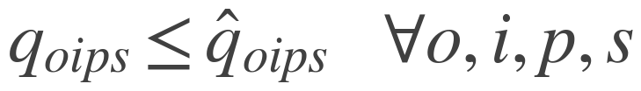
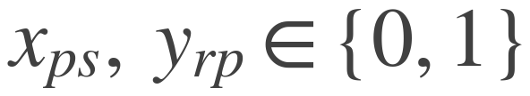
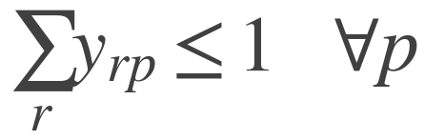
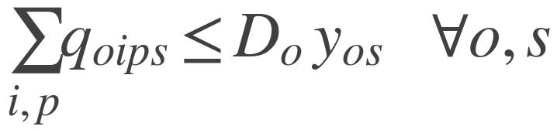

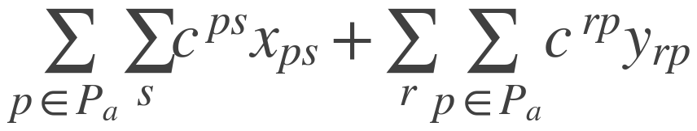
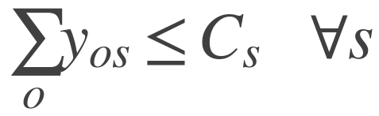
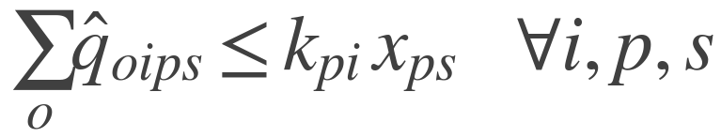
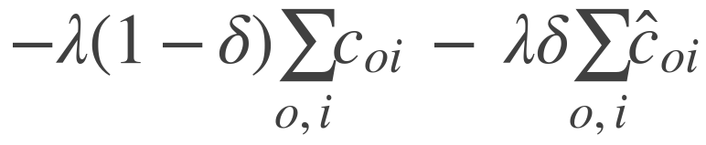
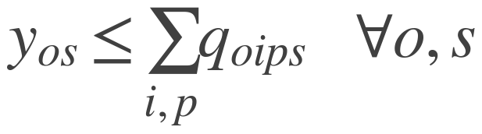
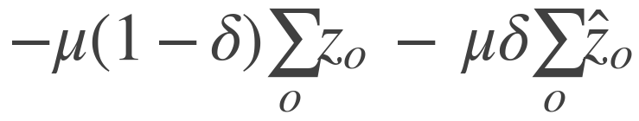
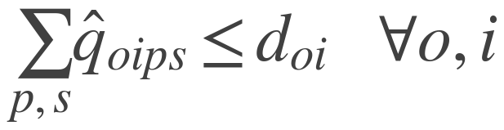
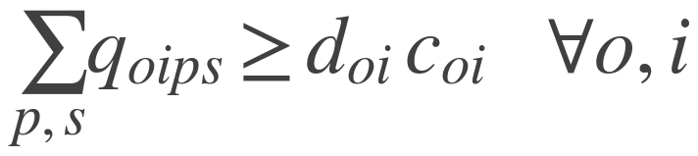
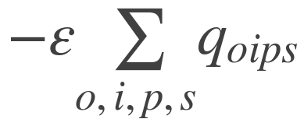
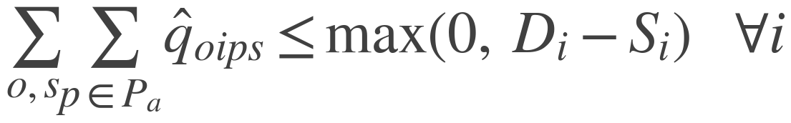

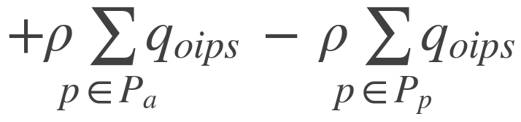
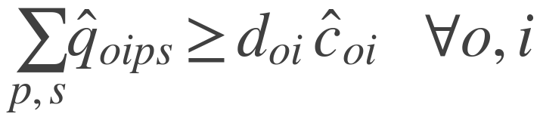

Chapter 05 · Methodology
第 26 頁
Proposed Exact Model: M4G
Decision Variables
Constraints · Resource, Valuation, Binding
VALUATION draw: units of SKU i of order o from pod p at station s
R1
V4
a pod goes to one station
completing an order requires every line closed
valued line closure and valued order completion
V4g
BINDING draw — what is actually executed
R2
an order no pod can cover cannot collect the completion reward
slot occupancy, bound line closure, bound completion
dispatching a pod requires a robot
R3
B1
pod and robot assignment — unchanged from M1G
one pod per robot
binding is a subset of valuation, per unit
Objective · T1–T6
R4
B2
one robot per pod
drawing for an order at a station occupies one of its slots
R5
B3
T1, T2
inherit committed pods and robots
travel: only newly dispatched pods pay; committed pods are sunk
V1
slot capacity — an INEQUALITY, unlike shi4
T3
a draw needs stock on that pod and that pod dispatched
B4
line closure, split across the binding and valuation layers by delta
no slot may be taken without a draw
T4
V2
B5
order completion, same split
never draw more than the residual demand
a bound closure needs the full residual bound
T5
V2a
B6
immediacy: among equally valued solutions, prefer executing now
new pods are valued only against demand inbound supply cannot cover
bound closures and completions are subsets of valued ones
T6
pod tier, binding layer only — no counterpart under an order atom
V3
B7
Linearised by Dinkelbach. All prices are in metres, read off the run in progress: mu = distance per completed order, delta = bound over valued completions.
a line counts as closed only when drawn in full
a bound completion needs every line bound-closed
Copyright © 2026 Center for Internet of Things Innovation, NTUST. All rights reserved.
版權所有 © 2026 國立臺灣科技大學 物聯網創新中心
CITI
The data and material contained in this file is copyrighted.
Please do not use without the author’s permission.
本檔案所含資料受版權保護，未經所有人之同意請勿擅自使用
Center for IoT Innovation

Slide 27

Chapter 05 · Methodology
第 27 頁
Proposed Heuristic: M5
Marginal-Line Greedy
Why the Comparison Stays Clean
M4G solves a MILP every time a slot frees. M5 solves the same model greedily: it repeatedly asks what the single best marginal move is, and takes it.
Every move sets a variable that already exists in M4G's MILP, and the loop keeps R1–R5, V1–V4 and B1–B7 satisfied throughout.
A. draw-line take one order line to its full current residual from stock already standing at a station
Every M5 solution is feasible for M4G. With both objectives written from the same price list, the gap between them is a real and reportable optimality gap rather than an unexplained difference.
B. dispatch fetch an idle pod, paying robot-to-pod plus pod-to-station distance
scored NET of the draws it unlocks — a dispatch alone is pure cost and would never be taken on its own
The objective is M4G's, term for term
Accept the most negative move; stop when none is negative.
delta is calibrated from the same bound-to-valued ratio M4G feeds, so the two solvers price identically. The one declared difference is line granularity: M5 cannot assemble a single line from two pods, which M4G can. That gap is declared, not hidden.
Station slots and free robots remain hard constraints, never prices — exactly as in M4G's B3. The splitting atom here is the LINE, not the unit: lambda accrues only when a line closes in full (V3, B5), so a per-unit move would score almost nothing until the last unit and a greedy search would never reach it.
Copyright © 2026 Center for Internet of Things Innovation, NTUST. All rights reserved.
版權所有 © 2026 國立臺灣科技大學 物聯網創新中心
CITI
The data and material contained in this file is copyrighted.
Please do not use without the author’s permission.
本檔案所含資料受版權保護，未經所有人之同意請勿擅自使用
Center for IoT Innovation

Slide 28
Chapter 05 · Methodology
第 28 頁
Model Comparison Framework
Dimension
M1G (baseline)
M4G / M5 (proposed)
Decision atom
order
item
Order splitting
none; one order in full at one station
across stations, epochs and pods; exercised only when the prices justify it
Completion variable
none; assignment implies coverage (shi5)
required (c, z); partial fulfilment breaks the implication
Slot constraint
shi4 equality; idle slots are force-filled
B3 inequality; idle slots may be left open
Two-layer ratio
pinned by hand, 1000 : 40
measured from the run in progress
Objective form
weighted linear sum, weights exogenous
ratio D / V, linearised by Dinkelbach
Price dimension
dimensionless weights
all prices in metres
Held constant
task allocation inside the model · pod and robot constraints · decision triggered on every freed slot · order-level station capacity · identical path planning and pod-return policy
Evaluation Design
Experimental Controls
Configurations differ only in the order-batching block; every arm runs on the same build.
Orders completed, items handled and backlog are reported together: splitting creates work in progress, so completed orders alone understate a splitting model.
Arms share seeds and are compared with a paired test.
Small instance M4G vs M1G the exact model against the exact baseline it derives from, under one simulator configuration.
Large instance M5 vs HADGS at fleet scale the baseline's own authors report M1G still leaves a 15.4 % gap and evaluate only their heuristic, so this follows their experimental design.
Copyright © 2026 Center for Internet of Things Innovation, NTUST. All rights reserved.
版權所有 © 2026 國立臺灣科技大學 物聯網創新中心
CITI
The data and material contained in this file is copyrighted.
Please do not use without the author’s permission.
本檔案所含資料受版權保護，未經所有人之同意請勿擅自使用
Center for IoT Innovation

Slide 29
第 29 頁
06 Experiment and Results
Copyright © 2026 Center for Internet of Things Innovation, NTUST. All rights reserved.
版權所有 © 2026 國立臺灣科技大學 物聯網創新中心
CITI
The data and material contained in this file is copyrighted.
Please do not use without the author’s permission.
本檔案所含資料受版權保護，未經所有人之同意請勿擅自使用
Center for IoT Innovation

Slide 30
Chapter 06 · Experiment and Results
第 30 頁
Experimental Design
Copyright © 2026 Center for Internet of Things Innovation, NTUST. All rights reserved.
版權所有 © 2026 國立臺灣科技大學 物聯網創新中心
CITI
The data and material contained in this file is copyrighted.
Please do not use without the author’s permission.
本檔案所含資料受版權保護，未經所有人之同意請勿擅自使用
Center for IoT Innovation

Slide 31
Chapter 06 · Experiment and Results
第 31 頁
Small-scale Results: M4G vs M1G
Copyright © 2026 Center for Internet of Things Innovation, NTUST. All rights reserved.
版權所有 © 2026 國立臺灣科技大學 物聯網創新中心
CITI
The data and material contained in this file is copyrighted.
Please do not use without the author’s permission.
本檔案所含資料受版權保護，未經所有人之同意請勿擅自使用
Center for IoT Innovation

Slide 32
Chapter 06 · Experiment and Results
第 32 頁
Heuristic Validation: M5 vs M4G
Copyright © 2026 Center for Internet of Things Innovation, NTUST. All rights reserved.
版權所有 © 2026 國立臺灣科技大學 物聯網創新中心
CITI
The data and material contained in this file is copyrighted.
Please do not use without the author’s permission.
本檔案所含資料受版權保護，未經所有人之同意請勿擅自使用
Center for IoT Innovation

Slide 33
Chapter 06 · Experiment and Results
第 33 頁
Large-scale Results: M5 vs HADGS
Copyright © 2026 Center for Internet of Things Innovation, NTUST. All rights reserved.
版權所有 © 2026 國立臺灣科技大學 物聯網創新中心
CITI
The data and material contained in this file is copyrighted.
Please do not use without the author’s permission.
本檔案所含資料受版權保護，未經所有人之同意請勿擅自使用
Center for IoT Innovation

Slide 34
Chapter 06 · Experiment and Results
第 34 頁
Discussion
Copyright © 2026 Center for Internet of Things Innovation, NTUST. All rights reserved.
版權所有 © 2026 國立臺灣科技大學 物聯網創新中心
CITI
The data and material contained in this file is copyrighted.
Please do not use without the author’s permission.
本檔案所含資料受版權保護，未經所有人之同意請勿擅自使用
Center for IoT Innovation

Slide 35
第 35 頁
07 Conclusion
Copyright © 2026 Center for Internet of Things Innovation, NTUST. All rights reserved.
版權所有 © 2026 國立臺灣科技大學 物聯網創新中心
CITI
The data and material contained in this file is copyrighted.
Please do not use without the author’s permission.
本檔案所含資料受版權保護，未經所有人之同意請勿擅自使用
Center for IoT Innovation

Slide 36
Chapter 07 · Conclusion
第 36 頁
Key Findings
Copyright © 2026 Center for Internet of Things Innovation, NTUST. All rights reserved.
版權所有 © 2026 國立臺灣科技大學 物聯網創新中心
CITI
The data and material contained in this file is copyrighted.
Please do not use without the author’s permission.
本檔案所含資料受版權保護，未經所有人之同意請勿擅自使用
Center for IoT Innovation

Slide 37
Chapter 07 · Conclusion
第 37 頁
Contributions
Copyright © 2026 Center for Internet of Things Innovation, NTUST. All rights reserved.
版權所有 © 2026 國立臺灣科技大學 物聯網創新中心
CITI
The data and material contained in this file is copyrighted.
Please do not use without the author’s permission.
本檔案所含資料受版權保護，未經所有人之同意請勿擅自使用
Center for IoT Innovation

Slide 38
Chapter 07 · Conclusion
第 38 頁
Limitations
Copyright © 2026 Center for Internet of Things Innovation, NTUST. All rights reserved.
版權所有 © 2026 國立臺灣科技大學 物聯網創新中心
CITI
The data and material contained in this file is copyrighted.
Please do not use without the author’s permission.
本檔案所含資料受版權保護，未經所有人之同意請勿擅自使用
Center for IoT Innovation

Slide 39
Chapter 07 · Conclusion
第 39 頁
Future Work
Copyright © 2026 Center for Internet of Things Innovation, NTUST. All rights reserved.
版權所有 © 2026 國立臺灣科技大學 物聯網創新中心
CITI
The data and material contained in this file is copyrighted.
Please do not use without the author’s permission.
本檔案所含資料受版權保護，未經所有人之同意請勿擅自使用
Center for IoT Innovation

Slide 40
第 40 頁
Thank you !
Kai-Hsiang, Chuang
2026
Industrial Management Department
Center for Internet of Things Innovation
National Taiwan University of Science and Technology
Copyright © 2026 Center for Internet of Things Innovation, NTUST. All rights reserved.
版權所有 © 2026 國立臺灣科技大學 物聯網創新中心
CITI
The data and material contained in this file is copyrighted.
Please do not use without the author’s permission.
本檔案所含資料受版權保護，未經所有人之同意請勿擅自使用
Center for IoT Innovation

Slide 41
第 41 頁
08 References
Copyright © 2026 Center for Internet of Things Innovation, NTUST. All rights reserved.
版權所有 © 2026 國立臺灣科技大學 物聯網創新中心
CITI
The data and material contained in this file is copyrighted.
Please do not use without the author’s permission.
本檔案所含資料受版權保護，未經所有人之同意請勿擅自使用
Center for IoT Innovation

Slide 42
第 42 頁
09 Q&A
Copyright © 2026 Center for Internet of Things Innovation, NTUST. All rights reserved.
版權所有 © 2026 國立臺灣科技大學 物聯網創新中心
CITI
The data and material contained in this file is copyrighted.
Please do not use without the author’s permission.
本檔案所含資料受版權保護，未經所有人之同意請勿擅自使用
Center for IoT Innovation

Slide 43
第 43 頁
10 Appendix
Copyright © 2026 Center for Internet of Things Innovation, NTUST. All rights reserved.
版權所有 © 2026 國立臺灣科技大學 物聯網創新中心
CITI
The data and material contained in this file is copyrighted.
Please do not use without the author’s permission.
本檔案所含資料受版權保護，未經所有人之同意請勿擅自使用
Center for IoT Innovation

Slide 44




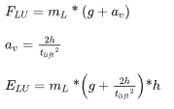


Chapter 10 · Appendix
第 44 頁
Energy Calculation Module
Constant Speed
Energy for rotating or turning
Acceleration
Energy for lowering
Energy for lifting
Deceleration
Rizqi, Z. U., Chou, S. Y., & Oscar, A. D. (2025). Towards energy-efficient Robotic Mobile Fulfillment System: Hybrid agent-based simulation with DEA-based surrogate machine learning. Applied Soft Computing, 176, 113141.
Copyright © 2026 Center for Internet of Things Innovation, NTUST. All rights reserved.
版權所有 © 2026 國立臺灣科技大學 物聯網創新中心
CITI
The data and material contained in this file is copyrighted.
Please do not use without the author’s permission.
本檔案所含資料受版權保護，未經所有人之同意請勿擅自使用
Center for IoT Innovation

Slide 45
Chapter 02 · Literature Gap
第 45 頁
RMFS Order-Picking Decision Research
Decision Problem | Decision Problem | Decision Problem | Decision Problem
Order Assignment (OA) / Pod Selection (PS) | Order Assignment (OA) / Pod Selection (PS) | Task Allocation (TA) | Path Planning (PP)
Picking Order Assignment (POA) | Picking Pod Selection (PPS)
Replenishment Order Assignment (ROA) | Replenishment Pod Selection (RPS)
Copyright © 2026 Center for Internet of Things Innovation, NTUST. All rights reserved.
版權所有 © 2026 國立臺灣科技大學 物聯網創新中心
CITI
The data and material contained in this file is copyrighted.
Please do not use without the author’s permission.
本檔案所含資料受版權保護，未經所有人之同意請勿擅自使用
Center for IoT Innovation

