Slide 1
Recurrent MADDPG for Object Detection and Assignment in
Combat Tasks
Author-
X. Wei, L. Yang, G. Cao, T. Lu and B. Wang, "Recurrent MADDPG for Object Detection and Assignment in Combat Tasks," in IEEE Access, vol. 8, pp. 163334-163343, 2020,
doi: 10.1109/ACCESS.2020.3022638.
Publisher: IEEE
Published on 08 September 2020
Presented by- SOMEET SINGH
A2368420003
Notes:
Amity School of Engineering and Technology

Slide 2
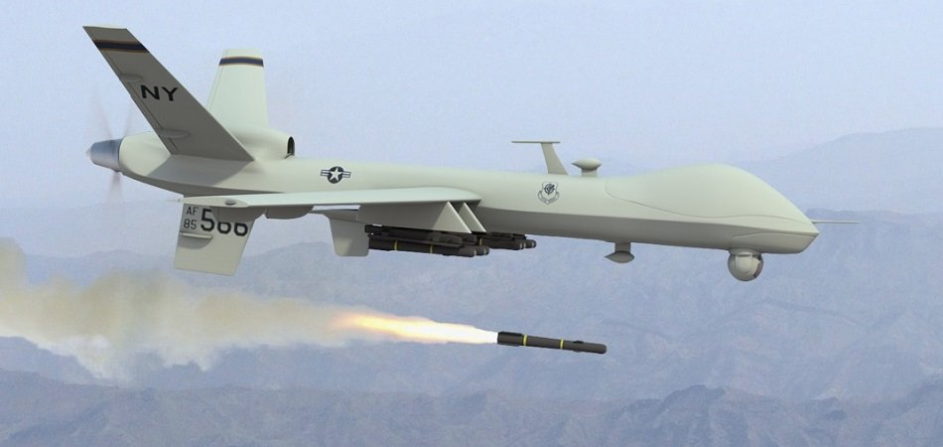
Introduction
In the future, as other artificial intelligence theories are developed, artificial intelligence will play a more critical role in wargames. The capabilities of multiagent modeling to describe complex systems and predict actions in dynamic environments are superior to those of traditional methods. In this paper, we use a 3D wargame engine from China Aerospace System Simulation Technology Co., Ltd. named All Domain Simulation (ACS), which supports land, sea, and air combat scenarios, to simulate combat.
we train the UAV’s behavior by well-designed reward shaping and multiagent reinforcement learning (MARL) with LSTM. We improved the RDPG algorithm and merged the MADDPG and RDPG algorithms

Slide 3
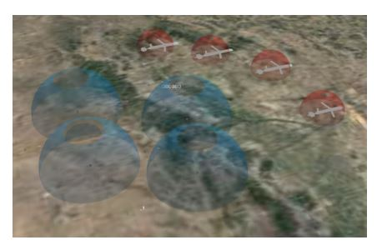
PROBLEM DESCRIPTION
This paper mainly aims to accomplish the multiagent monitoring and search task in a wide range of largescale, unknown, complex environments as quickly as possible.
The search mission requires the UAVs to have the autonomous search, response and navigation capabilities according to different environmental characteristics
the capability to overcome information interference from the external environment and the capability to track targets efficiently and autonomously in real-time

Slide 4
The UAVs in a cluster are defined as 1, 2 . . . N; and Xi is the status sequence of UAVi , including its position, sensing distance and orientation.
N is the number of UAVs, t is the simulation moment, T is the target position set in the environment, and (x, y)r is the target position coordinate.
B is the location set of the obstacles in the environment, (x, y)b is the location coordinates of the obstacles, (x, y)Xi is the dynamic position coordinates of UAVx at time t, and (vx , vy)Xi is the dynamic velocity coordinates of UAVx at time t.
To facilitate the research, the following assumptions are made:
1) Goals do not overlap.
2) The target and radar range do not overlap.
3) The UAV cluster is fixed at a stable flying altitude.
This paper aims to use a group of unmanned aerial vehicles (UAVs) to detect dynamic and static targets in a large-scale unstructured environment with obstacles.

Slide 5
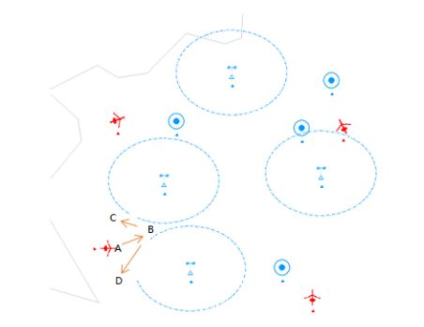
METHODS
MULTI UAV NAVIGATION AS A POMDP

Slide 6
OBSERVATION SPACE AND ACTION SPACE SPECIFICATION
The UAV group needs to obtain three information sources:
the first is the speed [x, y] and position [x, y] of the agent itself,
the second is the relative coordinate vector tau = [d0 . . . dN ] of other agents and the current agent.
The third is the relative coordinate vector psi = [d0 . . . dN ] of the current agent and the obstacles.

Slide 7
REWARD DESIGN
The reward value is the convergence direction of the neural network. When multiagent navigate in a complex environment, the reward of each agent depends on the distance to the nearest target and whether it collides with other agents.
The closer the distance is the greater the reward. C = ( −1, collision 0, not collision (2) Suppose that the distance between agent i and target j is D(i, j). Then, the reward of agent i is: Ri − min j le N (D(i, j)) + C.

Slide 8
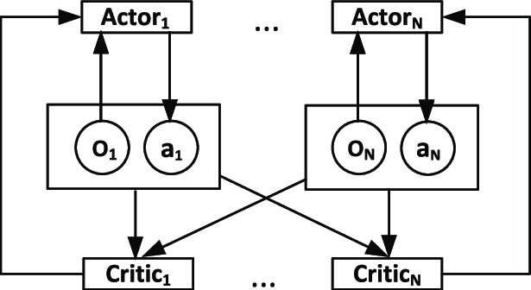
MADDPG
In the multiagent environment, N combat units can be expressed as Markov decision-making processes (MDPs). We define state S as all possible conditions of all agents and action A as a series of actions a1, a2, . . . an.
The policy for each agent is defined by πi , which is used to calculate the action based on the current status of si . After its execution, agent gets the reward ri . The goal of each agent in each iteration is to maximize its expected total revenue.
All agents share the same reward function and discount factor γ.

Slide 9
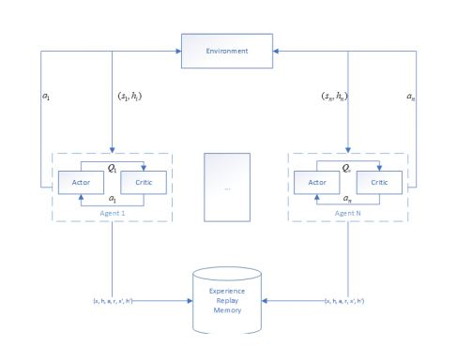
RECURRENT MADDPG
this paper proposes a multiagent actor-criticism model based on long short-term memory (LSTM) network recursion. The model only accepts data from one time frame per simulation step. The LSTM model extends the actor-critic framework of the MADDPG by storing the information before the step through the hidden layers, which makes learning using time series possible in a multiagent warfare environment.

Slide 10
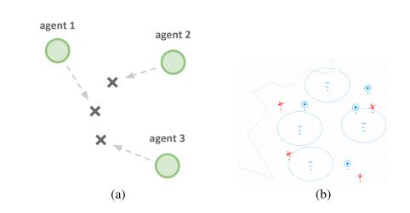
Experimentation
The Author constructed a the combat scenario as described in this paper that by combining the multiagent particle environment developed by OpenAI and the simulator named ACS.
There are several agents in this combat scenario. We combine the two training techniques with the MADDPG and fastMARDPG conduct comprehensive experiments to illustrate the performances of the two techniques.
one contains three agents and three targets, and the other includes four agents and four targets
The difference is that there are four obstacles in ACS environment. The four obstacles are four radar detectors. The agent needs to bypass radar detection, and then navigate to the target location automatically.

Slide 11
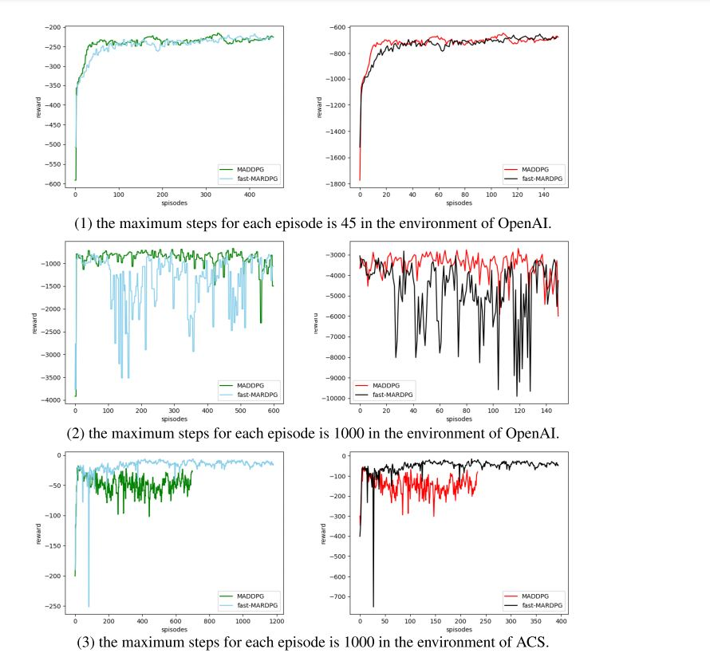
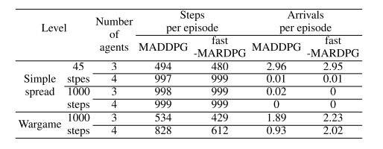
Experimentation Results
The comparison of the fast-MARDPG and MADDPG and the average reward of all agents for a simple navigate task with several agents and targets without obstacles in the OpenAI and ACS environments, each set of images describes the average reward value of three agents and four agents, where the maximum number of steps for each episode is 45 and 1000, respectively.

Slide 12
Conclusion
In this paper the author found given conclusion that when we focus on the two methods of MARL and the LSTM network and we combine and improve these two methods. Without map navigation and path planning, our method enables multiple UAVs to fly from arbitrary departure points to destinations in large-scale, complex environments.
The results demonstrate that the fast-MARDPG is more efficient than the MADDPG. However, there are still great defects in the experiment.
Regarding their time performance, there is still some work to do in the future.
For example, it is necessary to address how to make the accuracy rate no longer decrease under the situation of increasing agents.
Furthermore, how to design and fine-tune the reward function is necessary otherwise, it may yield unsatisfactory performance.

Slide 13
REFERENCES
N. Heess, J. Hunt, T. Lillicrap, and D. Silver, ‘‘Memory-based control with recurrent neural networks,’’ 2015, arXiv:1512.04455. [Online]. Available: https://arxiv.org/abs/1512.04455
R. Lowe, Y. Wu, A. Tamar, J. Harb, P. Abbeel, and I. Mordatch, ‘‘Multiagent actor-critic for mixed cooperative-competitive environments,’’ in Proc. Adv. Neural Inf. Process. Syst., 2017, pp. 6379–6390.
T. P. Lillicrap, J. J. Hunt, A. Pritzel, N. Heess, T. Erez, Y. Tassa, D. Silver, and D. Wierstra, ‘‘Continuous control with deep reinforcement learning,’’ Sep. 2015, arXiv:1509.02971. [Online]. Available: https://arxiv.org/abs/1509.02971
V. R. Konda and J. N. Tsitsiklis, ‘‘Actor-critic algorithms,’’ in Proc. Neural Inf. Process. Syst. Conf. Cambridge, MA, USA: MIT Press, 2000, pp. 1008–1014.
R. E. Wang, M. Everett, and J. How, ‘‘R-MADDPG for partially observable environments and limited communication,’’ 2020, arXiv:2002.06684. [Online]. Available: https://arxiv.org/abs/2002.06684
[6] S. Iqbal and F. Sha, ‘‘Actor-attention-critic for multi-agent reinforcement learning,’’ in Proc. 36th Int. Conf. Mach. Learn. (PMLR), 2019, pp. 2961–2970.
[7] Y. Yang, J. Hao, G. Chen, H. Tang, Y. Chen, Y. Hu, C. Fan, and Z. Wei, ‘‘Q-value path decomposition for deep multiagent reinforcement learning,’’ 2020, arXiv:2002.03950. [Online]. Available: https://arxiv.org/abs/2002.03950

Slide 14
[8] Y. Yang, J. Hao, B. Liao, K. Shao, G. Chen, W. Liu, and H. Tang, ‘‘Qatten: A general framework for cooperative multiagent reinforcement learning,’’ 2020, arXiv:2002.03939. [Online]. Available: https://arxiv.org/abs/2002.03939
[9] J. Han, C.-h. Wang, and G.-x. Yi, ‘‘Cooperative control of UAV based on multi-agent system,’’ in Proc. IEEE 8th Conf. Ind. Electron. Appl. (ICIEA), Jun. 2013, pp. 96–101. [10] P. Frasca, R. Carli, and F. Bullo, ‘‘Multiagent coverage algorithms with gossip communication: Control systems on the space of partitions,’’ in Proc. Amer. Control Conf., 2009, pp. 2228–2235.
[11] L. Matignon, G. J. Laurent, and N. Le Fort-Piat, ‘‘Hysteretic Q-learning: An algorithm for decentralized reinforcement learning in cooperative multi-agent teams,’’ in Proc. IEEE/RSJ Int. Conf. Intell. Robots Syst., Oct. 2007, pp. 64–69.
[12] E. Semsar-Kazerooni and K. Khorasani, ‘‘Multi-agent team cooperation: A game theory approach,’’ Automatica, vol. 45, no. 10, pp. 2205–2213, Oct. 2009.

