Slide 1
Unit-5
Data Visualization:

Slide 2
Data Visualization:
The ever-growing volume of data and its importance for business make data visualization an essential part of business strategy for many companies.
In this article, we review major data visualization instruments and name the key factors that influence the choice of visualization techniques and tools. We will talk about the most widely-used tools for data visualization and give a few pro tips on how to combine data visualizations into effective dashboards.

Slide 3
What determines data visualization choices
Ch. 16
Visualization is the first step to make sense of data. To translate and present complex data and relations in a simple way, data analysts use different methods of data visualization — charts, diagrams, maps, etc. Choosing the right technique and its setup is often the only way to make data understandable.
Vice versa, poorly selected tactics won't let you unlock the full potential of data or even make it irrelevant.

Slide 4
5 factors that influence data visualization choices:
Sec. 16.1
Audience. It’s important to adjust data representation to the specific target audience. For example, fitness mobile app users who browse through their progress can easily work with uncomplicated visualizations. On the other hand, if data insights are intended for researchers and experienced decision-makers who regularly work with data, you can and often have to go beyond simple charts.
Content. The type of data you are dealing with will determine the tactics. For example, if it’s time-series metrics, you will use line charts to show the dynamics in many cases. To show the relationship between two elements, scatter plots are often used. In turn, bar charts work well for comparative analysis.
Context. You can use different data visualization approaches and read data depending on the context. To emphasize a certain figure, for example, significant profit growth, you can use the shades of one color on the chart and highlight the highest value with the brightest one. On the contrary, to differentiate elements, you can use contrast colors.

Slide 5
Sec. 16.1
4. Dynamics. There are various types of data, and each type has a different rate of change. For example, financial results can be measured monthly or yearly, while time series and tracking data are changing constantly. Depending on the rate of change, you may consider dynamic representation (steaming) or static data visualization techniques in data mining.
5. Purpose. The goal of data visualization affects the way it is implemented. In order to make a complex analysis, visualizations are compiled into dynamic and controllable dashboards equipped with different tools for visual data analytics (comparison, formatting, filtering, etc.). However, dashboards are not necessary to show a single or occasional data insight.

Slide 6
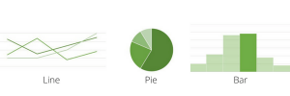
Data visualization techniques
Sec. 16.2
Depending on these factors, you can choose different data visualization techniques and configure their features. Here are the common types of data visualization techniques:
Charts
The easiest way to show the development of one or several data sets is a chart. Charts vary from bar and line charts that show the relationship between elements over time to pie charts that demonstrate the components or proportions between the elements of one whole.

Slide 7
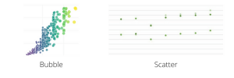
Plots
Plots allow to distribute two or more data sets over a 2D or even 3D space to show the relationship between these sets and the parameters on the plot. Plots also vary. Scatter and bubble plots are some of the most widely-used visualizations. When it comes to big data, analysts often use more complex box plots to visualize the relationships between large volumes of data.

Slide 8
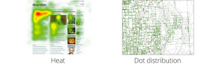
Maps
Maps are popular techniques used for data visualization in different industries. They allow locating elements on relevant objects and areas — geographical maps, building plans, website layouts, etc. Among the most popular map visualizations are heat maps, dot distribution maps, cartograms.

Slide 9
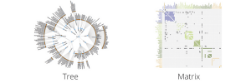
Diagrams and matrices
Diagrams are usually used to demonstrate complex data relationships and links and include various types of data in one visual representation. They can be hierarchical, multidimensional, tree-like.
Matrix is one of the advanced data visualization techniques that help determine the correlation between multiple constantly updating (steaming) data sets.

Slide 10
Data visualization tools
Together with the demand for data visualization and analysis, the tools and solutions in this area develop fast and extensively. Novel 3D visualizations, immersive experiences and shared VR offices are getting common alongside traditional web and desktop interfaces. Here are three categories of data visualization technologies and tools for different types of users and purposes.

Slide 11
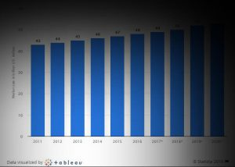
Data visualization tools for everyone
Tableau is one of the leaders in this field. Newbies and professional analytics companies like Statista rely on this platform to derive meaning from data and use insights for effective storytelling.

Slide 12
Apart from a user-friendly interface and a rich library of interactive visualizations and data representation techniques, Tableau stands out for its powerful capabilities. The platform provides large integration options including My SQL, Teradata, Hadoop and Amazon Web Services. This is a great tool for both occasional data visualizations and professional data analytics.
The system can easily handle any type of data, including streaming performance data, and allows to combine visualizations into functional dashboards. Tableau invests in AI and augmented analytics and equips customers with tools for advanced analytics and forecasting.

Slide 13
Data visualization tools for coders
This category of tools includes more sophisticated platforms. They stand out for rich functionality to fully unlock the benefits of data visualization and also allow to add visual data analytics techniques and features to complex scalable systems built on modern web app architecture approaches and cloud technologies.
Plotly is one of the most popular platforms in this category. It’s more complex than Tableau, however, comes with analytics perks. With this visualization tool, you can create charts using R or Python, build custom data analytics web apps with Python, and even use and collaborate in rich open-source libraries for R, Python and JavaScript.

Slide 14
Also in this category:
Sisense is another data visualization tool with full-stack analytics capabilities. This cloud-based platform has a drag-and-drop interface, can handle multiple data sources and supports natural language queries. It can be a bit complicated for rookies though.
IBM Watson Analytics is known for its NLP capabilities. The platform supports conversational data control and provides versatile dashboard building and data reporting tools. However, IBM Watson Analytics is not cheap and works best for large-scale data visualization and analytics tasks.

Slide 15

Tools for complex data visualization and analytics
The growing adoption of connected technology places a lot of opportunities before the companies and organizations. To deal with large volumes of multi-source often unstructured data, businesses search for more complex visualization and analytics solutions. This category includes Microsoft Azure Power BI, ELK stack Kibana and Grafana.
Power BI is exceptional for its highly intuitive drag-and-drop interface, short learning curve and large integration capabilities, including Salesforce and MailChimp. Not to mention moderate pricing ($9.99 per month for a Pro version).

Slide 16
Power BI became one of the most powerful data visualization and analytics tools that can handle literally any amount and any type of data.
First of all, the platform allows you to create customized reports from different data sources and get insights in a couple of clicks. Secondly, Power BI is powerful and can easily work with streaming real-time data. Finally, it’s not only fully compatible with Azure and other Microsoft services but also can directly connect to existing apps and drive analytics to custom systems.

Slide 17
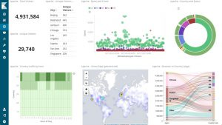
Kibana is the part of the Elastic Stack that turns data into visual insights. It’s built on and designed to work on Elasticsearch data. This exclusivity, however, does not prevent it from being one of the best data visualization tools for log data.

Slide 18
Kibana allows you to explore various big data visualization techniques in data science — interactive charts, maps, histograms, etc. Moreover, Kibana goes beyond building standard dashboards for data visualization and analytics.
This tool will help you create advanced analytics: combine visualizations from multiple sources to find correlations, explore trends and add machine learning features to reveal hidden relationships between events. Rich toolkit for developers and APIs come as a cherry on top.
Grafana — professional data visualization and analytic tool that supports a wide range of data sources, including AWS, Elasticsearch and Prometheus.
Even though Grafana is more flexible in terms of integrations compared to Kibana, each of the systems works best with its own type of data. In the case of Grafana, it’s metrics. It makes this tool popular for building IoT applications and creating visualizations for telemetry systems that use different IoT data collection methods.

Slide 19
Grafana allows you to visualize and compile different types of metrics data into complex dynamic dashboards. It has a wide variation of admin roles which makes it perfect for complex monitoring and control systems.
Additionally, it enables alerts and notifications based on predefined rules. And finally, Grafana has perks for fast data analytics, such as creating custom filters and making annotations — adding metadata to certain events on a dashboard.

