Slide 1
UNIT 4

Slide 2
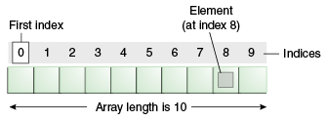
Java Arrays
An array is a collection of similar type of elements which has contiguous memory location

Slide 3
Types of Array in java
Single Dimensional Array
Multidimensional Array

Slide 4
Single Dimensional Array
Syntax to Declare an Array in Java
dataType[] arr; (or)
dataType []arr; (or)
dataType arr[];
Instantiation of an Array in Java
arrayRefVar=new datatype[size];

Slide 5
Example of Java Array
class Testarray{
public static void main(String args[]){
int a[]=new int[5];//declaration and instantiation
a[0]=10;//initialization
a[1]=20;
a[2]=70;
a[3]=40;
a[4]=50;
//traversing array
for(int i=0;i<a.length;i++)//length is the property of array
System.out.println(a[i]);
}}

Slide 6
Multidimensional Array in Java
dataType[][] arrayRefVar; (or)
dataType [][]arrayRefVar; (or)
dataType arrayRefVar[][]; (or)
dataType []arrayRefVar[];
Example
int[][] arr=new int[3][3];//3 row and 3 column

Slide 7
Addition of 2 Matrices in Java
class Testarray5{
public static void main(String args[]){
//creating two matrices
int a[][]={{1,3,4},{3,4,5}};
int b[][]={{1,3,4},{3,4,5}};
//creating another matrix to store the sum of two matrices
int c[][]=new int[2][3];
//adding and printing addition of 2 matrices
for(int i=0;i<2;i++){
for(int j=0;j<3;j++){
c[i][j]=a[i][j]+b[i][j];
System.out.print(c[i][j]+" ");
}
System.out.println();//new line
}
}}

Slide 8
Collections in Java
A Collection represents a single unit of objects, i.e., a group.

Slide 9
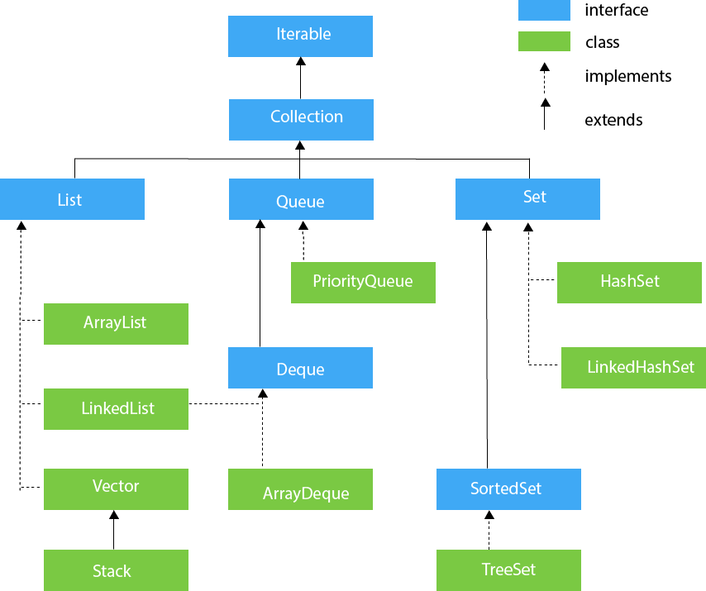
Collection Framework

Slide 10
List Interface
List <data-type> list1= new ArrayList();
List <data-type> list2 = new LinkedList();
List <data-type> list3 = new Vector();
List <data-type> list4 = new Stack();

Slide 11
ArrayList
class TestJavaCollection1{
public static void main(String args[]){
ArrayList<String> list=new ArrayList<String>();//Creating arraylist
list.add("Ravi");//Adding object in arraylist
list.add("Vijay");
list.add("Ravi");
list.add("Ajay");
//Traversing list through Iterator
Iterator itr=list.iterator();
while(itr.hasNext()){
System.out.println(itr.next());
}
}
Output
Ravi Vijay Ravi Ajay

Slide 12
LinkedList
public class TestJavaCollection2{
public static void main(String args[]){
LinkedList<String> al=new LinkedList<String>();
al.add("Ravi");
al.add("Vijay");
al.add("Ravi");
al.add("Ajay");
Iterator<String> itr=al.iterator();
while(itr.hasNext()){
System.out.println(itr.next());
}
}
}
Output
Ravi Vijay Ravi Ajay

Slide 13
Vector
Dynamic array to store the data elements.
public class TestJavaCollection3{
public static void main(String args[]){
Vector<String> v=new Vector<String>();
v.add("Ayush");
v.add("Amit");
v.add("Ashish");
v.add("Garima");
Iterator<String> itr=v.iterator();
while(itr.hasNext()){
System.out.println(itr.next());
}
output
Ayush Amit Ashish Garima

Slide 14
Stack
public class TestJavaCollection4{
public static void main(String args[]){
Stack<String> stack = new Stack<String>();
stack.push("Ayush");
stack.push("Garvit");
stack.push("Amit");
stack.push("Ashish");
stack.push("Garima");
stack.pop();
Iterator<String> itr=stack.iterator();
while(itr.hasNext()){
System.out.println(itr.next());
}
}
}
Output
Ayush Garvit Amit Ashish

Slide 15
Set Interface
Set<data-type> s1 = new HashSet<data-type>();
Set<data-type> s2 = new LinkedHashSet<data-type>();
Set<data-type> s3 = new TreeSet<data-type>();

Slide 16
HashSet
public class TestJavaCollection7{
public static void main(String args[]){
//Creating HashSet and adding elements
HashSet<String> set=new HashSet<String>();
set.add("Ravi");
set.add("Vijay");
set.add("Ravi");
set.add("Ajay");
//Traversing elements
Iterator<String> itr=set.iterator();
while(itr.hasNext()){
System.out.println(itr.next());
}
} output
Vijay Ravi Ajay

Slide 17
LinkedHashSet
public class TestJavaCollection8{
public static void main(String args[]){
LinkedHashSet<String> set=new LinkedHashSet<String>();
set.add("Ravi");
set.add("Vijay");
set.add("Ravi");
set.add("Ajay");
Iterator<String> itr=set.iterator();
while(itr.hasNext()){
System.out.println(itr.next());
}
} output
Ravi Vijay Ajay

Slide 18
TreeSet
public class TestJavaCollection9{
public static void main(String args[]){
//Creating and adding elements
TreeSet<String> set=new TreeSet<String>();
set.add("Ravi");
set.add("Vijay");
set.add("Ravi");
set.add("Ajay");
//traversing elements
Iterator<String> itr=set.iterator();
while(itr.hasNext()){
System.out.println(itr.next());
}
} output
Ajay Ravi Vijay

Slide 19
Java I/O
Stream
A stream is a sequence of data. In Java, a stream is composed of bytes. It's called a stream because it is like a stream of water that continues to flow.
1) System.out: standard output stream
2) System.in: standard input stream
3) System.err: standard error stream

Slide 20
OutputStream Hierarchy

Slide 21
InputStream class

