Slide 1
UNIT 5

Slide 2
Java JDBC
DBC stands for Java Database Connectivity. JDBC is a Java API to connect and execute the query with the database. It is a part of JavaSE (Java Standard Edition). JDBC API uses JDBC drivers to connect with the database. There are four types of JDBC drivers:
JDBC-ODBC Bridge Driver,
Native Driver,
Network Protocol Driver, and
Thin Driver

Slide 3
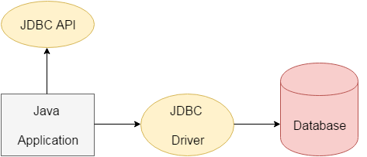

Slide 4
The java.sql package contains classes and interfaces for JDBC API. A list of popular interfaces of JDBC API are given below:
Driver interface
Connection interface
Statement interface
PreparedStatement interface
CallableStatement interface
ResultSet interface
ResultSetMetaData interface
DatabaseMetaData interface
RowSet interface

Slide 5
JDBC Driver
JDBC-ODBC bridge driver
Native-API driver (partially java driver)
Network Protocol driver (fully java driver)
Thin driver (fully java driver)

Slide 6
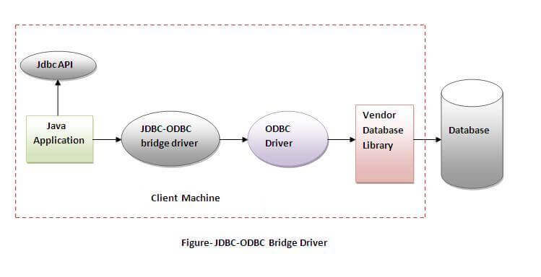
JDBC-ODBC bridge driver

Slide 7
JDBC-ODBC bridge driver
The JDBC-ODBC bridge driver uses ODBC driver to connect to the database. The JDBC-ODBC bridge driver converts JDBC method calls into the ODBC function calls.
This is now discouraged because of thin driver. Oracle does not support the JDBC-ODBC Bridge from Java 8. Oracle recommends that you use JDBC drivers provided by the vendor of your database instead of the JDBC-ODBC Bridge.

Slide 8
JDBC-ODBC bridge driver
Advantages
easy to use.
can be easily connected to any database.
Disadvantages:
Performance degraded because JDBC method call is converted into the ODBC function calls.
The ODBC driver needs to be installed on the client machine.

Slide 9
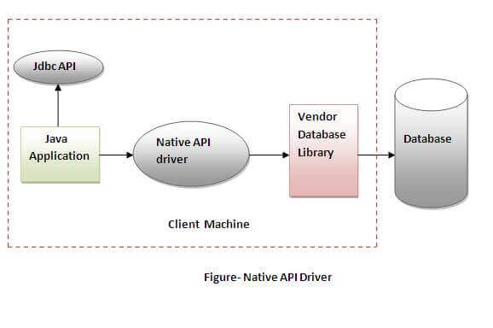
Native-API driver

Slide 10
Native-API driver
The Native API driver uses the client-side libraries of the database. The driver converts JDBC method calls into native calls of the data
Advantage:
performance upgraded than JDBC-ODBC bridge driver.
Disadvantage:
The Native driver needs to be installed on the each client machine.
The Vendor client library needs to be installed on client machine.
base API. It is not written entirely in java.

Slide 11
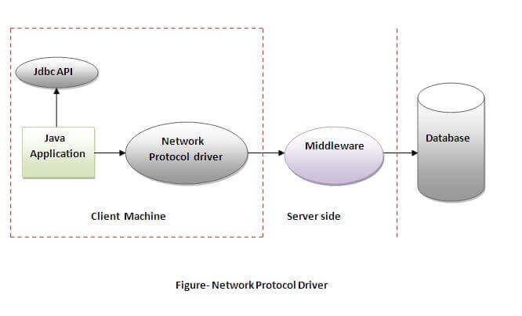
Network Protocol driver

Slide 12
Network Protocol driver
The Network Protocol driver uses middleware (application server) that converts JDBC calls directly or indirectly into the vendor-specific database protocol. It is fully written in java.
Advantage:
No client side library is required because of application server that can perform many tasks like auditing, load balancing, logging etc.
Disadvantages:
Network support is required on client machine.
Requires database-specific coding to be done in the middle tier.
Maintenance of Network Protocol driver becomes costly because it requires database-specific coding to be done in the middle tier.

Slide 13
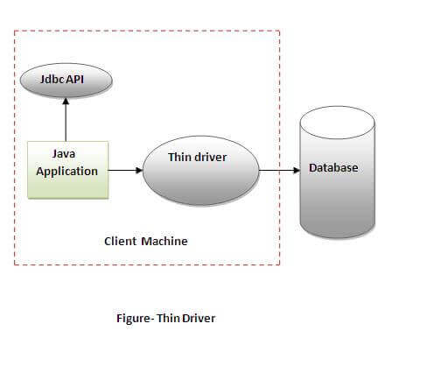
Thin driver

Slide 14
Thin driver
The thin driver converts JDBC calls directly into the vendor-specific database protocol. That is why it is known as thin driver. It is fully written in Java language.
Advantage:
Better performance than all other drivers.
No software is required at client side or server side.
Disadvantage:
Drivers depend on the Database.

Slide 15
Java Persistence API (JPA)
The Java Persistence API (JPA) is a specification of Java. It is used to persist data between Java object and relational database. JPA acts as a bridge between object-oriented domain models and relational database systems.

Slide 16
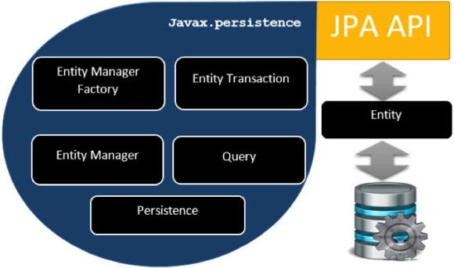
JPA - Architecture

Slide 17
Units | Description
EntityManagerFactory | This is a factory class of EntityManager. It creates and manages multiple EntityManager instances.
EntityManager | It is an Interface, it manages the persistence operations on objects. It works like factory for Query instance.
Entity | Entities are the persistence objects, stores as records in the database.
EntityTransaction | It has one-to-one relationship with EntityManager. For each EntityManager, operations are maintained by EntityTransaction class.
Persistence | This class contain static methods to obtain EntityManagerFactory instance.
Query | This interface is implemented by each JPA vendor to obtain relational objects that meet the criteria.

Slide 18
ORM Frameworks
Object Relational Mapping (ORM) is a functionality which is used to develop and maintain a relationship between an object and relational database by mapping an object state to database column. It is capable to handle various database operations easily such as inserting, updating, deleting etc.

Slide 19
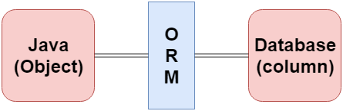
ORM Frameworks
Hibernate
TopLink
ORMLite
iBATIS
JPOX

Slide 20
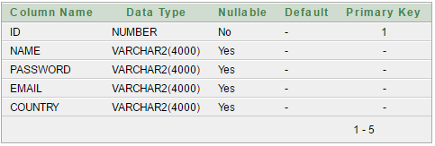
CRUD in Servlet
A CRUD (Create, Read, Update and Delete) application is the most important application for any project development. In Servlet, we can easily create CRUD application.

