Slide 1

Notes:
1st slide (Mandatory

Slide 2

Cubes
Topic/Course
Sub-Topic (Example: name of college)

Slide 3
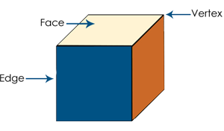
Cubes
Notes:
Title + Image + Text

Slide 4
Cuts and Pieces
N cuts will give N+1 pieces. If we have L number of cuts, B number of cuts, H number of cuts along length, breadth and height of a cube respectively, then Total number of pieces will be, (L+1)(B+1)(H+1).
Notes:
Title + Text

Slide 5

Question 1:
Directions for questions 1 to 3: A solid cube of side 8 cm has been painted red, blue and black on pairs of opposite faces. It is then cut into cubical blocks of side 2 cm each.
1. How many cubes have no face painted?
a. 1
b. 4
c. 8
d. 27
Notes:
Option c
Given cube is 4 x 4 x 4 cube where side of each cube is 2 cm
Number of zero face painted cubes = ${(n−2)}^{3}$ = ${(4−2)}^{3}$ = $2^{3}$ = 8

Slide 6
Question 2:
How many cubes have only 1 face painted?
a. 18
b. 22
c. 24
d. 8
Notes:
Option c
Number of cubes that have only one face painted = 6 ${(n−2)}^{2}$ = 6${(4−2)}^{2}$ = 24

Slide 7
Question 3:
How many cubes have only 2 faces painted?
a. 8
b. 16
c. 20
d. 24
Notes:
Option d
Cubes that have only two faces painted = 12 (n-2) = 12 (4-2)= 24

Slide 8
Question 4:
Directions for questions 4 to 8:
A solid cube is painted red on two adjacent sides and black on the sides opposite to the red sides, and green on the remaining sides. It is then cut into 64 smaller cubes of equal size.
4. How many cubes have only one side coloured?
a. 16
b. 24
c. 28
d. 32
Notes:
Option b
From each face, there are 4 cubes which are painted on one side
Total cubes = 4 * 6 faces = 24 cubes
For image – View→ Notes Page

Slide 9
Question 5:
5. How many smaller cubes have at least one side as red?
a. 16
b. 24
c. 28
d. 32
Notes:
Option c
Two of the cube’s faces are painted in red colour
From each face 16 cubes., but 4 are common
Total cubes that have at least one side as red = 16 + 16 – 4 = 28

Slide 10
Question 6:
6. How many cubes are there which are red on one side and black on the opposite side?
a. 0
b. 4
c. 8
d. 16
Notes:
Option a
There is no cube which is painted on its opposite sides

Slide 11
Question 7:
7. How many cubes have three sides painted?
a. 24
b. 8
c. 16
d. 20
Notes:
Option b
All corner cubes will be painted on three sides painted., and there are 8 corner cubes

Slide 12
Question 8:
8. How many cubes have one face green and one of the adjacent faces black or red?
a. 8
b. 16
c. 24
d. 28
Notes:
Option c
All the edge cubes of green face also have either red or green
There are 12 such cubes
Also, there are 12 more cubes on the opposite green face
Total number of cubes that have one face green
and one of the adjacent faces black or red are
12 + 12 = 24 cubes
For image View-> notes page

Slide 13
Question 9:
Directions for questions 9 to 12:
A cube has the following figures drawn on five of its faces: circle, cross, triangle, square and ellipse. The top surface is blank. The ellipse is between the cross and the triangle and the square is on the triangle’s right. The ellipse and the square are opposite to each other. Answer the following questions based on the given information.
9. Where is the circle?
a. Left of the triangle
b. On top
c. Bottom face
d. Opposite the triangle
Notes:
Option c
The following will be the arrangement according to the given conditions

Slide 14
Question 10:
10. How many arrangements are possible with the given data?
a. Only one
b. Two
c. Three
d. Four
Notes:
The following will be the arrangement according to the given conditions
For image View→ Notes page
Option a
This is the only arrangement possible with the given conditions

Slide 15
Question 11:
11. If the cube is rotated such that the face having the ellipse is towards
north, then which figure will face towards west?
a. Square
b. Triangle
c. Circle
d. Cross
Notes:
Option b
If cube is rotated such that the face having the ellipse is towards North, arrangement looks like this
For image View→ Notes page

Slide 16
Question 12:
12. The cube is rolled to get the ellipse on the top face. What is on the bottom face of the cube?
a. Square
b. Circle
c. Blank face of the cube
d. Triangle
Notes:
Option a
Square is always on the opposite face of ellipse
Hence, if ellipse is on top face, square will be on the bottom face

Slide 17
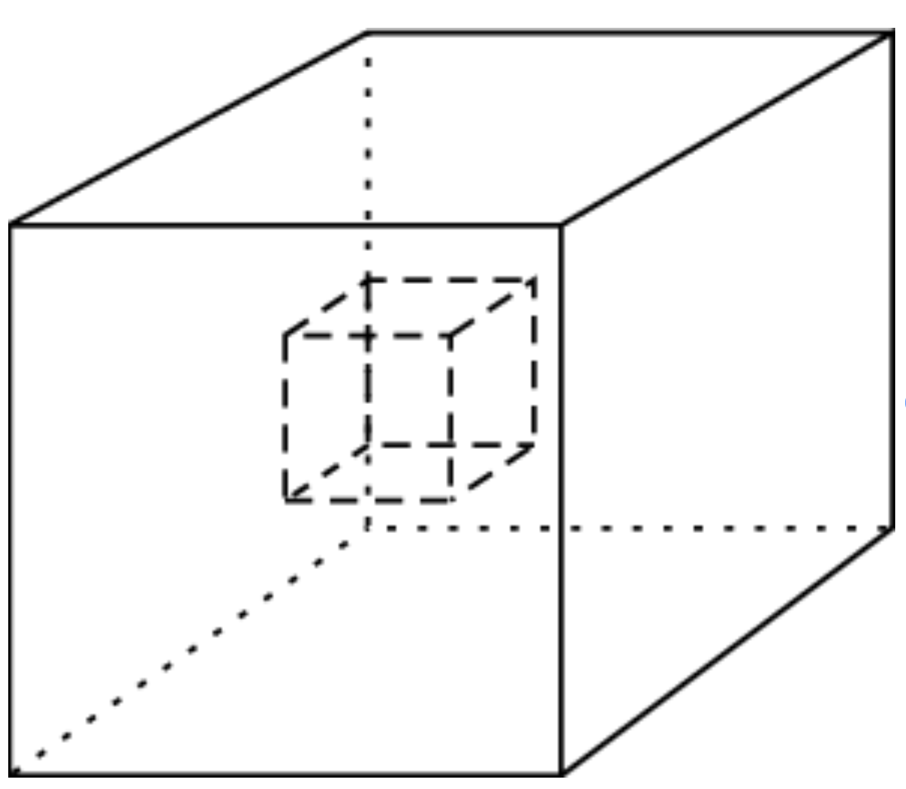
Question 13:
13. A hollow cube of size 5 cm is taken. It is made of smaller cubes of size 1 cm. If 4 faces of the outer surface of the cube are painted, totally how many faces of the smaller cubes remain unpainted?
a. 800
b. 488
c. 900
d. 500
Notes:
Option b
Total number of cubes in solid cube = 5 x 5 x 5 = 125 cubes
Total number of cubes in given hollow cube = $5^{3}$ - $3^{3}$ = 98 cubes
Total number of faces = 98 x 6 = 588
On each face of the larger cube there will be 25 faces of smaller cubes
Total faces painted = 25 x 4 = 100
Therefore, faces unpainted = 588 – 100 = 488

Slide 18
Question 14:
Directions for questions 14 to 16:A solid cube of side 9 cm has been painted green, red and yellow on pairs of opposite faces. It is then cut into cubical blocks of each side 3 cm.
14. How many cubes have none of the faces painted?
a. 1
b. 6
c. 8
d. 4
Notes:
When we see layer 1 figure, there are no cubes that have no face painted. Similarly, the layer 3 will have no cubes with no faces painted. So, we look at layer 2.
When we see layer 2 figure, there is only one small cube which is not colored. That is the core cube.
For image View → Notes Page

Slide 19
Question 15:
15. How many cubes have three faces painted?
a. 2
b. 4
c. 8
d. 12
Notes:
All the corner cubes will be having 3 faces colored

Slide 20
Question 16:
16. How many cubes have four faces painted?
a. 0
b. 1
c. 2
d. 3
Notes:
There is no small cube with four faces colored

Slide 21
Question 17:
17. What is the least number of cuts required to cut a cube into 84 identical pieces, assuming all cuts are made parallel to the faces of the cube?
11
12
13
10
Notes:
84identical pieces = 3*4*7= here 3 using 2 cuts in X, 4 using 3cuts in Y, 7 using 6cuts in Z ,
so totals cuts = 2+3+6= 11(least cuts)

Slide 22
Question 18:
18. A cube having an edge of 12 cm each. It is painted red on two opposite faces, blue on one other pair of opposite faces, black on one more face and one face is left unpainted. Then it is cut into smaller cubes of 1 cm each. Find the no. of smaller cubes which are having 0-face painted.
1100
1000
900
800
Notes:
5.According to the formula, cubes with no side painted= (12-2) ^3= 1000. But we have to include the cubes from the unpainted side too. It will be 10*10=100 So, total number of unpainted cubes= 1000+100=1100.

Slide 23
Question 19:
19. A cube of side 20cm is of blue colour with a 4cm wide yellow strip along all the sides on all the faces. The cube is then cut into 125 smaller equal size cubes. How many cubes have at least two yellow faces each?
125
44
54
27
Notes:
125 - (9*6) - 27 = 44

Slide 24
Question 20:
20. One hundred and twenty-five cubes of the same size are arranged in the form of a cube on a table. Then a column of five cubes is removed from each of the four corners. All the exposed faces of the rest of the solid (except the face touching the table) are coloured red. How many cubes do not have any coloured face?
125
44
54
36
Notes:
Cubes with no painting lie in the middle. Since there are 4 row below the top layer, total cubes with no painting are (9 x 4) = 36.
For image – View notes page of this particular slide

Slide 25

THANK YOU
Notes:
Thank you slide

