Slide 1
Network Routing: algorithms & protocols
Goal: find “good” path to each destination
Graph abstraction of a network
  Nodes: routers
  Edges: physical links (with assigned cost)
route computation algorithms
link-state (Dijkstra)
  each router knows complete topology & link cost information
  Run routing algorithm to calculate shortest path to each destination
distance-vector (Bellman-Ford)
  Each router knows direct neighbors & link costs to neighbors
  Calculate the shortest path to each destination through an iterative process based on the neighbors distances to each destination
5
B
3
C
2
5
A
2
1
F
3
1
2
D
E
1
Routing protocols
define the format of routing information exchanges
define the computation upon receiving routing updates
network topology changes over time, routing protocol must continuously update the routers with latest changes

Slide 2
Graph abstraction: costs
5
c(x,x’) = cost of link (x,x’)
- e.g., c(w,z) = 5
cost could always be 1, or
inversely related to bandwidth,
or inversely related to
congestion
v
3
w
2
5
u
2
1
z
3
1
2
x
y
1
Cost of path (x₁, x₂, x₃,…, x_{p}) = c(x₁,x₂) + c(x₂,x₃) + … + c(x_{p-1},x_{p})
Question: What’s the least-cost path between u and z ?
Routing algorithm: algorithm that finds least-cost path

Slide 3
Dijkstra’s algorithm
Assume net topology, link costs is known
computes least cost paths from one node to all other nodes
Create forwarding table for that node
Notation:
c(i,j): link cost from node i to j (∞ if not known)
D(v): current value of cost of path from source to dest. V
p(v): predecessor node along path from source to v, (neighbor of v)
N': set of nodes whose least cost path already known
1 Initialization:
2 N' = {A}
3 for all nodes v
4 if v adjacent to A
5 then D(v) = c(A,v)
6 else D(v) = ∞
7
8 Loop
find w not in N' such that D(w) is
minimum
10 add w to N'
11 update D(v) for all v adjacent to w and not in N':
12 D(v) = min( D(v), D(w) + c(w,v) )
13 /* new cost to v is either the old cost, or known shortest path cost to w plus cost from w to v */
14 until all nodes in N'

Slide 4
Dijkstra’s algorithm: example
Step
0
1
2
3
4
5
start N'
A
AD
ADE
ADEB
ADEBC
ADEBCF
D(B),p(B)
2,A
2,A
2,A
D(C),p(C)
5,A
4,D
3,E
3,E
D(D),p(D)
1,A
D(E),p(E)
infinity
2,D
D(F),p(F)
infinity
infinity
4,E
4,E
4,E
5
B
3
C
2
5
A
2
1
F
3
1
2
D
E
1

Slide 5
Dijkstra’s algorithm: example
Step
0
1
2
3
4
5
start N
A
AD
ADB
ADBE
ADBEC
ADEBCF
D(B),p(B)
2,A
2,A
D(C),p(C)
5,A
4,D
4,D
3,E
D(D),p(D)
1,A
D(E),p(E)
infinity
2,D
2,D
D(F),p(F)
infinity
infinity
infinity
4,E
4,E
Resulting forwarding table at A:
Resulting shortest-path tree for A:
destination
link
5
B
(A, B)
D
(A, D)
B
3
C
2
5
E
(A, D)
A
2
1
F
C
(A, D)
3
1
F
(A, D)
D
E
2
1

Slide 6
Dijkstra’s algorithm, discussion
Algorithm complexity: n nodes
each iteration: need to check all nodes, w, not in N
n(n+1)/2 comparisons: O(n²)
more efficient implementations possible: O(nlogn)
Oscillations possible:
e.g., link cost = amount of carried traffic
1
A
A
A
A
1+e
2+e
0
0
2+e
2+e
0
D
0
0
B
D
B
D
B
D
B
1+e
1
0
0
1+e
1
0
e
0
0
1
1+e
0
e
C
C
C
C
1
1
e
… recompute
routing
… recompute
… recompute
initially

Slide 7
Bellman-Ford Equation
Define: D_{x}(y) := cost of least-cost path from x to y
Then D_{x}(y) = min {c(x,v) + D_{v}(y) }
  where min is taken over all neighbors v of x
D_{u}(z) = min {c(u,v) + D_{v}(z),
c(u,x) + D_{x}(z),
c(u,w) + D_{w}(z) }
= min {2 + 5,
1 + 3,
5 + 3} = 4
5
v
3
w
2
5
u
2
1
z
3
1
2
x
y
1
Node leading to shortest path is next hop ➜ forwarding table

Slide 8
Distance vector protocl (1)
Basic idea:
Each node periodically sends its own distance vector estimate to neighbors
When a node x receives new DV estimate from neighbor v, it updates its own DV using B-F equation:
D_{x}(y) ← min_{v}{c(x,v) + D_{v}(y)} for each node y ∊ N
In normal cases, the estimate D_{x}(y) converge to the actual least cost d_{x}(y)

Slide 9
Distance Table: example
1
cost to destination via
B
C
E
E
Outgoing link
D ( )
A
B
C
D
A
1
7
6
4
B
14
8
9
11
A
B
C
D
A,1
D,5
D,4
D,2
7
D
5
5
4
2
D
A
8
2
1
E
D
2
destination
destination
forwarding table

Slide 10
Distance Vector Protocol (2)
Iterative, asynchronous: each local iteration caused by:
local link cost change
DV update message from neighbor
Distributed:
each node notifies neighbors only when its DV changes
  neighbors then notify their neighbors if necessary
Each node:
wait for (change in local link cost of msg from neighbor)
recompute estimates
if DV to any dest has changed, notify neighbors

Slide 11
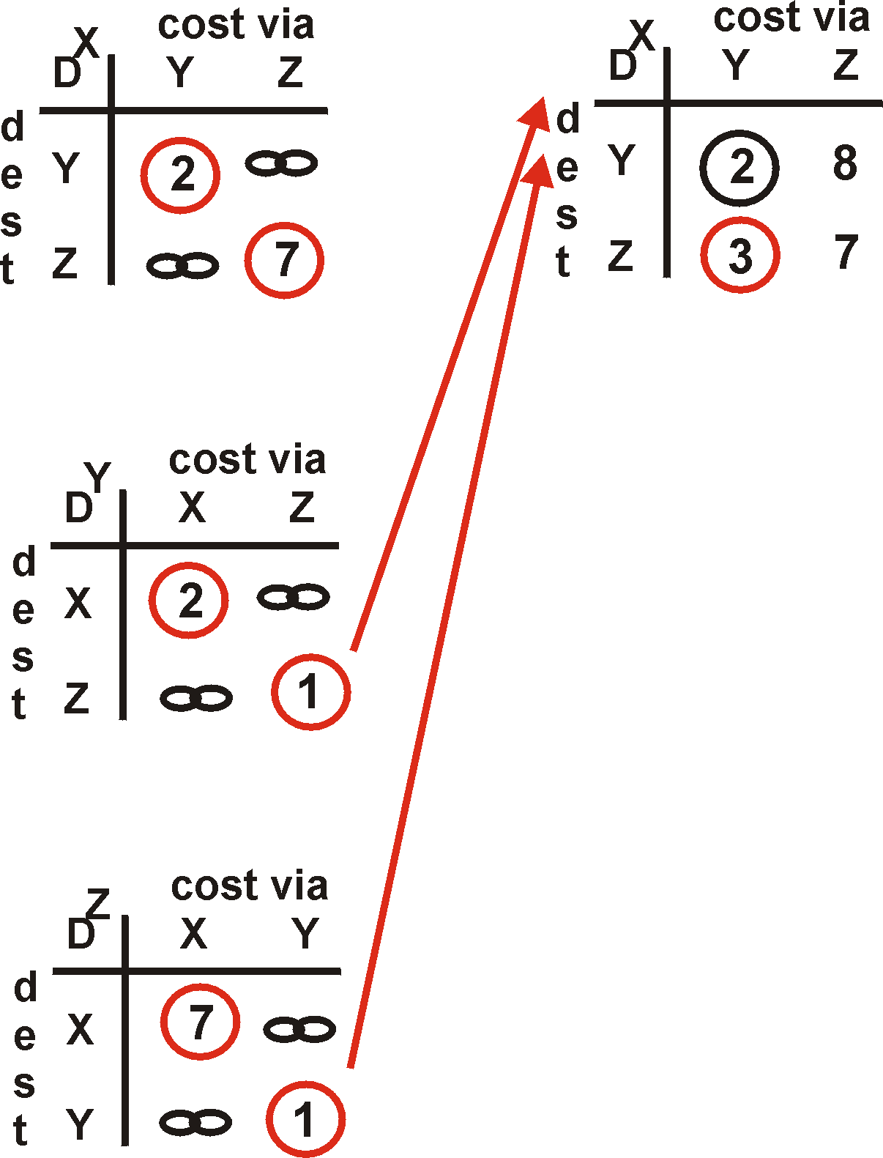
Distance Vector: an example
Y
2
1
X
Z
X
Z
7
D (Y,Z)
=
c(X,Z) + min {D (Y,w)}
w
=
7+1 = 8
X
Y
D (Z,Y)
=
c(X,Y) + min {D (Z,w)}
w
=
2+1 = 3

Slide 12
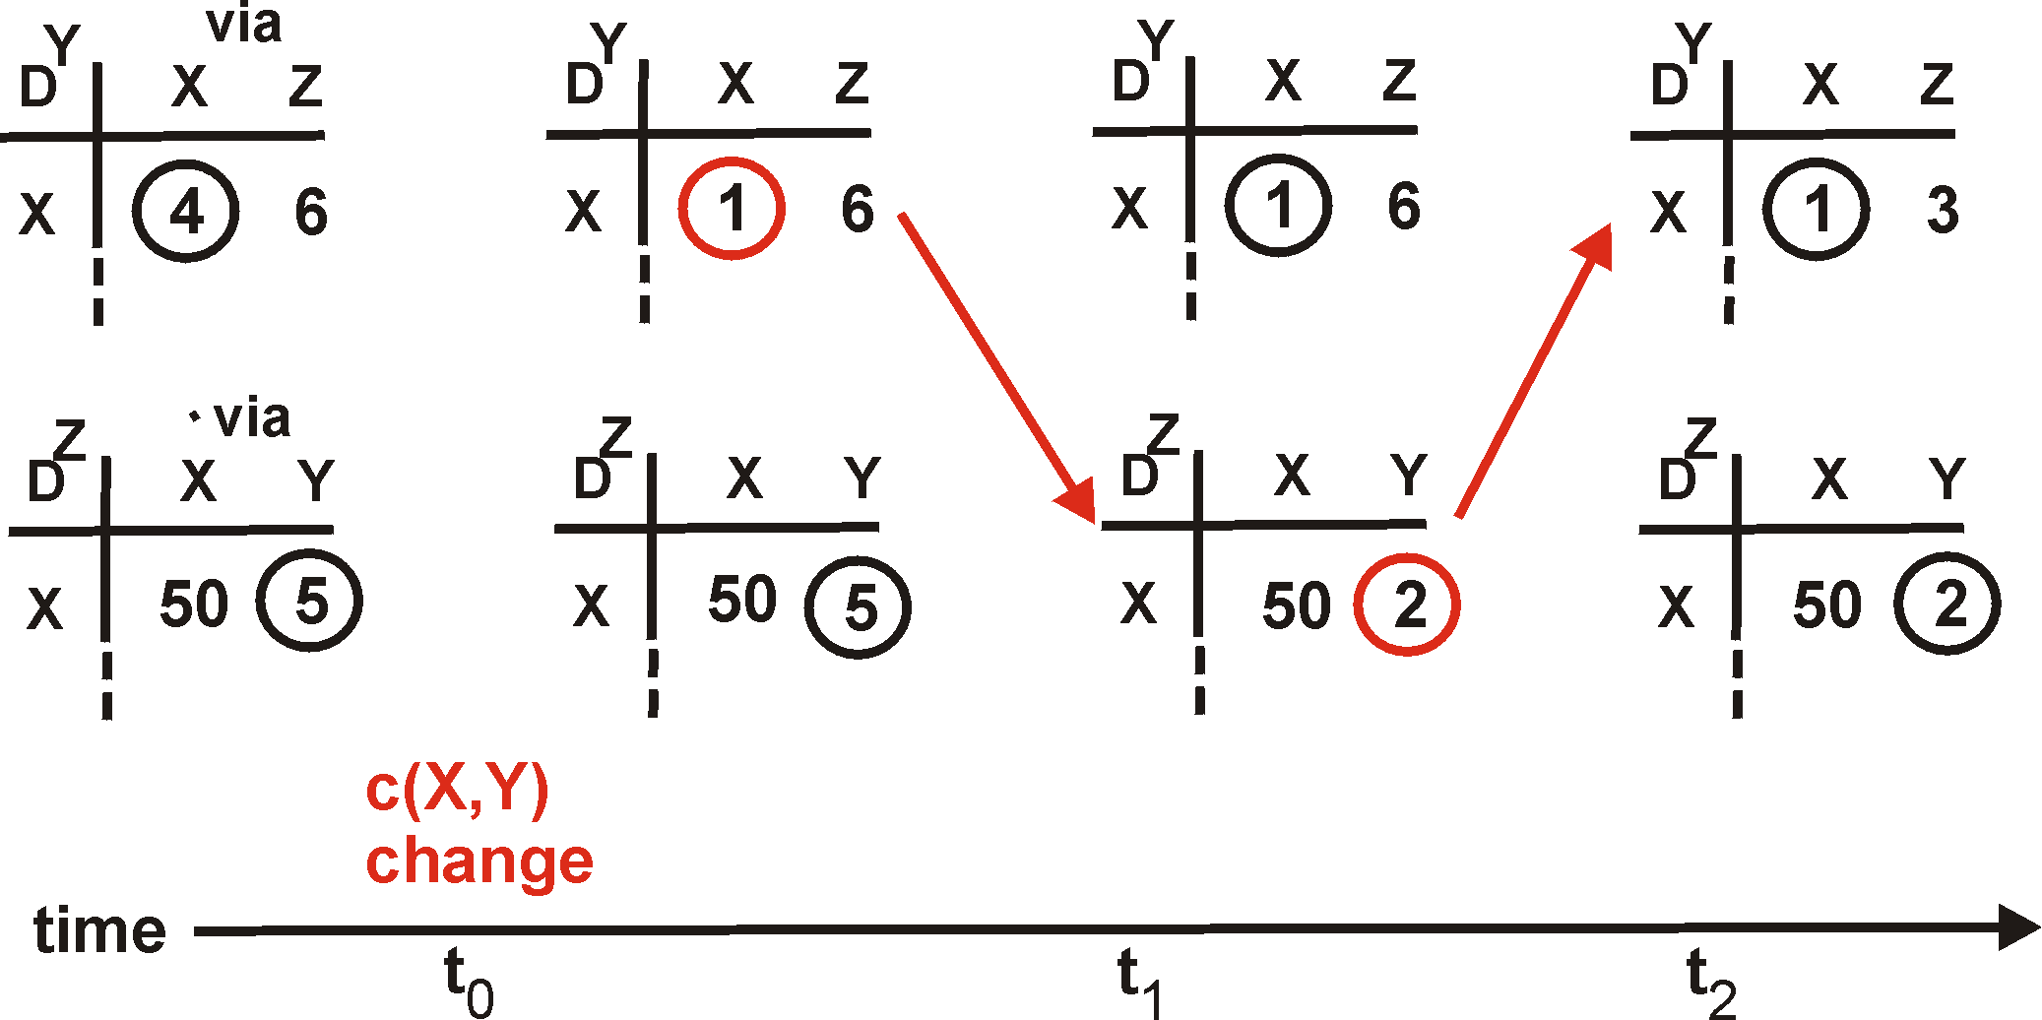
Distance Vector: link cost changes
Link cost changes:
node detects local link cost change
updates distance table (line 15)
if cost change in least cost path, notify neighbors (lines 23,24)
1
Y
4
1
X
Z
50
algorithm
terminates
“good news
travels
fast”

Slide 13
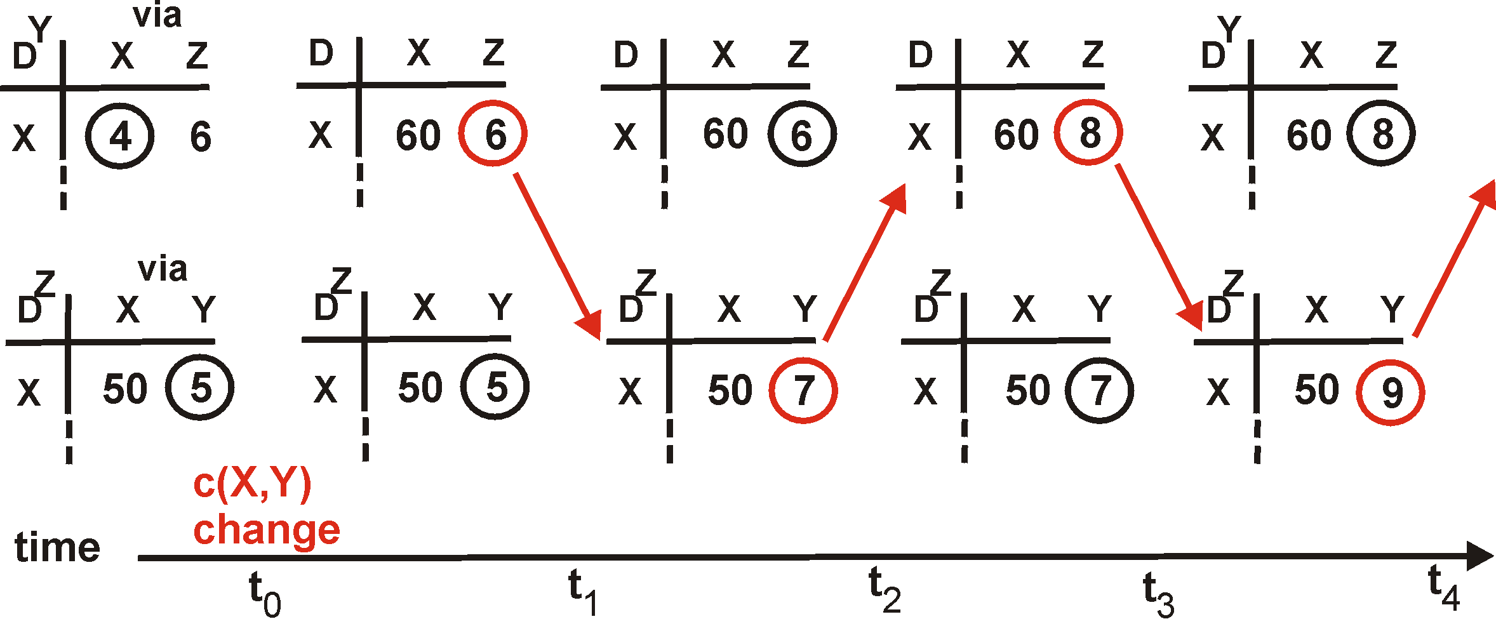
Distance Vector: link cost changes (2)
Link cost changes:
bad news travels slow - “count to infinity” problem!
60
Y
4
1
X
Z
50
algorithm
continues
on!

Slide 14
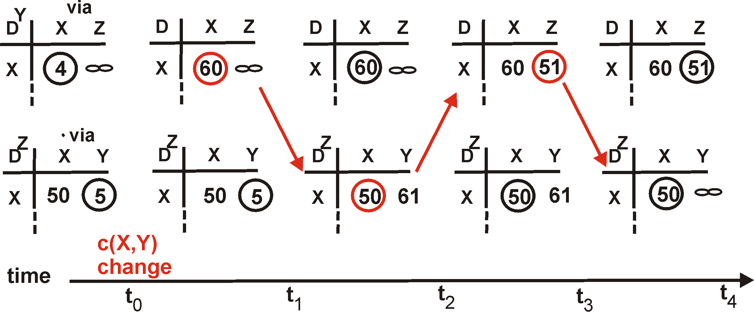
Distance Vector: poisoned reverse
If Z routes through Y to get to X :
  Z tells Y its (Z’s) distance to X is infinite (so Y won’t route to X via Z)
60
Y
4
1
X
Z
50
algorithm
terminates
Will this completely solve count to infinity problem?

Slide 15
An example for Distance Vector routing with Poisson reverse (PR)
A's routing table
A's update to B w/o PR
B's routing table
Dst Dis Nex
Dst Dis Nex
Dst Dis Nex
B 1 B
B 1
A 1 A
A 1 A
C 3 B
C 3
C 2 C
C 4 A 
D 4 B
D 4
D 3 C
D 5 A 
E 4 B
E 4
E 3 C
E 5 A 
F 7 B
F 7
F 6 C
F 8 A 
G 6 H
G 6
G 5 C
G 7 A 
H 2 H
H 2
H 3 H
H 3 H
A's update to B with PR:
B 1
1
2
1
C
A
B
C
D
D
3
1
2
4
E
E
F
2
3
H
4
G 6
4
H 2
G
F

Slide 16
Comparison of LS and DV algorithms
distance vector:
  distribute one’s own routing table to neighbors
    routing update can be large in size, but travels only one link
  each node only knows distances to other destinations
link state
  broadcast raw topology information to entire net
    routing update is small in size, but travels over all links in the net
  each node knows entire topology
Performance measure: Message complexity, Time to convergence
Robustness: what happens if router malfunctions?
LS:
  node can advertise incorrect link cost
  each node computes only its own table
DV:
  DV node can advertise incorrect path cost
  each node’s table used by others

Slide 17
What we have talked about routing
Dijkstra routing algorithm
  Given a topology map, compute the shortest paths to all the other nodes
Bellman-Ford routing algorithm
  Given the lists of distance to all destinations from all the neighbors, compute the shortest path to destination
  Known problem: count-to-infinity
  A simple (partial) solution: poison-reverse

Slide 18
Routing in the Internet
The Global Internet: a large number of Autonomous Systems (AS) interconnected with each other:
  Stub AS: end user networks (corporations, campuses)
    Multihomed AS: stub ASes that are connected to multiple service providers
  Transit AS: Internet service provider
Two-level routing hierarchy:
  Intra-AS
  Inter-AS

Slide 19
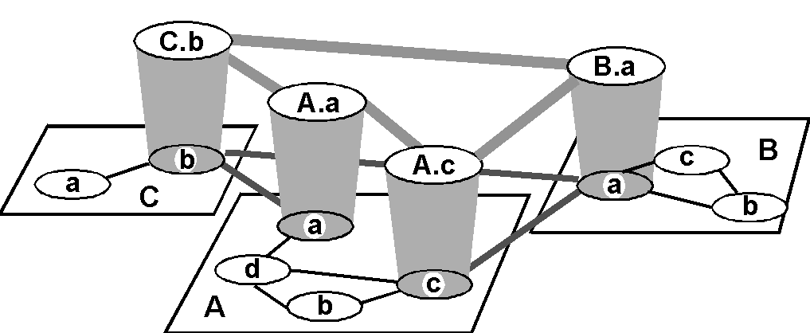
Internet Hierarchical Routing
Inter-AS border (exterior gateway) routers
Intra-AS (interior gateway) routers
autonomous system (AS): a set of routers under the same administrative domain
Each AS makes its own decision on internal routing protocol (IGP) to use
  All routers in one AS run the same IGP
border routers also run BGP

Slide 20
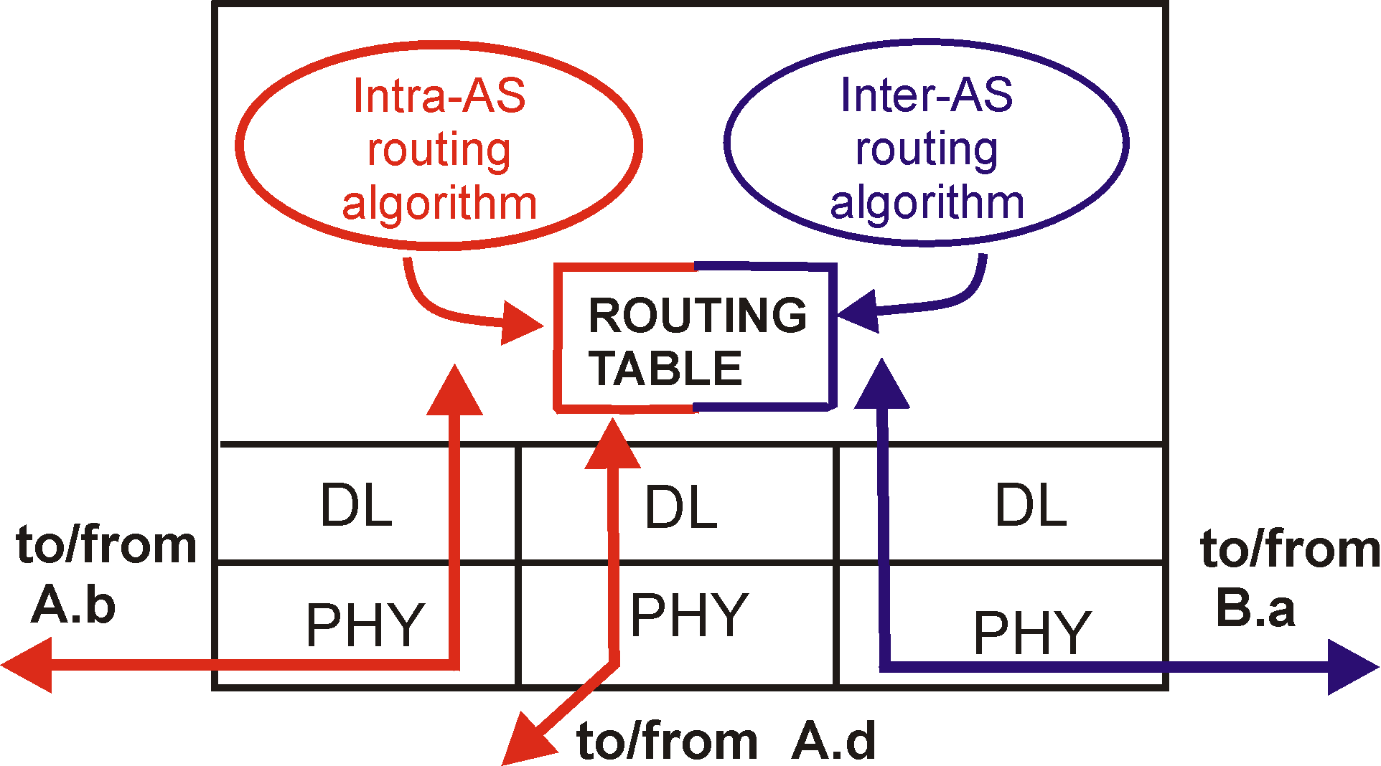
Intra-AS and Inter-AS routing
Border routers:
  perform inter-AS routing across AS boundaries
  perform intra-AS routing with other routers in each's own AS
C.b
B.a
A.a
b
A.c
c
a
C
a
b
a
B
d
c
A
b
intra-AS routing protocol
inter-AS routing protocol
network layer
inter-AS, intra-AS routing in
gateway A.c
link layer
physical layer

Slide 21
Intra-AS and Inter-AS routing
Inter-AS
routing
between
A and B
C.b
B.a
A.a
Host
18.2.4.157
b
A.c
c
a
C
a
b
a
B
d
c
Intra-AS routing
within AS B
Host-1
b
A
Intra-AS routing
within AS A
Forwarding table
131.179.0.0 outf-1
18.0.0.0 outf-2
23.0.0.0 outf-2
157.34.128.0 outf-3
222.8.192.0 outf-4

Slide 22
Intra-AS Routing:
Interior Gateway Protocols (IGP)
Most commonly used IGPs:
  IS-IS: Intermediate System to Intermediate System Routing protocol
  OSPF: Open Shortest Path First
  IGRP: Interior Gateway Routing Protocol (Cisco proprietary)
  RIP: Routing Information Protocol

Slide 23
RIP ( Routing Information Protocol)
Distance vector algorithm
  Distance metric: # of hops (max = 15 hops)
Neighbor routers exchanged routing advertisement every 30 seconds
Failure and Recovery: If no update from neighbor N heard after 180 sec  neighbor/link declared dead
  All routes via N invalidated; updates sent to neighbors
  neighbors in turn may send out new advertisements (if tables changed)
  Use poison reverse to prevent ping-pong loops (16 hops = ∞)
u
v
destination hops
u 1
v 2
w 2
x 3
y 3
z 2
A
B
w
x
C
D
z
y

Slide 24
RIP (Routing Information Protocol)
z
w
x
y
A
D
B
C
Destination Network Next Router Num. of hops to dest.
w A 2
y B 2
z B 7
x -- 1
…. …. ....
Routing table in D

Slide 25
RIP: Example
Dest. distance
w 1
x 1
z 4
…. ...
Advertisement
from A to D
z
w
x
y
A
D
B
C
Destination Network Next Router Num. of hops to dest.
w A 2
y B 2
z B A 7 5
x -- 1
…. …. ....
Routing table in D

Slide 26
RIP Implementation
route-d (daemon): an application-level process that manages RIP routing table and generates periodic RIP routing updates
  Process updates from neighbors
  send updates periodically to neighbors (if detect a failure, send right away)
Keeps the resulting routing table only (not all the updates)
routed
routed
Transport
(UDP)
Transport
(UDP)
network forwarding
(IP) table
network
(IP)
forwarding
table
link
link
physical
physical

Slide 27
OSPF (Open Shortest Path First)
A Link State protocol
  each node knows its directly connected neighbors & the link distance to each (link-state)
  each node periodically broadcasts its link-state to the entire network
Link-State Packet: one entry per neighbor router
  ID of the node that created the LSP
  a list of direct neighbors, with link cost to each
  sequence number for this LSP message (SEQ)
  time-to-live (TTL) for information carried in this LSP
  Use raw IP packet (protocol ID = 89)

Slide 28
Building a complete map using Link State
Everyone broadcasts a piece of the topology
Put all the pieces together, you get the complete map
Then each node carries out its own routing calculation independently

Slide 29
Link-State Routing Protocol
The routing daemon running at each node: Builds and maintains topology map at each node
  Stores and forwards most recent LSP from all other nodes
    decrement TTL of stored LSP; discard info when TTL=0
  Compute routes using Dijkstra’s algorithm
  generates its own LSP periodically with increasing SEQ

Slide 30
Reliable Flooding of LSP
forward each received LSP to all neighbor nodes but the one that sent it
  each ISP is reliably delivered over each link
  use the source-ID and SEQ in a LSP to detect duplicates
LSPs sent both periodically and event-driven
X
A
X
A
X
A
X
A
C
B
D
C
B
D
C
B
D
C
B
D

Slide 31
Advanced features supported by OSPF
Security: all OSPF messages authenticated
Multiple same-cost paths allowed
For each link, multiple cost metrics for different TOS (eg, satellite link cost set “low” for best effort; high for real time)
Integrated uni- and multicast support:
  Multicast OSPF (MOSPF) uses same topology data base as OSPF
Hierarchical OSPF in large domains.

Slide 32

Hierarchical OSPF

Slide 33
Hierarchical OSPF
Two-level hierarchy: local area, backbone.
  Link-state advertisements only in area
  each nodes has detailed area topology; only know direction (shortest path) to nets in other areas.
Area border routers: “summarize” distances to nets in own area, advertise to other Area Border routers.
Backbone routers: run OSPF routing limited to backbone.
Boundary routers: connect to other AS’s.

Slide 34
Inter-AS routing
x
BGP (Border Gateway Protocol): the de facto standard
Path Vector protocol:
  similar to Distance Vector protocol
  each Border router broadcast to neighbors (peers) entire path (I.e, sequence of ASs) to destination
  E.g., Path (X,Z) = X,Y1,Y2,Y3,…,Z

Slide 35
Example:
Forwarding Table in Router d of AS A
Suppose AS A learns from the inter-AS protocol that subnet x is reachable from AS B (gateway A.c) but not from AS C.
Inter-AS protocol propagates reachability info to all internal routers.
Router d determines from intra-AS routing info that its interface I is on the least cost path to c.
Puts in forwarding table entry (x, I).

Slide 36
Choosing among multiple ASes
Now suppose AS1 learns from the inter-AS protocol that subnet x is reachable from AS3 and from AS2.
To configure forwarding table, router 1d must determine towards which gateway it should forward packets for dest x.
This is also the job on inter-AS routing protocol!
Hot potato routing: send packet towards closest of two routers.
Use routing info
from intra-AS
protocol to determine
costs of least-cost
paths to each
of the gateways
Determine from
forwarding table the
interface I that leads
to least-cost gateway.
Enter (x,I) in
forwarding table
Learn from inter-AS
protocol that subnet
x is reachable via
multiple gateways
Hot potato routing:
Choose the gateway
that has the
smallest least cost

Slide 37
Internet inter-AS routing: BGP
BGP (Border Gateway Protocol): the de facto standard
BGP provides each AS a means to:
  Obtain subnet reachability information from neighboring ASs.
  Propagate the reachability information to all routers internal to the AS.
  Determine “good” routes to subnets based on reachability information and policy.
Allows a subnet to advertise its existence to rest of the Internet: “I am here”

Slide 38
BGP basics
Pairs of routers (BGP peers) exchange routing info over a TCP connection: BGP sessions
  BGP sessions do not necessarily correspond to physical links.
When AS2 advertises a prefix to AS1, AS2 is promising it will forward any datagrams destined to that prefix towards the prefix.
3c
3a
2c
3b
2a
AS3
2b
1c
AS2
1a
1b
AS1
1d
eBGP session
iBGP session

Slide 39
Distributing reachability info
With eBGP session between 3a and 1c, AS3 sends prefix reachability info to AS1.
1c can then use iBGP to distribute this new prefix reach info to all routers in AS1
1b can then re-advertise the new reach info to AS2 over the 1b-to-2a eBGP session
When router learns about a new prefix, it creates an entry for the prefix in its forwarding table.
3c
P
3a
2c
3b
2a
AS3
2b
1c
AS2
1a
1b
AS1
1d
eBGP session
iBGP session

Slide 40
Path attributes & BGP routes
When advertising a prefix, advert includes BGP attributes.
  prefix + attributes = “route”
  most important attribute: AS-PATH: contains the ASs through which the advert for the prefix passed: AS 67 AS 17
When an eBGP router receives route advert, uses import policy to accept/decline.
eBGP router also applies export policy to decide which routers to tell which neighbor eBGP router

Slide 41
BGP route selection
Router may learn about more than 1 route to some prefix. Router must select route.
Elimination rules:
  Local preference value attribute: policy decision
  Shortest AS-PATH
  Closest NEXT-HOP router: hot potato routing
  Additional criteria

Slide 42
BGP messages
BGP messages exchanged using TCP.
BGP messages:
  OPEN: opens TCP connection to peer and authenticates sender
  UPDATE: advertises new path (or withdraws old)
  KEEPALIVE keeps connection alive in absence of UPDATES; also ACKs OPEN request
  NOTIFICATION: reports errors in previous msg; also used to close connection

Slide 43
BGP routing policy
A,B,C are provider networks
X,W,Y are customers (of provider networks)
X is dual-homed: attached to two networks
  X does not want to route from B via X to C
  .. so X will not advertise to B a route to C

Slide 44
BGP routing policy (2)
A advertises to B the path AW
B advertises to X the path BAW
Should B advertise to C the path BAW?
  No way! B gets no “revenue” for routing CBAW since neither W nor C are B’s customers
  B wants to force C to route to w via A
  B wants to route only to/from its customers!

Slide 45
Why different Intra- and Inter-AS routing ?
Policy:
Inter-AS: admin wants control over how its traffic routed, who routes through its net.
Intra-AS: single admin, so no policy decisions needed
Scale:
hierarchical routing saves table size, reduced update traffic
Performance:
Intra-AS: can focus on performance
Inter-AS: policy may dominate over performance

