Slide 1

Chapter 21
Network Layer:
Address Mapping,
Error Reporting,
and Multicasting
21.<number>
Copyright © The McGraw-Hill Companies, Inc. Permission required for reproduction or display.

Slide 2
21-1 ADDRESS MAPPING
The delivery of a packet to a host or a router requires two levels of addressing: logical and physical. We need to be able to map a logical address to its corresponding
physical address and vice versa. This can be done by using either static or dynamic mapping.
Topics discussed in this section:
Mapping Logical to Physical Address
Mapping Physical to Logical Address
21.<number>

Slide 3

Figure 21.1 ARP operation
21.<number>

Slide 4

Figure 21.2 ARP packet
21.<number>

Slide 5
Hardware Type: This is to specify the type of hardware used by the local network to transmit the Address Resolution Protocols message. Once common hardware under this category would be the ‘Ethernet’ with a value equal to 1, and field size would be 2.
Protocol Type: To assign a fixed number in this field, IPV4 has a number 2048.
Hardware size: This is the length in bytes for the MAC address; generally, we see the ethernet has a MAC address of 6 bytes long.
Protocol Size: It represents the length of the IPV4 logical address, IPV4 address re generally 4 bytes long.
OpCode: This is the length of the logical address in bytes; it specifies the nature of the ARP message. An ARP Request has an assigned value of 1, whereas the ARP reply holds the value of 2.
Sender MAC address: Layer 2 address for the device sending the message.
Sender IP address: Protocol address in IPV4 for the device sending the message.
Target MAC address: Layer 2 of the intended receiver. This field does not hold any value during the request phase and works only during the reply phase.
Target IP address:
21.<number>

Slide 6
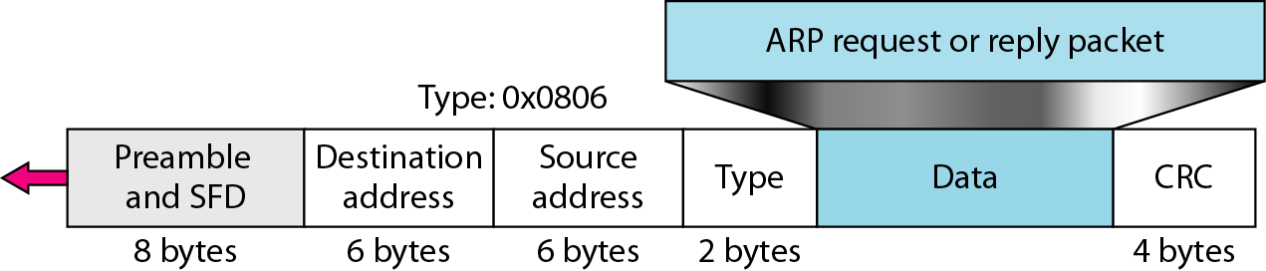
Figure 21.3 Encapsulation of ARP packet
21.<number>

Slide 7

Figure 21.4 Four cases using ARP
21.<number>

Slide 8

Note
An ARP request is broadcast;
an ARP reply is unicast.
21.<number>

Slide 9

Figure 21.6 Proxy ARP
21.<number>

Slide 10
2. Reverse Address Resolution Protocol (RARP) –
Reverse ARP is a networking protocol used by a client machine in a local area network to request its Internet Protocol address (IPv4) from the gateway-router’s ARP table. The network administrator creates a table in gateway-router, which is used to map the MAC address to corresponding IP address.
When a new machine is setup or any machine which don’t have memory to store IP address, needs an IP address for its own use. So the machine sends a RARP broadcast packet which contains its own MAC address in both sender and receiver hardware address field.
21.<number>

Slide 11
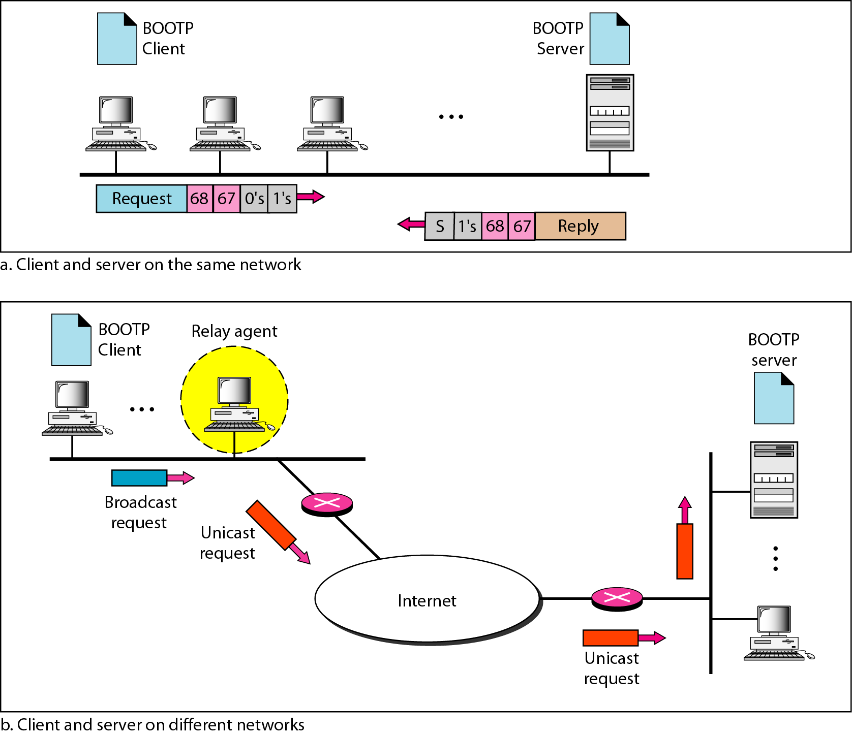
Figure 21.7 BOOTP client and server on the same and different networks
21.<number>

Slide 12
Note
DHCP provides static and dynamic address allocation that can be
manual or automatic.
21.<number>

Slide 13
DHCP definition
DHCP stands for dynamic host configuration protocol and is a network protocol used on IP networks where a DHCP server automatically assigns an IP address and other information to each host on the network so they can communicate efficiently with other endpoints.
21.<number>

Slide 14
Components of DHCP
When working with DHCP, it’s important to understand all of the components. Below is a list of them and what they do:
DHCP server: A networked device running the DCHP service that holds IP addresses and related configuration information. This is most typically a server or a router but could be anything that acts as a host, such as an SD-WAN appliance.
DHCP client: The endpoint that receives configuration information from a DHCP server. This can be a computer, mobile device, IoT endpoint or anything else that requires connectivity to the network. Most are configured to receive DHCP information by default.
IP address pool: The range of addresses that are available to DHCP clients. Addresses are typically handed out sequentially from lowest to highest.
Subnet: IP networks can be partitioned into segments known as subnets. Subnets help keep networks manageable.
Lease: The length of time for which a DHCP client holds the IP address information. When a lease expires, the client must renew it.
DHCP relay: A router or host that listens for client messages being broadcast on that network and then forwards them to a configured server. The server then sends responses back to the relay agent that passes them along to the client. This can be used to centralize DHCP servers instead of having a server on each subnet.
21.<number>

Slide 15
21-2 ICMP
The IP protocol has no error-reporting or error-correcting mechanism. The IP protocol also lacks a mechanism for host and management queries. The Internet Control Message Protocol (ICMP) has been designed to compensate for the above two deficiencies. It is a companion to the IP protocol.
Topics discussed in this section:
Types of Messages
Message Format
Error Reporting and Query
Debugging Tools
21.<number>

Slide 16

Figure 21.8 General format of ICMP messages
21.<number>

Slide 17
Note
ICMP always reports error messages to the original source.
21.<number>

Slide 18
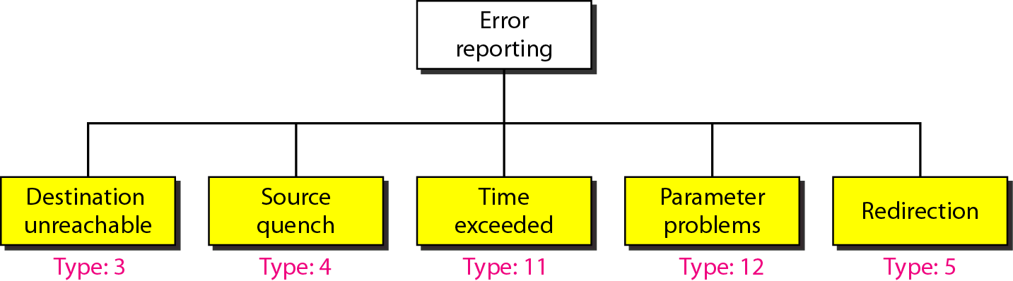
Figure 21.9 Error-reporting messages
21.<number>

Slide 19
Echo Request, Echo Reply
  Used to test destination accessibility and status. A host sends an Echo Request and listens for a corresponding Echo Reply. This is most commonly done using the ping command.
Destination Unreachable, Echo Reply
  Sent by a router when it cannot deliver an IP datagram. A datagram is the unit of data, or packet, transmitted in a TCP/IP network.
Source Quench
  Sent by a host or router if it is receiving data too quickly for it to handle. The message is a request that the source reduce its rate of datagram transmission.
Redirect Message
  Sent by a router if it receives a datagram that should have been sent to a different router. The message contains the address to which the source should direct future datagrams. This is used to optimize the routing of network traffic.
Router Advertisement, Router Solicitation
  Allow hosts to discover the existence of routers. Routers periodically broadcast their IP addresses via Router Advertisement messages. Hosts may also request a router address by broadcasting a Router Solicitation message to which a router replies with a Router Advertisement.
Time Exceeded
  Sent by a router if the datagram has reached the maximum limit of routers through which it can travel.
Parameter Problem
  Sent by a router if a problem occurs during the transmission of a datagram such that it cannot complete processing. One potential source of such a problem is invalid datagram header.
Timestamp Request, Timestamp Reply
  Used to synchronize the clocks between hosts and to estimate transit time.
Information Request, Information Reply
  Obsolete. These messages were used earlier by hosts to determine their inter-network addresses, but are now considered outdated and should not be used.
Address Mask Request, Address Mask Reply
  Used to find the mask of the subnet (i.e. what address bits define the network). A host sends an Address Mask Request to a router and receives an Address Mask Reply in return.
21.<number>

Slide 20
Note
Important points about ICMP error messages:
❏ No ICMP error message will be generated in
response to a datagram carrying an ICMP error
message.
❏ No ICMP error message will be generated for a
fragmented datagram that is not the first fragment.
❏ No ICMP error message will be generated for a
datagram having a multicast address.
❏ No ICMP error message will be generated for a
datagram having a special address such as
127.0.0.0 or 0.0.0.0.
21.<number>

Slide 21
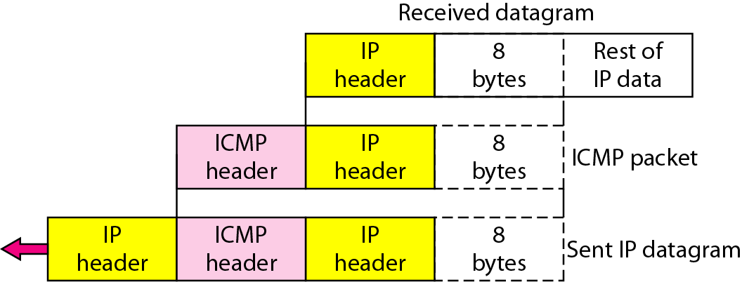
Figure 21.10 Contents of data field for the error messages
21.<number>

Slide 22
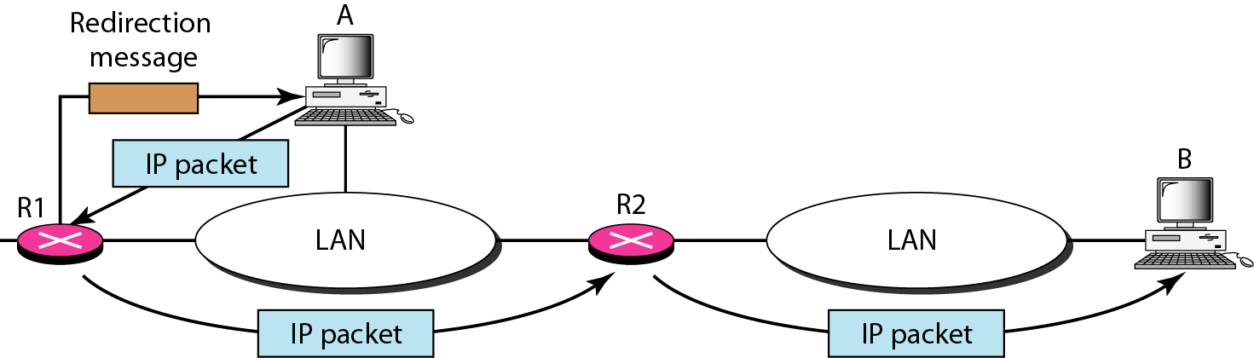
Figure 21.11 Redirection concept
21.<number>

Slide 23

Figure 21.12 Query messages
21.<number>

Slide 24
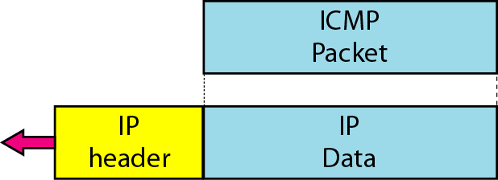
Figure 21.13 Encapsulation of ICMP query messages
21.<number>

Slide 25
Example 21.2
Figure 21.14 shows an example of checksum calculation for a simple echo-request message. We randomly chose the identifier to be 1 and the sequence number to be 9. The message is divided into 16-bit (2-byte) words. The words are added and the sum is complemented. Now the sender can put this value in the checksum field.
21.<number>

Slide 26
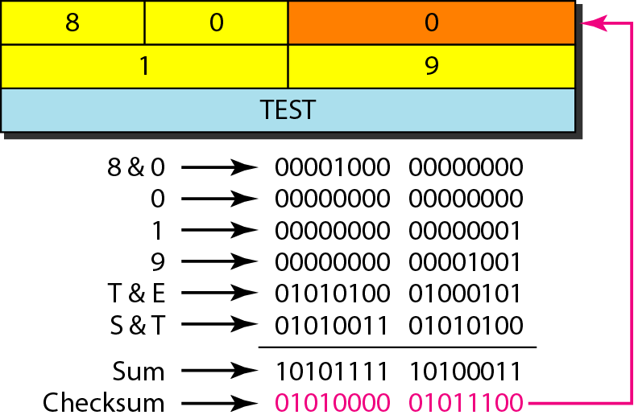
Figure 21.14 Example of checksum calculation
21.<number>

Slide 27
Example 21.3
We use the ping program to test the server fhda.edu. The result is shown on the next slide. The ping program sends messages with sequence numbers starting from 0. For each probe it gives us the RTT time. The TTL (time to live) field in the IP datagram that encapsulates an ICMP
message has been set to 62. At the beginning, ping defines the number of data bytes as 56 and the total number of bytes as 84. It is obvious that if we add 8 bytes of ICMP header and 20 bytes of IP header to 56, the result is 84. However, note that in each probe ping defines the number of bytes as 64. This is the total number of bytes in the ICMP packet (56 + 8).
21.<number>

Slide 28
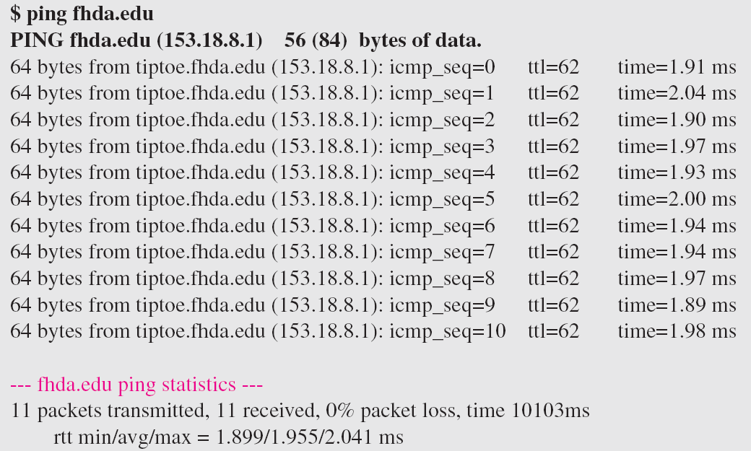
Example 21.3 (continued)
21.<number>

Slide 29
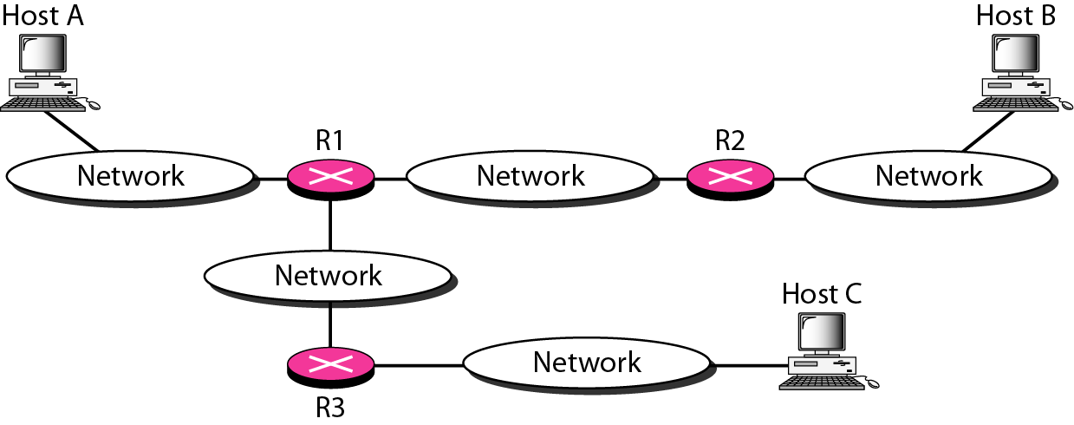
Figure 21.15 The traceroute program operation
21.<number>

Slide 30
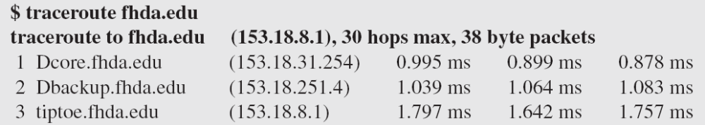
Example 21.4
We use the traceroute program to find the route from the computer voyager.deanza.edu to the server fhda.edu. The following shows the result:
The unnumbered line after the command shows that the destination is 153.18.8.1. The packet contains 38 bytes: 20 bytes of IP header, 8 bytes of UDP header, and 10 bytes of application data. The application data are used by traceroute to keep track of the packets.
21.<number>

Slide 31
Example 21.4 (continued)
The first line shows the first router visited. The router is named Dcore.fhda.edu with IP address 153.18.31.254. The first round-trip time was 0.995 ms, the second was 0.899 ms, and the third was 0.878 ms. The second line shows the second router visited. The router is named Dbackup.fhda.edu with IP address 153.18.251.4. The three round-trip times are also shown. The third line shows the destination host. We know that this is the destination host because there are no more lines. The destination host is the server fhda.edu, but it is named tiptoe.fhda.edu with the IP address 153.18.8.1. The three round-trip times are also shown.
21.<number>

Slide 32
Example 21.5
In this example, we trace a longer route, the route to xerox.com (see next slide). Here there are 17 hops between source and destination. Note that some round-trip times look unusual. It could be that a router was too busy to process the packet immediately.
21.<number>

Slide 33
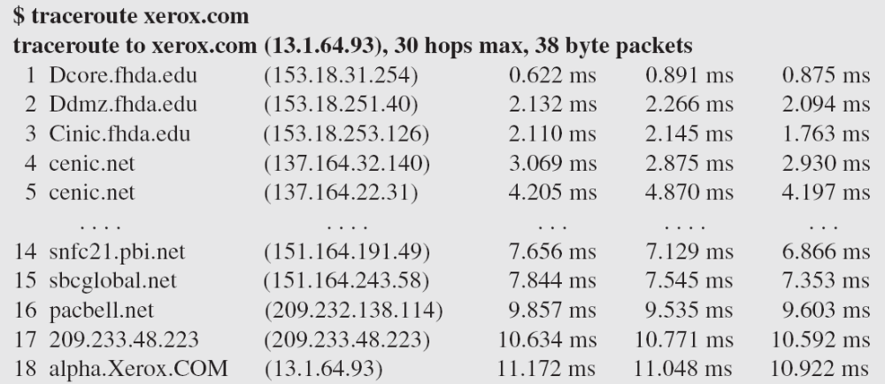
Example 21.5 (continued)
21.<number>

Slide 34
21-3 IGMP
The IP protocol can be involved in two types of communication: unicasting and multicasting. The Internet Group Management Protocol (IGMP) is one of the necessary, but not sufficient, protocols that is involved in multicasting. IGMP is a companion to the IP protocol.
Topics discussed in this section:
Group Management
IGMP Messages and IGMP Operation
Encapsulation
Netstat Utility
21.<number>

Slide 35
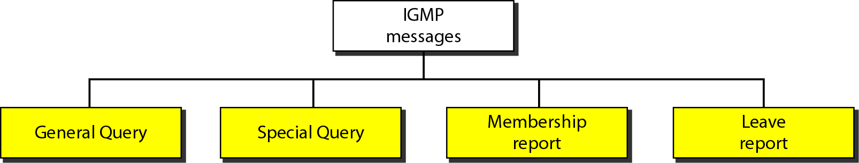
Figure 21.16 IGMP message types
21.<number>

Slide 36
General membership queries
  Sent by multicast routers to determine which multicast addresses are of interest to systems attached to the network(s) they serve to refresh the group membership state for all systems on its network.
Group-specific membership queries
  Used for determining the reception state for a particular multicast address
Group-and-source-specific queries
  Allow the router to determine if any systems desire reception of messages sent to a multicast group from a source address specified in a list of unicast addresses
Membership reports
  Sent by multicast receivers in response to a membership query or asynchronously when first registering for a multicast group
Leave group messages
  Sent by multicast receivers when specified multicast transmissions are no longer needed at the receiver
21.<number>

Slide 37
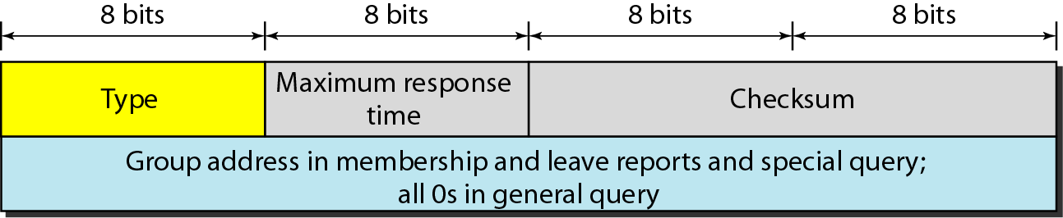
Figure 21.17 IGMP message format
21.<number>

Slide 38
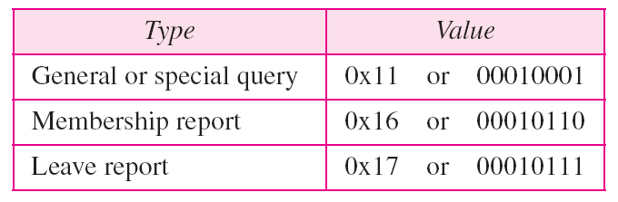
Table 21.1 IGMP type field
21.<number>

Slide 39
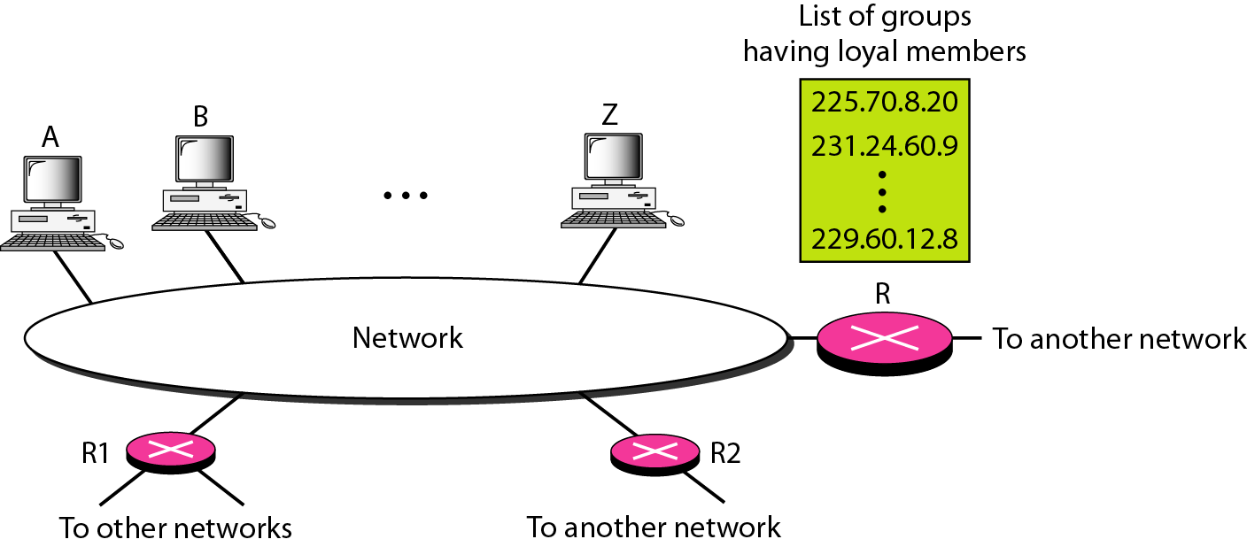
Figure 21.18 IGMP operation
21.<number>

Slide 40
Note
In IGMP, a membership report is sent twice, one after the other.
21.<number>

Slide 41
Note
The general query message does not define a particular group.
21.<number>

Slide 42
Example 21.6
Imagine there are three hosts in a network, as shown in Figure 21.19. A query message was received at time 0; the random delay time (in tenths of seconds) for each group is shown next to the group address. Show the sequence of report messages.
Solution
The events occur in this sequence:
a. Time 12: The timer for 228.42.0.0 in host A expires,
and a membership report is sent, which is received by
the router and every host including host B which
cancels its timer for 228.42.0.0.
21.<number>

Slide 43
Example 21.6 (continued)
b. Time 30: The timer for 225.14.0.0 in host A expires, and
a membership report is sent which is received by the
router and every host including host C which cancels its
timer for 225.14.0.0.
c. Time 50: The timer for 238.71.0.0 in host B expires,
and a membership report is sent, which is received by
the router and every host.
d. Time 70: The timer for 230.43.0.0 in host C expires,
and a membership report is sent, which is received by
the router and every host including host A which
cancels its timer for 230.43.0.0.
21.<number>

Slide 44
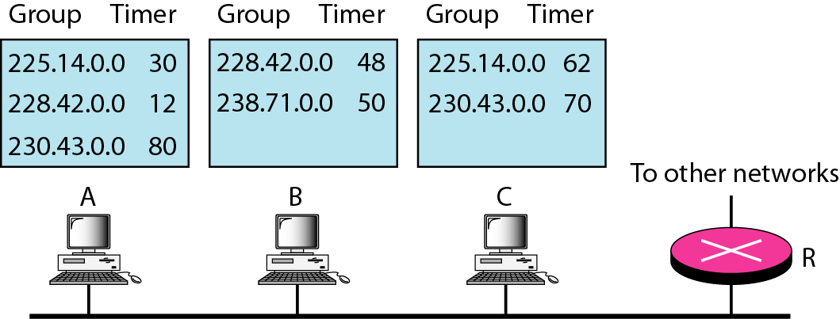
Figure 21.19 Example 21.6
21.<number>

Slide 45
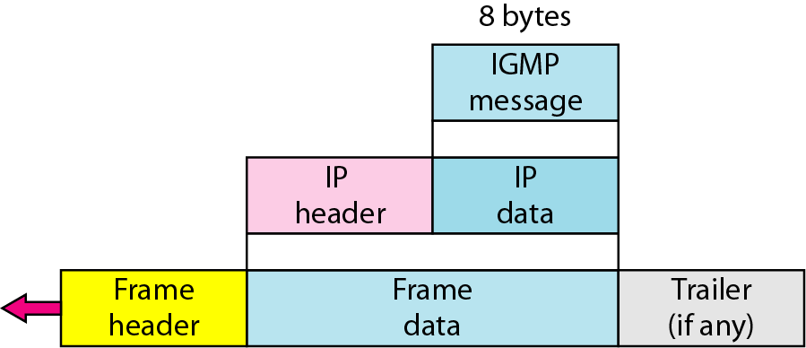
Figure 21.20 Encapsulation of IGMP packet
21.<number>

Slide 46
Note
The IP packet that carries an IGMP packet has a value of 1 in its TTL field.
21.<number>

Slide 47
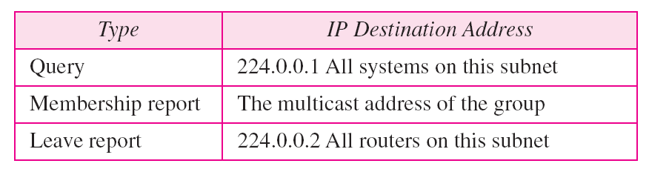
Table 21.2 Destination IP addresses
21.<number>

Slide 48
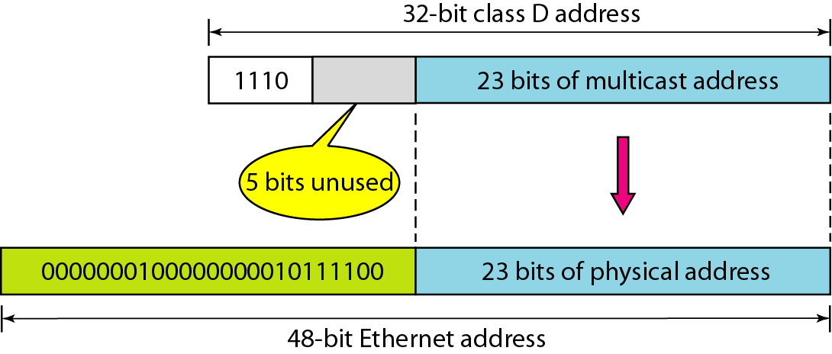
Figure 21.21 Mapping class D to Ethernet physical address
21.<number>

Slide 49
Note
An Ethernet multicast physical address is in the range
01:00:5E:00:00:00 to 01:00:5E:7F:FF:FF.
21.<number>

Slide 50
Example 21.7
Change the multicast IP address 230.43.14.7 to an Ethernet multicast physical address.
Solution
We can do this in two steps:
a. We write the rightmost 23 bits of the IP address in
hexadecimal. This can be done by changing the
rightmost 3 bytes to hexadecimal and then subtracting
8 from the leftmost digit if it is greater than or equal to
8. In our example, the result is 2B:0E:07.
21.<number>

Slide 51
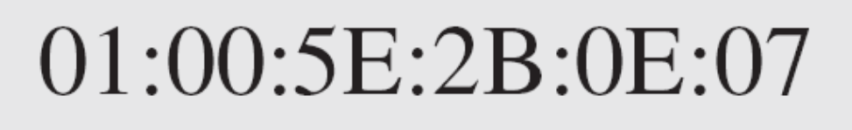
Example 21.7 (continued)
b. We add the result of part a to the starting Ethernet
multicast address, which is 01:00:5E:00:00:00. The
result is
21.<number>

Slide 52
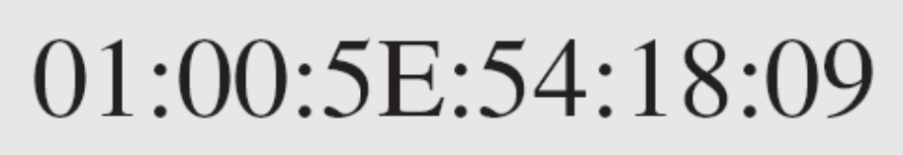
Example 21.8
Change the multicast IP address 238.212.24.9 to an Ethernet multicast address.
Solution
a. The rightmost 3 bytes in hexadecimal is D4:18:09. We
need to subtract 8 from the leftmost digit, resulting in
54:18:09.
b. We add the result of part a to the Ethernet multicast
starting address. The result is
21.<number>

Slide 53
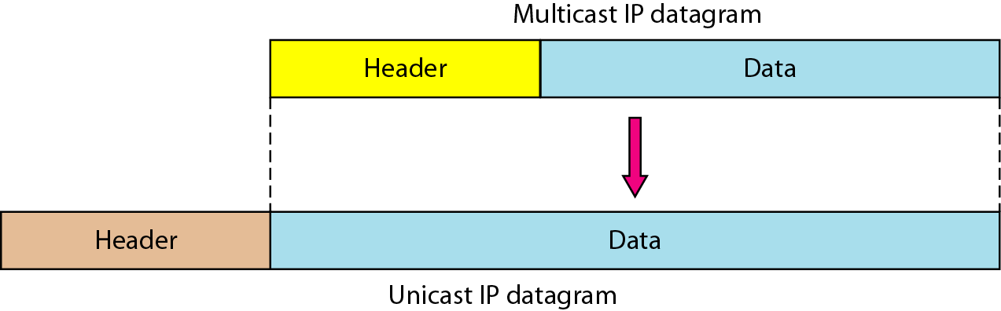
Figure 21.22 Tunneling
21.<number>

Slide 54
Example 21.9
We use netstat (see next slide) with three options: -n, -r, and -a. The -n option gives the numeric versions of IP addresses, the -r option gives the routing table, and the -a option gives all addresses (unicast and multicast). Note that we show only the fields relative to our discussion. “Gateway” defines the router, “Iface” defines the interface.
Note that the multicast address is shown in color. Any packet with a multicast address from 224.0.0.0 to 239.255.255.255 is masked and delivered to the Ethernet interface.
21.<number>

Slide 55
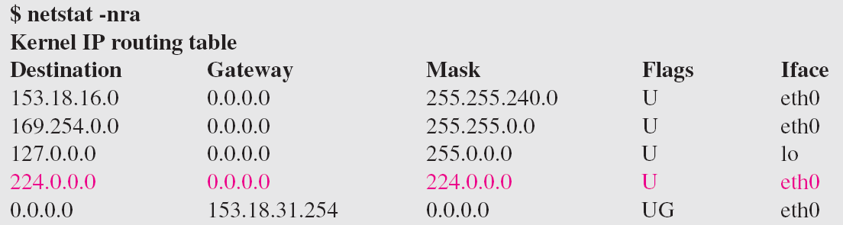
Example 21.9 (continued)
21.<number>

Slide 56
21-4 ICMPv6
We discussed IPv6 in Chapter 20. Another protocol that has been modified in version 6 of the TCP/IP protocol suite is ICMP (ICMPv6). This new version follows the same strategy and purposes of version 4.
Topics discussed in this section:
Error Reporting
Query
21.<number>

Slide 57
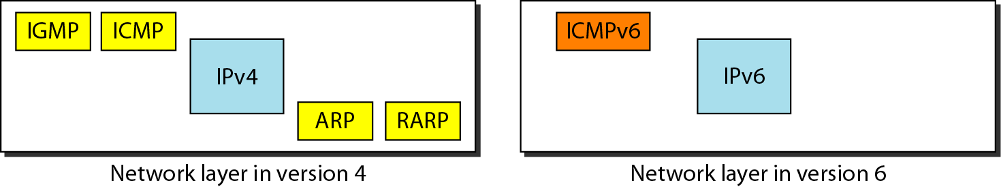
Figure 21.23 Comparison of network layers in version 4 and version 6
21.<number>

Slide 58
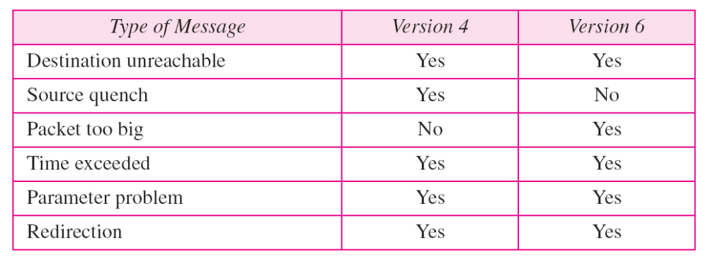
Table 21.3 Comparison of error-reporting messages in ICMPv4 and ICMPv6
21.<number>

Slide 59
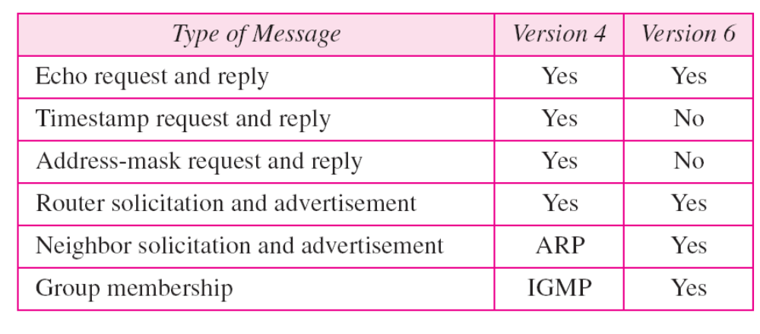
Table 21.4 Comparison of query messages in ICMPv4 and ICMPv6
21.<number>

