Slide 1

Chapter 23
Process-to-Process Delivery:
UDP, TCP, and SCTP
23.<number>
Copyright © The McGraw-Hill Companies, Inc. Permission required for reproduction or display.

Slide 2
23-1 PROCESS-TO-PROCESS DELIVERY
The transport layer is responsible for process-to-process delivery—the delivery of a packet, part of a message, from one process to another. Two processes communicate in a client/server relationship, as we will see later.
Topics discussed in this section:
Client/Server Paradigm
Multiplexing and Demultiplexing
Connectionless Versus Connection-Oriented Service
Reliable Versus Unreliable
Three Protocols
23.<number>

Slide 3

Note
The transport layer is responsible for process-to-process delivery.
23.<number>

Slide 4

Figure 23.1 Types of data deliveries
23.<number>

Slide 5

Figure 23.2 Port numbers
23.<number>

Slide 6

Figure 23.3 IP addresses versus port numbers
23.<number>

Slide 7

Figure 23.4 IANA ranges
23.<number>

Slide 8
TCP/IP has decided to use universal port numbers for servers; these are called well-known port number.
❑ Well-known ports. The ports ranging from 0 to 1023 are assigned and controlled
by ICANN. These are the well-known ports.
❑ Registered ports. The ports ranging from 1024 to 49,151 are not assigned or controlled
by ICANN. They can only be registered with ICANN to prevent duplication.
❑ Dynamic ports. The ports ranging from 49,152 to 65,535 are neither controlled nor
registered. They can be used as temporary or private port numbers
23.<number>

Slide 9

Figure 23.5 Socket address
23.<number>

Slide 10

Figure 23.6 Multiplexing and demultiplexing
23.<number>

Slide 11

Figure 23.7 Error control
23.<number>

Slide 12
1. Detecting and discarding corrupted packets.
2. Keeping track of lost and discarded packets and resending them.
3. Recognizing duplicate packets and discarding them.
4. Buffering out-of-order packets until the missing packets arrive.
23.<number>

Slide 13
Sequence Numbers
Error control requires that the sending transport layer knows which packet is to be resent and the receiving transport layer knows which packet is a duplicate, or which packet has arrived out of order. This can be done if the packets are numbered. We can add a field to the transport-layer packet to hold the sequence number of the packet.
23.<number>

Slide 14

Figure 23.8 Position of UDP, TCP, and SCTP in TCP/IP suite
23.<number>

Slide 15
23-2 USER DATAGRAM PROTOCOL (UDP)
The User Datagram Protocol (UDP) is called a connectionless, unreliable transport protocol. It does not add anything to the services of IP except to provide process-to-process communication instead of host-to-host communication.
Topics discussed in this section:
Well-Known Ports for UDP
User Datagram
Checksum
UDP Operation
Use of UDP
23.<number>

Slide 16


Table 23.1 Well-known ports used with UDP
23.<number>

Slide 17

Example 23.1
In UNIX, the well-known ports are stored in a file called /etc/services. Each line in this file gives the name of the server and the well-known port number. We can use the
grep utility to extract the line corresponding to the desired application. The following shows the port for FTP. Note that FTP can use port 21 with either UDP or TCP.
23.<number>

Slide 18

Example 23.1 (continued)
SNMP uses two port numbers (161 and 162), each for a different purpose, as we will see in Chapter 28.
23.<number>

Slide 19

Figure 23.9 User datagram format
23.<number>

Slide 20
Note
UDP length
= IP length – IP header’s length
23.<number>

Slide 21

Figure 23.10 Pseudoheader for checksum calculation
23.<number>

Slide 22

The following is the content of a UDP header in hexadecimal format.
a. What is the source port number?
b. What is the destination port number?
c. What is the total length of the user datagram?
d. What is the length of the data?
e. Is the packet directed from a client to a server or vice versa?
f. What is the client process?
23.<number>

Slide 23
a. The source port number is the first four hexadecimal digits (CB84)16, which means that the source port number is 52100.
b. The destination port number is the second four exadecimal digits (000D)16, whichmeans that the destination port number is 13.
c. The third four hexadecimal digits (001C)16 define the length of the whole UDP packet as 28 bytes.
d. The length of the data is the length of the whole packet minus the length of the header, or 28 − 8 = 20 bytes.
e. Since the destination port number is 13 (well-known port), the packet is from the client to the server.
f. The client process is the Daytime (see Table 24.1)
23.<number>

Slide 24
Example 23.2
Figure 23.11 shows the checksum calculation for a very small user datagram with only 7 bytes of data. Because the number of bytes of data is odd, padding is added for checksum calculation. The pseudoheader as well as the padding will be dropped when the user datagram is delivered to IP.
23.<number>

Slide 25

Figure 23.11 Checksum calculation of a simple UDP user datagram
23.<number>

Slide 26

Figure 23.12 Queues in UDP
23.<number>

Slide 27
23-3 TCP
TCP is a connection-oriented protocol; it creates a virtual connection between two TCPs to send data. In addition, TCP uses flow and error control mechanisms at the transport level.
Topics discussed in this section:
TCP Services
TCP Features
Segment
A TCP Connection
Flow Control
Error Control
23.<number>

Slide 28

Table 23.2 Well-known ports used by TCP
23.<number>

Slide 29

Figure 23.13 Stream delivery
23.<number>

Slide 30

Figure 23.14 Sending and receiving buffers
23.<number>

Slide 31

Figure 23.15 TCP segments
23.<number>

Slide 32
Note
The bytes of data being transferred in each connection are numbered by TCP.
The numbering starts with a randomly generated number.
23.<number>

Slide 33

Example 23.3
The following shows the sequence number for each segment:
23.<number>

Slide 34
Note
The value in the sequence number field of a segment defines the
number of the first data byte
contained in that segment.
23.<number>

Slide 35
Note
The value of the acknowledgment field in a segment defines
the number of the next byte a party expects to receive.
The acknowledgment number is cumulative.
23.<number>

Slide 36

Figure 23.16 TCP segment format
23.<number>

Slide 37

Figure 23.17 Control field
23.<number>

Slide 38

Table 23.3 Description of flags in the control field
23.<number>

Slide 39

Figure 23.18 Connection establishment using three-way handshaking
23.<number>

Slide 40
Note
A SYN segment cannot carry data, but it consumes one sequence number.
23.<number>

Slide 41
Note
A SYN + ACK segment cannot
carry data, but does consume one
sequence number.
23.<number>

Slide 42
Note
An ACK segment, if carrying no data, consumes no sequence number.
23.<number>

Slide 43

Figure 23.19 Data transfer
23.<number>

Slide 44

Figure 23.20 Connection termination using three-way handshaking
23.<number>

Slide 45
Note
The FIN segment consumes one sequence number if it does
not carry data.
23.<number>

Slide 46
Note
The FIN + ACK segment consumes
one sequence number if it
does not carry data.
23.<number>

Slide 47

Figure 23.21 Half-close
23.<number>

Slide 48

Figure 23.22 Sliding window
23.<number>

Slide 49
Note
A sliding window is used to make transmission more efficient as well as
to control the flow of data so that the destination does not become
overwhelmed with data.
TCP sliding windows are byte-oriented.
23.<number>

Slide 50
Example 23.4
What is the value of the receiver window (rwnd) for host A if the receiver, host B, has a buffer size of 5000 bytes and 1000 bytes of received and unprocessed data?
Solution
The value of rwnd = 5000 − 1000 = 4000. Host B can receive only 4000 bytes of data before overflowing its buffer. Host B advertises this value in its next segment to A.
23.<number>

Slide 51
Example 23.5
What is the size of the window for host A if the value of rwnd is 3000 bytes and the value of cwnd is 3500 bytes?
Solution
The size of the window is the smaller of rwnd and cwnd, which is 3000 bytes.
23.<number>

Slide 52
Example 23.6
Figure 23.23 shows an unrealistic example of a sliding window. The sender has sent bytes up to 202. We assume that cwnd is 20 (in reality this value is thousands of bytes). The receiver has sent an acknowledgment number of 200 with an rwnd of 9 bytes (in reality this value is thousands of bytes). The size of the sender window is the minimum of rwnd and cwnd, or 9 bytes. Bytes 200 to 202 are sent, but not acknowledged. Bytes 203 to 208 can be sent without worrying about acknowledgment. Bytes 209 and above cannot be sent.
23.<number>

Slide 53

Figure 23.23 Example 23.6
23.<number>

Slide 54
Note
Some points about TCP sliding windows:
❏ The size of the window is the lesser of rwnd and
cwnd.
❏ The source does not have to send a full window’s
worth of data.
❏ The window can be opened or closed by the
receiver, but should not be shrunk.
❏ The destination can send an acknowledgment at
any time as long as it does not result in a shrinking
window.
❏ The receiver can temporarily shut down the
window; the sender, however, can always send a
segment of 1 byte after the window is shut down.
23.<number>

Slide 55
Note
ACK segments do not consume sequence numbers and are not acknowledged.
23.<number>

Slide 56
Note
In modern implementations, a retransmission occurs if the retransmission timer expires or three duplicate ACK segments have arrived.
23.<number>

Slide 57
Note
No retransmission timer is set for an ACK segment.
23.<number>

Slide 58
Note
Data may arrive out of order and be temporarily stored by the receiving TCP,
but TCP guarantees that no out-of-order segment is delivered to the process.
23.<number>

Slide 59

Figure 23.24 Normal operation
23.<number>

Slide 60

Figure 23.25 Lost segment
23.<number>

Slide 61
Note
The receiver TCP delivers only ordered data to the process.
23.<number>

Slide 62

Figure 23.26 Fast retransmission
23.<number>

Slide 63
23-4 SCTP
Stream Control Transmission Protocol (SCTP) is a new reliable, message-oriented transport layer protocol. SCTP, however, is mostly designed for Internet applications that have recently been introduced. These new applications need a more sophisticated service than TCP can provide.
Topics discussed in this section:
SCTP Services and Features
Packet Format
An SCTP Association
Flow Control and Error Control
23.<number>

Slide 64
Note
SCTP is a message-oriented, reliable protocol that combines the best features of UDP and TCP.
23.<number>

Slide 65
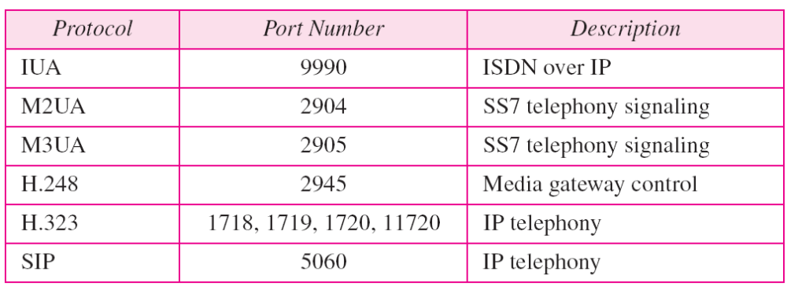
Table 23.4 Some SCTP applications
23.<number>

Slide 66
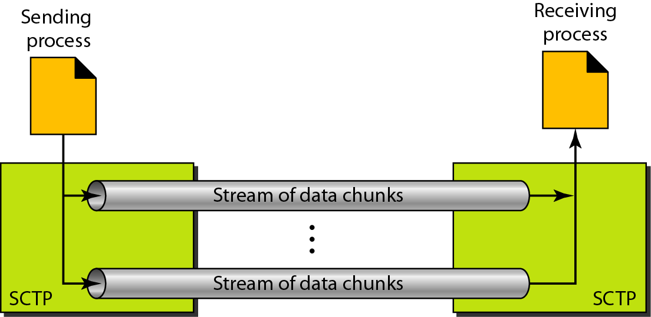
Figure 23.27 Multiple-stream concept
23.<number>

Slide 67
Note
An association in SCTP can involve multiple streams.
23.<number>

Slide 68
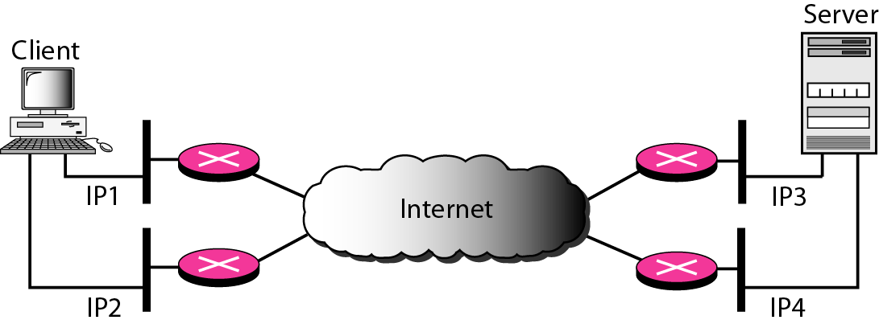
Figure 23.28 Multihoming concept
23.<number>

Slide 69
Note
SCTP association allows multiple IP addresses for each end.
23.<number>

Slide 70
Note
In SCTP, a data chunk is numbered using a TSN.
23.<number>

Slide 71
Note
To distinguish between different streams, SCTP uses an SI.
23.<number>

Slide 72
Note
To distinguish between different data chunks belonging to the same stream, SCTP uses SSNs.
23.<number>

Slide 73
Note
TCP has segments; SCTP has packets.
23.<number>

Slide 74
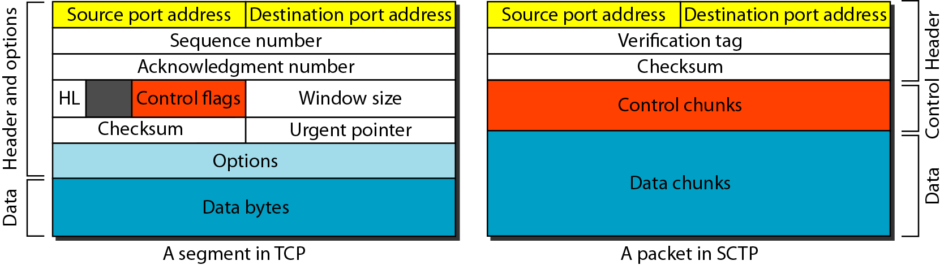
Figure 23.29 Comparison between a TCP segment and an SCTP packet
23.<number>

Slide 75
Note
In SCTP, control information and data information are carried in separate chunks.
23.<number>

Slide 76
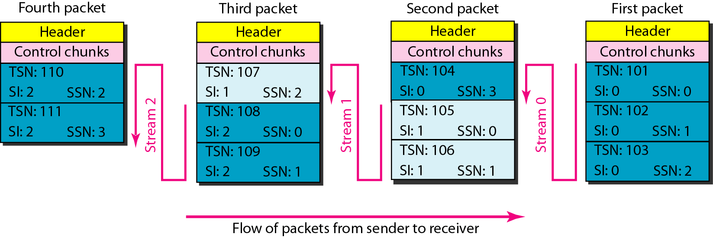
Figure 23.30 Packet, data chunks, and streams
23.<number>

Slide 77
Note
Data chunks are identified by three items: TSN, SI, and SSN.
TSN is a cumulative number identifying the association; SI defines the stream; SSN defines the chunk in a stream.
23.<number>

Slide 78
Note
In SCTP, acknowledgment numbers are used to acknowledge only data chunks;
control chunks are acknowledged by other control chunks if necessary.
23.<number>

Slide 79
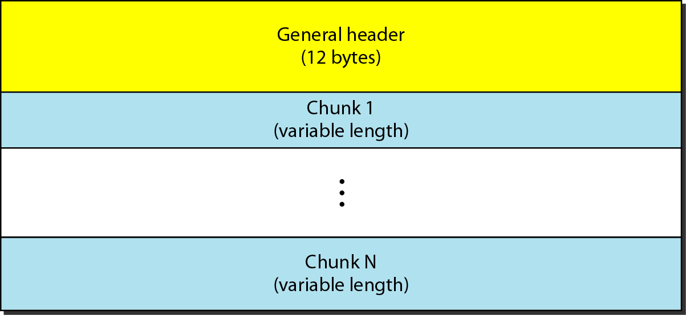
Figure 23.31 SCTP packet format
23.<number>

Slide 80
Note
In an SCTP packet, control chunks come before data chunks.
23.<number>

Slide 81
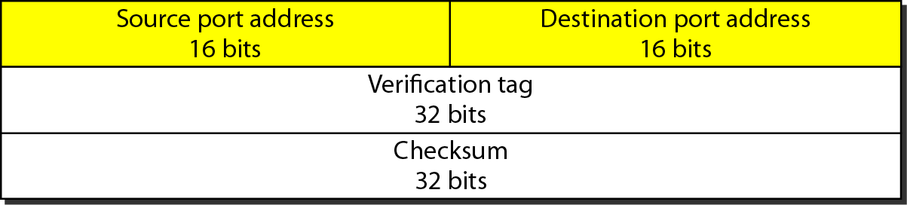
Figure 23.32 General header
23.<number>

Slide 82
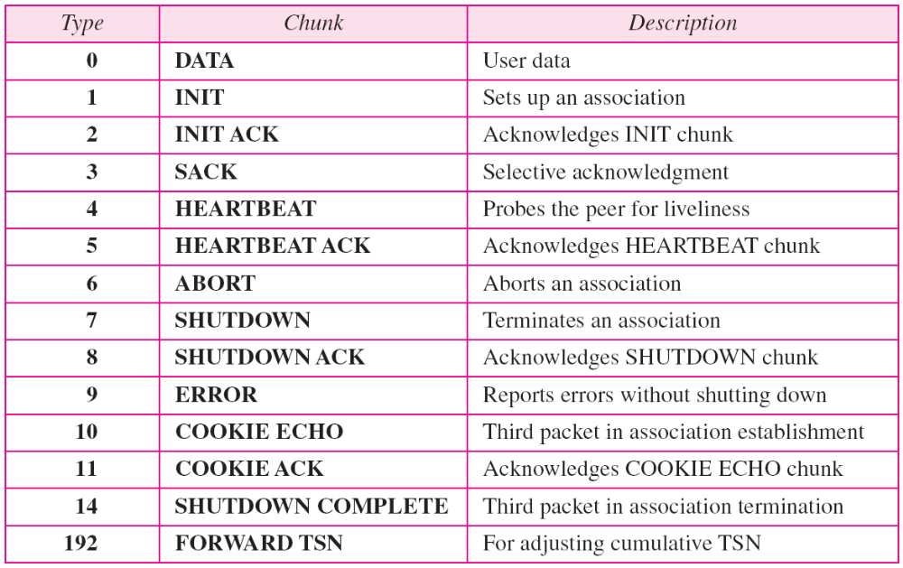
Table 23.5 Chunks
23.<number>

Slide 83
Note
A connection in SCTP is called an association.
23.<number>

Slide 84
Note
No other chunk is allowed in a packet carrying an INIT or INIT ACK chunk.
A COOKIE ECHO or a COOKIE ACK chunk can carry data chunks.
23.<number>

Slide 85
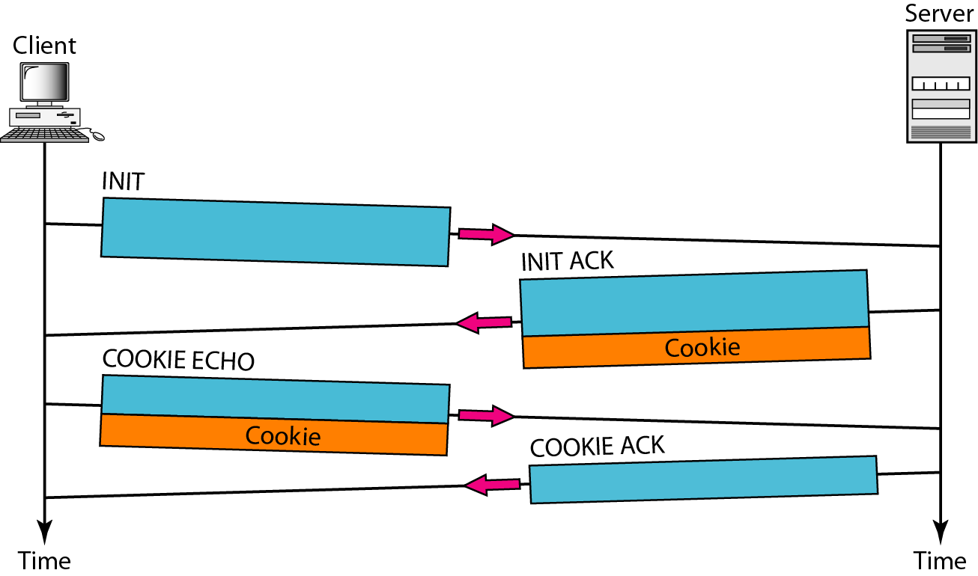
Figure 23.33 Four-way handshaking
23.<number>

Slide 86
Note
In SCTP, only DATA chunks
consume TSNs;
DATA chunks are the only chunks
that are acknowledged.
23.<number>

Slide 87
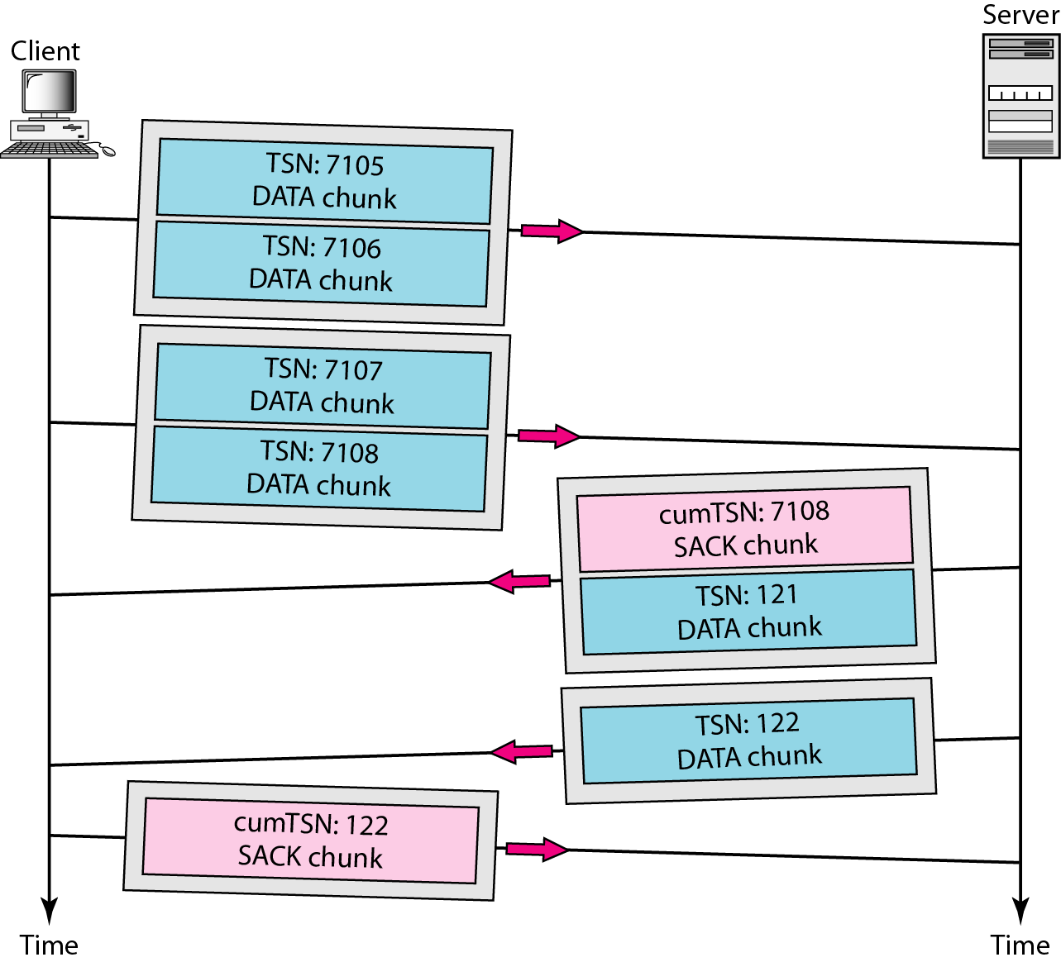
Figure 23.34 Simple data transfer
23.<number>

Slide 88
Note
The acknowledgment in SCTP defines the cumulative TSN, the TSN of the last data chunk received in order.
23.<number>

Slide 89
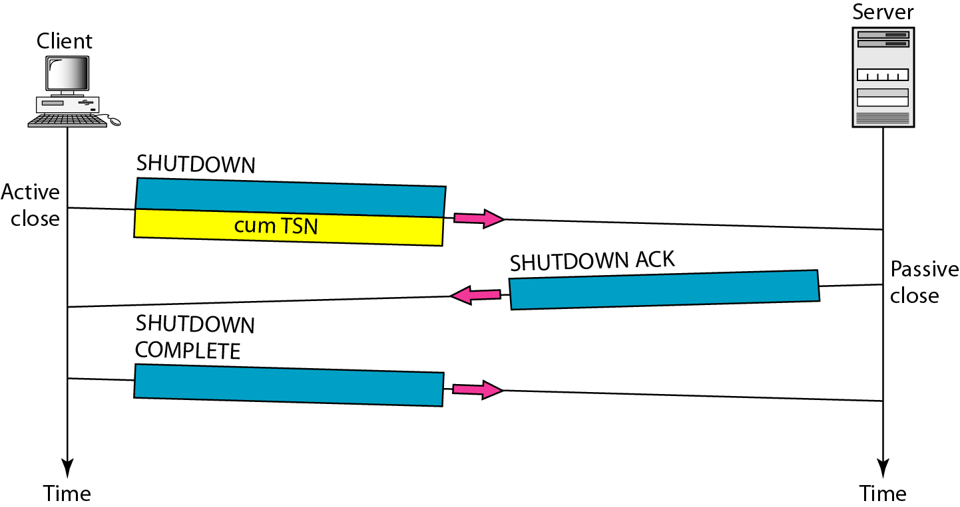
Figure 23.35 Association termination
23.<number>

Slide 90
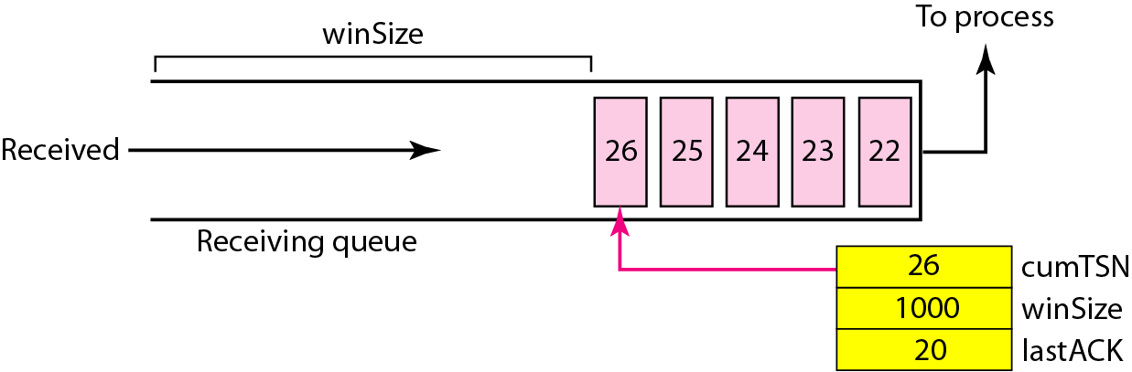
Figure 23.36 Flow control, receiver site
23.<number>

Slide 91
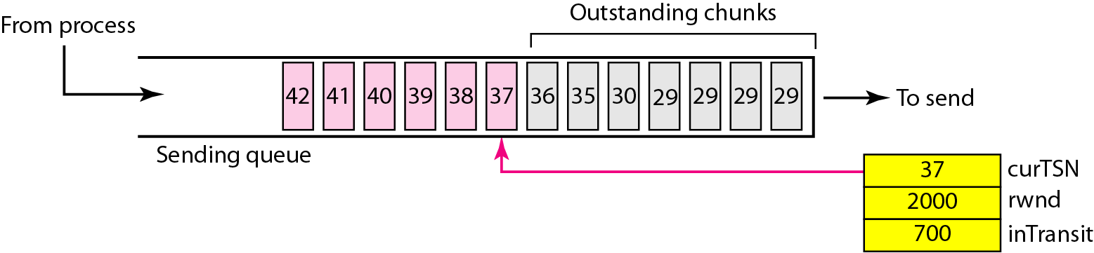
Figure 23.37 Flow control, sender site
23.<number>

Slide 92
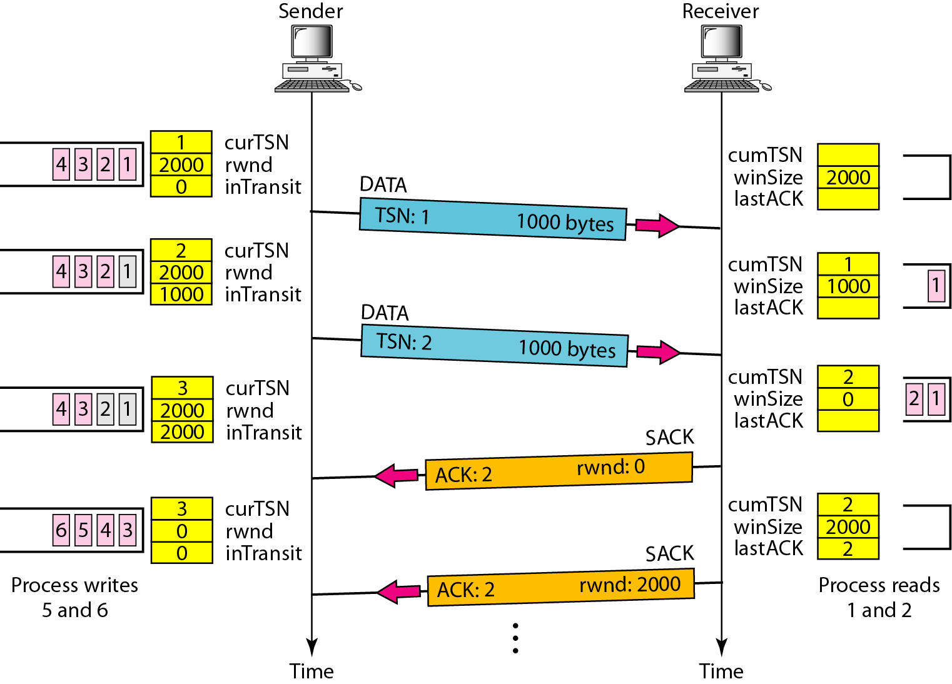
Figure 23.38 Flow control scenario
23.<number>

Slide 93
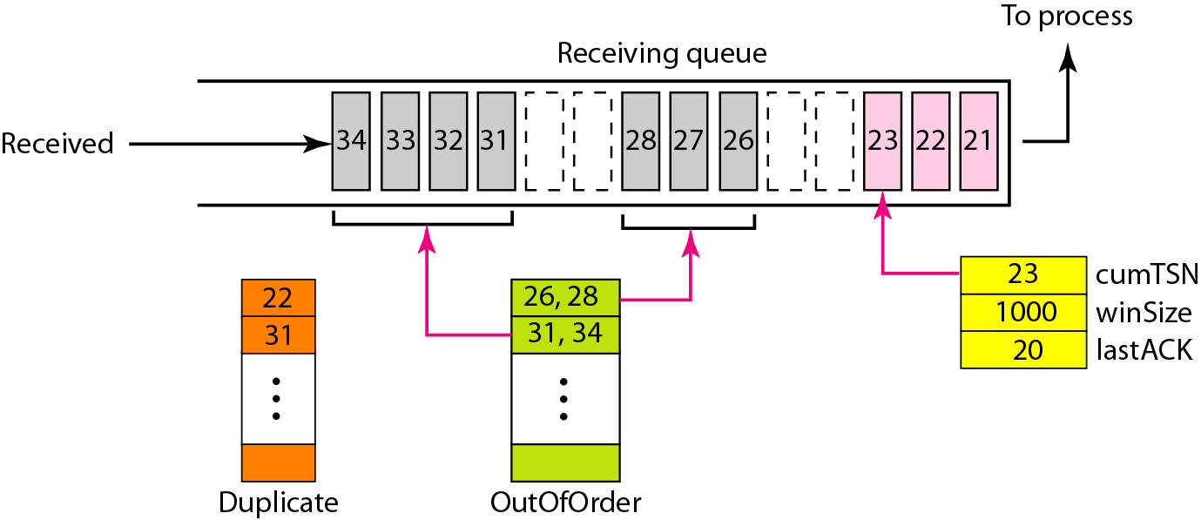
Figure 23.39 Error control, receiver site
23.<number>

Slide 94
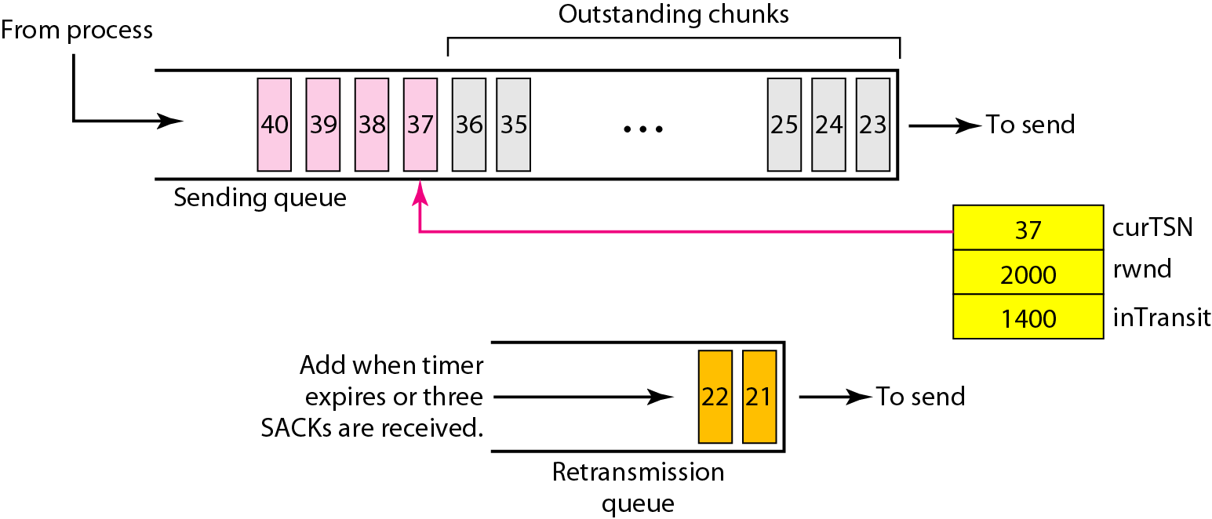
Figure 23.40 Error control, sender site
23.<number>

