Slide 1
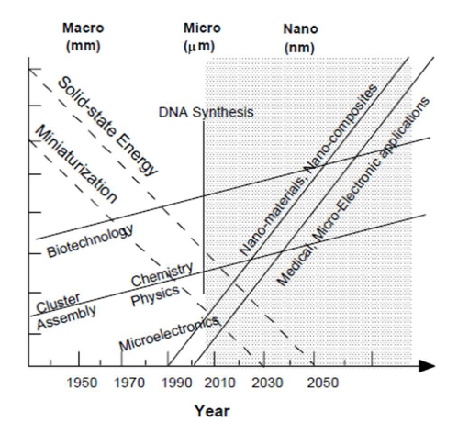

Slide 2
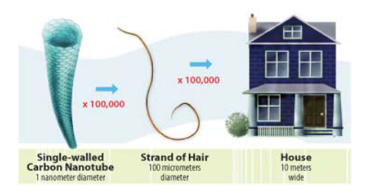

Slide 3
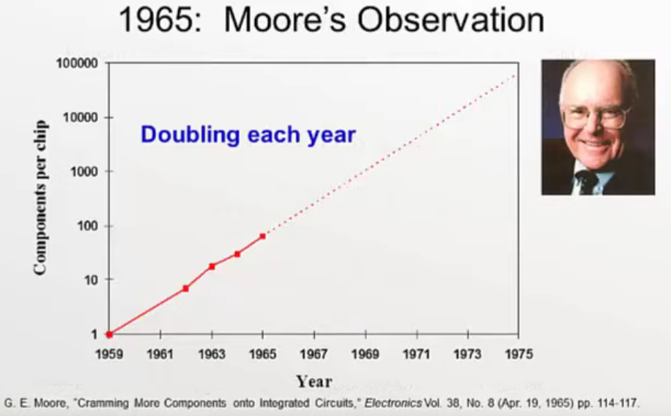
What are nanomaterials?

Slide 4
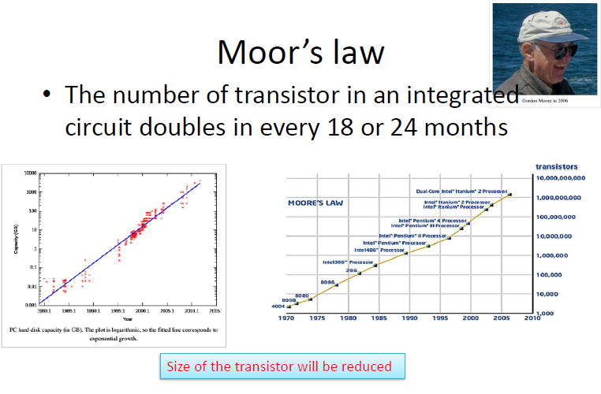

Slide 5
Surface Effects
As a particle decreases in size, a greater proportion of atoms are found at the surface compared to those inside. For example, a particle of
Size-30 nm-> 5% of its atoms on its surface
Size-10 nm->20% of its atoms on its surface
Size-3 nm-> 50% of its atoms on its surface
Nanoparticals are more reactive than large particles (Catalyst)

Slide 6
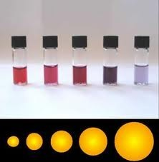
Quantum Effects
Quantum confinement
The quantum confinement effect can be observed once the diameter of the particle is of the same magnitude as the wavelength of the electron Wave function.
Quantum confinement is responsible for the increase of energy difference between energy states and band gap. A phenomenon tightly related with the optical and electronic properties of the materials.
When materials are this small, their electronic and optical properties deviate substantially from those of bulk materials.(GOLD)

Slide 7
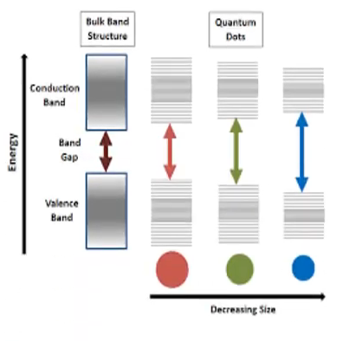

Slide 8
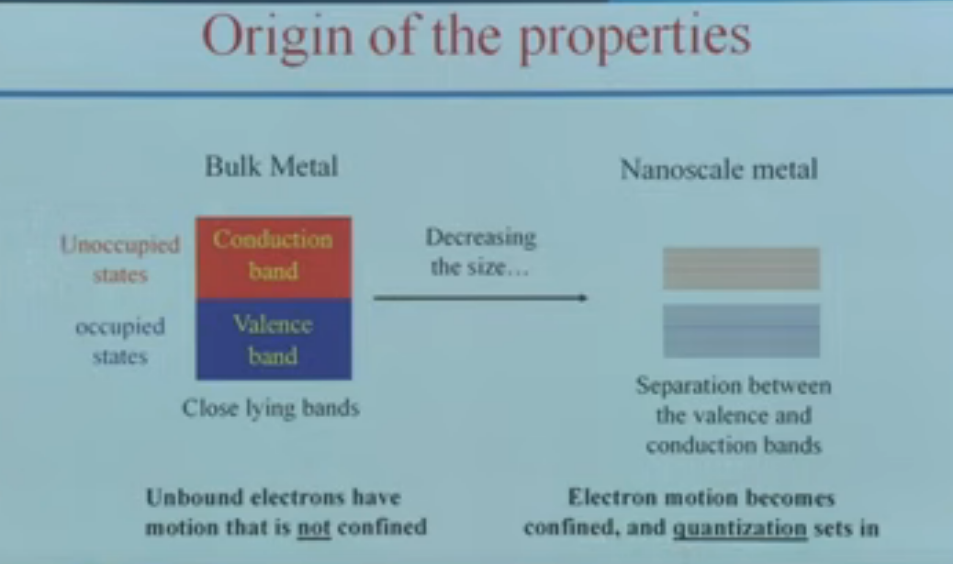

Slide 9
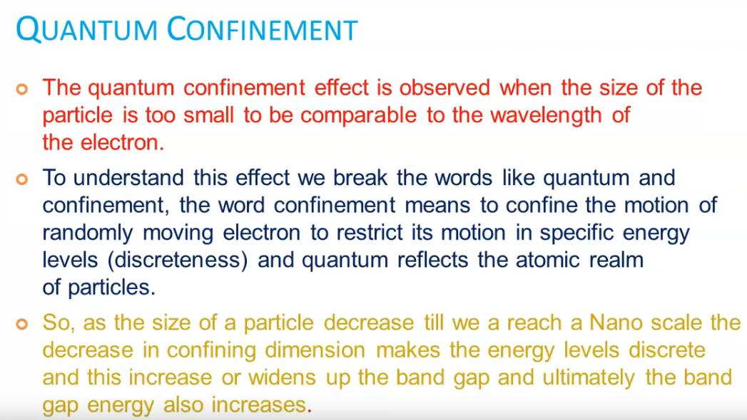

Slide 10
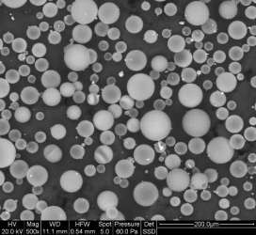
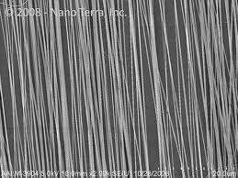
Nanomaterial shapes
nanomaterials can be nanoscale in
one dimension ( surface films )
Two dimensions ( strands or fiber)
Three dimensions ( particles )
They can exist in single or fused forms with spherical, tubular, and irregular shapes.

Slide 11
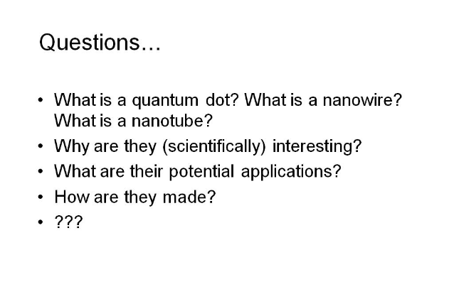

Slide 12
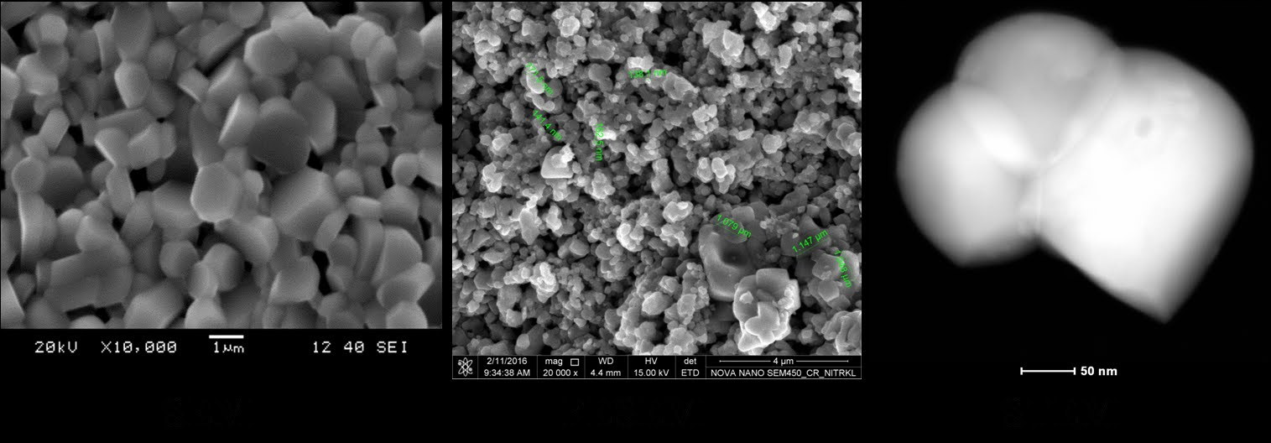

Slide 13
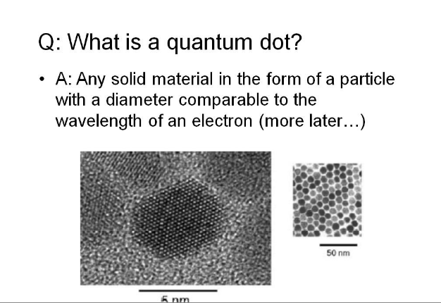

Slide 14
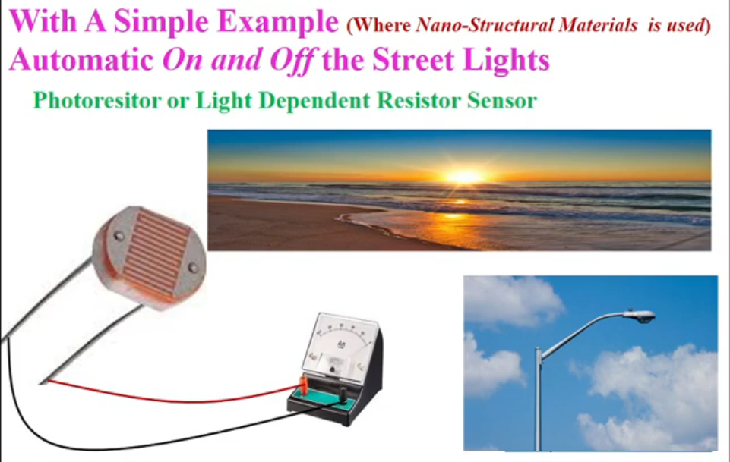

Slide 15
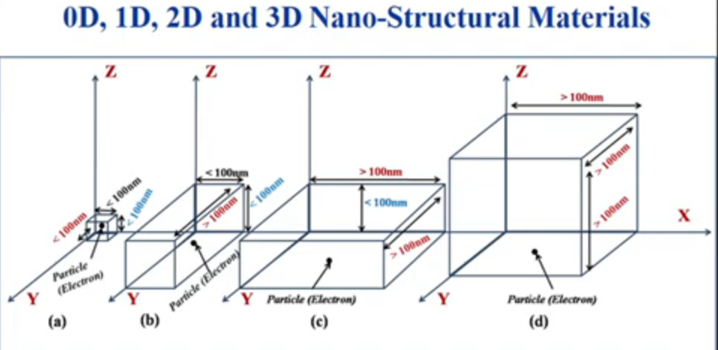

Slide 18
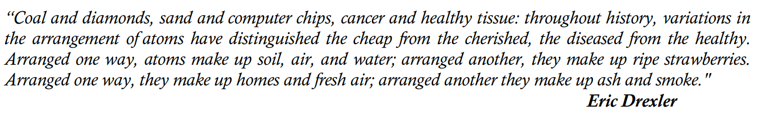

Slide 19
Each day we deal with many materials.
Can you specify carbon based materials around you?

Slide 20
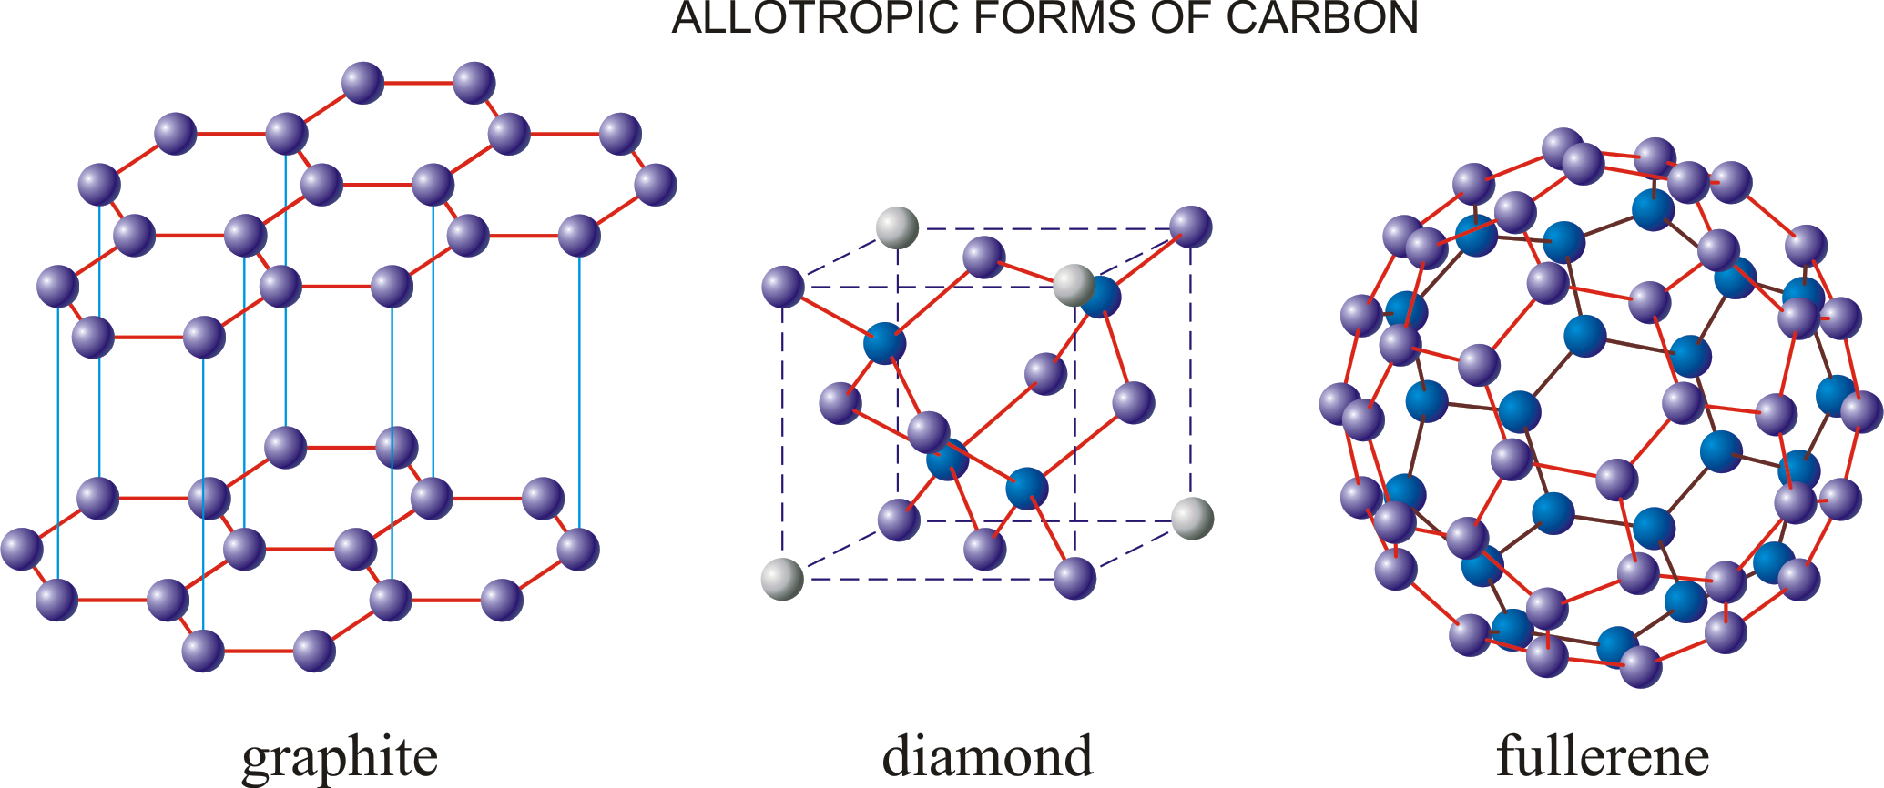

Slide 21
The molecules of Fullerene family are very suitable for the improvement of new molecules as carrier molecules by absorbing or by attaching other kinds of atoms in the desired fields of technology.

Slide 22


