Slide 1
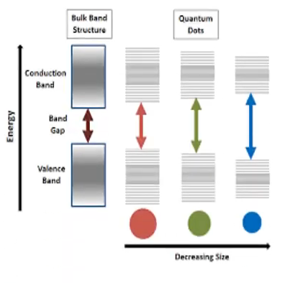

Slide 2
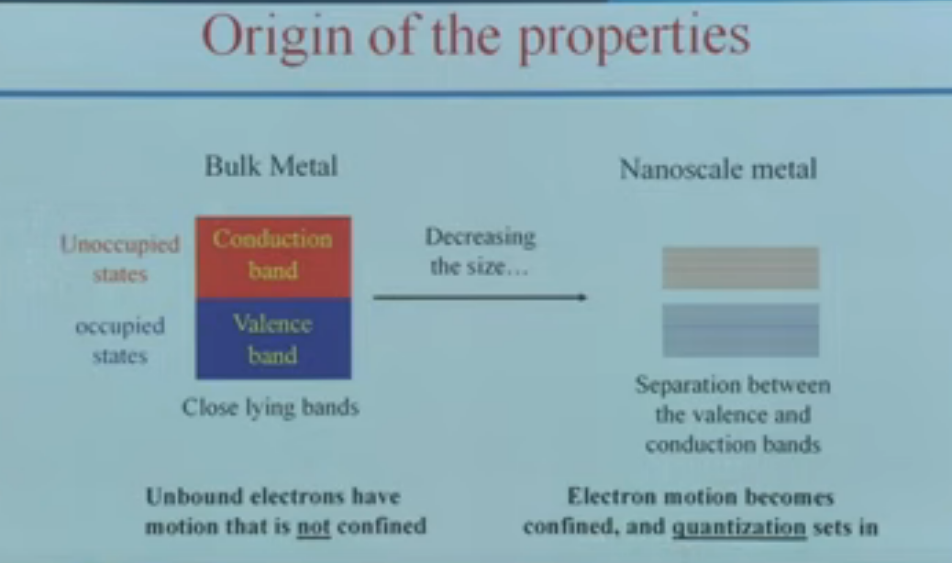

Slide 3
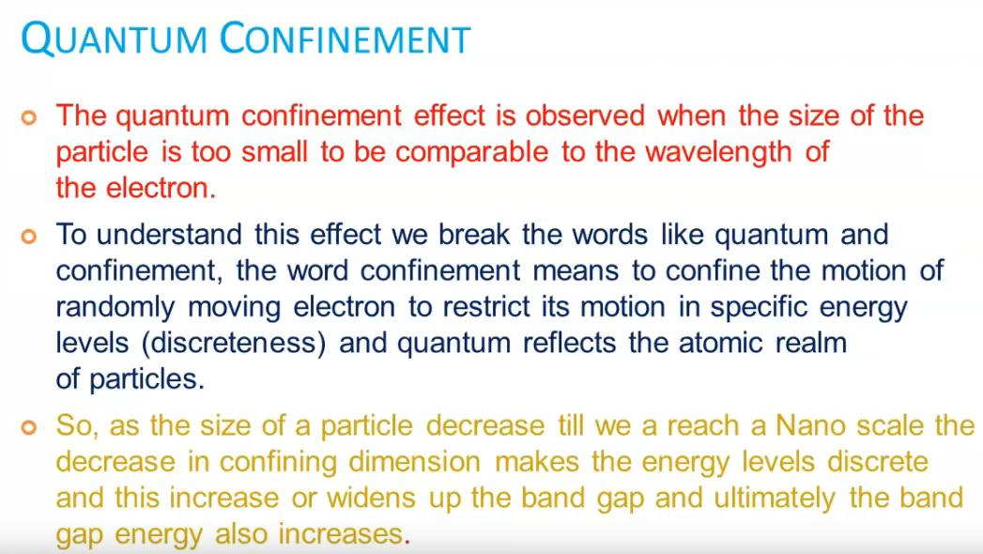

Slide 4
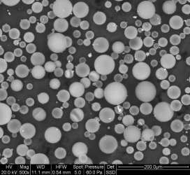
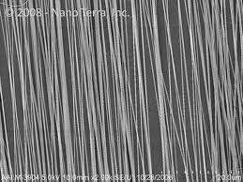
Nanomaterial shapes
nanomaterials can be nanoscale in
one dimension ( surface films )
Two dimensions ( strands or fiber)
Three dimensions ( particles )
They can exist in single or fused forms with spherical, tubular, and irregular shapes.

Slide 5
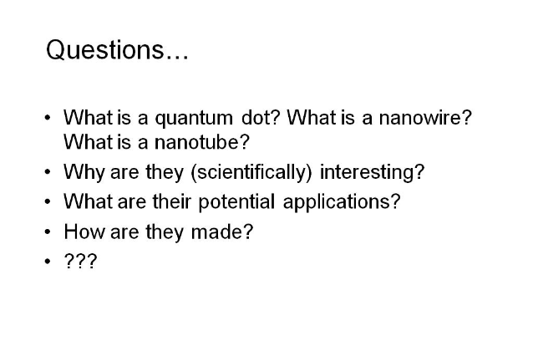

Slide 6
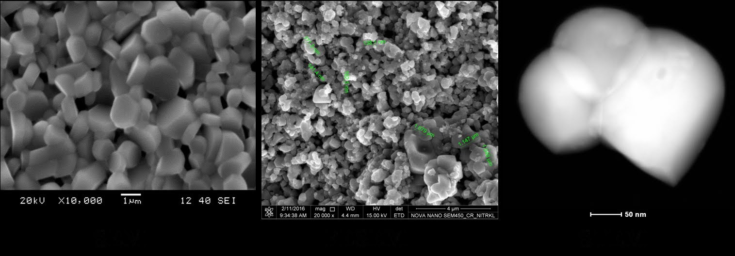

Slide 7
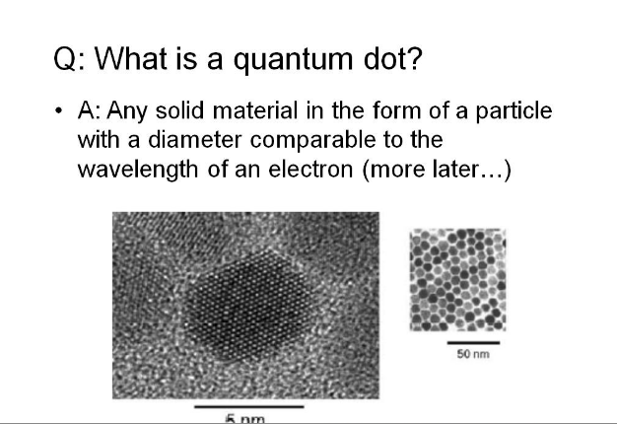

Slide 8
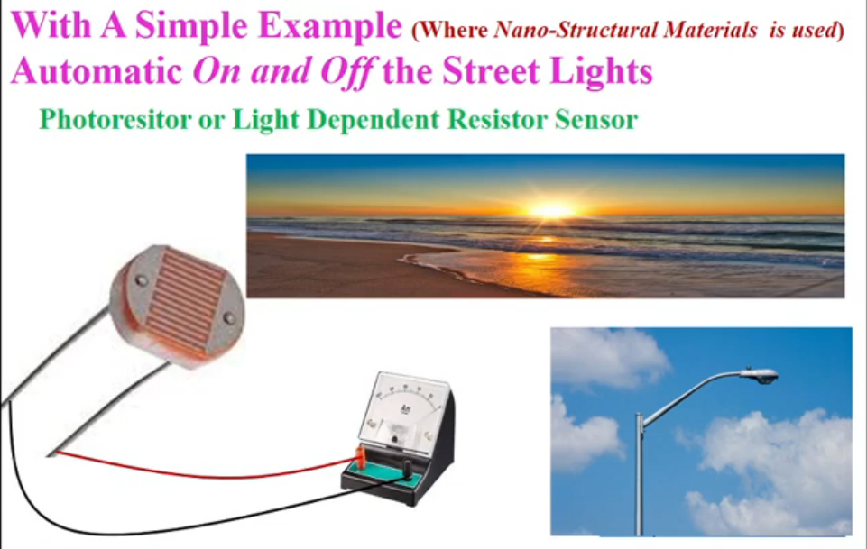

Slide 9
