Slide 1


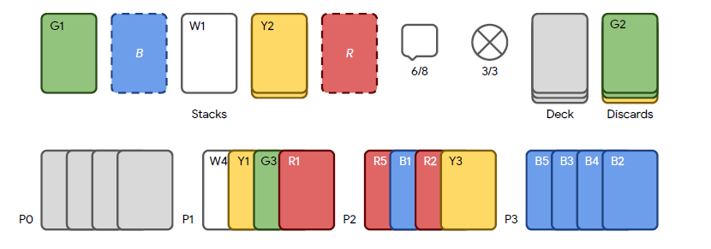
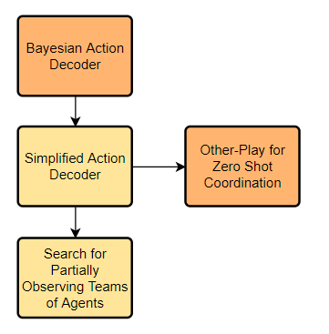
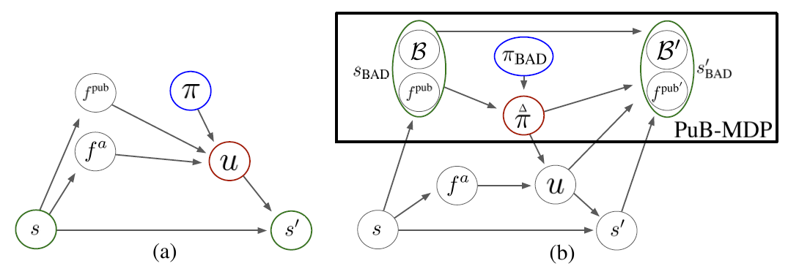
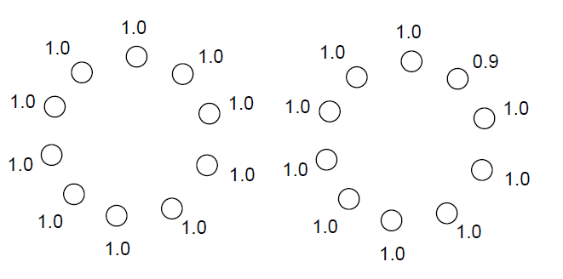
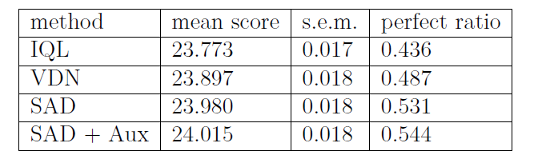
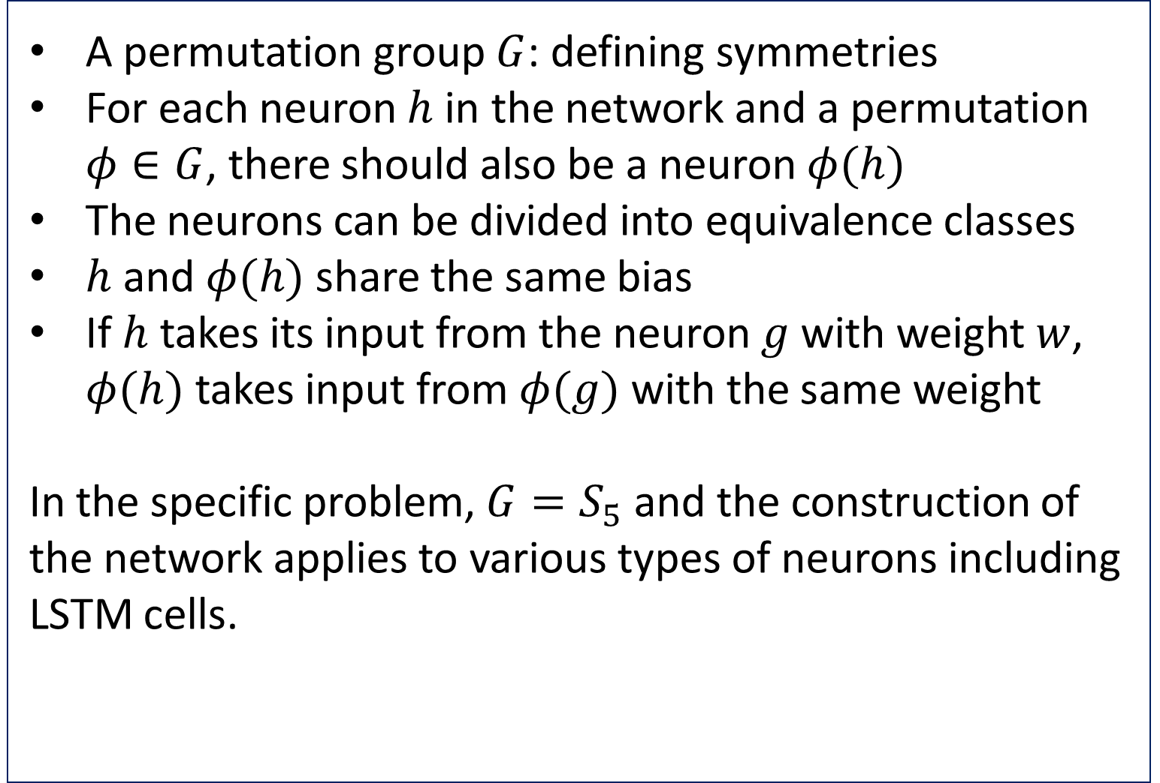
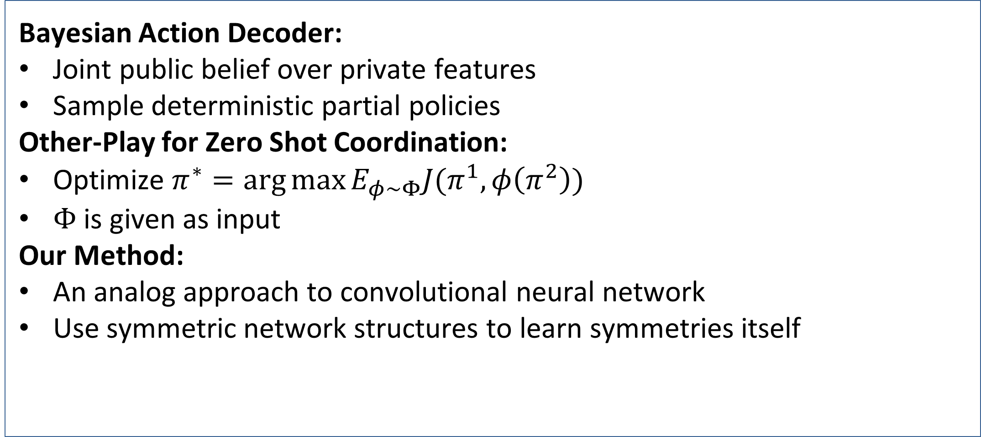
The Hanabi Game
Xiuhan Wang, Jing Wei
Institute for Interdisciplinary Information Sciences, Tsinghua University
Introduction
Motivation:
A benchmark of fully cooperative
games of imperfect information
Contribution:
Surveyed a sequence of learning
methods and compared their
performance
Used a symmetric network in order
to learn symmetries itself
State of the Art
Methods
Bayesian Action Decoder:
Joint public belief over private features
Sample deterministic partial policies
Other-Play for Zero Shot Coordination:
Optimize $π^{∗}=\arg{max⁡{E_{φ∼Φ}J(π^{1},φ\left(π^{2}\right))}}$
$Φ$ is given as input
Our Method:
An analog approach to convolutional neural network
Use symmetric network structures to learn symmetries itself
Details
Experiments
A permutation group $G$: defining symmetries
For each neuron $h$ in the network and a permutation $φ∈G$, there should also be a neuron $φ(h)$
The neurons can be divided into equivalence classes
$h$ and $φ(h)$ share the same bias
If $h$ takes its input from the neuron $g$ with weight$w$, $φ(h)$ takes input from $φ(g)$ with the same weight
In the specific problem, $G=S_{5}$ and the construction of the network applies to various types of neurons including LSTM cells.
The performances under different training settings:
Bayesian Action Decoder and its variants perform better than the previous methods!
Experiments for our symmetric network are still running.
Artificial Intelligence Course Project

