Slide 1
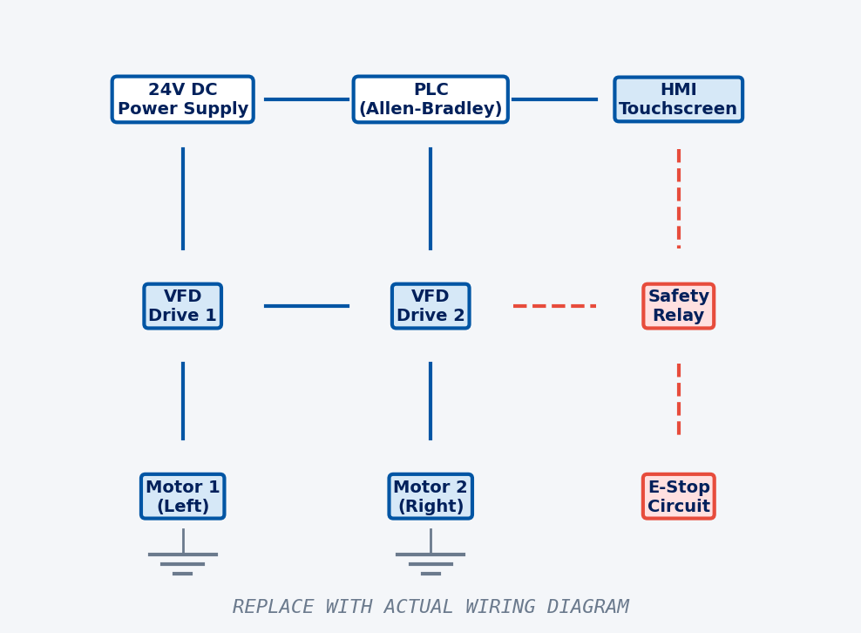
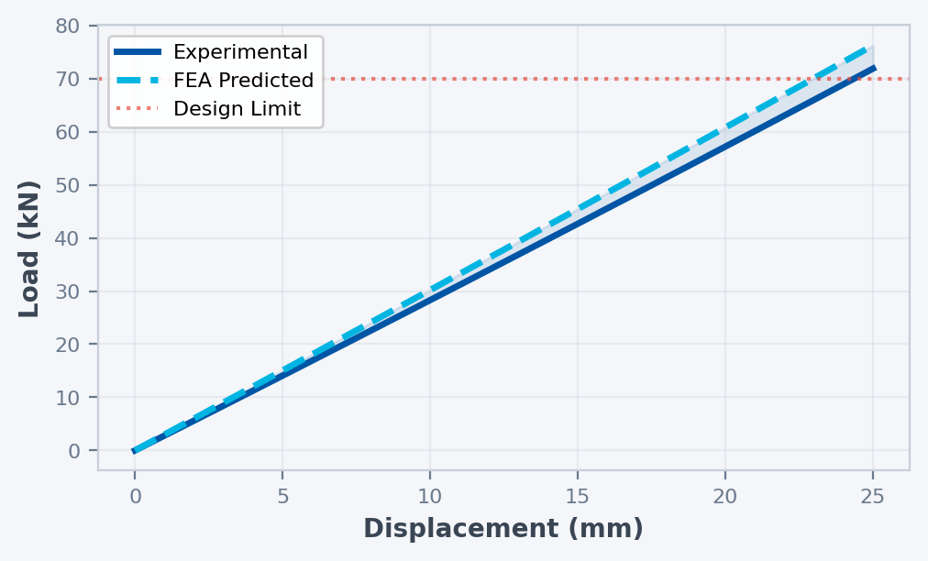
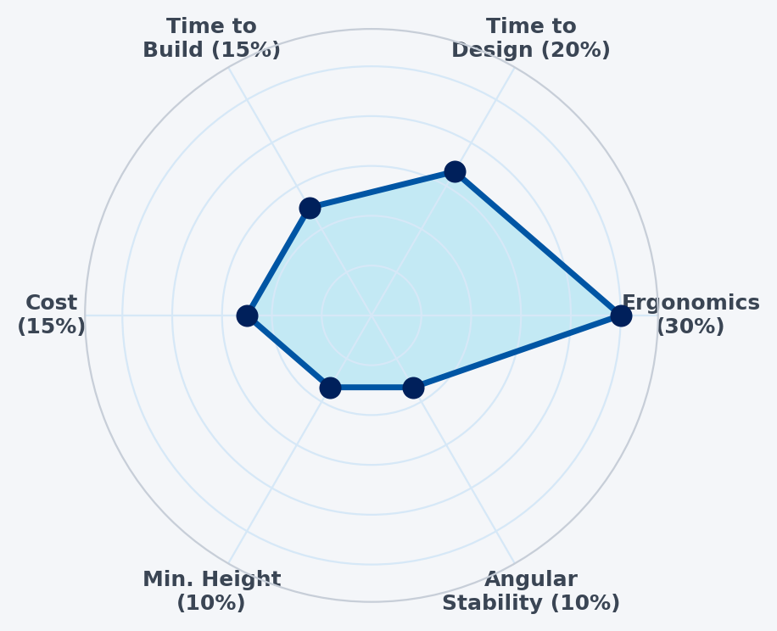
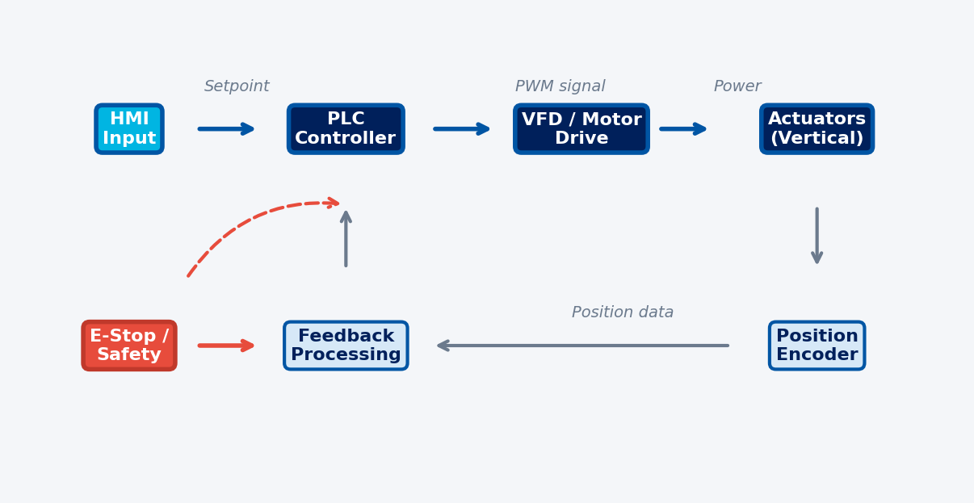
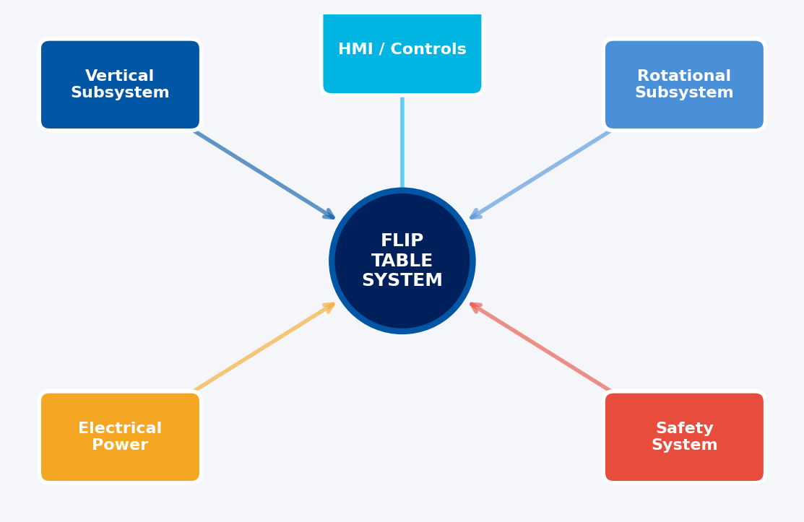
AIRBUS
AIRBUS FLIP TABLE
THE UNIVERSITY OF BRITISH COLUMBIA
Mechanical Engineering · Team T2
Automated Vertical & Rotational Positioning System
Kenneth · Gyan · Ryan · Oliver · Mfon · Jordan
ROBOTICS · CAPSTONE 2025–2026
TEAM T2
PROJECT OVERVIEW
FINAL CAD ASSEMBLY
KEY PERFORMANCE METRICS
CLIENT: AIRBUS ROBOTICS
6 ft+
1000 lb
500 lb
0.05 m/s
Flip tables are large tabletops (~2.4m × 1.8m) that vertically translate and rotate. They simulate fuselage positions for robots used to drill or install fasteners on an aircraft fuselage at different orientations.
Under-Table
Clearance
Static Load
Capacity
Dynamic Load
Capacity
Min. Vertical
Speed
PROBLEM
Current flip tables are manually rotated and difficult to operate, limiting throughput and introducing ergonomic risk for operators.
INSERT CAD RENDER / 3D MODEL HERE
TESTING & VALIDATION
OBJECTIVE
TEST | TARGET | RESULT
Vertical Translation | ≥ 0.05 m/s | ✓ PASS
Static Load | 1,000 lb | ✓ PASS
Dynamic Load | 500 lb | ✓ PASS
Under-Table Clearance | ≥ 6 ft | ✓ PASS
E-Stop Response | < 1 s | ✓ PASS
HMI Response | < 0.5 s | ✓ PASS
Angular Stability | ≤ 0.5° | ~ CHECK
Redesign the flip table to implement automated vertical translation with integrated safety, HMI, and improved ergonomics.
SCOPE & REQUIREMENTS
Automate vertical and rotational motion
Integrate safety system & Human-Machine Interface (HMI)
Improve ergonomic design and operator access
Minimum vertical speed: 0.05 m/s
Min. 6 ft clearance under tabletop
Static load: 1,000 lb | Dynamic load: 500 lb
FEA STRESS ANALYSIS
WIRING DIAGRAM
*Rotation downscoped after client discussion — separate detailed design provided.
Low
PROTOTYPE SPECIFICATIONS
INSERT FEA RESULTS IMAGE HERE
PARAMETER | VALUE
Table Dimensions | ~2.4 m × 1.8 m
Under-Table Clearance | ≥ 6 ft (min.)
Static Load Capacity | 1,000 lb
Dynamic Load Capacity | 500 lb
Vertical Speed | ≥ 0.05 m/s
Safety System | E-Stop, Light Curtain
HMI | Touchscreen + Physical Controls
Rotation | Design provided separately
High
Replace with actual wiring schematic
LOAD vs. DISPLACEMENT
PROTOTYPE
EVALUATION CRITERIA
INSERT PROTOTYPE PHOTO HERE
Placeholder data — replace with actual test results
RECOMMENDATIONS
CONTROL SYSTEM ARCHITECTURE
Overall
Add safety cage or light curtain
Reduce assembly weight
Redesign for DFMA
DESIGN PROCESS
Vertical Subsystem
1
→
2
→
3
→
4
Optimize with stainless steel channels
Add polycarbonate cover
Add rigging provisions
Client Needs &
Requirements
Concept
Generation
Detailed
Design & FEA
Prototype
Build & Test
Rotational Subsystem
Lower torque brake & gearbox
Improve redundant braking mechanism
Electrical & Controls
SYSTEM ARCHITECTURE
Add safety switch on cabinet
Refine PID control algorithm
AIRBUS ROBOTICS · Capstone Project 2025–2026
UBC Mechanical Engineering · Design & Innovation Day
TEAM T2 · 36" × 48" Poster

