Slide 1
Critical Function Prototyping and Concept Refinement
November 13th 2025
Paper: K. Petrakis, A. Wodehouse, and A. Hird, “Physical prototyping rationale in design student projects: an analysis based on the concept of purposeful prototyping,” Design Science, vol. 7, p. e7, Jan. 2021, doi: 10.1017/dsj.2021.6.
Notes:
"Good morning everyone. Today, I'll be presenting a summary and reflection on a paper called 'Physical Prototyping Rationale in Design Student Projects'.
This research takes a deep dive into a topic that's incredibly relevant for all of us in this room, especially as we work on our capstone projects: it explores why and how design students actually use physical prototypes, and what separates a successful project from a less successful one when it comes to model-making."

Slide 2
Introduction
Prototyping is a critical and integral part of design education
Prototype boost creativity, aid concept evaluation, and improve final outcomes.
Research Question: How effective is prototypes being used to improve engineering design?
Hypothesis: Students often underutilize prototypes.
To address this, author introduces “purposeful prototyping”
Notes:
"We all know that prototyping is a critical part of engineering design. We build models that can range from simple appearance mockups to fully functional hardware. The goal is to boost our creativity and help us evaluate our concepts. So naturally, we ask the question of are we actually using our prototype properly?
This question rises because the author argues that, while prototyping is a major part of our education, it's often poorly understood and implemented. Students tend to have a very narrow view of what a prototype is for, which prevents them from getting the maximum benefit from the time and effort they put into building them."
"This leads to the core concept of the paper: Purposeful Prototyping. The idea is that before you even start building, you should have a clear, specific purpose in mind.

Slide 3
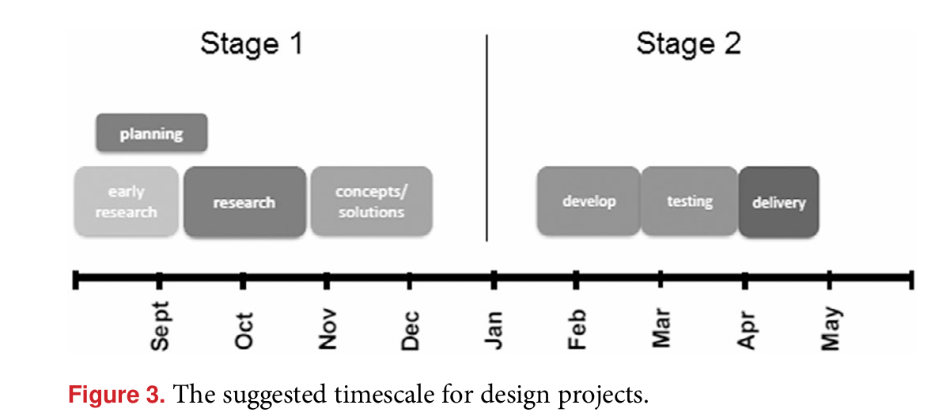
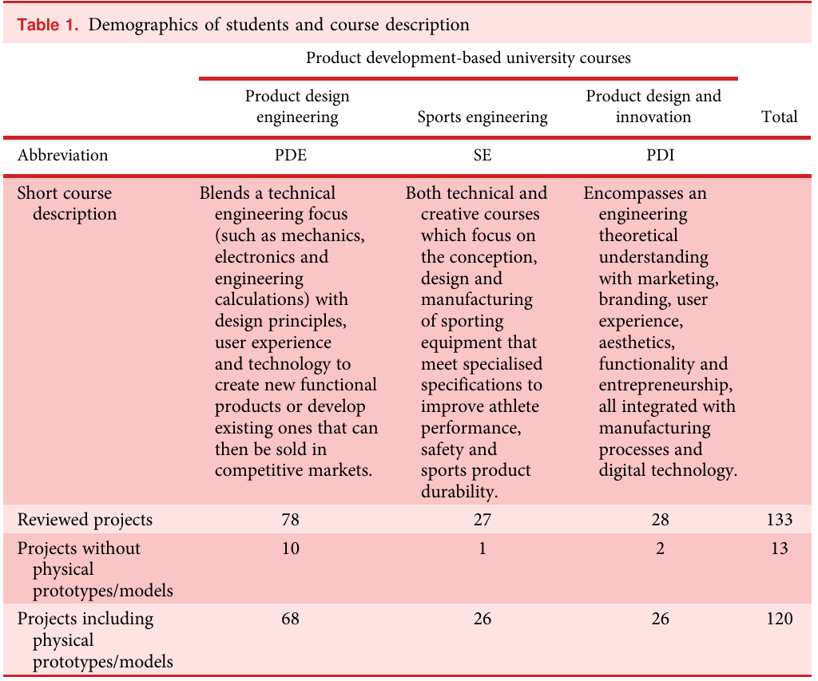
Method
Data Source: 133 individual student design projects from three different undergraduate courses (Product Design Engineering, Sports Engineering, Product Design & Innovation).
The analysis focused on the 120 projects that included physical prototypes.
Data Collection: For each of the 120 projects, they performed an in-depth review of the final project reports and design portfolios.
Notes:
"So, how did they investigate this? The researchers conducted a retrospective study, meaning they analyzed projects after they were already completed. They reviewed 120 final-year individual design projects from a UK university.
The projects were a full academic year long, divided into two stages as shown in this timeline. A key part of their analysis was to see if students were prototyping early in 'Stage 1' to explore ideas, or only at the end in 'Stage 2' to validate their final design."
One thing to note, look at figure 3, that is their timeline for their project, does it look similar to something?

Slide 4
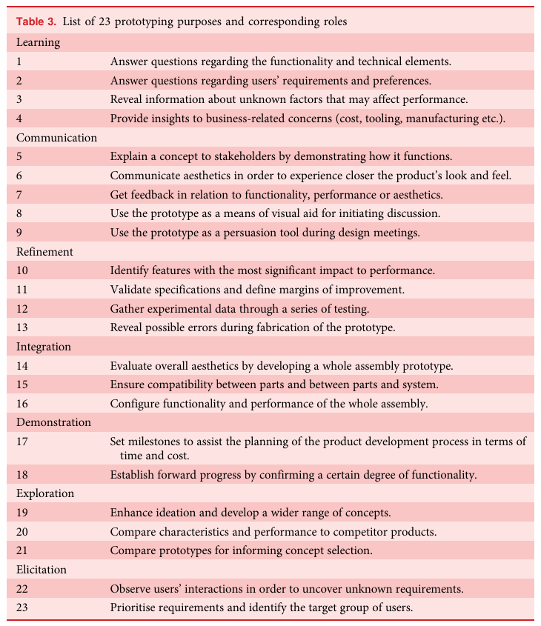
Method (Cont)
Analysis Process:
Identified every instance of a physical prototype created by the students.
Analyzed the students' written rationale, quotes, and visual evidence to determine the purpose of each prototype.
Classification was done using a pre-defined list of 23 distinct prototyping purposes
They noted when prototyping occurred (early "Stage 1" vs. later "Stage 2") and how extensively each of the 23 purposes was used.
Crucially, they correlated their findings with the students' final academic grade for the project to see if the use of specific prototyping purposes was linked to higher performance.
Notes:
“Next, To analyze the projects, they developed a detailed framework based on those seven roles. They identified 23 specific, actionable purposes for creating a prototype.
You don't need to read this whole list, but the point is to show how detailed their analysis was. For every physical model a student built, the researchers went through their report and portfolio to see if it was used to, for example, 'Answer questions about functionality,' which is purpose #1, or 'Enhance ideation,' which is purpose #19. This allowed them to quantify exactly what students were doing."

Slide 5
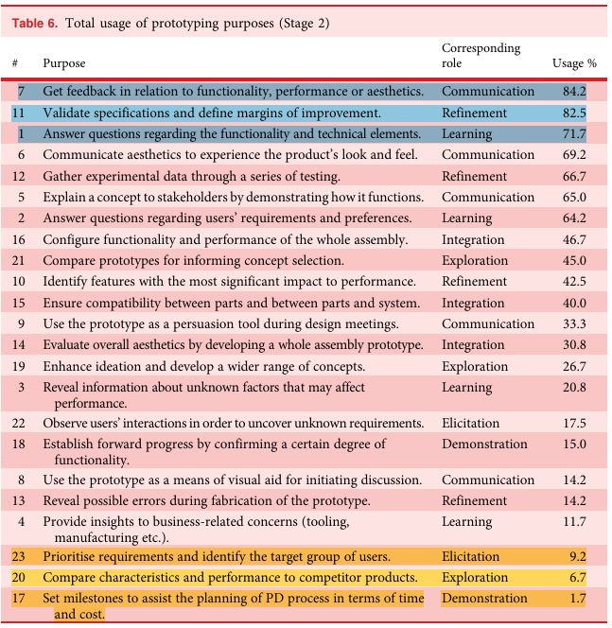
Results
Students Have a Narrow Prototyping Scope: Students overwhelmingly use prototypes for a few "traditional" and late-stage purposes. The most common were:
Getting feedback on functionality or aesthetics (84.2%)
Validating specifications and defining improvements (82.5%)
Answering questions about functionality and technical elements (71.7%)
Notes:
"This brings us to the core results, and the findings are really clear. This table shows the usage rate of each purpose across all 120 projects.
As you can see, students overwhelmingly use prototypes for three main reasons: getting feedback, validating specifications, and answering technical questions. Over 70% of projects used prototypes for these late-stage, validation-focused tasks. This confirms the authors' initial hypothesis: students have a very narrow scope for prototyping.

Slide 6
Results (Cont.)
Many Powerful Purposes are Underused:
Project Planning: Only 1.7% used prototypes to set milestones and plan their project timeline
Exploration & Elicitation: They rarely used prototypes to discover unknown user requirements, compare concepts, or enhance ideation. They used them to confirm what they already knew, not to explore new territory.
Learning from the Building Process: Purposes like "revealing fabrication errors" (14%) or gaining insights into "manufacturing concerns" (12%) were rarely considered.
Notes:
"But what's even more telling than what students did use prototypes for, is what they didn't. This slide highlights the many powerful purposes that were almost completely neglected.
First, let's look at Project Planning. An incredibly low 1.7% of students used prototypes to set milestones and manage their project timeline. This statistic is critical because, as the paper notes, students who failed to build any prototype at all often cited poor time management as the reason. This shows a huge missed opportunity to keep projects on track.
Next is Exploration and Elicitation. Students rarely used prototypes to discover unknown user requirements or to compare different concepts against each other. The key takeaway here is that they used their models to confirm what they already knew, not to explore new territory. They weren't using prototypes as a tool for discovery.
And finally, there was a failure to Learn from the Building Process itself. Valuable purposes like 'revealing fabrication errors' or 'gaining insights into manufacturing concerns' were rarely considered, with usage rates of only 14% and 12% respectively. This shows that students tend to focus only on the final outcome, not on the valuable lessons that the act of building can teach them."

Slide 7
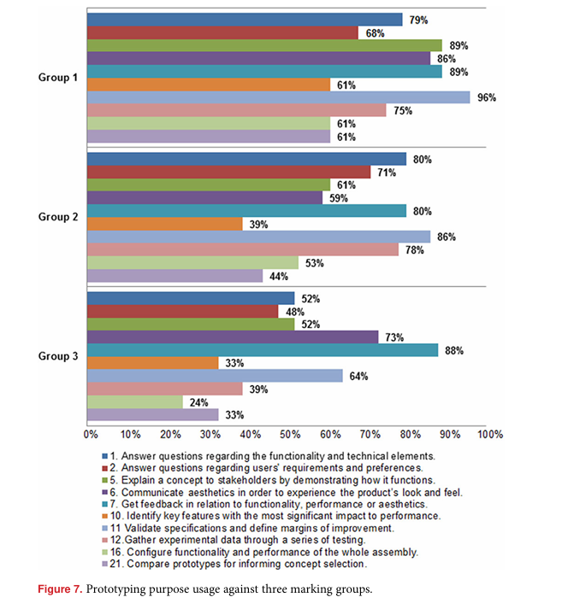
Results (Cont. 2)
A Clear Link to Academic Performance: There was a strong correlation between the types of purposes used and project success.
Most beneficial purposes:
Explaining a concept by demonstrating its functionality
identify key performance features
Gathering experimental data through testing
Informing concept selection by creating and comparing multiple prototypes
Early Prototyping is Linked to Success: Only 12.5% of students prototyped in the early stage of their project
Using prototypes for early-stage purposes achieve higher grades. (See Appendix A)
Notes:
“Another question they ask is, does this actually matter for grades? The answer is a definitive yes. This graph is the most important finding in the paper. It plots the usage of key purposes against the students' final marks, from the highest-scoring projects in 'Group 1' to the lowest in 'Group 3'.
The trend is undeniable. This shows a direct correlation between using prototypes for deep, analytical work and achieving a better outcome."
"This link to success is even clearer when looking at early-stage activities. High-performing students in Group 1 were far more likely to use prototypes to enhance ideation and compare concepts.
This shows that prototyping isn't just about proving your final design works. It's about using it as an exploration tool early on to ensure you're heading in the right direction in the first place."

Slide 8
Conclusion
Students tend to view prototyping as a validation activity at the end of a project, rather than a learning and exploration tool to be used throughout
This limited perspective prevents us from reaping major benefits, especially in project planning, risk reduction, and early-stage innovation
To achieve a good design, we need to consider a broader range of prototyping purposes
Notes:
"So, to summarize the conclusions:
Students generally have a narrow view of prototyping, seeing it primarily as a final validation tool, not a learning tool for the entire process.
There is a strong link between academic performance and the use of specific, high-value purposes like testing, data gathering, and concept comparison.
Next, using prototypes for early-stage exploration and project planning is a key differentiator for successful projects, but it's a practice that is widely neglected."
Finally, to get a good design, we should consider more prototyping purposes

Slide 9
Reflection & Application
Self-Audit: Look at the prototypes we are planning to build. What is their explicit purpose? Are we just building something to "have a prototype," or are we trying to answer a specific question?
Go Beyond Validation: Are our prototypes for testing the final design? Could we build a quick, low-fidelity model this week to explore a tricky user interaction (Purpose #2), compare two competing mechanism ideas (Purpose #4), or simply to better understand the scale and feel of your concept in 3D (Purpose #15)?
Notes:
"Now for the most important part: what does this mean for us and our MECH 45X-490 projects? This research gives us a direct roadmap for how to improve our own design process.
We should ask ourselves: What is the explicit purpose of the next model we plan to build? Are we just building it because we feel we should, or are we trying to answer a specific question? Are we using it to reduce risk by testing a key function now, instead of waiting until the end? Are we using it to plan our next steps and manage our time effectively?"
"Ultimately, this paper has changed my perspective. It encourages a shift in mindset from 'Building to Show' to 'Building to Learn.'
A prototype isn't just a polished object for the final presentation. It's a thinking tool. A quick, rough model that answers a critical question or reveals a fatal flaw early on is far more valuable to the design process than a perfect-looking model that tells you nothing new. It’s about embracing prototyping as an iterative part of the journey, not just the destination."

Slide 10
Implication to Design and Engineering
This paper reframes prototyping from being just a "proof of work" to being a "method of thinking." A prototype isn't just the answer; it's a tool to find the right questions.
It highlights that the process of building and interacting with a physical object can reveal insights that CAD models or simulations cannot (e.g., unexpected fabrication challenges, ergonomic feel, user confusion).
It shows that being strategic and purposeful is as important in the workshop as it is in theoretical analysis.
Notes:
This even applies after we graduate, having a mindset of doing a prototype with a purpose allows you to answer the right questions.
In engineering and design, prototype are essential because it allows us to assess stuff that we missed.
Before we build, we need to consider their purpose, remember the concept of “purposeful prototyping”. This is a tool to help us become more strategic, more effective, and more purposeful designers. I’d encourage everyone to take a look at this framework when planning the next steps for their own projects."

Slide 11
Questions?

Slide 12
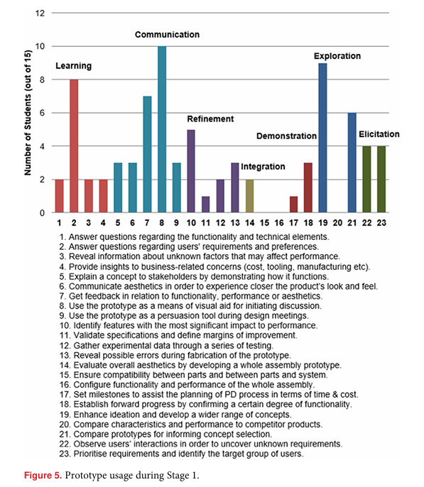
Appendix A : Early Prototype Purpose

