Slide 1


对抗学习在众包数据中的应用
杨文军
导师：李超群
0

Slide 2
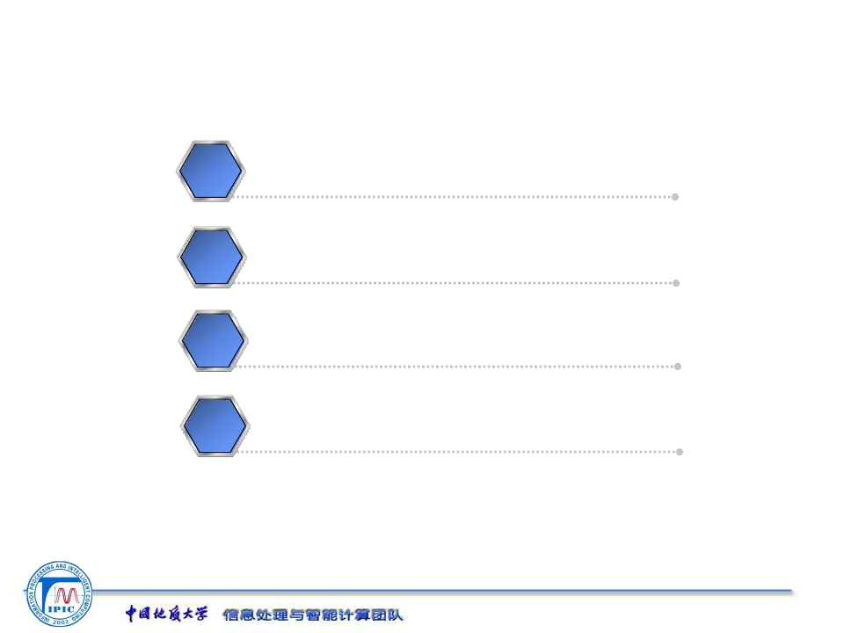
对抗学习
一
二
三
四
众包学习
实验部分
未来工作
1/8

Slide 3
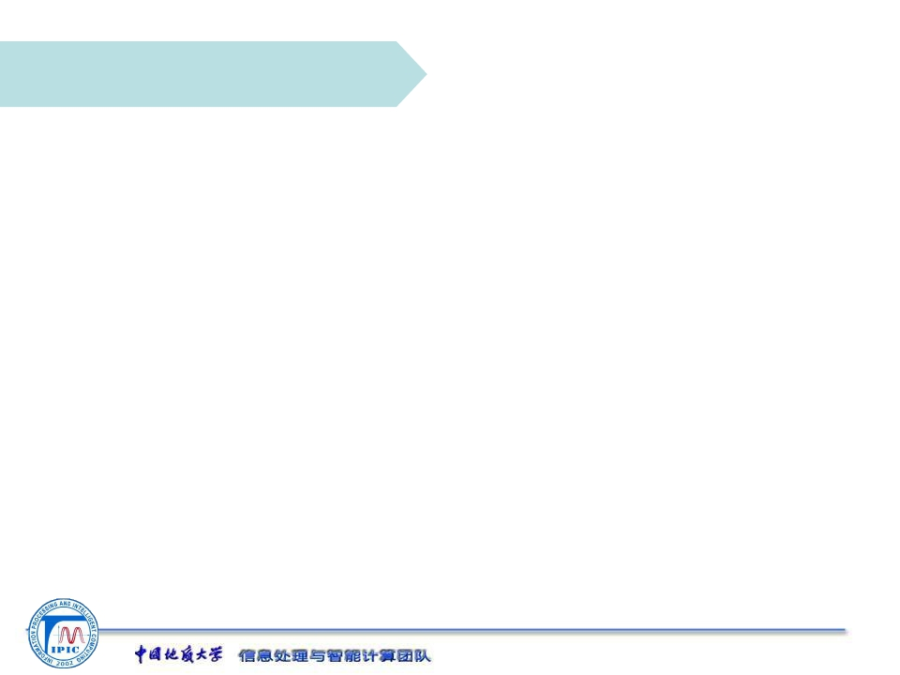
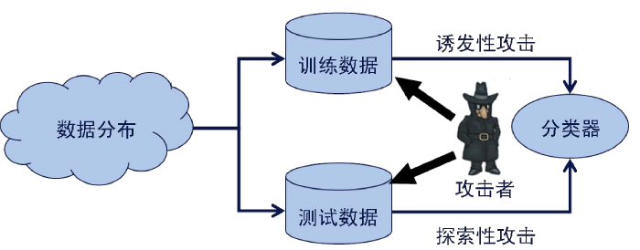

对抗学习
经典的机器学习算法，往往考虑训练数据与测试数据是相同分布。
2/8

Slide 4
对抗学习
因此在制定学习策略时，不仅需要考虑原有的数据集，同时需要考虑对手的策略
2/8

Slide 5
对抗学习
攻击者和防守者之间构成一种互相竞争的关系。
攻击者(adveraries,spammer)：通过操纵数据，降低分类精度
防守者(classifier,filter,data miner)：检测攻击，建立更鲁棒的分类器。
2/8

Slide 6
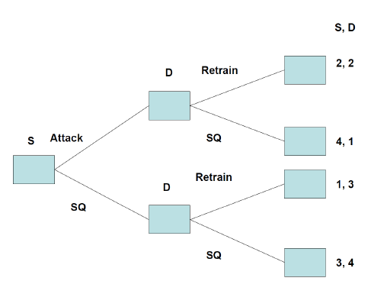
对抗学习
S: Spammer
D: Data Miner
SQ: Status Quo
S,D: Payoff
2/8

Slide 7
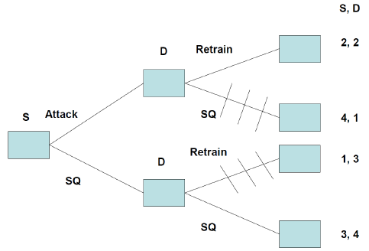
对抗学习
S: Spammer
D: Data Miner
SQ: Status Quo
S,D: Payoff
2/8

Slide 8
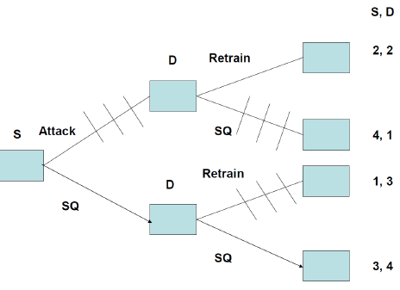
对抗学习
S: Spammer
D: Data Miner
SQ: Status Quo
S,D: Payoff
2/8

Slide 9
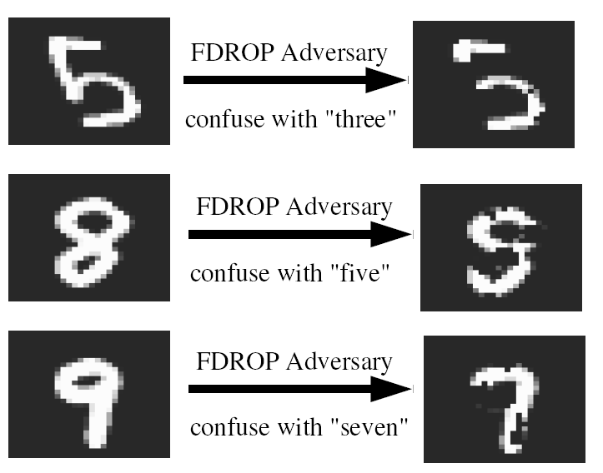
对抗学习
An Adversarial View of Covariate Shift and a Minimax Approach.
when constructing the classifier, we cannot anticipate in advance which features may be deleted in the future.
The approach we take here is to construct a classifier which is optimal in the worst-case deletion scenario, thus avoiding any modeling assumptions about the deletion mechanism.
2/8

Slide 10
对抗学习
This can be formulated as a two-player game, where the action of one player (the classifier builder) is to choose robust classifier parameters, whereas the other player (the feature removal mechanism) tries to delete the features which would be most harmful given the current classifier.
Standard support vector machines (SVMs)：
Where we use the notation
2/8

Slide 11
对抗学习
In the feature deletion case, the adversary may change the input by deleting features from it.
the worst-case hinge loss, for example
2/8

Slide 12
对抗学习
The worst-case hinge loss over the entire training set is The overall optimization problem, which we denote by FDROP.
The above can be explicitly written as a minimax optimization problem:
2/8

Slide 13
对抗学习
1.An Equivalent Quadratic Program:
2/8

Slide 14
对抗学习
Since the maximization (with respect to ) is over a linear function, the optimum will be at the vertices, and is therefore integral.
2/8

Slide 15
对抗学习
S: Spammer
D: Data Miner
SQ: Status Quo
S,D: payoff
2/8

Slide 16
对抗学习
2. BMRM (Bundle Methods for Regularized Risk Minimization)
Solve the following minimization problem:
where and is a convex nonnegative loss
function. In this paper
2/8

Slide 17
对抗学习
Stackelberg Games for Adversarial Prediction Problems
2/8

Slide 18
对抗学习
S: Spammer
D: Data Miner
SQ: Status Quo
S,D: payoff
2/8

