Slide 1
Impact of Russia-Ukraine Crisis on Software Engineering Services
Neil Barton, Katie Gove

Slide 2
Agenda
Who Is Affected?
Challenges
Short Term
Medium Term
Long Term
Wise Precautions
What Else Can Be Done?

Slide 3
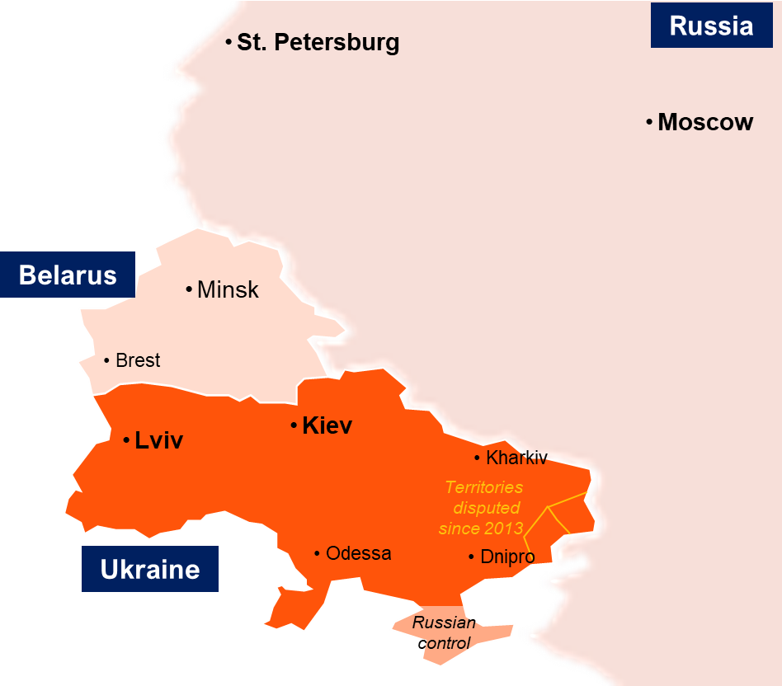
This Is About Three Countries, Not Just Ukraine
Russia
Ukraine
Belarus
Notes:
This analysis is focused on the immediate situation and implications for the Ukraine, Russia and Belarus. Gartner recognizes that there are likely implications for many more in the days and weeks to come.

Slide 4
Software Engineering Services From RUB
There are ~250,000 people in RUB working for exporting IT service providers
More like ~1 million if you count captive centers and IT in RUB domestic markets
Around 70,000 are in Ukraine, ~130,000 in Russia, ~50,000 in Belarus
Most large- and mid-tier system integrators have some presence in RUB
Many software product companies have development centers in RUB
Tech Consulting and Outsourcing Firms:
EPAM
DXC (Luxoft)
SoftServe
Ciklum
DataArt
N-iX
Daxx
Infopulse
Hitachi (GlobalLogic)
Many global system integrators have some development capacity in RUB
Software Product Companies:
Acronis
Corel (Parallels)
F5 (NGNIX)
GitLab
Jelastic
JetBrains
Kaspersky
Veeam
100 software startups in Ukraine raised capital in the last year
Other Captive Centers
Intel
Nestle
PwC
Siemens
Samsung
AB InBev
Huawei
Bosch
eBay
100+ research and development centers in Ukraine

Slide 5
4 Scenarios for Software Engineering Delivery
Most Severe (1%-2% of organizations)
Profile: Developers are predominantly in Ukraine
Inadequate precautions taken so far
Expect 3-6 months business disruption while searching for developers in net new locations
Severe (3%-5% of organizations)
Profile: Developers are predominantly in Ukraine
“Wise Precautions” already taken
Expect 1-3 months business disruption while alternative arrangements kick in
Medium (4%-8% of organizations)
Profile: Developers predominantly in Belarus or Russia
Face growing business disruption caused by sanctions and desire to mitigate risk
Still have time to move work to other locations (though amid the context of an already tight talent market)
Medium-Low (85%-95% of organizations)
Profile: No developers in RUB countries
No immediate severe operational impact
Some parts of software supply chain at risk
Still face broader risks (cybersecurity, inflation, energy and commodity shortages)
Increased challenge to retain developers — talent crunch further exacerbated — in the face of new opportunities, especially for cybersecurity work

Slide 6
Short-Term Operational Challenges
Developers unavailable to work as normal
Caught up in military action
Working from home, internet connectivity interrupted
Fleeing the country
Cyberattacks affecting Ukraine delivery centers
Impact
Urgent Sev 1 fixes cannot be implemented and deployed
Planned new features are delayed
Current projects stalled indefinitely

Slide 7
Medium-Term Challenges
Aggravation of tech talent shortages
~250,000 developers become unavailable
Cost of developers continues to rise, driven by high demand and supply constraints
Interruption to money flows — payments, vendor internal transfers, salaries
Sanctions may affect ability to pay through international money transfer systems
Exchange rate changes should not affect buyers, because in the regions, developers are paid in local currency based on spot USD rates. (But this could easily affect developers’ livelihoods.)
Disruption while work is transferred to new locations
Developers relocating out of Ukraine to EU countries e.g., Poland
Work reassigned to engineers in other development locations
Responding to increased cyberattacks on Western countries and organizations
NotPetya, SolarWinds, HermeticWiper, etc.

Slide 8
Long-Term Challenges
Reluctance to invest in other Eastern European locations
Most at risk: Baltics (Latvia, Lithuania, Estonia)
Next: Romania, Bulgaria
Potential concern: Hungary, Poland, Czech Republic, Slovakia, Slovenia, Moldova, Turkey
Products from Russian-based technology companies may face restrictions
Western countries may withdraw export of technology components and licenses

Slide 9
Wise Precautions
Ensure data sovereignty of intellectual property
Ensure all code, data, designs, documentation, test scripts, configurations and similar artifacts are stored on servers in your home jurisdiction
Increase network security
Strengthen air gaps and security operations centers
Increase vigilance against malware and vulnerabilities
Strengthen business continuity plans
Prepare for country outages in Ukraine, Russia and Belarus
Prepare for the impact of residential internet outages for developers working from home
Employ developer pairing
Shadow team members in RUB countries to start knowledge transfer, enabling work to be moved as easily as possible

Slide 10
What Else Can Be Done?
Relocation of work
Move developers out of Ukraine to EU countries such as Poland (This path was established after previous crises, e.g., Crimea 2014, 2020 Belarus election)
Reassign work to engineers in other development locations
Reconsider dev centers in foreign locations subject to geopolitical risk
Deprioritize: China
Prioritize:
Western Europe, North America, low-cost domestic centers
Asia
Latin America

Slide 11
Relevant Gartner Research
The Russia-Ukraine Crisis and Potential Impact on Cloud Service Providers
Supply Chain Brief: Risks of Growing Russian-Ukrainian Tensions Put Global Supply Chains on High Alert
Quick Answer: Geopolitical Risks Are Growing in Ukraine; What Can Be Learned From NotPetya?
Mitigate Offshore and Nearshore Service Delivery Location Risks Created by Geopolitical Instability

