Slide 1

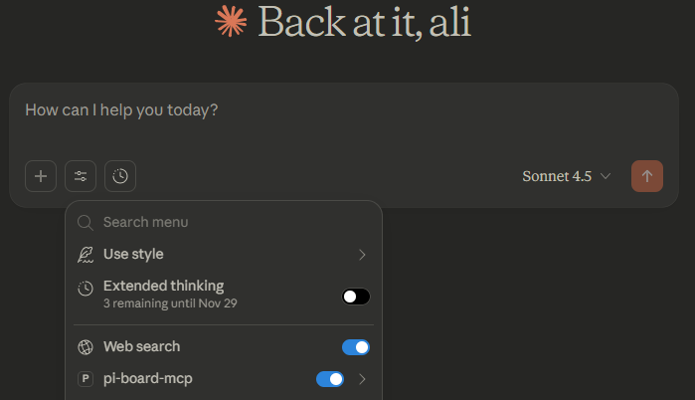
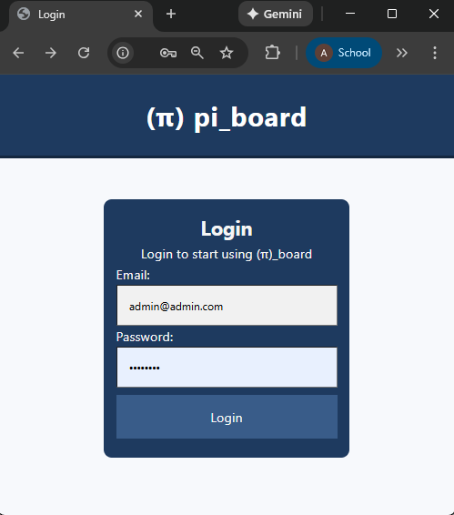
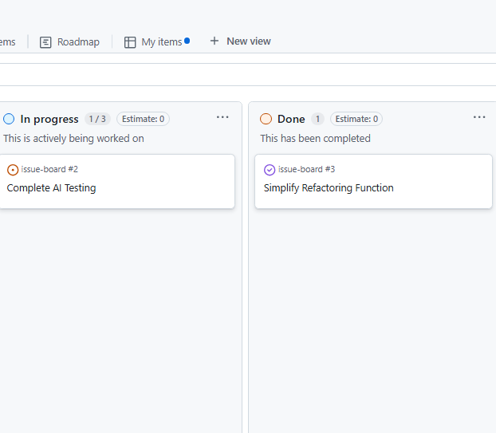
π-Board: Kanban-Style Alternative to Traditional To-Do Lists
Ali Eren Karaca, Virginia Wesleyan University, CS-489: Research in Computer Science – Dr. John Wang
Abstract
Many to-do lists are either too complex or over-simplistic for personal use. Issue boards in the software domain address this challenge by integrating visualization with structured functionality to increase efficiency. Pi-board applies this Kanban-style approach for personal use by providing an open-source alternative.
Literature
Kanban positively affects task prioritization and decision-making through visualization and increased transparency.¹
Kanban increases control over tasks by capping work-in-progress and reducing average lead time. ¹
Kanban enhances the quality of task completion through workflow optimization. ²
Visual Overview
Figure 1: Claude Desktop Integration
Figure 2: Web Interface
Figure 3: Kanban board from GitHub
Results
The implementation of π-board demonstrates that Kanban principles can be adapted for personal task management. By providing a visual interface of all tasks, users gain oversight of their responsibilities. By enabling AI integration, personal productivity can be further enhanced through a Kanban style alternative to traditional to-do lists.
Discussion
The project shows that Kanban-based visualization can be integrated with traditional to-do lists to improve personal productivity and task completion; however, its effectiveness ultimately depends on consistent user engagement.
Introduction
Kanban boards aim to visualize workflows and simplify the identification of bottlenecks by placing tasks into different columns according to their status. The benefits of Kanban has the following key aspects on workflow:
Limits work-in-progress (WIP)
Reduces task completion time
Improves task prioritization
With π-board, benefits of Kanban can be applied to personal task management to support personal growth and success.
Methods
The open-source π-board is built using Java, Maven, and requires a database, preferably PostgreSQL or Supabase, both of which are open-source. π-board implements a Kanban-style workflow visualization of personal tasks through the web-based user interface.
Beyond its standard functionality, π-board is designed to integrate seamlessly with local AI systems, such as Claude Desktop, via the MCP interface, enabling AI supported workflow assistance.
References
Sathe, C.A. and Panse, C. (2023),“An Empirical Study of Project Management Constraints in Agile Software Development: Multigroup Analysis between Scrum and Kanban”, Brazilian Journal of Operations and Production Management , Vol. 20,No.3 special edition, e20231796https://doi.org/10.14488/BJOPM.1796.2023
dos Santos, P. S., Beltrão, A. C., de Souza, B. P., & Travassos, G. H. (2018). On the benefits and challenges of using Kanban in Software Engineering: A structured synthesis study. Journal of Software Engineering Research and Development, 6(1). https://doi.org/10.1186/s40411-018-0057-1
Huang, C.-C., & Kusiak, A. (1996). Overview of kanban systems. International Journal of Computer Integrated Manufacturing, 9(3), 169–189. https://doi.org/10.1080/095119296131643

