Slide 1
Projeto DA
Grupo 2 – Turma 1 (G01_3)
Afonso Dias– up202006721
Gonçalo Miranda – up202108773
Vitor Bizarro – up202007888

Slide 2
Reading Dataset
  Read from default dataset in the beggining of the program;
  The user can, however, choose to create graphs from custom datasets by placing them on the data folder;
  Can reload the dataset at any given time during execution;
  The data is organized in a main graph, created right after the dataset is read.

Slide 3
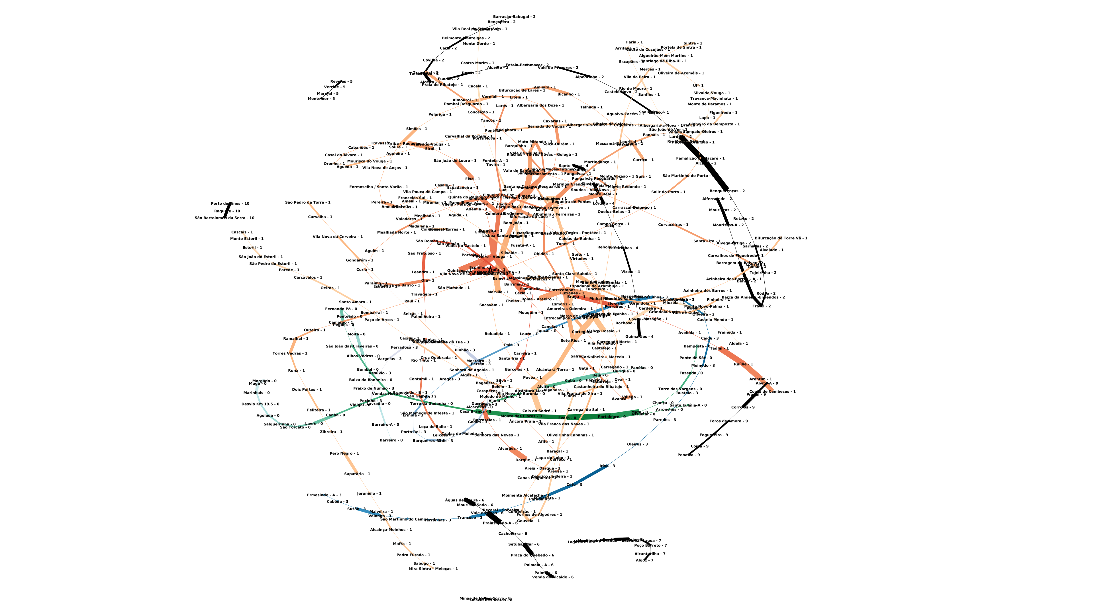
Graph Used
The graph used in this project represents the stations as vertices and the edges represent any trip you can take from one station to another.
Each edge has its own capacity, which is the number of trains that can circulate at the same time on that part of the network.

Slide 4
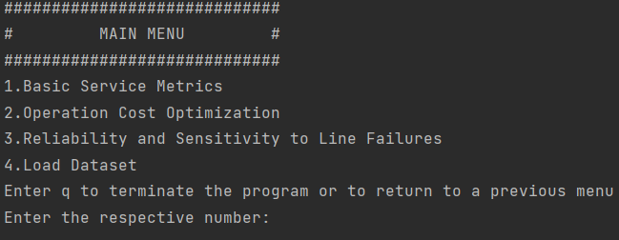
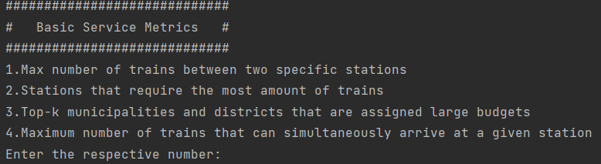
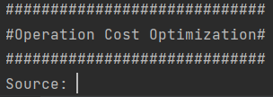
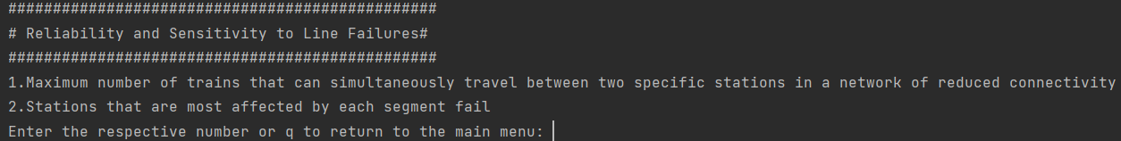
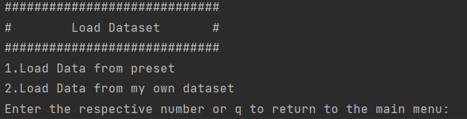
User Interface:
Here are the various menus that compose the user interface.

Slide 5
Main Algorithms
Max-Flow (Edmonds-Karp Algorithm) and a few variants appropriate to the project – complexity of O(VE^2);
Min-Cost (Bellman-Ford & Djikstra’s approach) – complexity of O(E logV);
BFS (Breath-First Search) – complexity of O(V+E);
Algorithm used to determine the maximum number of trains between two stations – Brute Force –complexity of O(V^3 E^2).

Slide 6
Tasks Implemented:
T1.1;
T1.2;
T1.3;
T2.1;
T2.2 (Slow Execution Time – not optimal :/ );
T3.1;
T4.1;
T5.1.

