Slide 1
MOVIE RATING SYSTEM
Submitted By
Mr. X
Mr. Y
Mr. Z
In the partial fulfillment of the requirement for the award of degree of
Bachelor of Technology in Computer Science & Engineering
(B. Tech CSE)
Submitted To
Department of Information Technology
University
2022
Guide : Mr. A
Dept. of IT

Slide 2
TABLE OF CONTENTS
Introduction
Motivation
Literature Survey
Objectives
Machine Learning
Proposed System
Results & Analysis
Conclusion & Future Scope
References

Slide 3
INTRODUCTION
Movie Rating System is a natural language processing (NLP) technique used to determine whether data is positive or negative.
It is a study of human behavior in which we extract user opinion and emotion from plain text.
It identifies the opinion or attitude that a person has towards a topic or an object.
Movie Rating System is also known as Opinion Mining.

Slide 4
MOTIVATION
Since humans express their thoughts and feelings more openly than ever before, movie rating system is fast becoming an essential tool to monitor and understand sentiment in all types of data.
Automatically analyzing customer feedback, such as opinions in survey responses and social media conversations, allows brands to learn what makes customers happy or frustrated, so that they can tailor products and services to meet their customer’s needs.
Movie Rating System, helps political organizations in understanding the behavior of voters.

Slide 5
LITERATURE SURVEY
In the year 2018, H. M. Keerthi Kumar et. al.^{[1]} used hybrid feature extraction method where the features are extracted by using both statistical and lexicon methods.
In the year 2018, Gurshobit Singh Brar et. al.^{[2]} proposed sentiment analysis system of movie review using supervised machine learning techniques.
In the year 2019, Nehal Mohamed Ali et. al.^{[3]} proposed sentiment analysis system of movie reviews using deep learning.
In the year 2021, Samuel Onalaja et. al.^{[4]} proposed aspect-based approach sentiment analysis system of movie reviews.
In the year 2022, Kifayat Ullah et. al.^{[5]} proposed deep neural network-based approach for sentiment analysis of movie reviews.

Slide 6
OBJECTIVES
Classify tweets on the basis of positive and negative sentiments.
Design and develop sentiment analysis system using machine learning.
Comparative analysis of machine learning algorithm.

Slide 7
MACHINE LEARNING
Machine Learning is a branch of artificial intelligence (AI) and computer science which focuses on the use of data and algorithms to imitate the way that humans learn. So, machine learning is a technique where the machine learns from the available data that it reads and automates accordingly. Machine Learning is done in two ways:
Supervised Learning
Unsupervised Learning

Slide 8
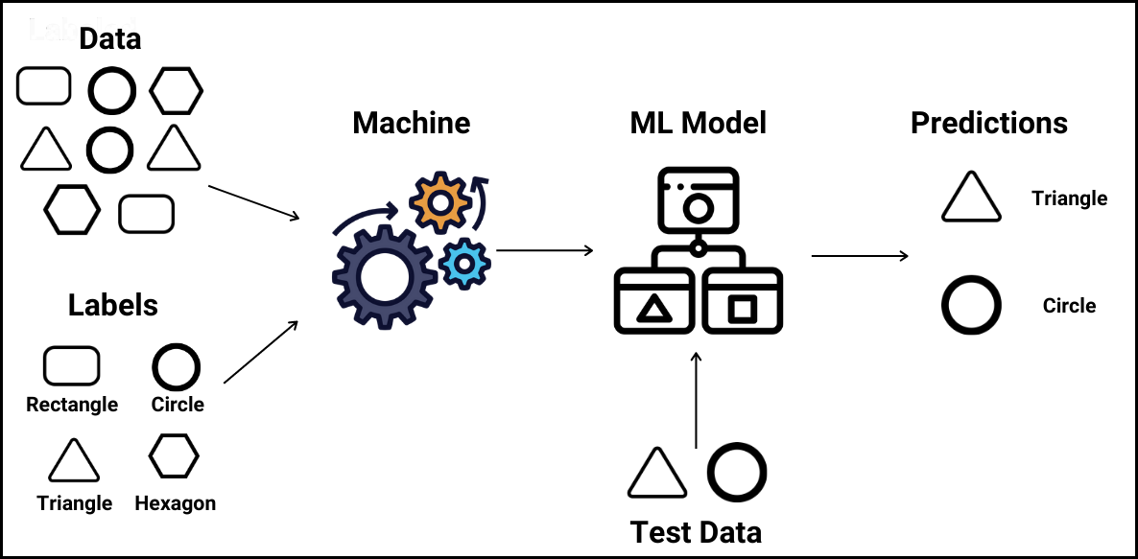
Supervised Learning
Supervised learning is where we have input variables (X) and an output variable (Y). We use a machine learning algorithm to learn the mapping function from the input to the output. It is called supervised learning because the process of learning from training data can be thought of as a teacher who is supervising the learning process.
In the this figure, the teacher explicitly provides information on the input data.

Slide 9
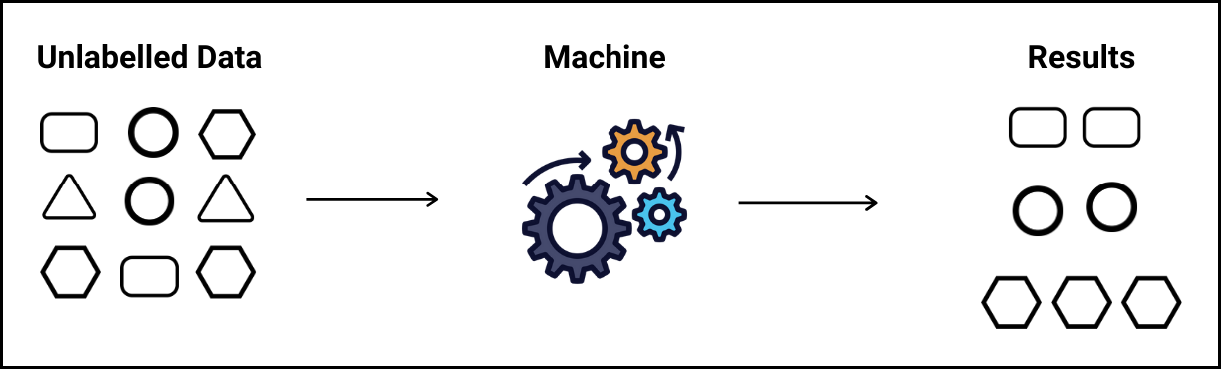
Unsupervised Learning
Unsupervised learning is where machine learning algorithms analyze the data and segregate them based on their shape, size and color. It is called unsupervised because no explicit output data is required and can be termed unsupervised.
In this figure, segregation is done by machine learning algorithms on unlabelled data.
For this project, we used Naïve Bayes algorithm and K-Nearest Neighbour (KNN) algorithm for classification of tweets and both are supervised learning algorithms.

Slide 10
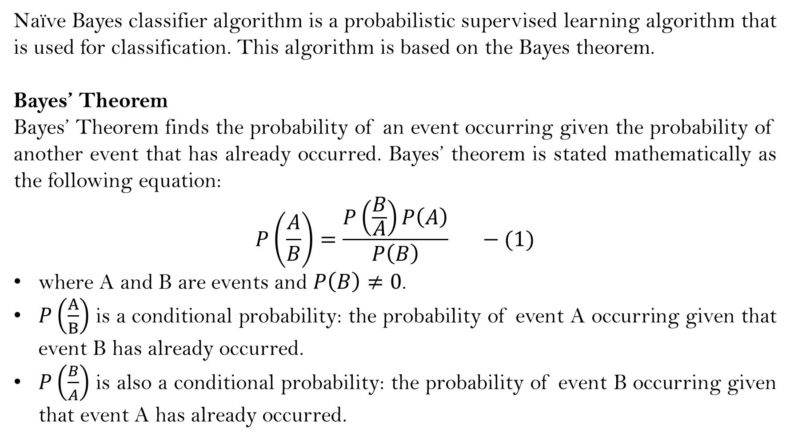
Naïve Bayes Algorithm
Naïve Bayes classifier algorithm is a probabilistic supervised learning algorithm that is used for classification. This algorithm is based on the Bayes theorem.
Bayes’ Theorem
Bayes’ Theorem finds the probability of an event occurring given the probability of another event that has already occurred. Bayes’ theorem is stated mathematically as the following equation:
$$P\left(\frac{A}{B}\right)=\frac{P\left(\frac{B}{A}\right)P\left(A\right)}{P\left(B\right)} −(1)$$
where A and B are events and $P\left(B\right)≠0$.
$P\left(\frac{A}{B}\right)$ is a conditional probability: the probability of event A occurring given that event B has already occurred.
$P\left(\frac{B}{A}\right)$ is also a conditional probability: the probability of event B occurring given that event A has already occurred.

Slide 11
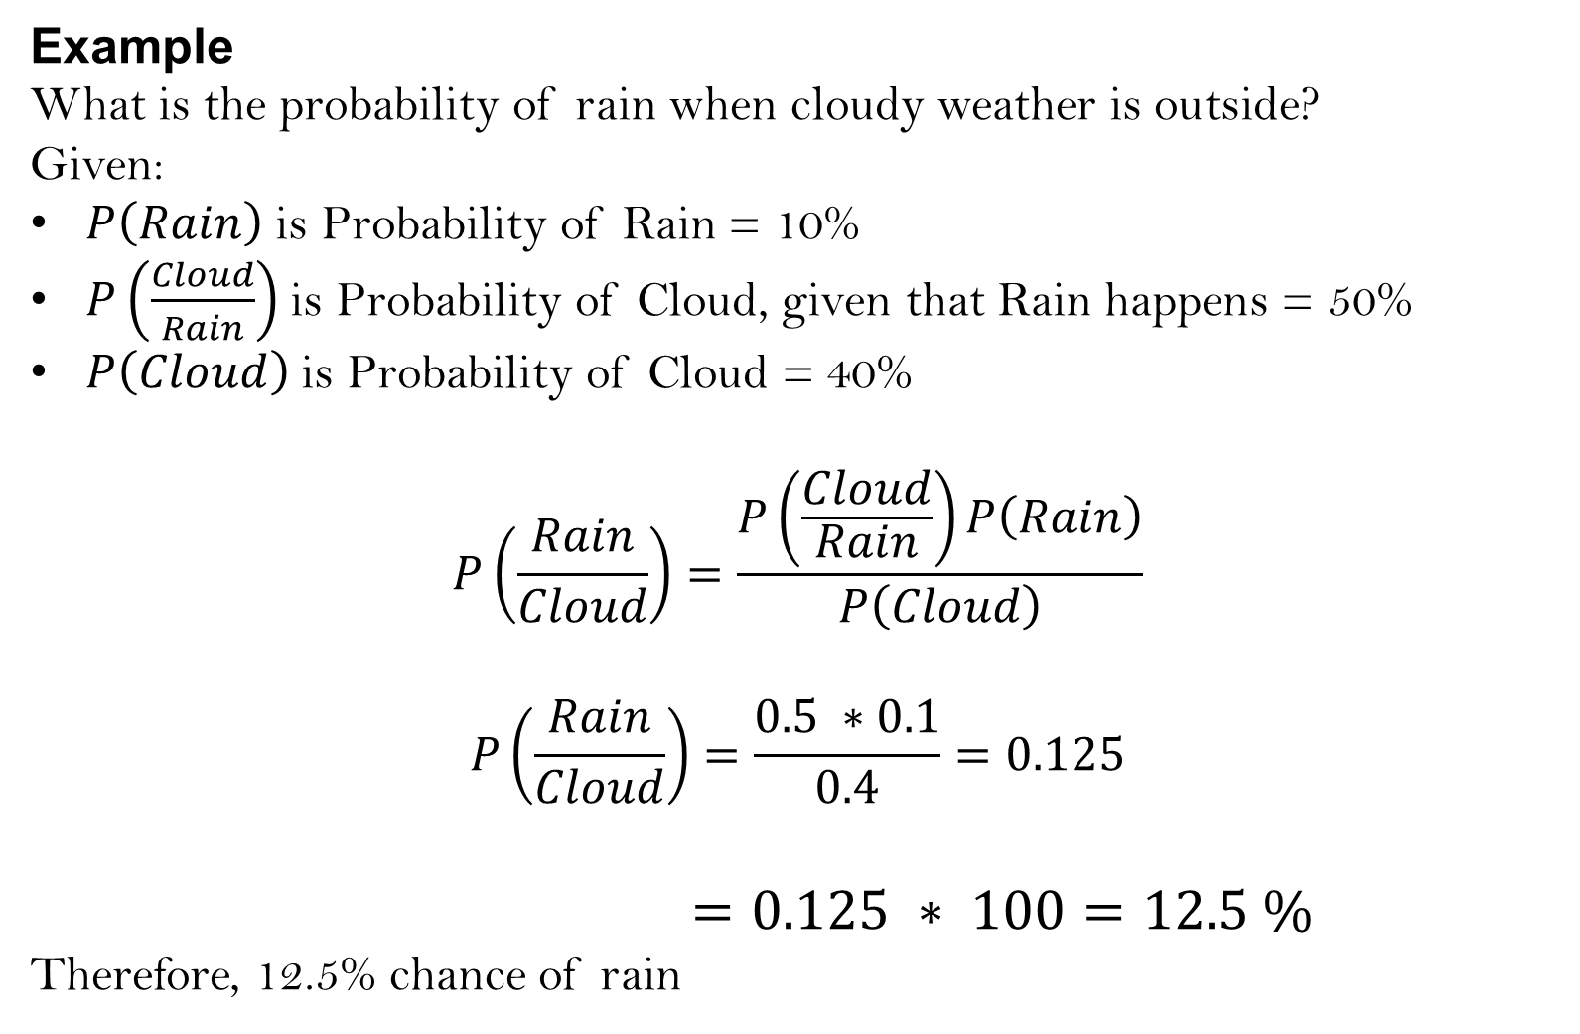
Example
What is the probability of rain when cloudy weather is outside?
Given:
$P\left(Rain\right)$ is Probability of Rain = 10%
$P\left(\frac{Cloud}{Rain}\right)$ is Probability of Cloud, given that Rain happens = 50%
$P\left(Cloud\right)$ is Probability of Cloud = 40%
$$P\left(\frac{Rain}{Cloud}\right)=\frac{P\left(\frac{Cloud}{Rain}\right)P\left(Rain\right)}{P\left(Cloud\right)}$$
$$P\left(\frac{Rain}{Cloud}\right)=\frac{0.5 ∗0.1}{0.4}=0.125$$
$=0.125 ∗ 100=12.5 \%$
Therefore, 12.5% chance of rain

Slide 12
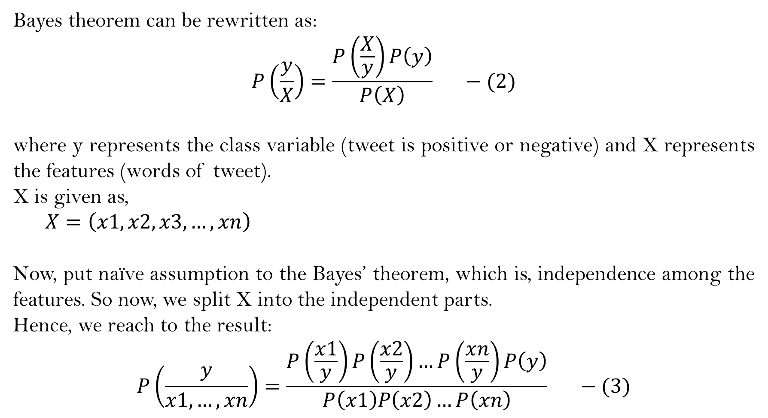
Bayes theorem can be rewritten as:
$$P\left(\frac{y}{X}\right)=\frac{P\left(\frac{X}{y}\right)P\left(y\right)}{P\left(X\right)} −(2)$$
where y represents the class variable (tweet is positive or negative) and X represents the features (words of tweet).
X is given as,
$$X=\left(x1,x2,x3,…,xn\right)$$
Now, put naïve assumption to the Bayes’ theorem, which is, independence among the features. So now, we split X into the independent parts.
Hence, we reach to the result:
$$P\left(\frac{y}{x1,…,xn}\right)=\frac{P\left(\frac{x1}{y}\right)P\left(\frac{x2}{y}\right)…P\left(\frac{xn}{y}\right)P\left(y\right)}{P\left(x1\right)P\left(x2\right)…P\left(xn\right)} −(3)$$

Slide 13
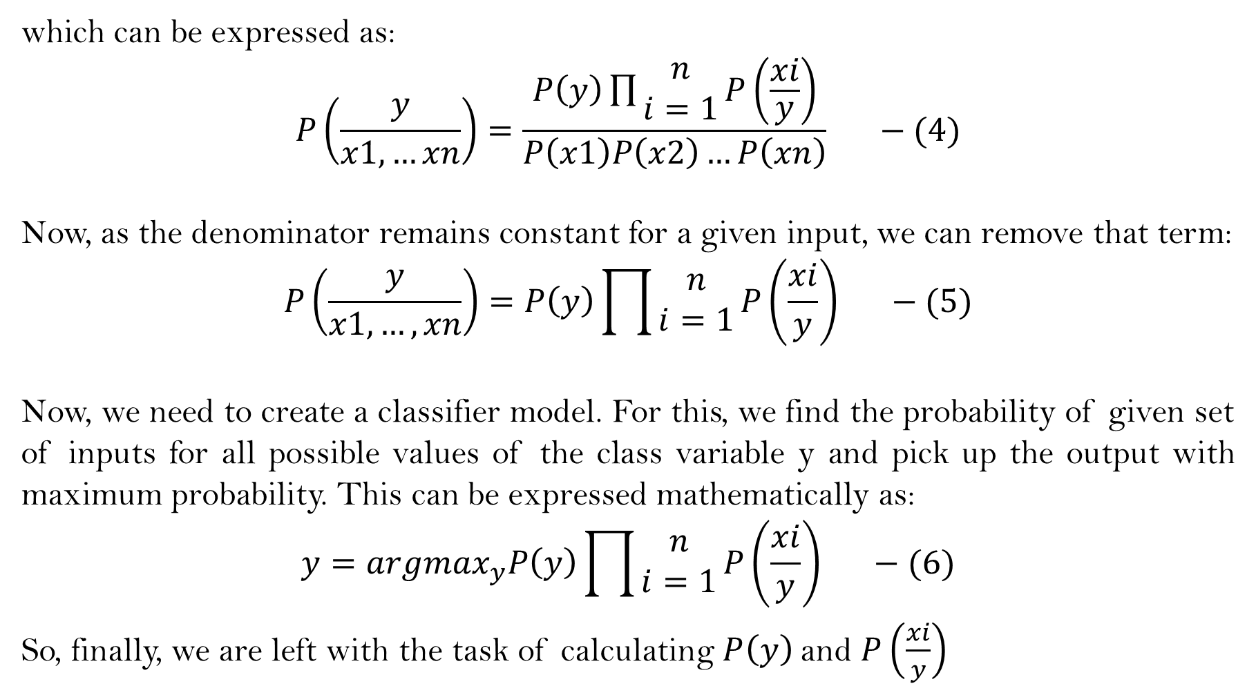
which can be expressed as:
$$P\left(\frac{y}{x1,…xn}\right)=\frac{P\left(y\right)\prod{\begin{aligned}n \\ i=1\end{aligned}}P\left(\frac{xi}{y}\right)}{P\left(x1\right)P\left(x2\right)…P\left(xn\right)} −(4)$$
Now, as the denominator remains constant for a given input, we can remove that term:
$$P\left(\frac{y}{x1,…,xn}\right)=P\left(y\right)\prod{\begin{aligned}n \\ i=1\end{aligned}}P\left(\frac{xi}{y}\right) −(5)$$
Now, we need to create a classifier model. For this, we find the probability of given set of inputs for all possible values of the class variable y and pick up the output with maximum probability. This can be expressed mathematically as:
$$y={argmax}_{y}P\left(y\right)\prod{\begin{aligned}n \\ i=1\end{aligned}}P\left(\frac{xi}{y}\right) −(6)$$
So, finally, we are left with the task of calculating $P\left(y\right)$and $P\left(\frac{xi}{y}\right)$

Slide 14
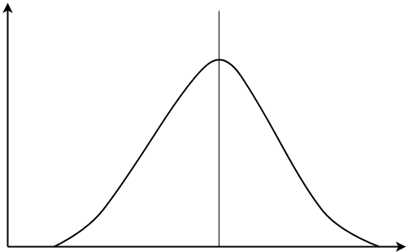
Types of Naïve Bayes
Gaussian Naïve Bayes
Multinomial Naïve Bayes
Bernaulli Naïve Bayes
Gaussian Naïve Bayes
In Gaussian Naïve Bayes, continuous values associated with each feature are assumed to be distributed according to a Gaussian distribution (bell shaped curve). A Gaussian distribution is also called Normal distribution.

Slide 15
Multinomial Naïve Bayes
This is mostly used for document classification problem. The features used by the classifier are the frequency of the words present in the document.
Bernaulli Naïve Bayes
This is similar to the multinomial naïve bayes but the features are binary (i.e. a word occurs in a document or not).

Slide 16
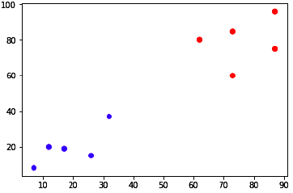
K-Nearest Neighbour (KNN) Algorithm
K-Nearest Neighbors (KNN) classifier algorithm is a type of supervised learning algorithm which can be used for classification problems in which a new data point is classified in a group which are close to new data point and K is your chosen number of nearest neighbors.
Example
Suppose we have a dataset which can be plotted as follows −

Slide 17
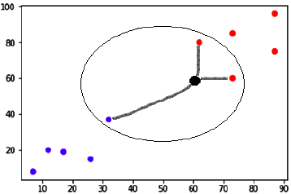
Now, we need to classify new data point with black dot (at point 60,60) into blue or red class. We are choosing K = 3 i.e. it would find three nearest data points. It is shown in the diagram −
We can see in the above diagram the three nearest neighbors of the data point with black dot. Among those three, two of them lies in Red class hence the black dot will also be assigned in red class.

Slide 18
PROPOSED SYSTEM
Data collection
Data preprocessing
Training ML algorithm (Naïve Bayes & KNN)
New Tweet
Trained Model
Prediction

Slide 19
Proposed System
Algorithm : Classification of tweets
Input : Dataset (raw tweets)
Output : Sentiment of dataset
The classification has been carried in following steps:
Step 1 : Data collection
The Twitter dataset {50k tweets (25k positive & 25k negative)} collected for the sentiment analysis was of the CSV (comma-separated values) format.

Slide 20
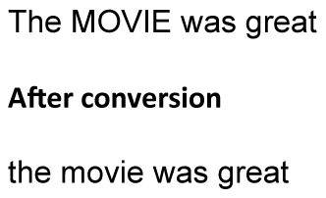
Step 2 : Data preprocessing
Input : Dataset
Output : Bag-of-words (BoW)
For data preprocessing, following steps is done in BoW:
Step 2.1 : Converting all the words to lowercase
Example

Slide 21
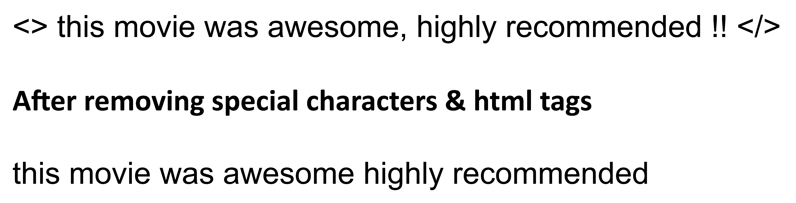
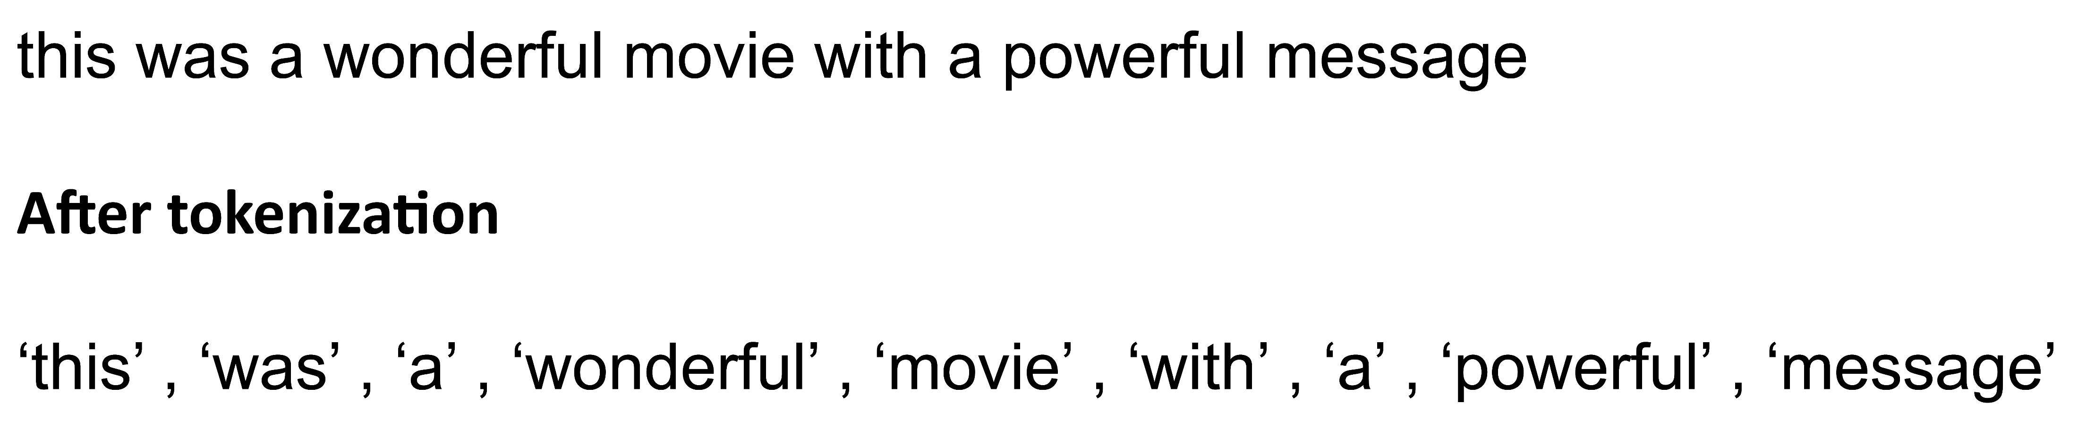
Step 2.2 : Removing special characters & html tags
Example
Step 2.3 : Tokenization
Breaking up a sequence of strings into pieces or converting string into list
Example

Slide 22
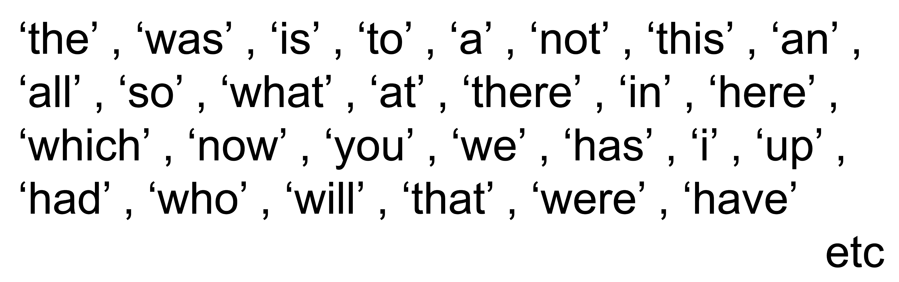
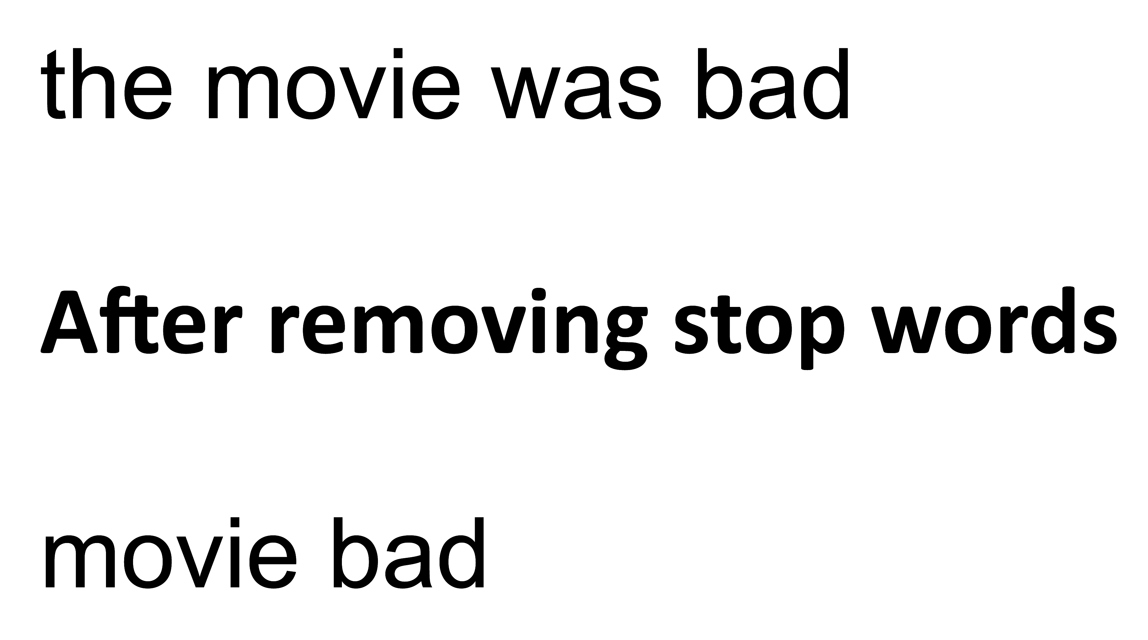
Step 2.4 : Removing stop words
Stop words
Example

Slide 23
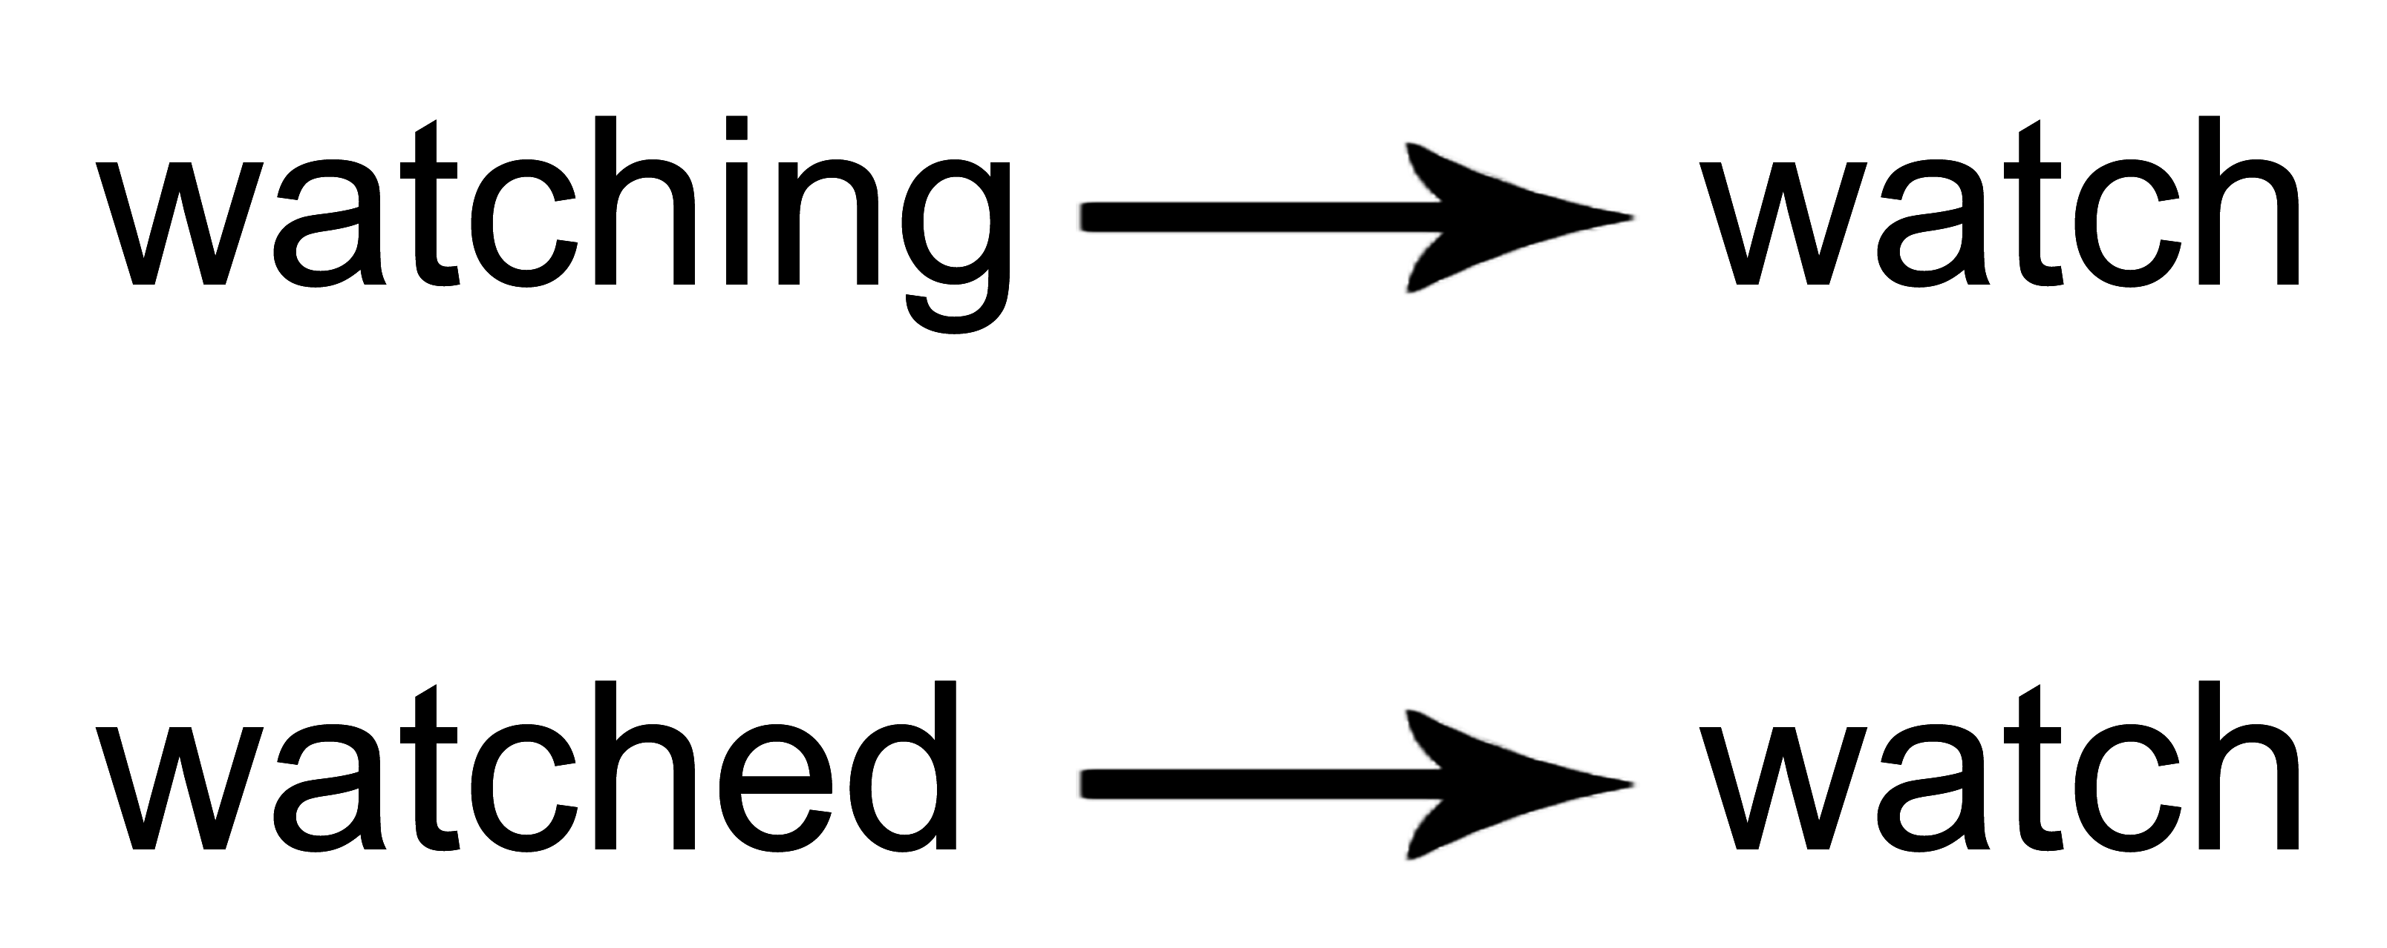
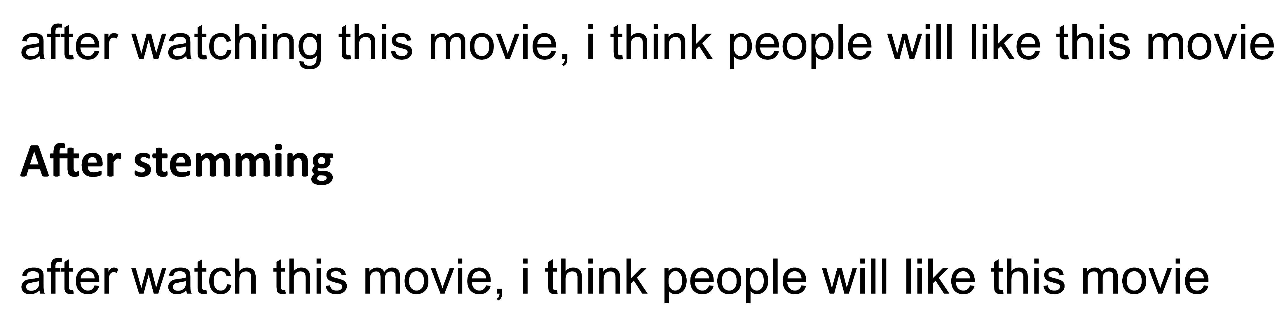
Step 2.5 : Stemming
Taking the root word as the main word
Example
Step 2.6 : Rejoining our list of words into string

Slide 24
Step 3 : Train the model
Dataset is segregated sequentially in 70 : 30 ratio.
Input : BoW (70 % of processed dataset)
Output : Trained model
Step 4 : Test the model
Input : BoW (30 % of processed dataset)
Output : Accuracy of classifiers
Step 5 : Validation/Prediction
Input : Data unknown to model
Output : Sentiment of input data
The models will now be validated against data unknown to the classifier.

Slide 25
RESULTS & ANALYSIS
Experimental Setup
System configuration
- Processor Intel core i5 7th Gen
- RAM 8 GB
Software used
- Anaconda v2.2.0 (Jupyter Notebook)
- Language Python
Libraries & Packages
- Pandas
- Matplotlib
- Seaborn
- Time (module)
- NLTK (Natural Language Toolkit)
- Sklearn (Scikit-learn)

Slide 26
Results
Accuracy of classification while testing the models
Model | Accuracy
Gaussian Naïve Bayes | 78.99 %
Multinomial Naïve Bayes | 82.62 %
Bernaulli Naïve Bayes | 82.43 %
K-Nearest Neighbors | 64.47 %

Slide 27
Confusion matrix
TN 6156 | FP 1248
FN 1876 | TP 5595
TN 6094 | FP 1310
FN 1274 | TP 6197
Gaussian NB
Multinomial NB
TN 5932 | FP 1472
FN 1141 | TP 6330
TN 4282 | FP 3122
FN 2162 | TP 5309
Bernaulli NB
KNN

Slide 28
Validation
Input : New tweet “<> This movie was great! After watching this movie, I think people will start loving MS Dhoni. </>”
Output : Tweet is Negative (Gaussian)
: Tweet is Positive (Multinomial)
: Tweet is Positive (Bernaulli)
: Tweet is Negative (K-Nearest Neighbors)

Slide 29
Overall accuracy in validation:
Total number of tweets taken : 50
Confusion matrix
TN 21 | FP 4
FN 6 | TP 19
TN 20 | FP 5
FN 4 | TP 21
Gaussian NB
Multinomial NB
TN 18 | FP 6
FN 3 | TP 23
TN 14 | FP 10
FN 9 | TP 17
Bernaulli NB
KNN

Slide 30
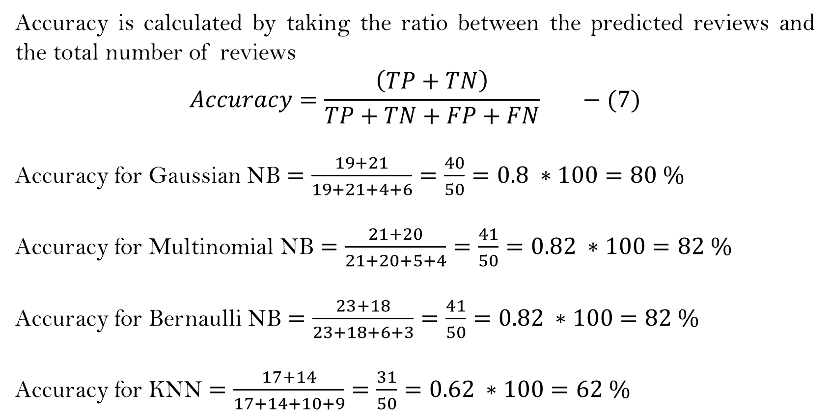
Accuracy is calculated by taking the ratio between the predicted reviews and the total number of reviews
$$Accuracy=\frac{\left(TP+TN\right)}{TP+TN+FP+FN} −(7)$$
Accuracy for Gaussian NB $=\frac{19+21}{19+21+4+6}=\frac{40}{50}=0.8 ∗100=80 \%$
Accuracy for Multinomial NB $=\frac{21+20}{21+20+5+4}=\frac{41}{50}=0.82 ∗100=82 \%$
Accuracy for Bernaulli NB $=\frac{23+18}{23+18+6+3}=\frac{41}{50}=0.82 ∗100=82 \%$
Accuracy for KNN $=\frac{17+14}{17+14+10+9}=\frac{31}{50}=0.62 ∗100=62 \%$

Slide 31
Prediction of overall rating of movie
Example
#lalsinghchaddha
We take 100 tweets for this movie
Positive | Negative
80 % | 20 %
Movie Rating = 8/10

Slide 32
Analysis
Time efficiency
Model | Runtime
Gaussian Naïve Bayes | 0.004 msec.
Multinomial Naïve Bayes | 0.007 msec.
Bernaulli Naïve Bayes | 0.006 msec.
K-Nearest Neighbors | 0.186 msec.

Slide 33
Comparative analysis
Parameter | Gaussian NB | Multinomial NB | Bernaulli NB | KNN
Accuracy | 78.99 % | 82.62 % | 82.43 % | 64.47 %
Runtime | 0.004 msec. | 0.007 msec. | 0.006 msec. | 0.186 msec.
TP | 5595 | 6197 | 6330 | 5309
TN | 6156 | 6094 | 5932 | 4282
FP | 1248 | 1310 | 1472 | 3122
FN | 1876 | 1274 | 1141 | 2162

Slide 34
Comparison with the state-of-the-art literature
Proposed System
Parameter | G. NB | M. NB | B. NB | KNN | Paper 1 Ref. no. 3 | Paper 2 Ref. no. 4 | Paper 3 Ref. no. 5
Accuracy | 78.99 % | 82.62 % | 82.43 % | 64.47 % | 89.20 % | 67.19 % | 91.98 %
Runtime | 0.004 msec. | 0.007 msec. | 0.006 msec. | 0.186 msec.

Slide 35
CONCLUSION & FUTURE SCOPE
Results & Analysis shows that multinomial naïve bayes model and bernaulli naïve bayes model have higher classification accuracy than gaussian naïve bayes model and k-nearest neighbors model.
Both multinomial naïve bayes model, bernaulli naïve bayes model and gaussian naïve bayes model tends to classify faster than k-nearest neighbors model.
These models can be enhanced to increase the classification accuracy.
These models can be improved to deal with sarcastic tweets.

Slide 36
REFERENCES
[1] Kumar, H. M., Harish, B. S., & Darshan, H. K. (2018). Sentiment Analysis on IMDb Movie Reviews Using Hybrid Feature Extraction Method. International Journal of Interactive Multimedia & Artificial Intelligence, 5(5).
[2] Brar, G. S., & Sharma, A. (2018). Sentiment analysis of movie review using supervised machine learning techniques. International Journal of Applied Engineering Research, 13(16), 12788-12791.
[3] Ali, N. M., Abd El Hamid, M. M., & Youssif, A. (2019). Sentiment analysis for movies reviews dataset using deep learning models. International Journal of Data Mining & Knowledge Management Process (IJDKP) Vol, 9.
[4] Onalaja, S., Romero, E., & Yun, B. (2021). Aspect-based Sentiment Analysis of Movie Reviews. SMU Data Science Review, 5(3), 10.
[5] Ullah, K., Rashad, A., Khan, M., Ghadi, Y., Aljuaid, H., & Nawaz, Z. (2022). A Deep Neural Network-Based Approach for Sentiment Analysis of Movie Reviews. Complexity, 2022.

Slide 37
THANK YOU

