Slide 1
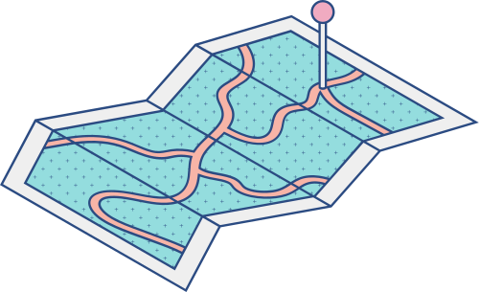





project title
Habit tracer

Slide 2
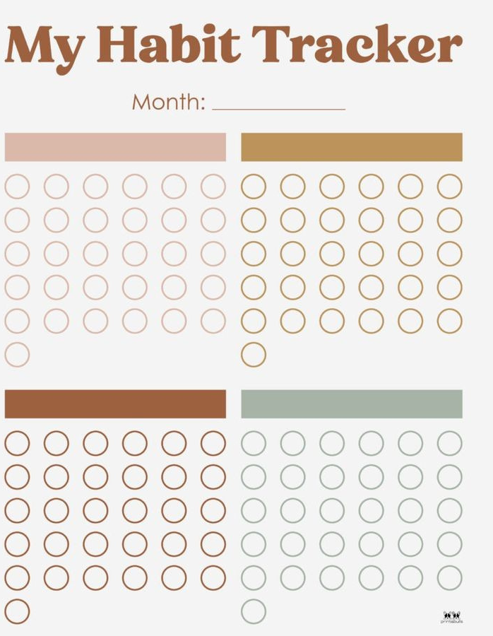
Program Goals
• IT HELPS THE USER TO ORGANIZE HIS TIME AND TASKS.
•KNOW THE TASKS THAT HAVE BEEN COMPLETED AND THE REMAINING TASKS.
•SEE WHAT WAS ACCOMPLISHED IN EACH TASK.

Slide 3
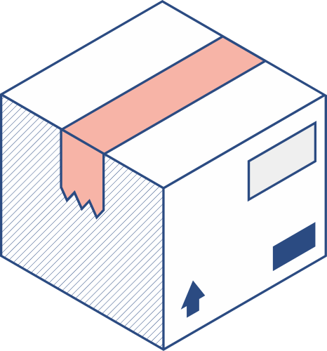


How was the program created?

Slide 4
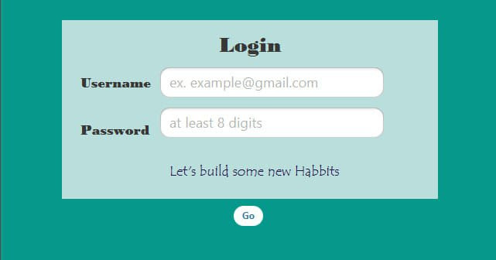
1) first scene(log in)

Slide 5
.First scene consist of two fields
1.at Two fields, the program asks the user for his name and password, then presses the button" go".
2.The program stores names and passwords.
3. If it matches the name and password of the user, it moves it to the next page.
4. If it was an error, it gives it an error and does not move to the next page.

Slide 6
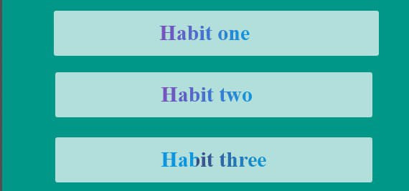
2. Second scene

Slide 7
.The second page consists of a number of tasks, and the user chooses the task that he has to accomplish.

Slide 8
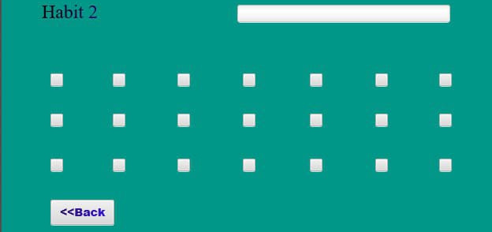
3. Third scene

Slide 9
.On this page, the user clicks on the box, a check mark will appear in it, and when exiting to the previous page, that mark will not disappear
.And there will be a box at the top of the page that indicates the percentage of completion of the task, and by pressing the buttons, the percentage in this field will increase, and there will be an indicator next to the task through which the user knows the percentage of completion of the task.

Slide 10

Project team
-Afaf wael mukhtar
-sara ashraf
-mariam hesham

