Slide 1

Matplotlib Final Presentation
By: Alex Fahrenkrug

Slide 2

  Introduction

Slide 3
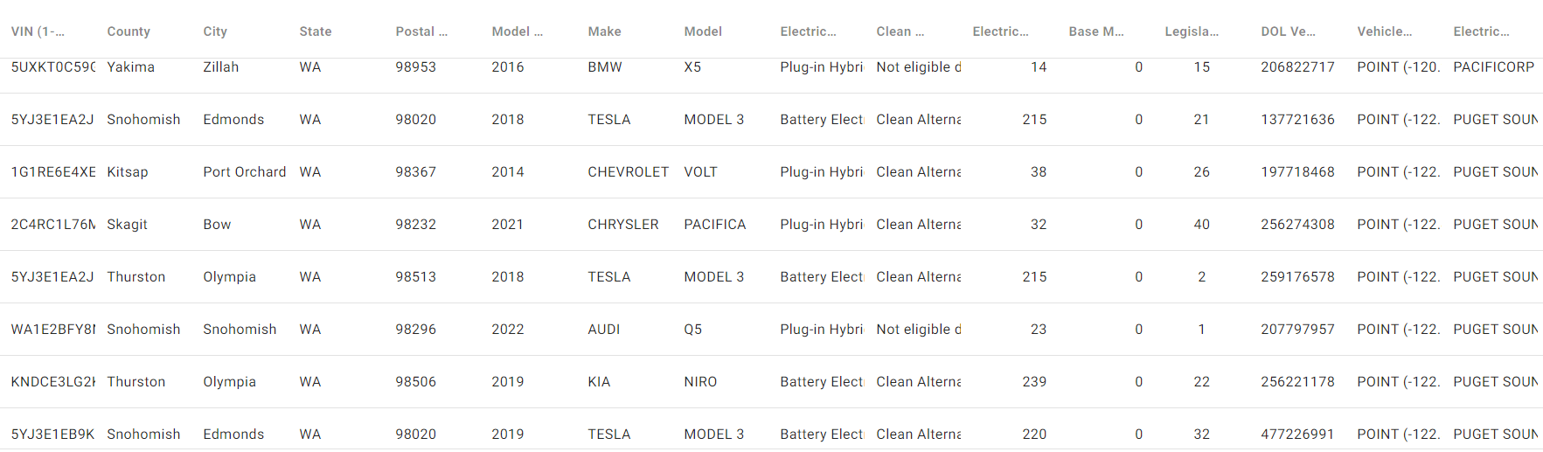
Dataset of Choice/Overview
The dataset includes information from Washington’s EV population (Data.gov)

Slide 4

Purpose
Explain the practicality of electric cars over time by:
  Research in battery life
  Change in Electric Range
  Production Fluctuation over time

Slide 5
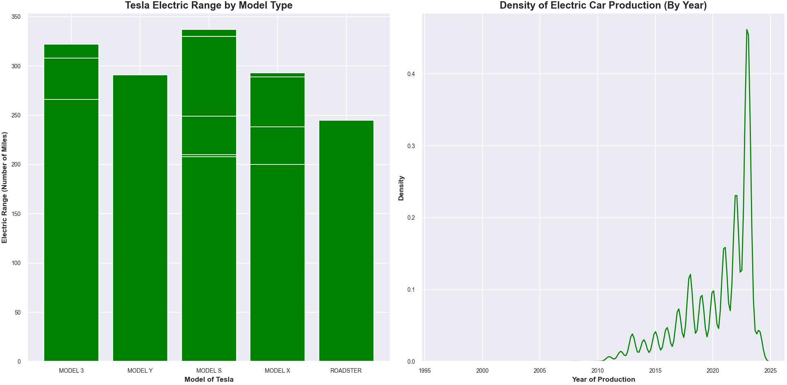

Slide 6
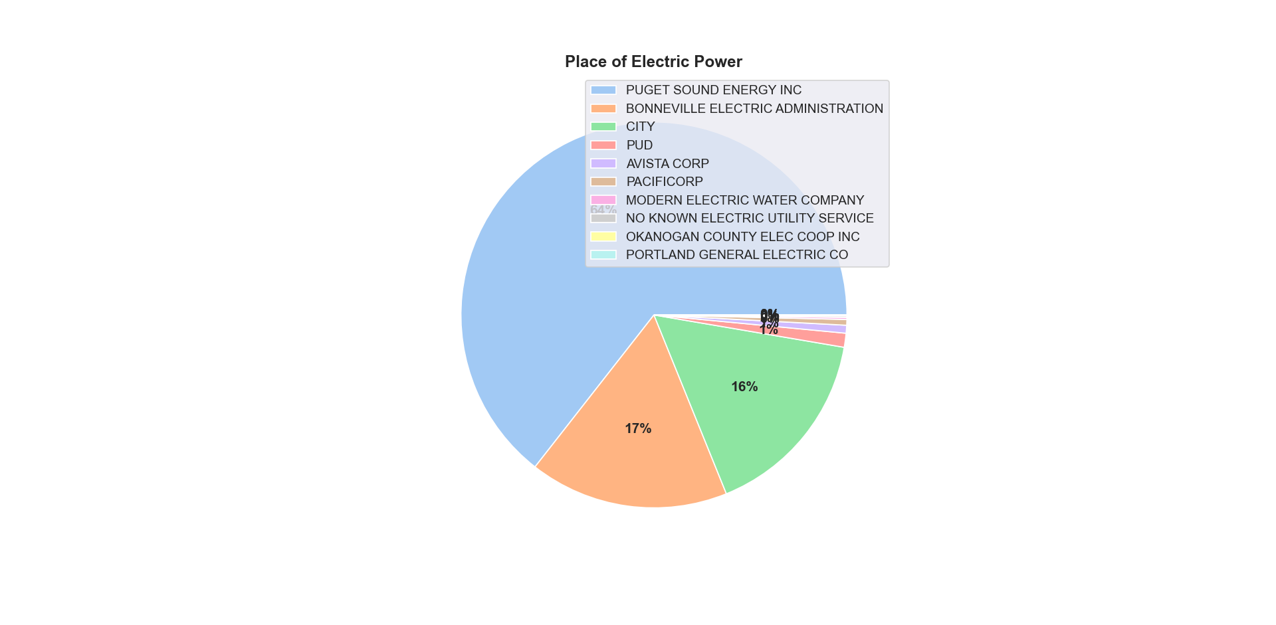

Slide 7
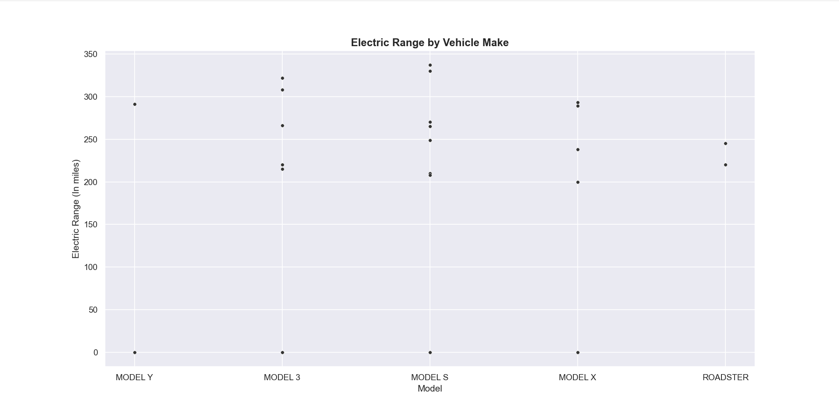

Slide 8
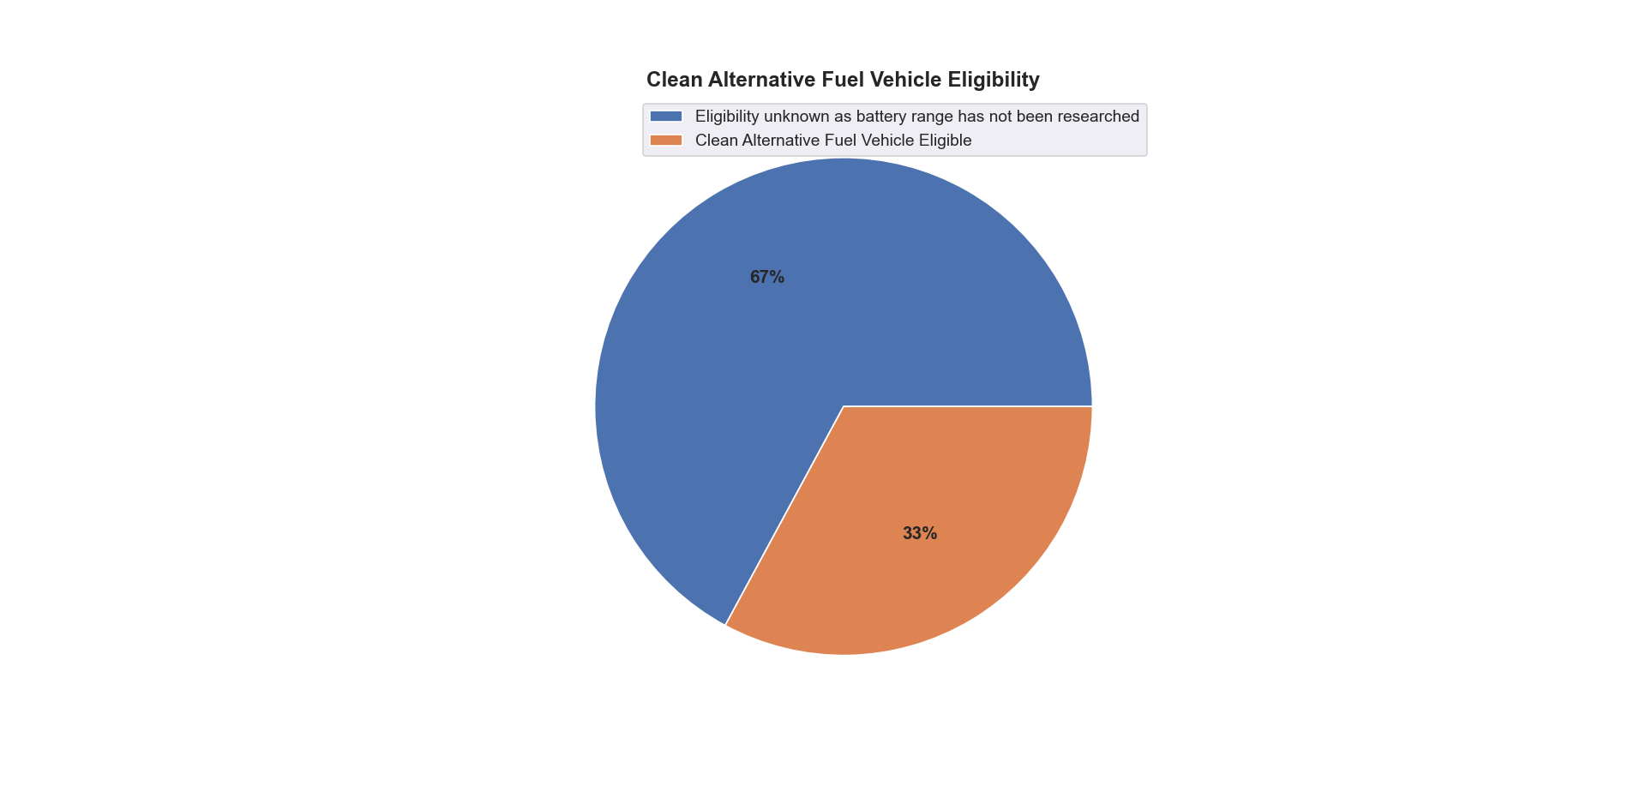

Slide 9
  Concluding Thoughts

Slide 10
  Thank You!

