Slide 1
Predictive Models for Dementia Risk Detection
Presented By: Afanda Mol Glancy, M.Tech – S4, NE
Roll # M210501
Guided By: Mr. Mathews Abraham , Assistant Professor
Department of Information Technology , RSET

Slide 2
CONTENTS
Introduction
Motivation
Problem Statement
Goals and Objectives
Literature survey
Proposed Method
System Architecture
Modules Explanation
Results
Conclusion
References

Slide 3
INTRODUCTION
Dementia is a progressive, neurodegenerative disease that can be clinically characterized by impaired memory and many other cognitive functions.
Early identification of Alzheimer’s dementia is to identify the difference between positive and negative linguistic and cognitive abilities of the patients.
Using predictive analytics in healthcare can improve quality
Application : Clinical Practice , Public health , Research , Health policy
Multifactorial nature of dementia , Lack of standardized models , Limited data availability .

Slide 4
MOTIVATION
Identifying dementia at an early stage is of greater significance than treating the condition after it has progressed.
Timely diagnosis of dementia is fundamental for decelerating its progression as well as allowing maximized benefits of pharmaceutical interventions
Personalized care and Health equity
Need to find a balance between accuracy and costly tests
Empowerment and Patient Autonomy

Slide 5
PROBLEM STATEMENT
Treatment of dementia is most effective when started early in the disease process
Misunderstood of old age problems
Inaccurate predictions led to improper treatments
Existing prediction models may have limitations in terms of accuracy, applicability, and scalability
Therefore, there is a critical need to develop robust and validated prediction models that can accurately estimate an individual's risk of developing dementia

Slide 6
GOALS AND OBJECTIVES
Standalone framework for screening the dementia stages in order to diagnose it sooner
Automated system should predict early on set dementia
Help advance research
Automate the cost-effective, non-invasive, digital pre-screening of patients at risk for dementia
Early diagnosis help to take personal decisions and family members to plan

Slide 7
LITERATURE SURVEY
Sl.No | Paper | Method | Advantages | Limitations
1. | A Novel AI-Based System for Detection and Severity Prediction of Dementia Using MRI , IEEE Access 2021 | DCGAN based Augmentation | Spatial conformity of the images not altered Multi-class CNN-based classifier | Time consuming
2. | Stacked Deep Dense Neural Network Model to Predict Alzheimer’s Dementia Using Audio Transcript Data , IEEE Access 2022 | CNN & Bidirectional Long-Short Term Memory | Grid Search helps to get accurate predictions predict early onset dementia | Availability of dataset is limited Binary classification
3. | DEMNET model workflow process for classifying dementia stages , IEEE Access 2021 | CNN | SMOTE technique is used to solve imbalance multi-class CNN-based classifier | Not a standalone framework Trained on small dataset
Notes:
Novel DCGAN-based Augmentation and Classification model .Comparison of three different datasets original dataset, geometrically transformed images, and a GAN-augmented dataset .Classify dementia into four categories depending upon its prominence in the MRI scan . Addresses the problem of improper augmentation of medical images using conventional augmentation techniques.
Designed hybrid model with CNN & Bidirectional Long-Short Term Memory and proposed a Stacked Deep Dense Neural Network . Models was trained end-to-end using DementiaBank clinical transcript dataset . Investigated under two settings: Randomly initialized and Glove embedding. Hyperparameter optimization is performed using Grid Search CNN is utilized to create a framework that can be used to detect specific dementia disease characteristics from MRI images
CNN architecture is proposed with relatively small parameters to detect the types of dementia which is suitable for training a smaller dataset and named DEMNET . Generates high-resolution disease probability maps from the local brain structure to a multilayer perceptron
SMOTE technique is used to address the class imbalance problem
Occlusion sensitivity map

Slide 8
LITERATURE SURVEY
Sl.No | Paper | Method | Advantages | Limitations
4. | A Deep Convolutional Neural Networks Based Approach for Alzheimer’s Disease and Mild Cognitive Impairment Classification Using Brain Images , IEEE Access 2022 | DNN | 3 stages CN, MCI, and AD is considered DenseNet model and used a forward-direction shortcut bridge connection | Due to bridge connections some features missing
5. | Studying the Manifold Structure of Alzheimer’s Disease: A Deep Learning Approach Using Convolutional Autoencoders , IEEE Journal 2020 | Convolutional autoencoders | automatic non-linear decomposition of a very large dataset showing large correlations with clinical variables | Low accuracy score Svm is used
Notes:
Novel DNN based model for distinguishing AD and MCI patients from Cognitively Normal individuals. VGG-19 architecture is used.
In back Propagation, deeper models suffer from the problem of vanishing gradient and information loss are solved by Dense-Block notion from the original DenseNet architecture . To minimize the computational time required in the network, we have replaced all the convolutional operations by depth-wise convolutional operations.
Exploratory data analysis of AD based on deep convolutional autoencoders. Finding links between cognitive symptoms and underlying neurodegeneration process by fusing the information of neuropsychological test outcomes with the imaging features CAE architecture tool perform an automatic non-linear decomposition of a very large dataset

Slide 9
PROPOSED METHOD
Comparison between different machine learning and deep learning techniques to identify the risk of dementia
Machine learning algoritms like Xgboost and Catboost
Deep learning methods like CNN and Tabnet
Ensemble model of xgboost and catboost

Slide 10
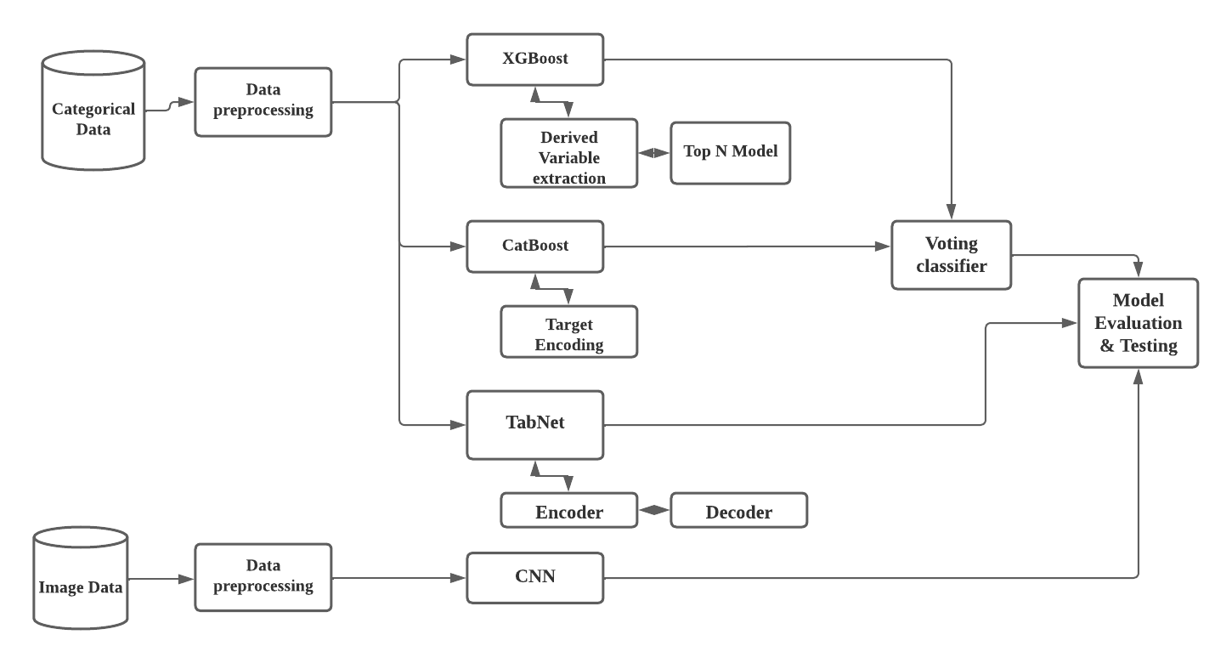
SYSTEM ARCHITECTURE

Slide 11
DATASET USED
Collects Dementia Data (Oasis-1, Oasis-2) Offered By Oasis
It includes the unique number, gender, handedness, age, years of education, socioeconomic status, MMSE result, and CDR index of the test subjects
Images of MRI scan
Data includes the number of brain structure which is generated with the longitudinal or cross-sectional brain MRI data
Notes:
Open Access Series of Imaging Studies

Slide 12
MODULE 1 : Data Preprocessing module
Input : Images from dataset / Categorical data
Data cleaning and transformation - handling missing values, encoding categorical variables, and scaling numerical features.
Image preprocessing -normalization, Standardization to extract the relevant features
Feature selection is the process of selecting a subset of relevant features from your dataset
Feature engineering involves creating new features from existing ones
Data splitting and Data balancing

Slide 13
MODULE 2 : XGBOOST Modelling
Creation of derived variables, and new indexes are generated with existing independent variables
Gradient Boosting is applied to extract Cover, Frequency, and Gain indexes
extraction of derived variables in order to expand independent variables
Grid Search and parallel process applied to Top-N groups
Grid of each hyper-parameter is generated for parameter tuning

Slide 14
MODULE 3 : CatBoost Modelling
Target Encoding, replaces the categorical values with the average target value for each category
Combines multiple weak models to create a stronger model
Uses decision trees as the weak models and trains them sequentially
SHAP values are used to explain the contribution of each feature to the final prediction.
Notes:
CatBoost is based on gradient boosted decision trees. During training, a set of decision trees is built consecutively. Each successive tree is built with reduced loss compared to the previous trees.

Slide 15
MODULE 4 : TabNet Modelling
Categorical features are converted to numerical values using an embedding layer
Maps each category to a low-dimensional continuous vector
Selects a subset of features using a sparse attention mechanism
Attention mechanism assigns a weight to each feature based on its importance to the task
Each decision step consists of a feature transformer, a masked attention mechanism, and a decision function
Notes:
uses sequential attention to choose which features to reason from at each decision step.
attentive transformer consists of a fully connected (FC) layer, a BatchNorm layer, and Prior scales layer, and a Sparsemax layer.
TabNet decoder architecture consists of a feature transformer, followed by the fully connected layers at the decision step.

Slide 16
MODULE 5 : CNN
convolutional layers apply a set of filters or kernels to the input image to extract features
generates a feature map
pooling layers downsample the feature maps
activation functions introduce nonlinearity to the network by applying a transformation
fully connected layers take the flattened output of the convolutional and pooling layers and transform it into a vector of scores
softmax layer takes the output of the fully connected layers and normalizes it into a probability distribution

Slide 17
MODULE 6 : Model Evaluation and Testing
Voting classifier – XGBoost and catboost
Accuracy of each 3 models is calculated for categorical data
Accuracy of Voting classifier
Accuracy of CNN model is calculated
Prediction is done using each models

Slide 18
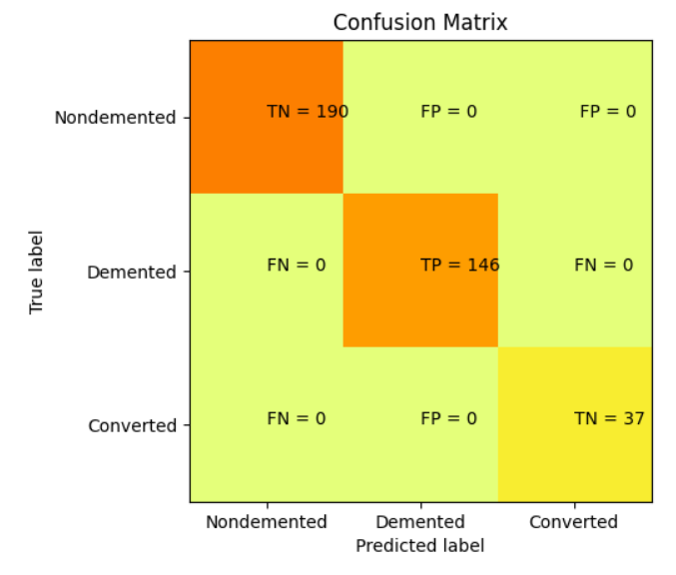
RESULTS
Classification Report - XGBoost
Precision | Recall | F1 Score | Support
1.00 | 1.00 | 1.00 | 190
1.00 | 1.00 | 1.00 | 146
1.00 | 1.00 | 1.00 | 37

Slide 19
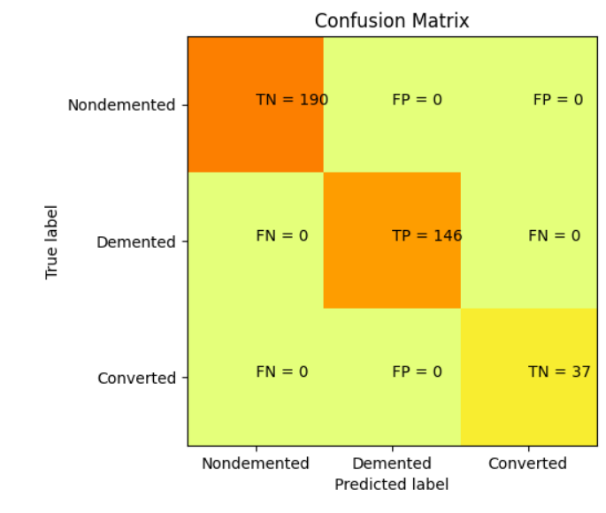
RESULTS
Classification Report - CatBoost
Precision | Recall | F1 Score | Support
0.98 | 0.97 | 0.97 | 190
0.99 | 0.98 | 0.98 | 146
0.99 | 0.97 | 0.97 | 37

Slide 20
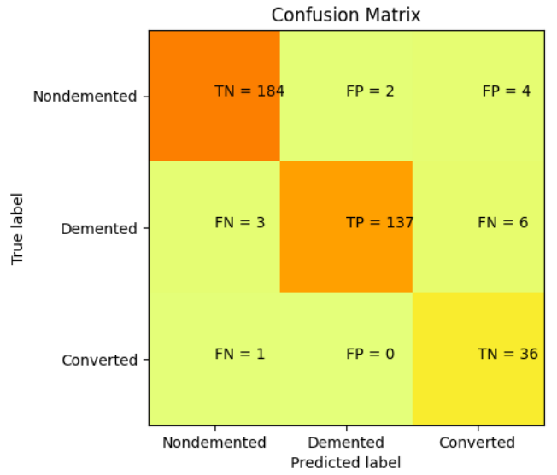
RESULTS
Classification Report – TabNet
Precision | Recall | F1 Score | Support
0.98 | 0.97 | 0.97 | 190
0.99 | 0.94 | 0.96 | 146
0.78 | 0.97 | 0.87 | 37

Slide 21
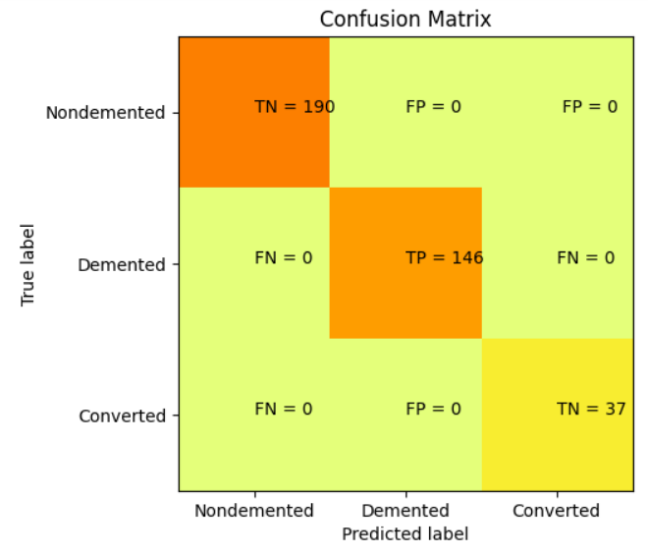
RESULTS
Classification Report – Voting Classifier
Precision | Recall | F1 Score | Support
1.00 | 1.00 | 1.00 | 814
1.00 | 1.00 | 1.00 | 146
1.00 | 1.00 | 1.00 | 37

Slide 22
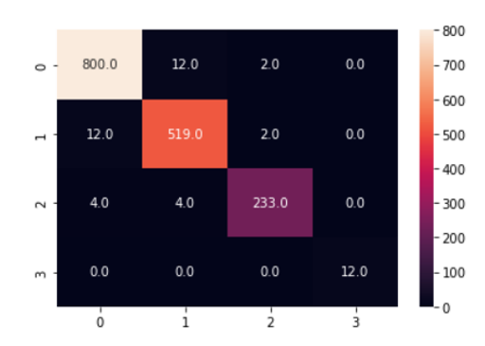
RESULTS
Classification Report – CNN
Precision | Recall | F1 Score | Support
0.98 | 0.98 | 0.98 | 190
0.97 | 0.97 | 0.97 | 533
0.98 | 0.97 | 0.97 | 241

Slide 23
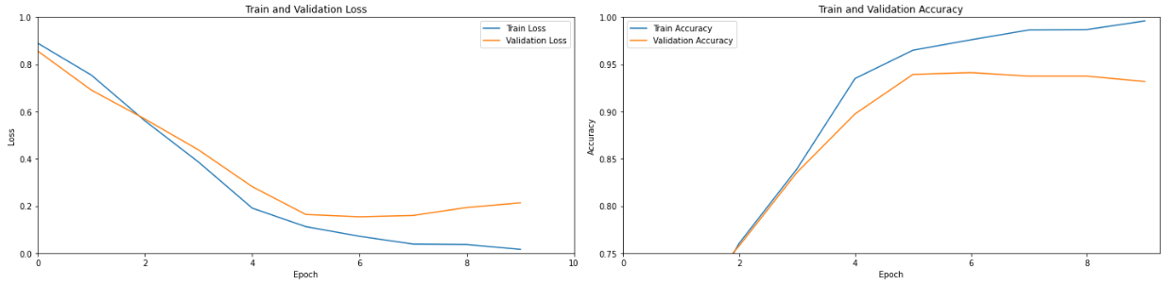
RESULTS

Slide 24
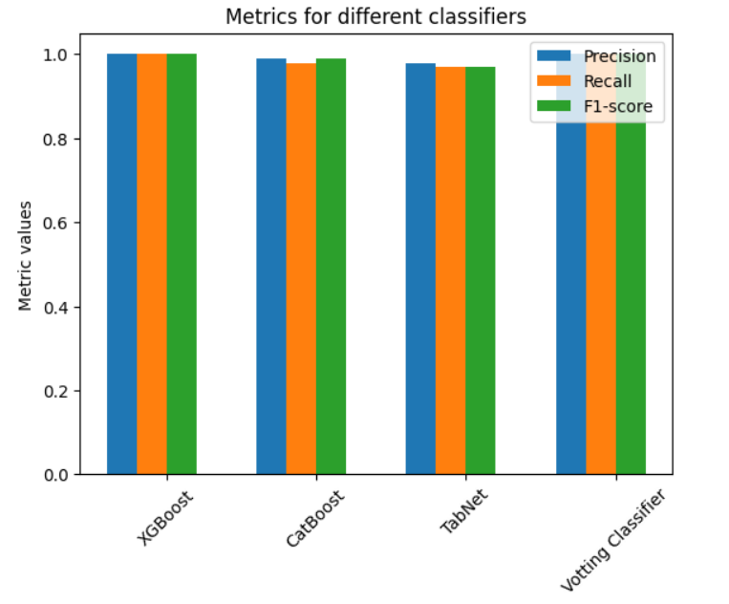
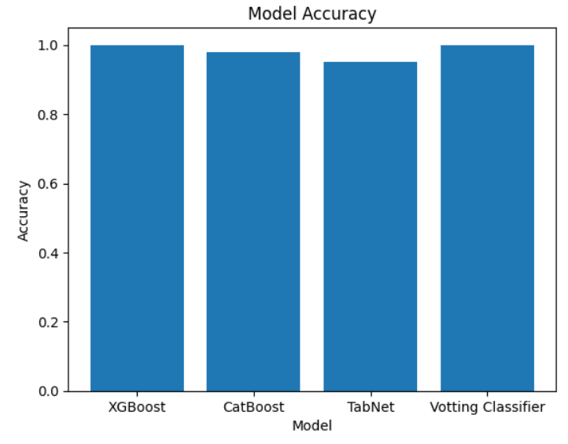
RESULTS
Comparison of precision Recall and F1score
Comparison of Accuracy

Slide 25
CONCLUSION
Dementia in later life has emerged as a significant public health challenge in recent years with continuing decreasing life expectancy.
As a clinical syndrome, dementia causes one’s lowering cognitive function in multiple areas, such as memory, language, and judgment and thereby prevents his or her activities of daily living
Machine learning neuroimaging challenge for automated diagnosis of Mild Cognitive Impairment, we developed a method for multiclass classification.
Future scope of dementia risk prediction is promising, with opportunities to integrate diverse data sources, develop personalized risk prediction models, improve validation and standardization, integrate into clinical practice

Slide 26
REFERENCES
[1]V. Jain, O. Nankar, D. J. Jerrish, S. Gite, S. Patil and K. Kotecha, "A Novel AI-Based System for Detection and Severity Prediction of Dementia Using MRI," in IEEE Access, vol. 9, pp. 154324-154346, 2021, doi: 10.1109/ACCESS.2021.3127394
[2]YY. F. Khan, B. Kaushik, M. K. I. Rahmani and M. E. Ahmed, "Stacked Deep Dense Neural Network Model to Predict Alzheimer’s Dementia Using Audio Transcript Data," in IEEE Access, vol. 10, pp. 32750-32765, 2022, doi: 10.1109/ACCESS.2022.3161749.
[3]S. Murugan et al., "DEMNET: A Deep Learning Model for Early Diagnosis of Alzheimer Diseases and Dementia From MR Images," in IEEE Access, vol. 9, pp. 90319-90329, 2021, doi: 10.1109/ ACCESS .2021 . 3090474.
[4]R. A. Hazarika, D. Kandar and A. K. Maji, "A Deep Convolutional Neural Networks Based Approach for Alzheimer’s Disease and Mild Cognitive Impairment Classification Using Brain Images," in IEEE Access, vol. 10, pp. 99066-99076, 2022, doi: 10.1109/ACCESS.2022.3206389.
[5]Francisco J. Martinez-Murcia , Andres Ortiz , Juan-Manuel Gorriz , Javier Ramirez , And Diego Castillo-Barnes , “Studying The Manifold Structure Of Alzheimer’s Disease: A Deep Learning Approach Using Convolutional Autoencoders “,in IEEE Journal Of Biomedical And Health Informatics, Vol. 24, No. 1, January 2020

Slide 27


