Slide 1


Slide 2

AI-Powered Personalized Learning System

Slide 3
Group Members Introduction
Group Id: S25PROJECT63F44
Samra Ashfaq Khan: BC220201726
Abdulrehman: BC220201712

Slide 4

INTRODUCTION OF PROJECT
This project aims to develop an AI-driven personalized learning system that adapts to students' learning styles, strengths and weaknesses. The system will store student progress data, analyze their performance using AI and recommend customized learning materials, quizzes and study plans. It will use machine learning algorithms to predict areas where students need improvement and provide intelligent tutoring through chatbots and automated assessments.

Slide 5
Provide Here the Diagram of Process Model. You can make the diagram of process model according to your choice but it should be correct.

Slide 6
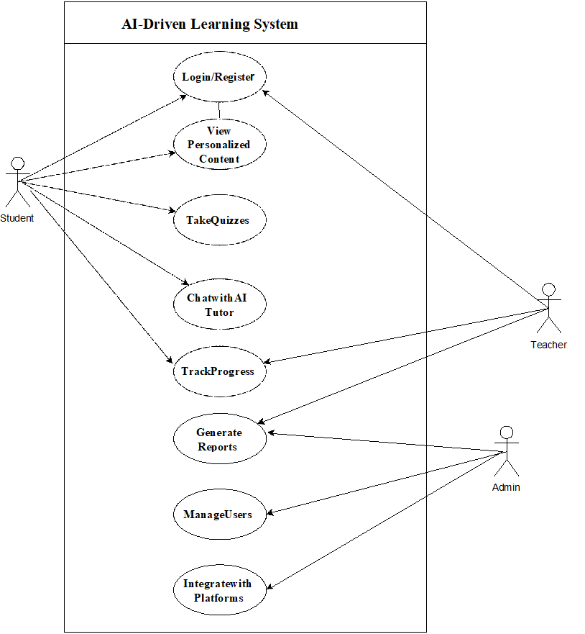
Use Case Diagram

Slide 7
Business Rules Catalog
Write down here some core business rules/functional requirements of your project.

Slide 8
Architectural Design
Provide Architecture Diagram Here

Slide 9
Team Structure
Provide here the diagrammatic view of your team structure and key responsibilities.

Slide 10
Project Schedule
Provide the Schedule (Gantt Chart) of your
project here.

Slide 11
Sequence Diagrams
Provide some core sequence diagrams here. Provide one diagram per slide and give heading at top for each sequence diagram.

Slide 12
Logical Model/Class Diagram

Slide 13
Entity-Relationship Diagram

Slide 14
Database Diagram

Slide 15
User Interfaces
Provide screen shots of GUI in different slides of your application here

Slide 16
Tools
Write the various tools you have used
during the development of this application

