Slide 1
FOOTWEAR
By Afaq Ur Rehman

Slide 2
Problem Statement
1.Limited Brand Visibility: The website needs to showcase the shoe collections of different brands effectively, giving equal visibility to each brand. This can be challenging as some brands may have more popular shoes, and customers may not be aware of lesser-known brands.
2.User Interface Design: The website must have a user-friendly interface that is easy to navigate and search. Customers should be able to filter their search results based on their preferences, such as color, size, and brand.
3.Digital Payment Methods: The website needs to offer secure and reliable digital payment options to customers. It should support multiple payment gateways and provide a seamless checkout experience.
4.Inventory Management: The website must keep an accurate record of available shoes and their sizes, and ensure that customers are not shown out-of-stock items. It should also update the inventory in real-time to avoid any conflicts in sales.
5.Customer Support: The website must have a robust customer support system in place to handle queries, complaints, and returns efficiently. It should offer multiple channels of support, such as phone, email, and chat, and provide timely and helpful responses to customers.

Slide 3
Solution
1.Display popular shoes of each brand on the homepage.
2.Use attractive product images and descriptions to showcase the uniqueness of each brand.
3.Kept the website design clean and simple.
4.Provided easy navigation with clear categories and filters.
5.Allow multiple payment options such as credit cards, debit cards, e-wallets, and net banking.
Implement an inventory management system that automatically updates the stock levels of each product.
6.Set up alerts to notify when the stock is running low or when an item is out of stock.
7.Set up a dedicated customer support team to handle queries, complaints, and returns.
Offer multiple channels of support such as email, phone, and chat.

Slide 4
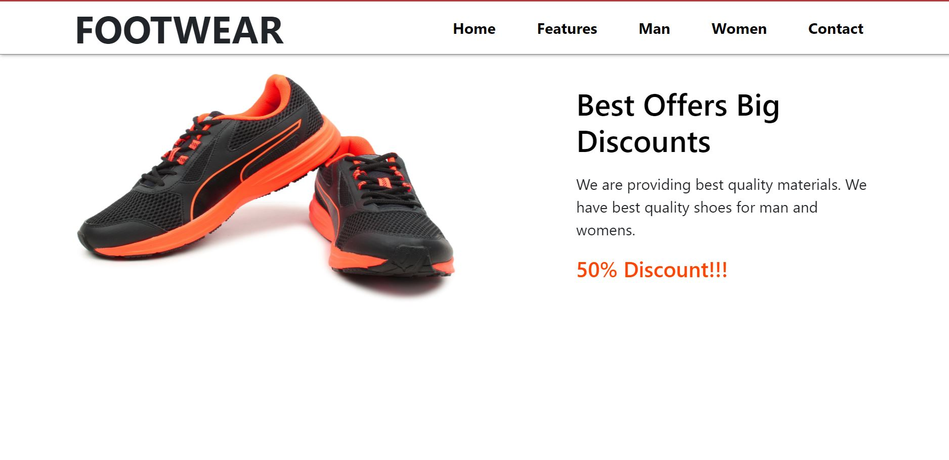

Slide 5
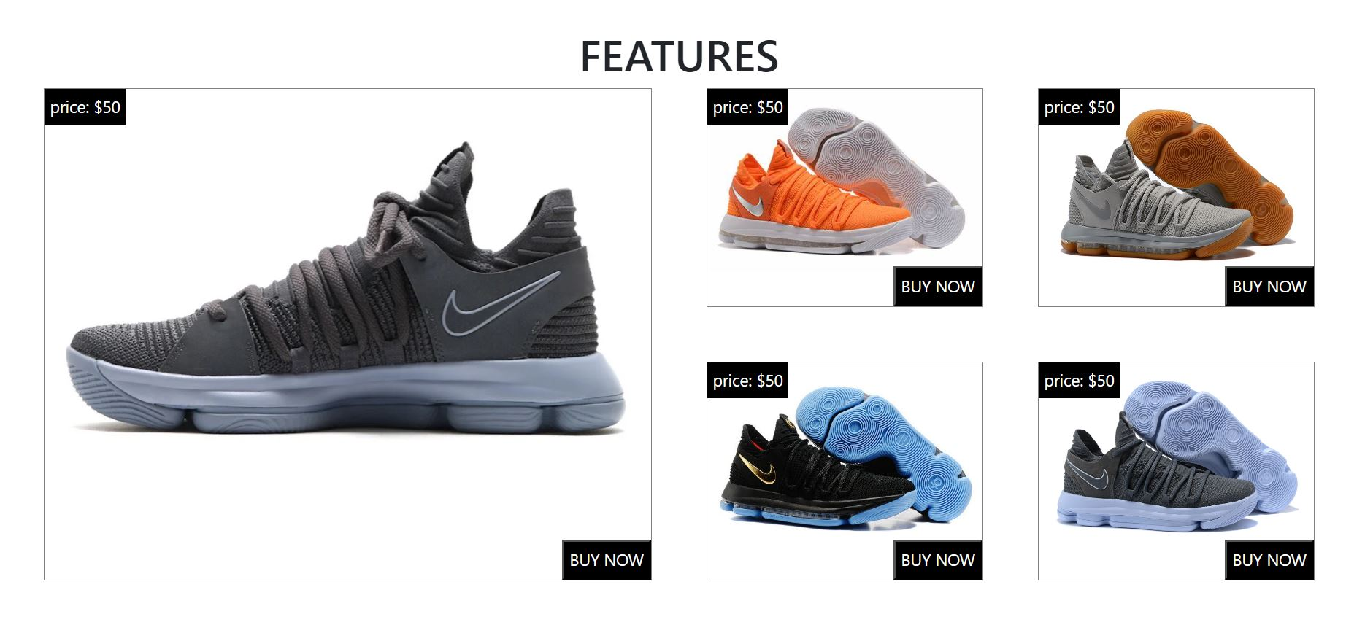

Slide 6
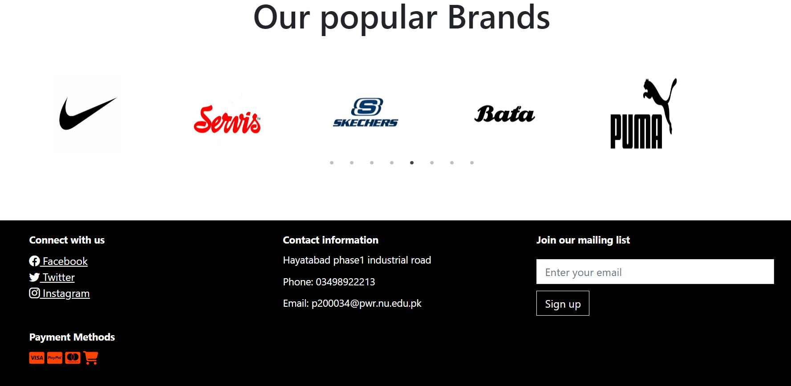

Slide 7
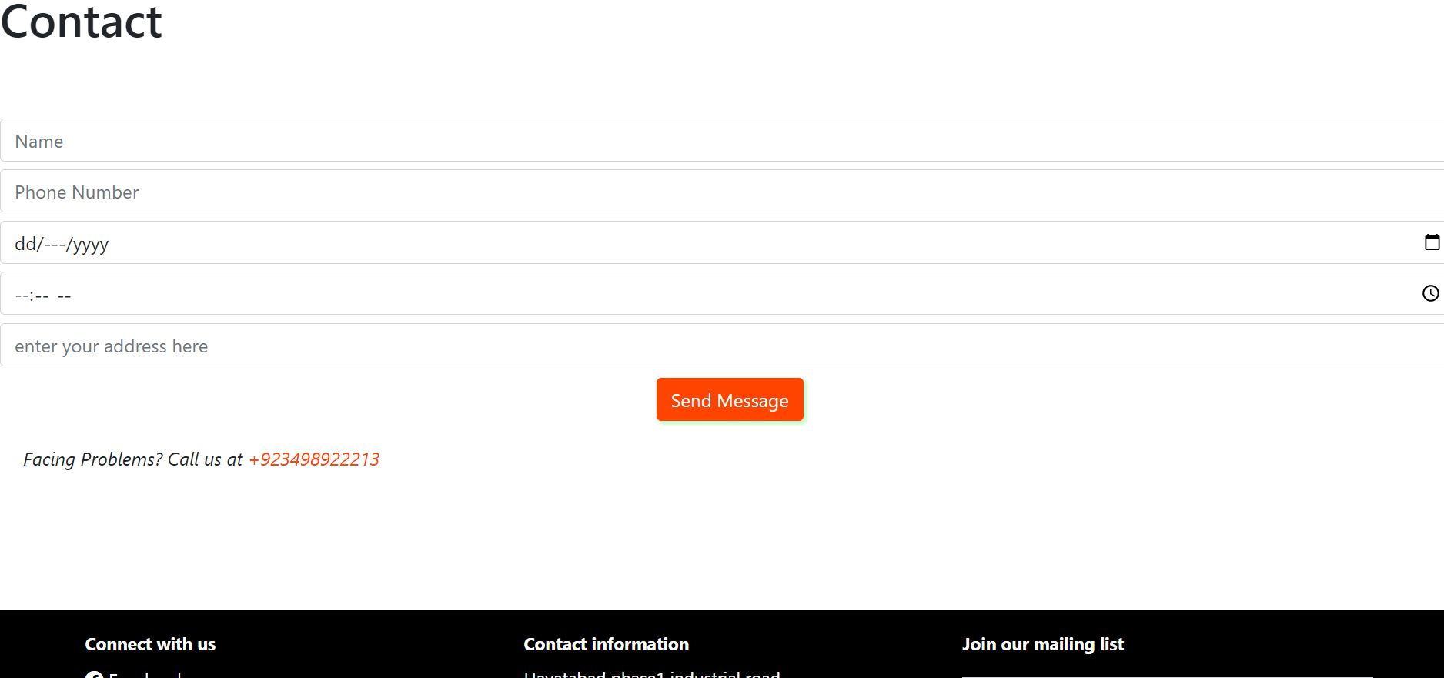

Slide 8
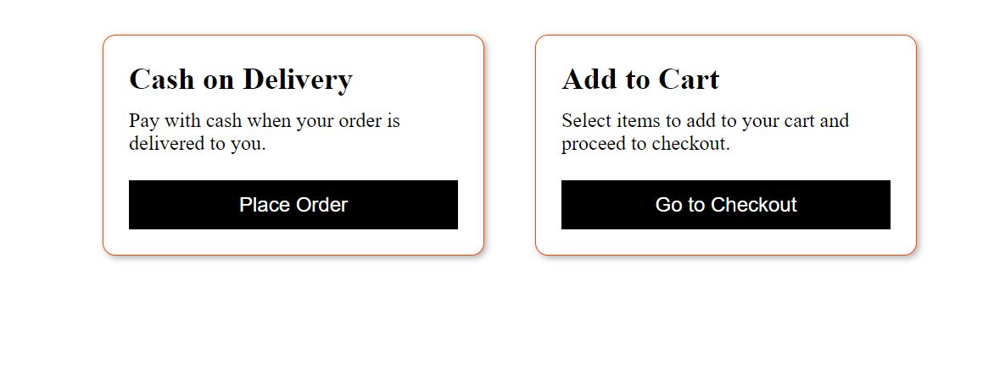

Slide 9
