Slide 1


A Context-Aware Multilingual Aspect-Based Framework for Product Recommendation
Capstone Project Final Defense
Research Team
Institutional Details
Afsin Sultana — 2022-1-60-113
Raiyan Fardin Haque — 2022-1-60-240
Md Sabbir Hossain — 2022-1-60-270
Md Arafat Hossain — 2022-1-60-330
Department: Computer Science & Engineering
Institution: East West University
Supervisor: Nishat Tasnim, Lecturer, CSE Department
Date: August 13, 2026

Slide 2



Introduction
This work proposes a context-aware, multilingual, aspect-based product recommendation framework for Bangladeshi e-commerce. Built on Daraz Bangladesh reviews in Bangla, English, and code-switched language, the system converts raw customer text into structured sentiment and aspect information — combining review analysis, aspect extraction, and hybrid retrieval to recommend products aligned with user queries.

Slide 3

Problem Statement
① Unstructured Review Overload
② Shallow Recommendations
③ Multilingual Retrieval Complexity
E-commerce platforms accumulate massive customer review text spanning Bangla, English, and Banglish (code-switched). This content remains unstructured and resistant to systematic parsing — making it nearly impossible to extract actionable product intelligence at scale.
Traditional systems collapse nuanced product quality into a single star rating or surface-level keywords. Fine-grained attributes — battery backup, bass response, heating, delivery service — are entirely ignored, producing generic and often irrelevant suggestions.
Transliterated, noisy queries such as "kom dame valo powerbank" impose high retrieval friction. Standard keyword engines and monolingual embeddings fail to bridge language variants, penalizing Bangladeshi shoppers who naturally code-switch.

Slide 4


Research Questions & Objectives
Guiding Research Questions
Project Objectives
1
Sentiment Analysis Efficacy
Fine-Grained Annotation & Aspect Mapping
RQ1: How effectively can product reviews be analyzed to derive meaningful, fine-grained sentiment information across multilingual inputs?
Annotate review-level sentiment and consolidate 83 raw attributes into 16 canonical aspect groups for structured product profiling.
2
Aspect Extraction Quality
Aspect-Aware Hybrid Retrieval
RQ2: How effectively can product-specific aspects be extracted from Bangla, English, and Banglish review data?
Build a retrieval pipeline combining dense transformer embeddings, character n-gram sparse signals, and neural reranking for robust multilingual matching.
RecomPro Web Deployment
3
Recommendation Precision
Deploy an interactive application surfacing aspect-level feedback — "Loved for" and "Watch out for" — alongside ranked recommendations.
RQ3: How effectively can the framework recommend suitable products in response to natural language queries?

Slide 5

Literature Review (1/2)
Ref
Core Idea
Limitation
Why It Matches Our Work
[3]
Hybrid LLM recommendation using collaborative, content-based, and semantic scoring; supports cold-start and grounded recommendation.
High latency, hallucination risk, privacy concerns, and context-length limitations.
Matches our hybrid recommendation approach and use of semantic retrieval beyond simple keyword matching.
[14]
Two-stage framework combining LLM-based aspect extraction from reviews with aspect-aware recommendation graphs.
Aspect extraction depends on prompt quality and manual refinement; review processing is time-consuming.
Strongly matches our aspect-based review analysis and recommendation goal.
[15]
LLM-based automated query–product relevance labeling for e-commerce search using few-shot prompting, CoT, and RAG+MMR.
Performance depends on prompt design, metadata richness, and dataset balance.
Matches our query-to-product relevance objective and search-oriented recommendation setup.

Slide 6

Literature Review (2/2)
Ref
Core Idea
Limitation
Why It Matches Our Work
[17]
Retrieval-augmented multilingual e-commerce attribute prediction using filtering, BM25, and reranking.
Limited coverage and tested on a single main LLM setup.
Matches our multilingual setting and structured product-attribute understanding.
[19]
Hybrid recommendation using LLM user embeddings, transformer-based ranking, ontology reasoning, and knowledge distillation.
Strong dependence on domain ontology and evaluation on only one dataset.
Matches our hybrid ranking strategy and multi-signal recommendation design.
[6]
Explainable e-commerce recommendation with an LLM-powered product knowledge graph, offline construction, and online serving pipeline.
Limited category scope, mostly item-centric results, and hallucination concerns.
Matches our e-commerce recommendation focus and explainable, structured product understanding.

Slide 7
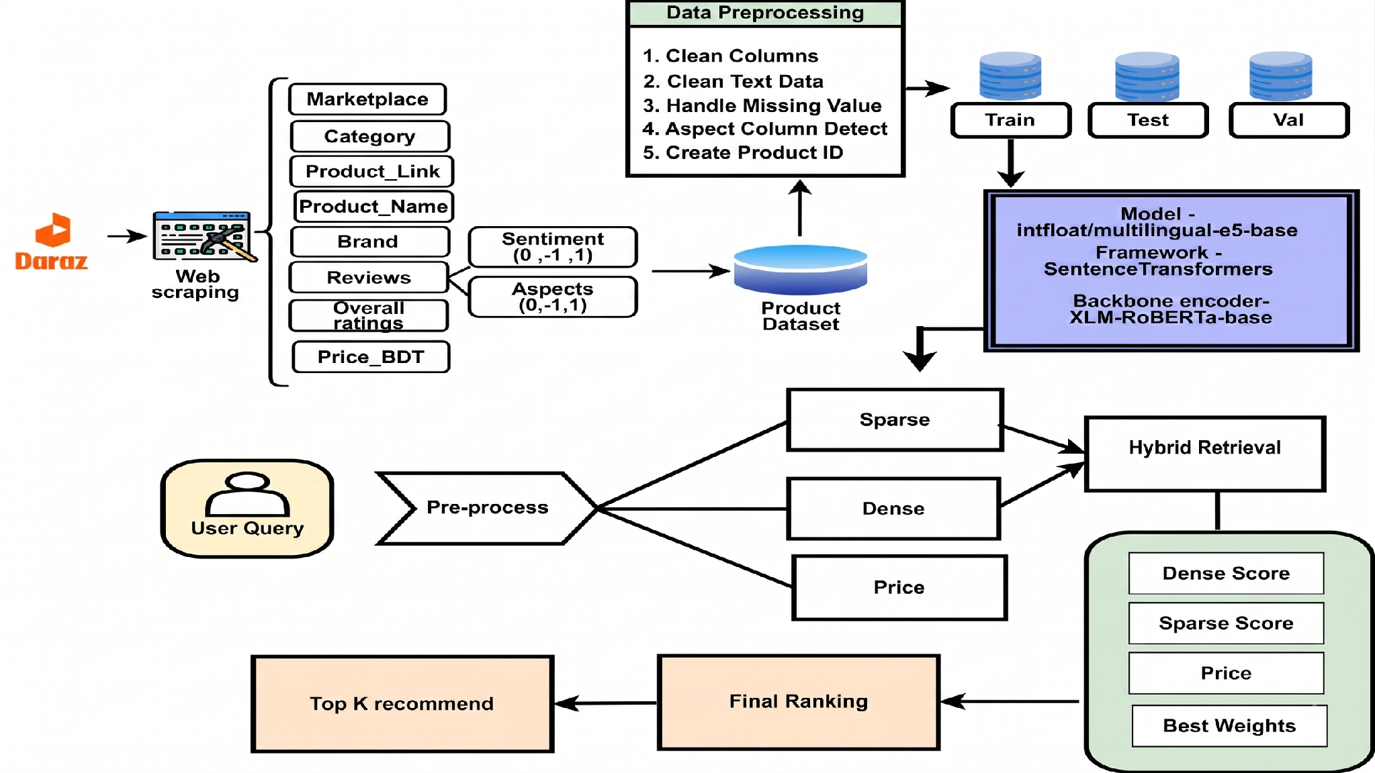

Slide 8







End-to-End System Architecture
Phase 1
Phase 2
Phase 3
Data Collection & Preprocessing
20,685 reviews · 302 products · Schema harmonization · Unicode cleaning
Aspect Grouping & Profiling
83 raw attributes → 16 canonical aspects · Per-product sentiment aggregation
Dual Encoding & Indexing
Dense transformer vectors + sparse character n-grams
Phase 4
Phase 5
Query Understanding & Scoring
9 feature signals · Budget parsing · Category hard-constraint masking
Neural Reranking & Deployment
3-layer MLP reranker · Blended final score · RecomPro web application

Slide 9
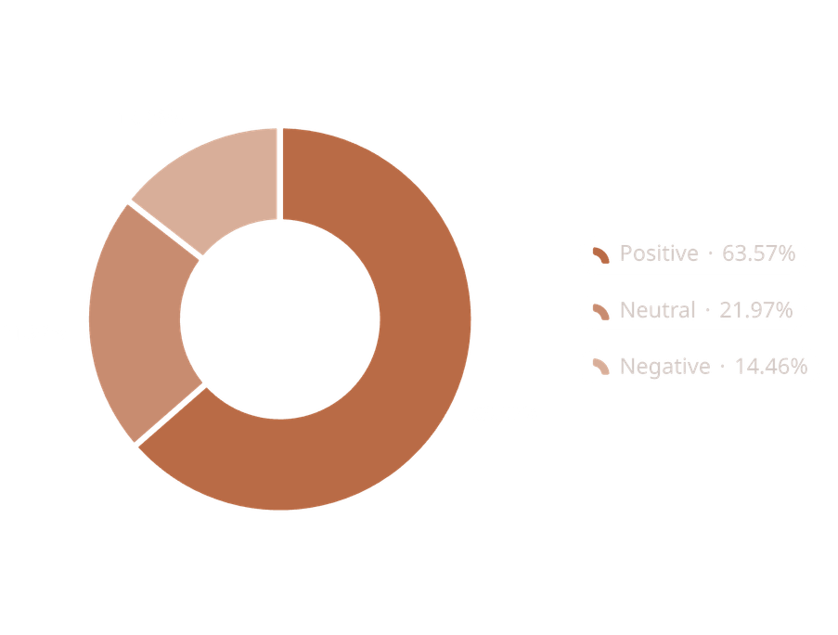
Dataset Overview
20,685
302
Usable Reviews
Unique Products
19
83
E-Commerce Categories
Raw Aspect Columns
Marketplace | .. | Category | ………. | Reviews | Sentiment | Aspects (Quality) | Aspects (Connection)
Daraz | .. | Mouse | …….. | একদম আহামরি কিছু না। খুবই হালকা এবং দাম অনুযায়ী ভালো। আমার ডেলিভারি চার্জ সহ ২৩৮ টাকা লেগেছে এই দামে ভালো প্রোডাক্ট 🙂. | 1 | 1 | 0
Daraz | … | Router | …….. | Connection drop মাঝে মাঝে। | -1 | 0 | -1
Daraz | .. | ear_headphone | ……… | good quality but majhe majeh connection thake na. | 0 | 1 | -1
Sentiment Distribution

Slide 10

Data Preprocessing
01
02
03
Standardized Schema
Text Cleaning
Missing Value Handling
Unified column names and schema across all categories.
Removed noise, special characters, and irrelevant markup from review text.
Safely imputed or flagged missing entries to preserve data integrity.
04
05
Aspect Column Detection
Unique Product IDs
Automatically identified and validated aspect annotation columns per category.
Generated stable unique identifiers for consistent product tracking.

Slide 11


Data Split & Dense Model Fine-Tuning
Leakage-Controlled Data Split
Base Model & Training Configuration
Product-level splitting ensures all 302 products remain in the catalog while preventing identical review text from leaking across splits — a critical design decision for unbiased evaluation.
Parameter
Value
Backbone Model
intfloat/multilingual-e5-base (XLM-RoBERTa)
Train Set
Training Objective
Multiple Negatives Ranking Loss (InfoNCE, τ = 0.05)
16,557 reviews
80% of corpus
Training Pairs
19,134 query–profile pairs
Batch Size
32
Validation
Optimizer
AdamW
2,059 reviews
10% of corpus
Learning Rate
2e-5
Warmup Steps
1,492 steps
Epochs
11 (with early stopping)
Test Set
2,069 reviews
10% of corpus

Slide 12
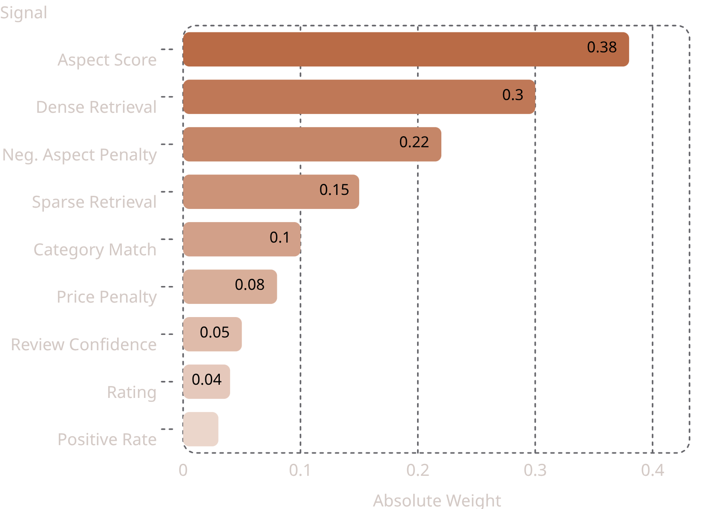
Hybrid Scoring & Neural Reranker
Manual Hybrid Scoring Formula
Scoremanual = 0.38 × Aspect + 0.30 × Dense + 0.15 × Sparse + 0.10 × Category + 0.05 × RevConf + 0.04 × Rating + 0.03 × PosRate − 0.08 × PricePen − 0.22 × NegAspectPen
Signal Weight Breakdown
Neural Reranker & Final Blend
3-Layer MLP Reranker
Trained with backpropagation on hard negative samples. Produces Scorereranker — a learned ranking signal that captures cross-feature interactions missed by the manual formula.
Blended Final Ranking
Scorefinal = 0.70 × Scorereranker + 0.30 × Scoremanual
Neural signal dominates; manual weights serve as interpretable regularization.
Real-Time Query Features
Budget parsing ("under 1000 taka"), category hard-constraint masking, and an out-of-domain guard filter ensure robust handling of edge-case queries in production.

Slide 13
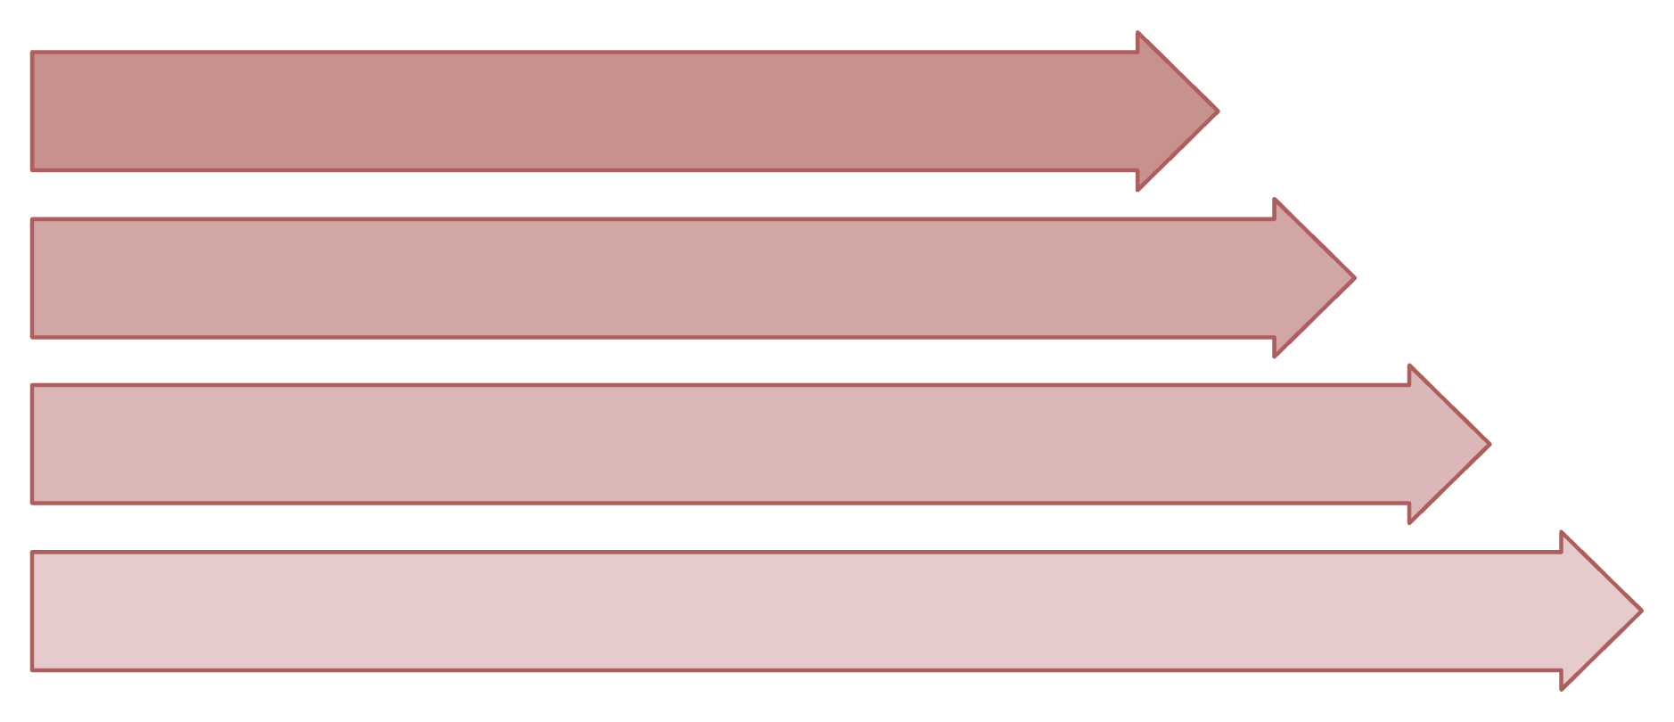
How the System Recommends Products
Query Input
Dual Retrieval
Query Understanding
Feature Fusion
1
Query Input
2
Dual Retrieval
Query Understanding
Feature Fusion
Neural Reranking
Multilingual preprocessing
Dense + Sparse branches
3
4
5
Aspect & budget parsing
9-signal scoring
MLP score blending
6
Ranked Output
Transparent evidence

Slide 14

Result Analysis
NATURAL REVIEW QUERIES
ASPECT-FOCUSED QUERIES
1,130 Test Queries
908 Test Queries
Metric
Score
Metric
Score
Suitable@1
91.24%
Hit@10
61.34%
Suitable@3
93.19%
AspectSat@1
82.34%
NDCG_suit@10
0.9751
NegAvoid@1
98.90%
Hit@10
44.96%
Suitable@1
53.85%
AspectSat@1
79.80%
NDCG_suit@10
0.9573
NegAvoid@1
99.27%

Slide 15
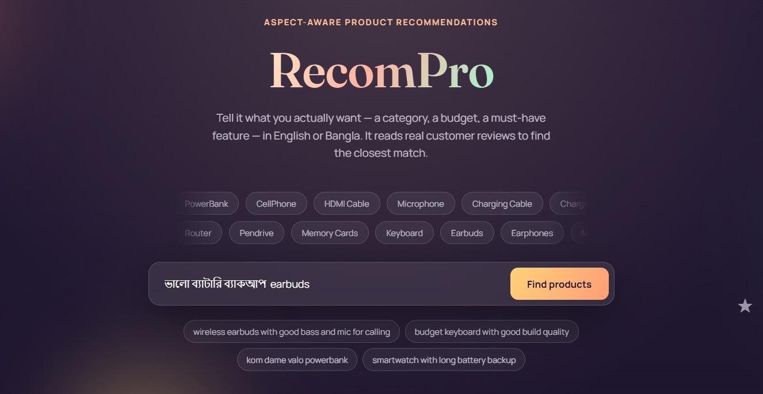
Website Overview

Slide 16
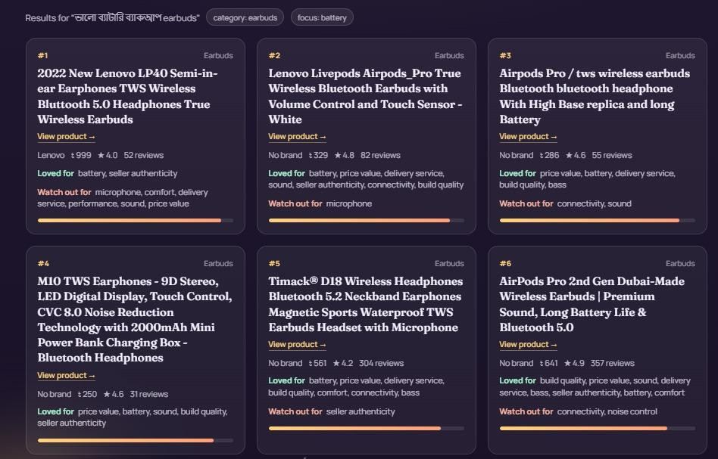

Slide 17
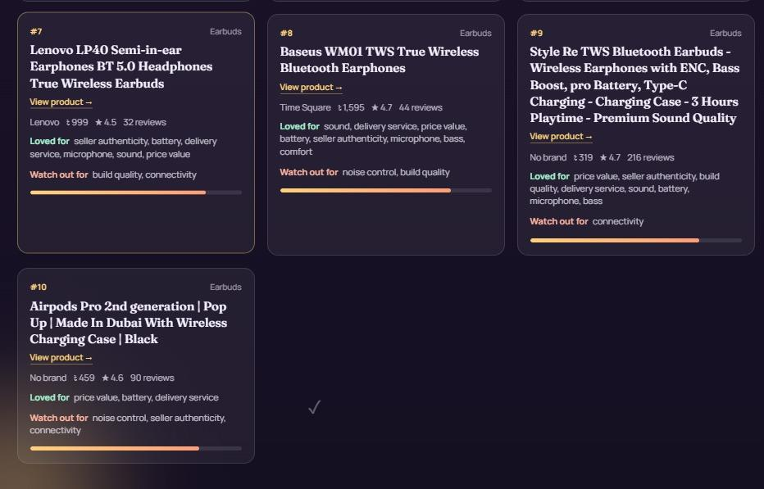

Slide 18
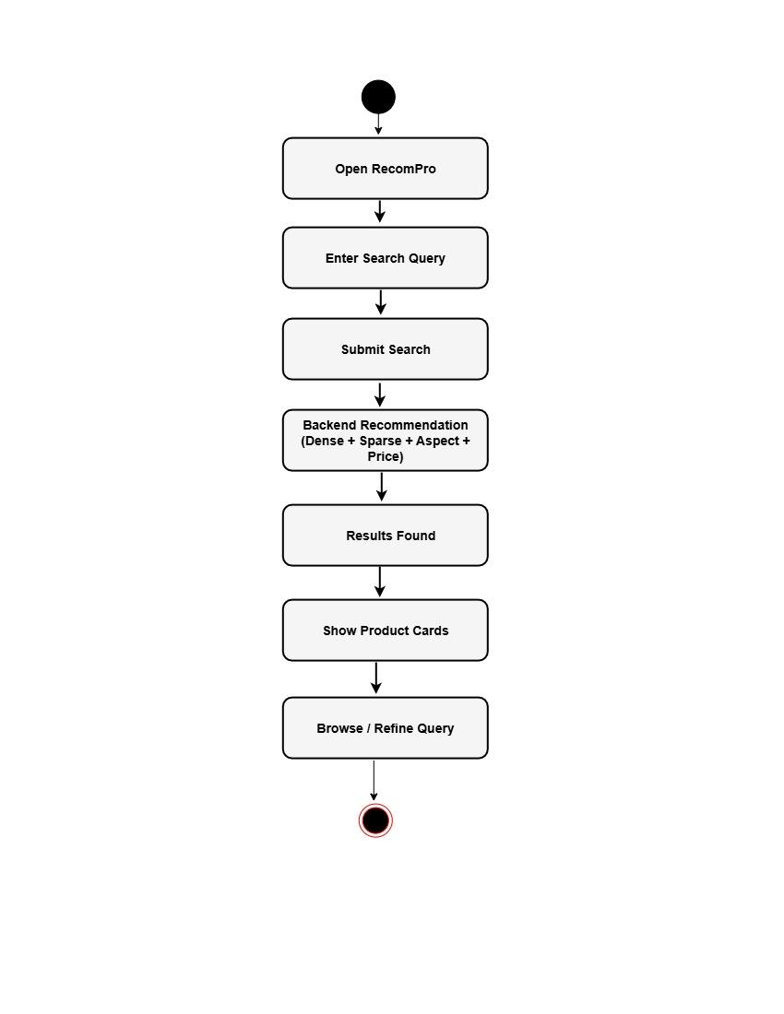
Activity Diagram

Slide 19
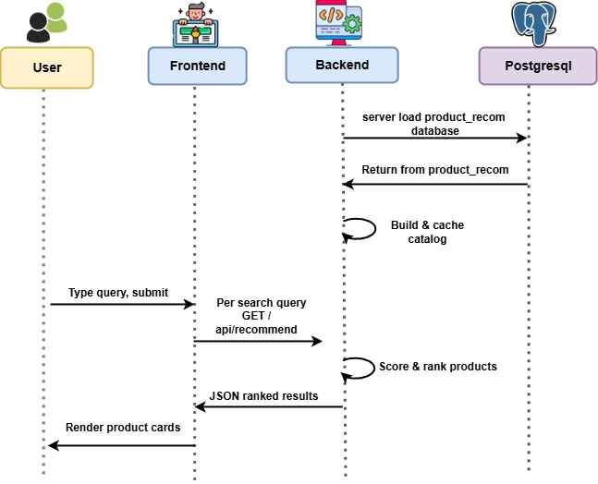
Sequence Diagram

Slide 20

Limitations
Out-of-Domain Query Handling
Manual Data Collection
Limited Category Coverage & Deployment
Reviews were collected manually, limiting scalability and making rapid dataset expansion difficult.
The Web Application lacks a rejection mechanism for unsupported queries and may return lexically similar but semantically incorrect products.
The framework operates within a fixed set of product categories and does not yet support direct marketplace redirection.

Slide 21






Future Work
Web Deployment
Deploy the recommendation application for real-world use.
Query Rejection
Add unsupported-query detection and rejection before recommendation.
Automated Data Collection
Improve data collection with controlled automated expansion.
Category & Marketplace Linking
Extend category coverage and support direct product linking and marketplace redirection.
Richer Metadata
Add richer product metadata such as availability, discount, delivery, and seller-related information.

Slide 22
Conclusion
Novel Framework
Superior Retrieval Performance
Actionable E-Commerce Tool
First context-aware, multilingual aspect-based product recommendation framework specifically designed for the Bangla-English-Banglish e-commerce environment — addressing a gap no prior system has filled.
Combining dense semantic retrieval, sparse lexical matching, and neural reranking achieved NDCG_suit@10 of 0.9751 and a 91.24% Suitable@1 rate — state-of-the-art results for this domain.
RecomPro successfully bridges opinion mining and product search, providing transparent "Loved for" and "Watch out for" review summaries that support informed, confident purchasing decisions.

Slide 23
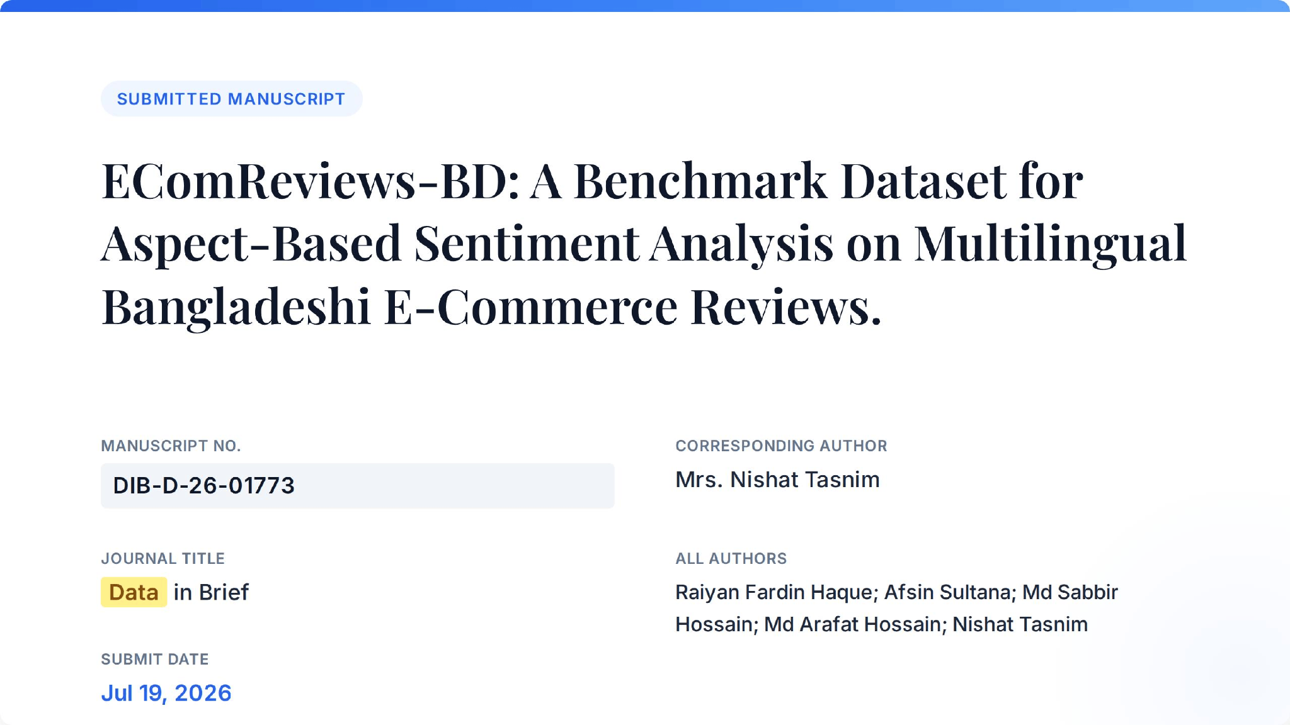


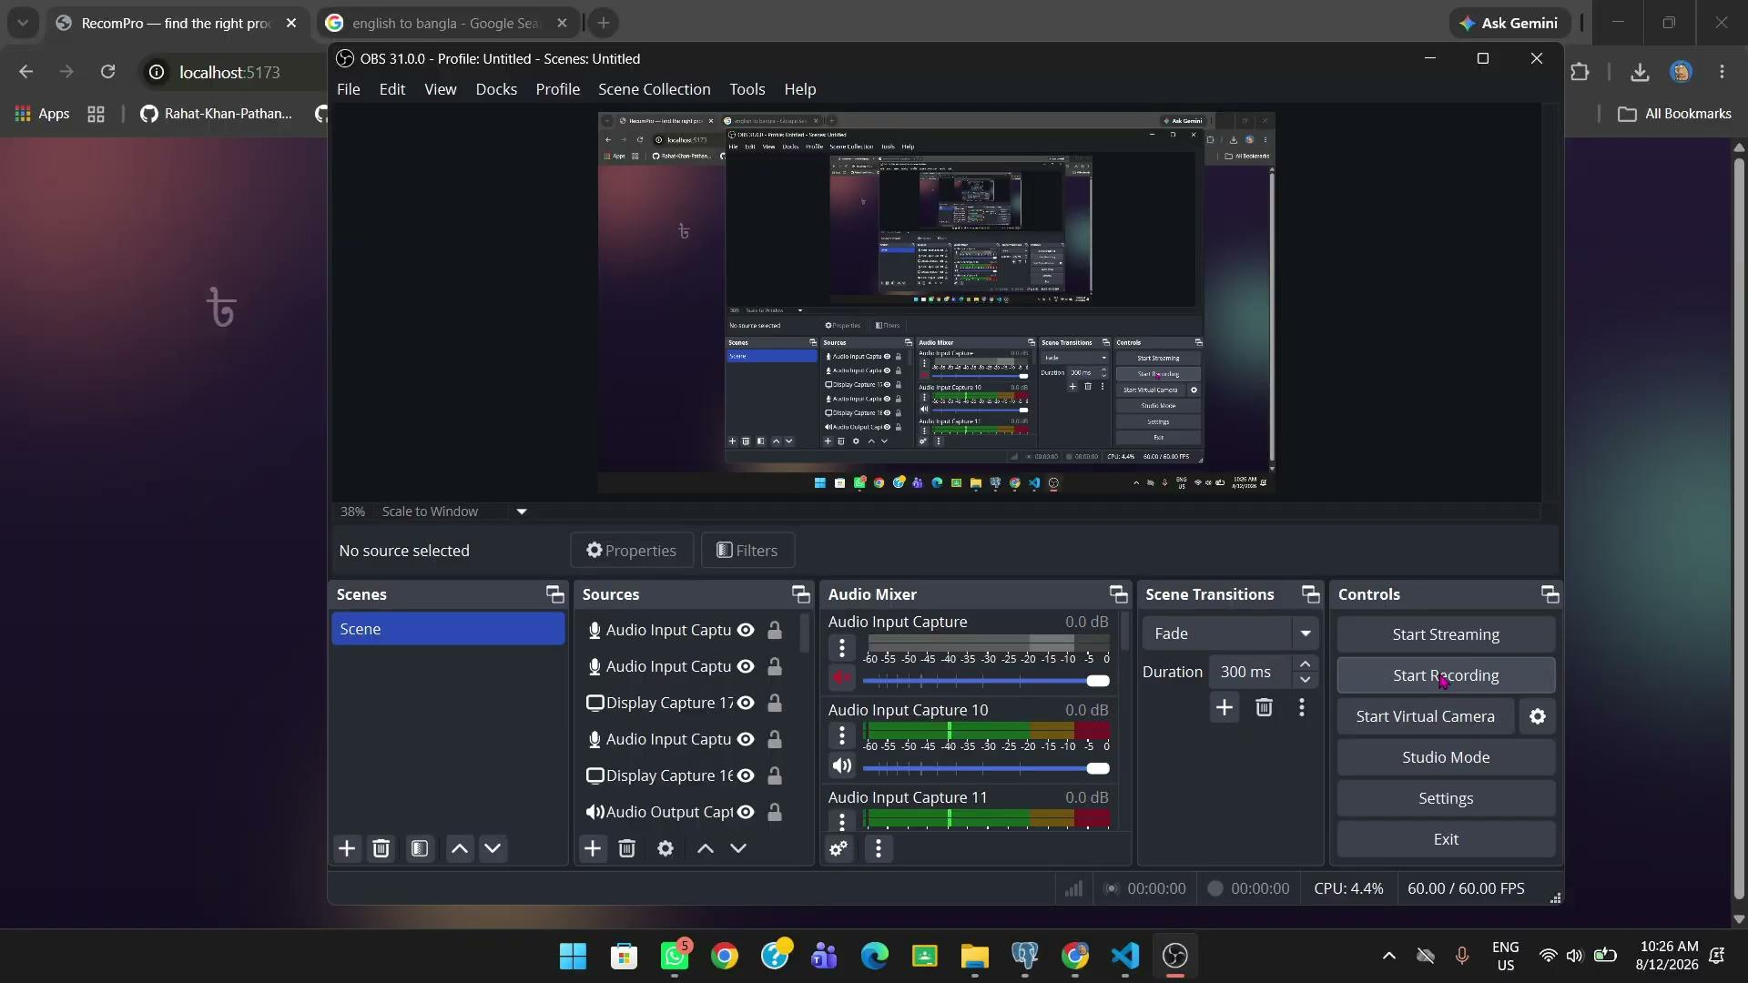

Notebook
Github
Web Page Video

Slide 24
References
[3] R. Z. Z. C. L. L. L. Xinyu Li, "Personalized Language Modeling from Personalized Human Feedback," arXiv, vol. 3, p. 21, 2024. https://arxiv.org/abs/2402.05133
[14] T. R. K. Pavan Gunda, "Hybrid GPT and Neural Models for Personalized E-Commerce: A Novel Framework for Adaptive and Transparent Product Recommendations," ITEGAM-JETIA, vol. 12, p. https://itegam-jetia.org/journal/index.php/jetia/en/article/view/2874
[15] B. S. N. O. rkadeep Acharya, "LLM Based Generation of Item-Description for Recommendation System," pp. https://dl.acm.org/doi/abs/10.1145/3604915.3610647
[17] X. L. Z. F. J. X. +. 4. I. &. C. Chenhao Fang, "LLM-Ensemble: Optimal Large Language Model Ensemble Method for," in SIGIR 2024: The 47th International ACM SIGIR Conference on Research and Development in Information Retrieval, Washington DC USA , 2024. https://dl.acm.org/doi/abs/10.1145/3626772.3661357

Slide 25


