Slide 1
Business Analytics
MBAI5100

Slide 2
Business Analytics
Instructor:
Amirmohsen Golmohammadi / Amir
Email: amirmohsen.golmohammadi@ontariotechu.ca
Office: BIT3018
Office hours:
By appointment
Open door policy

Slide 3

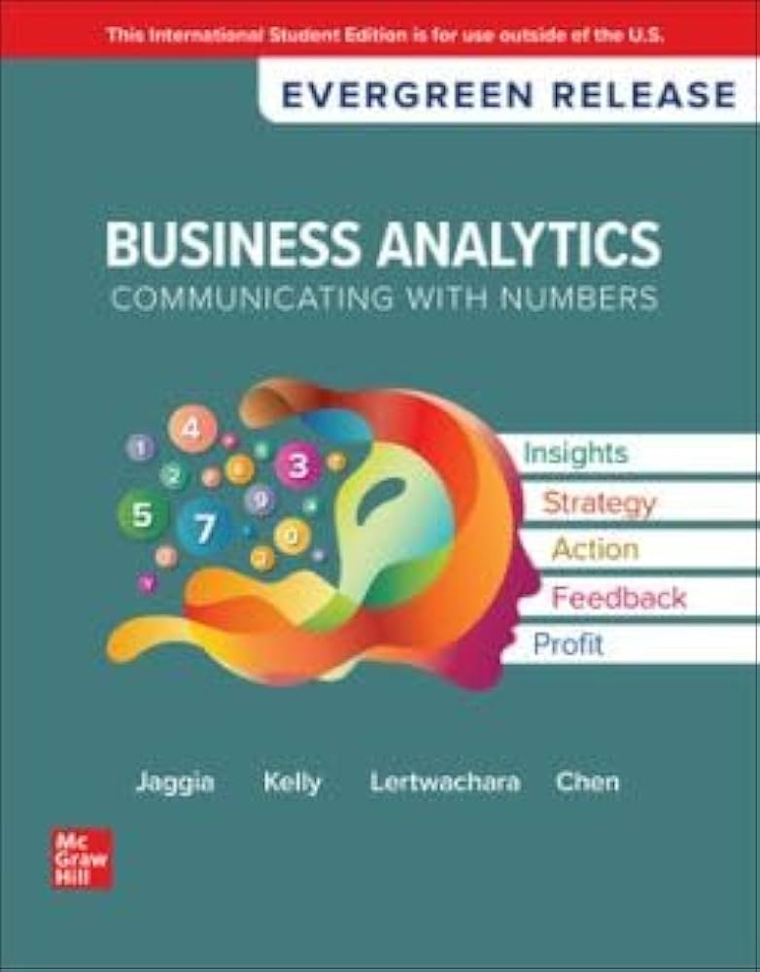
Textbook
Textbooks are optional
You can download the ebook for free at: https://www.statlearning.com/

Slide 4
Learning Objectives
Understand what business analytics is
Prepare and clean data
Summarize data using descriptive analytics
Use predictive analytics methods and tools to estimate the value of variables in the future
Use prescriptive analytics methods and tools to make better business decisions

Slide 5
Topics
Basics of python (Anaconda distribution and JupyterLab)
Data preparation and wrangling
Summary measures
Regression and logistics regression
Forecasting
Data mining
Prescriptive analytics (simulation and optimization)

Slide 6
Programming with Python
In the class, I use Anaconda and JupyterLab.
You can use any IDE for this course.
You will learn more about programming with Python in MBAI5300 (Programming and data processing)
Download Anaconda from: https://www.anaconda.com/download
Once installation is complete, open Anaconda Navigator and launch JupyterLab

Slide 7
Evaluation
Evaluation |  | Deadline | Weight
Participation |  |  | 10%
Quiz 1 |  | October 9 | 12.5%
Quiz 2 |  | November 6 | 12.5%
Assignment |  | October 30 | 20%
Final project | Proposal | October 9 | 10%
 | Presentation | November 20 | 10%
 | Final report | December 4 | 25%

Slide 8
Project
You are doing this project from the perspective of an analyst employed by a public or private organization.
Project should be done in groups of no less than 3 and no more than 5.
The number of group members will not affect your grade.
You need to consider a well-defined business questions and use the skills that you acquire in the class to address it.
Public real datasets should be used for the project:
Kaggle.com
City of Toronto Open Data portal: https://www.toronto.ca/city-government/data-research-maps/open-data/ (similar portals exist for other big cities as well)
https://data.nasdaq.com/ and https://wrds-www.wharton.upenn.edu/

Slide 9
Project
Deadlines:
Group selection: September 18
Please let me know if you need me to assign you to a group
Proposal: October 9
A template is provided online
3 pages maximum (including everything)
Presentation: November 20
20 minutes presentation
Final report: December 4
You are required to only use the packages that we learned in the class.

