Slide 1
Optimization
Business Analytics

Slide 2
Optimization
The process of finding the best value (Minimum/Maximum) for an objective function by changing decision variables with respect to constraints.
Very common in all the industries.
Examples:
Maximize profit
Minimize cost
Minimize risk

Slide 3
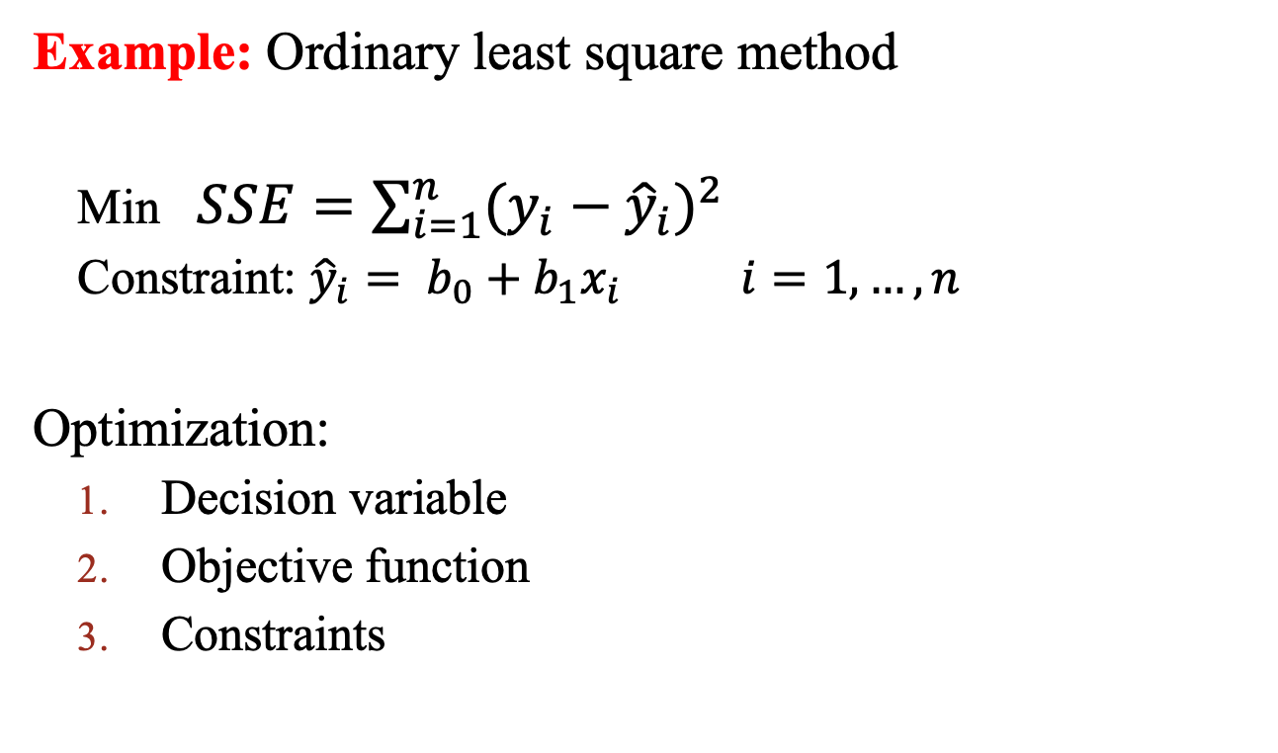
Optimization
Example: Ordinary least square method
Min $SSE=\sum_{i=1}^{n}{{(y_{i}−{\hat{y}}_{i})}^{2}}$
Constraint: ${\hat{y}}_{i}= b_{0}+b_{1}x_{i} i=1,…,n$
Optimization:
Decision variable
Objective function
Constraints

Slide 4
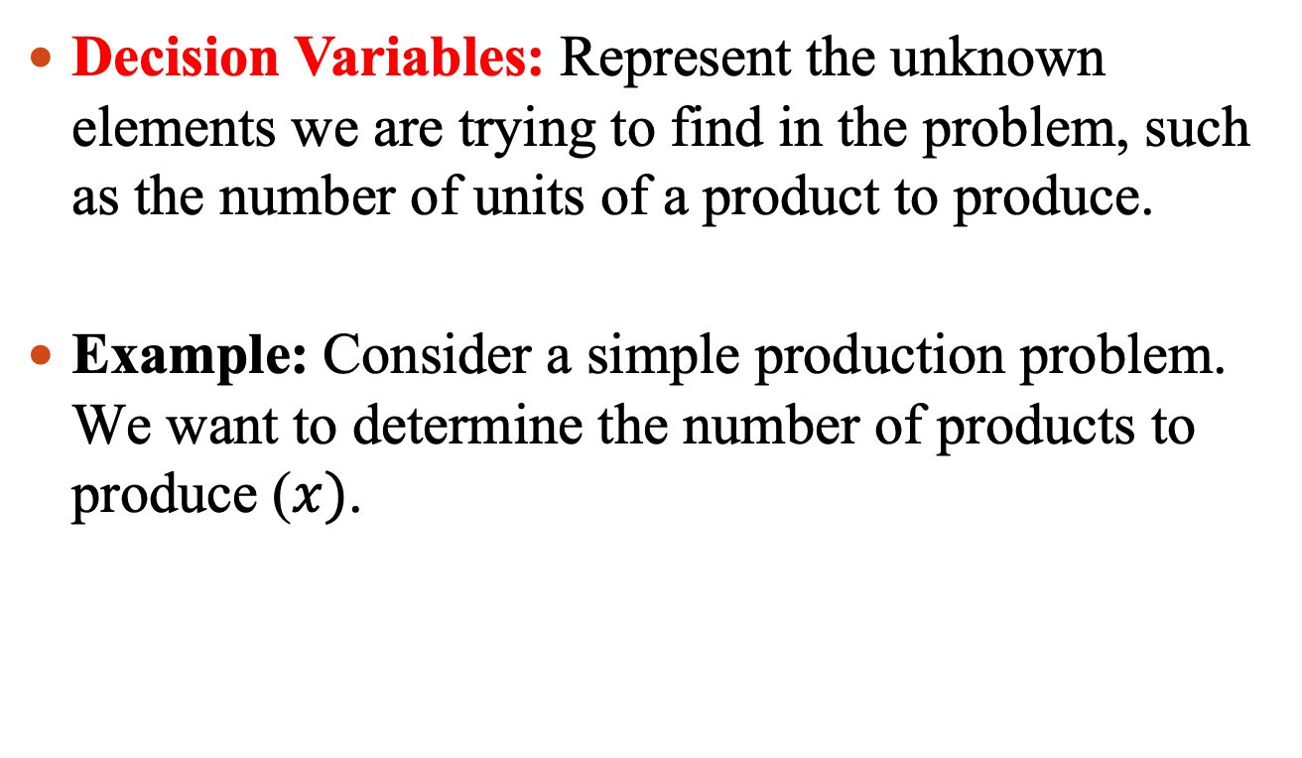
Optimization
Decision Variables: Represent the unknown elements we are trying to find in the problem, such as the number of units of a product to produce.
Example: Consider a simple production problem. We want to determine the number of products to produce ($x)$.

Slide 5
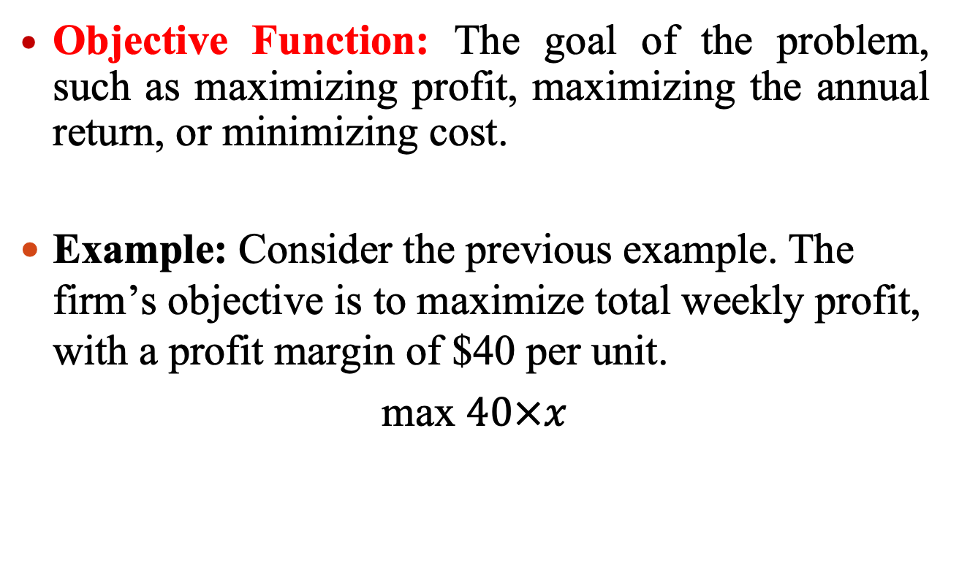
Optimization
Objective Function: The goal of the problem, such as maximizing profit, maximizing the annual return, or minimizing cost.
Example: Consider the previous example. The firm’s objective is to maximize total weekly profit, with a profit margin of $40 per unit.
max $40×x$

Slide 6
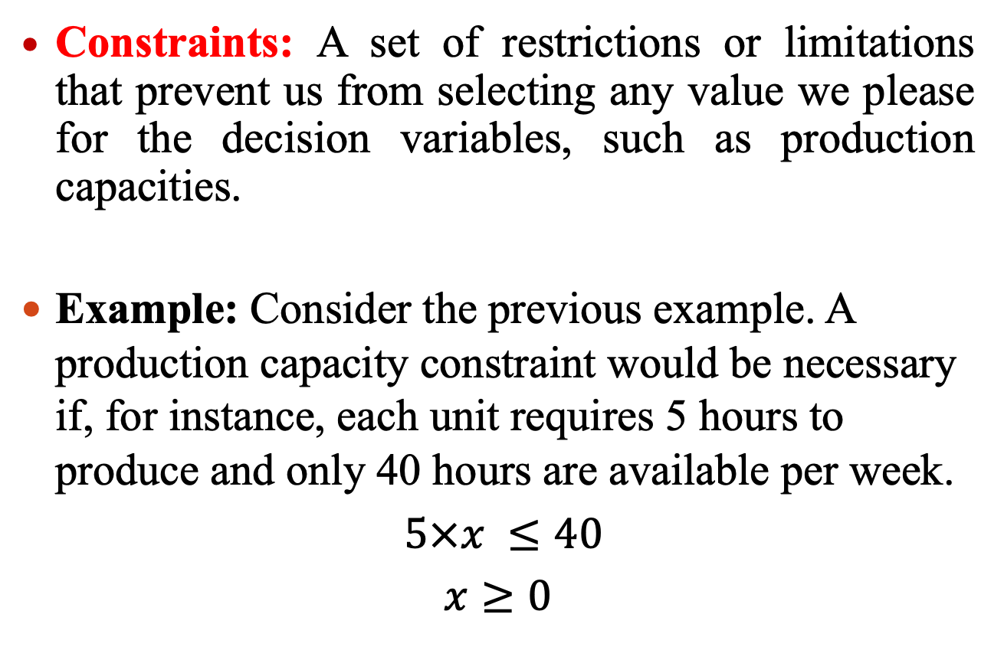
Optimization
Constraints: A set of restrictions or limitations that prevent us from selecting any value we please for the decision variables, such as production capacities.
Example: Consider the previous example. A production capacity constraint would be necessary if, for instance, each unit requires 5 hours to produce and only 40 hours are available per week.
$5×x ≤40$
$x≥0$

Slide 7
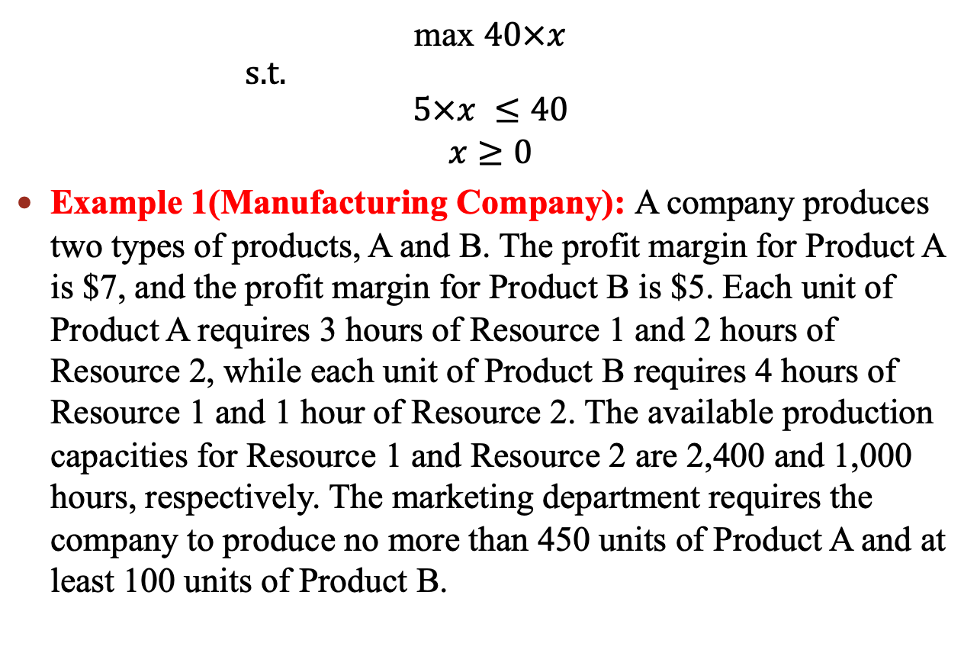
Optimization
max $40×x$
s.t.
$$5×x ≤40$$
$x≥0$
Example 1(Manufacturing Company): A company produces two types of products, A and B. The profit margin for Product A is $7, and the profit margin for Product B is $5. Each unit of Product A requires 3 hours of Resource 1 and 2 hours of Resource 2, while each unit of Product B requires 4 hours of Resource 1 and 1 hour of Resource 2. The available production capacities for Resource 1 and Resource 2 are 2,400 and 1,000 hours, respectively. The marketing department requires the company to produce no more than 450 units of Product A and at least 100 units of Product B.

Slide 8
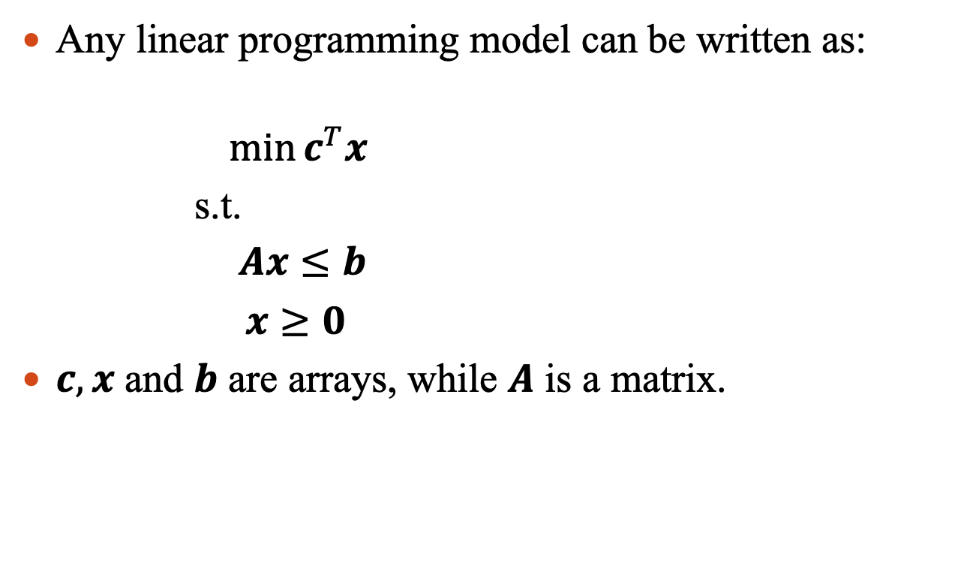
Optimization
Any linear programming model can be written as:
$$\min{c^{T}x}$$
s.t.
$Ax≤b$
$x≥0$
$c, x$ and $b$ are arrays, while $A$ is a matrix.

Slide 9
Optimization
Example 2(Ordering quantity): A company has two suppliers for a product. The company must decide how many units to purchase from each supplier. The purchase cost from Supplier 1 is $5 per unit and from Supplier 2 is $6 per unit. The capacities of Supplier 1 and Supplier 2 are 4,000 and 5,000 units per month, respectively. The company's demand is 7,000 units per month and must be fully satisfied. Based on historical data, 9% of Supplier 1's products are defective and 6% of Supplier 2's products are defective. The company inspects all received items and only ships the good products to customers. The inspection cost is $1 per unit.

Slide 10
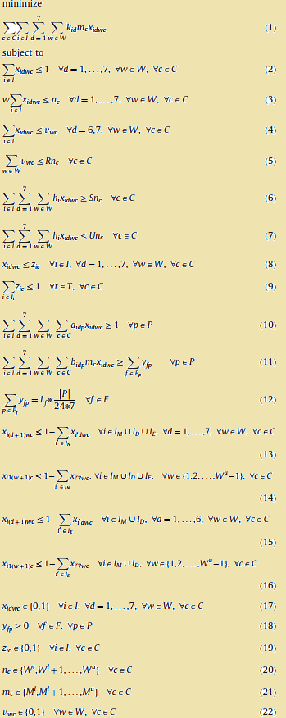
Optimization
Example 2(Ordering quantity): A company has two suppliers for a product. The company must decide how many units to purchase from each supplier. The purchase cost from Supplier 1 is $5 per unit and from Supplier 2 is $6 per unit. The capacities of Supplier 1 and Supplier 2 are 4,000 and 5,000 units per month, respectively. The company's demand is 7,000 units per month and must be fully satisfied. Based on historical data, 9% of Supplier 1's products are defective and 6% of Supplier 2's products are defective. The company inspects all received items and only ships the good products to customers. The inspection cost is $1 per unit.

